Slide 1
Fans vs. Haters:
A Brief Text Analysis on tweets about Apple
Shuheng Li
Xinyi Liu

Slide 2


Shut up and give me your $$$

Slide 3




SuperSteveJobsFan@luoyonghao · 3m
I have to say, Apple has by far the best customer care service I have ever received! @Apple @AppStore"
CNDotaBestDota @xiaomiboy · 2d
you guys are cheep little freaks and I hope u get testicular cancer and loose a nut @apple

Slide 4
Sentiment Scoring
And Data Cleaning

Slide 5

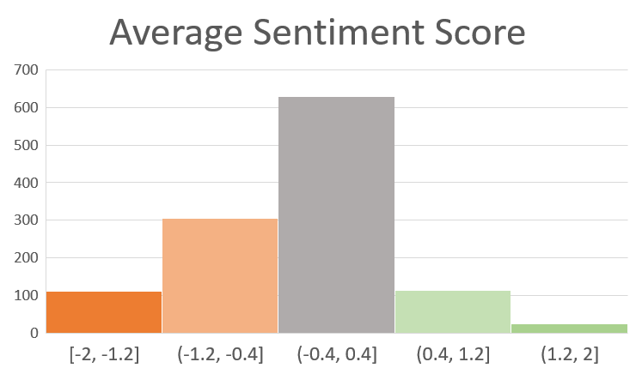
Human-labeled Sentiment score
-2.0 ~ -1.2 | Strongly Negative
-1.2 ~ -0.4 | Negative
-0.4 ~ 0.4 | Neutral
0.4 ~ 1.2 | Positive
1.2 ~ 2.0 | Strongly Positive

Slide 6
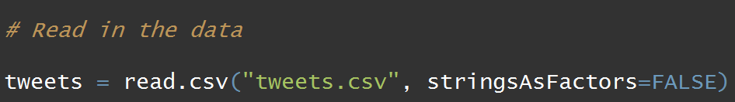
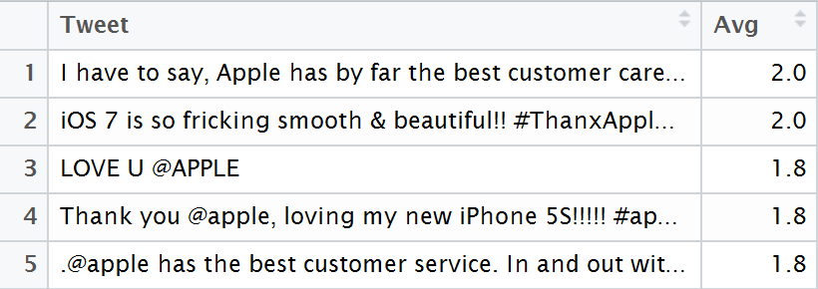
Read data

Slide 7
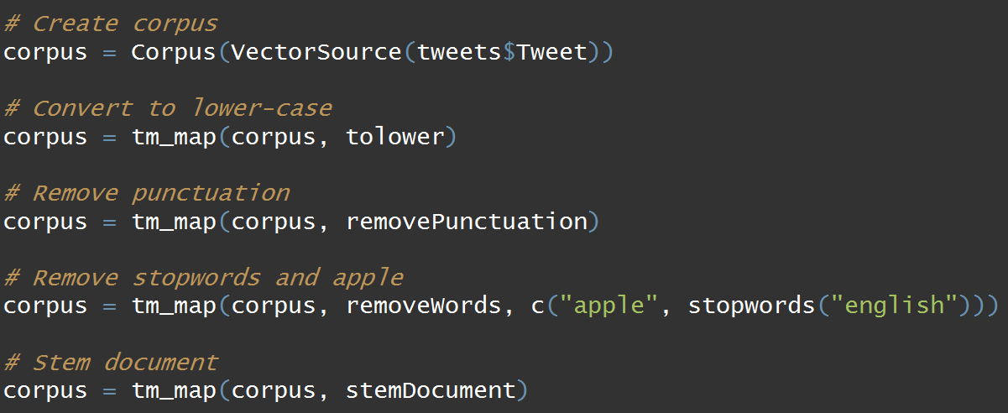
I have to say, Apple has by far the best customer care service I have ever received! @Apple @AppStore
i have to say, apple has by far the best customer care service i have ever received! @apple @appstore
i have to say apple has by far the best customer care service i have ever received apple appstore
say far best customer care service ever received appstore
say far best custom care servic ever receiv appstor

Slide 8
Document Term Matrix
Using Bag-of-Words

Slide 9
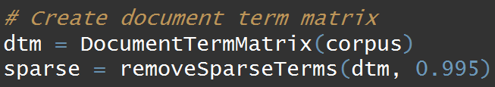

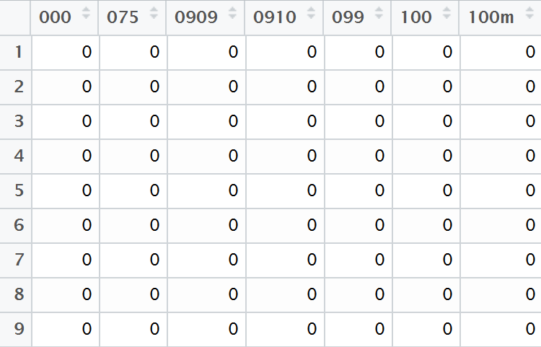
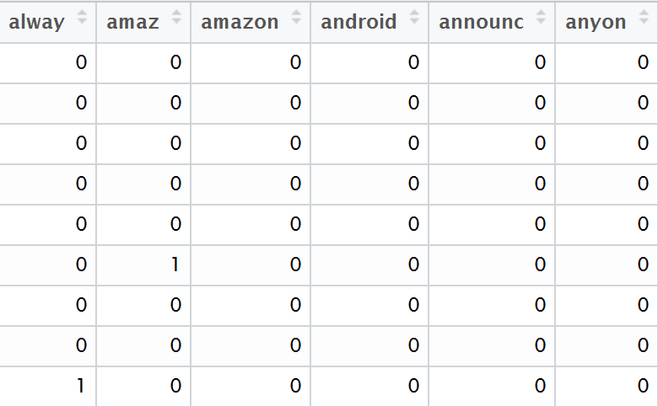
Tokenization

Slide 10
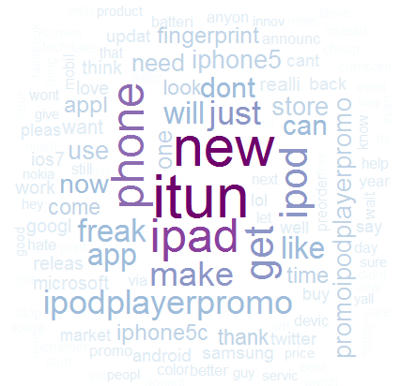
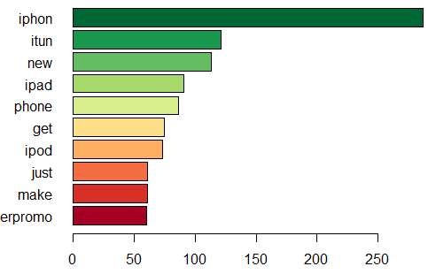
Visualization – Most Frequent words

Slide 11
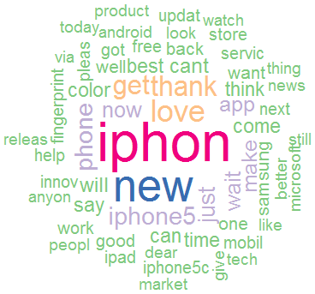
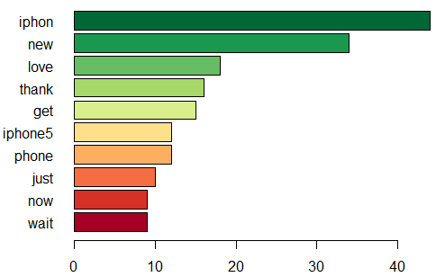
Most Frequent words by sentiment - Positive

Slide 12
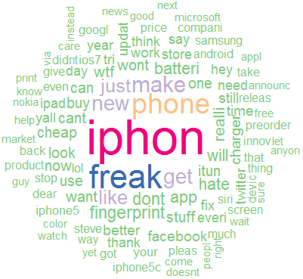
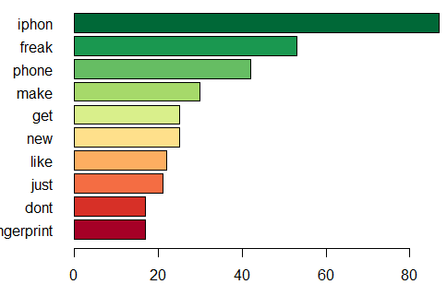
Most Frequent words by sentiment - Negative

Slide 13
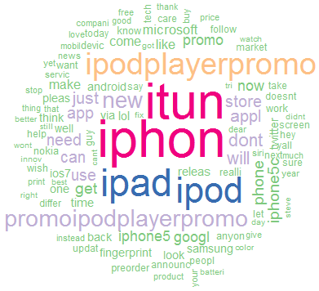
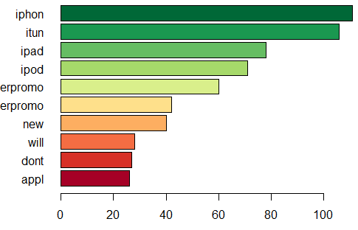
Most Frequent words by sentiment - Neutral

