Slide 1

Smartphone User Trace Analytics
Anand Niranjan
Swaminathan Tirunelveli Vijayaraghavan
A7 – University of North Carolina at Charlotte

Slide 2
Problem Statement
Objective
To achieve security in smartphones beyond single entry authentication
Challenging Tasks
Segregate actual user of smartphone from unauthorized users
Analyze the patterns of user behavior on different smartphones
Predict the accuracy of touch traces for validation
Ensure minimum investment to develop this model

Slide 3
Smartphone & Security
Nowadays, security of one’s smartphone in turn determines the security of his bank accounts, photos, documents, emails and so on.
Stats shows mobile usage increases every year when compared to other devices.
As storage of sensitive data increases in phones; breach & threat also increases
1.02 billion records breached in 2014
5.2 million smartphones were lost or stolen in the U.S. in 2014.

Slide 4
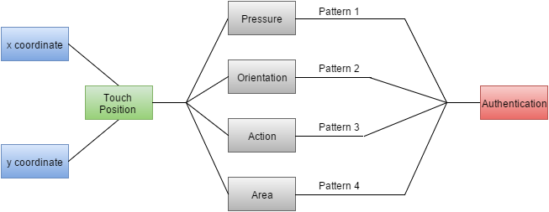
User Based Security in Smartphones
Touch patterns of a particular user varies significantly that is sufficient to define his own security policy.
Though this method is user specific, it varies from device to device for the same user.
Pressure applied, phone orientation, area coverage by fingers differs for every user.
The policies are formulated based on the usage of apps like Wikipedia article, image comparison game and answer questionnaire.

Slide 5
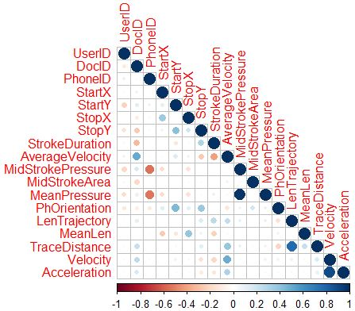
Feature Correlation & Inverse Relation
Features that can differentiate actual user of smartphone from unauthorized users:
Position – x, y coordinates
Pressure applied
Area covered
Length of trajectory
Duration of stroke
Velocity
Acceleration
Phone orientation

Slide 6
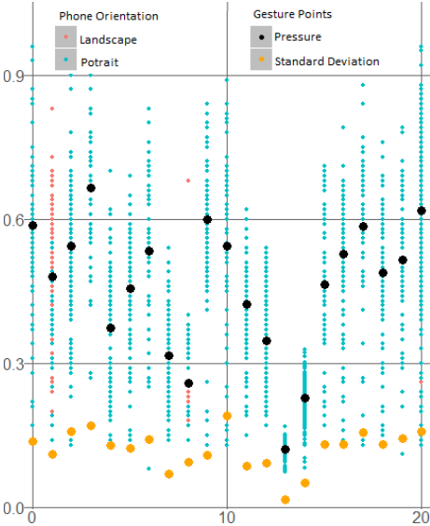
Touch ID and Touch Patterns
“Average iPhone user unlocks device 80 times per day”, says Apple.
89% of total unlocks comes from Touch ID, this shows the reliability of the security system.
Apple has spent 32% more in R&D in 2013 (iPhone 5s released) compared to its previous year.
Though touch sensors are the most efficient security mechanism, it is not suitable for all range of smartphones.

Slide 7
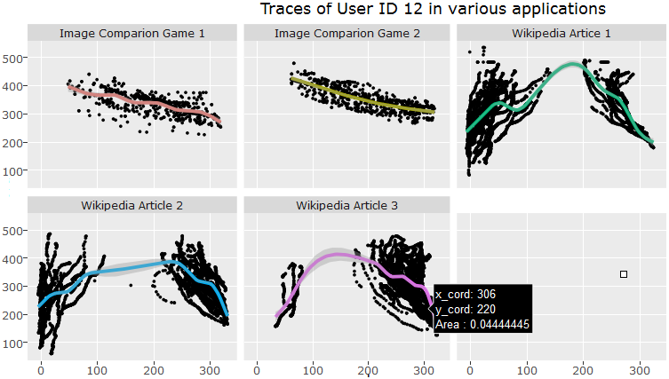
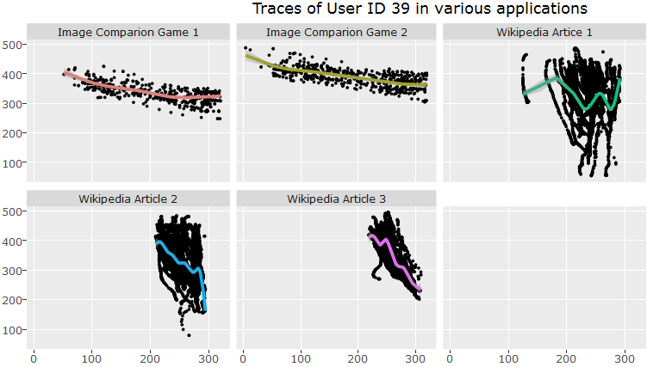
Analyzing Touch Traces of Users

Slide 8
One for all – Security Policy
The security policy defined for one user using his trace patterns, can be used for other applications.
In recent times, many applications like drop box, google drive, bank of America and other sensitive apps use touch ID for authentication.
But this is specific to devices, that has fingerprint sensors enabled. With our security method, these applications can use the touch pattern security policy.

Slide 9
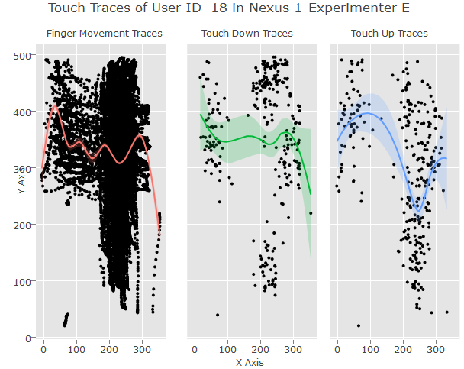
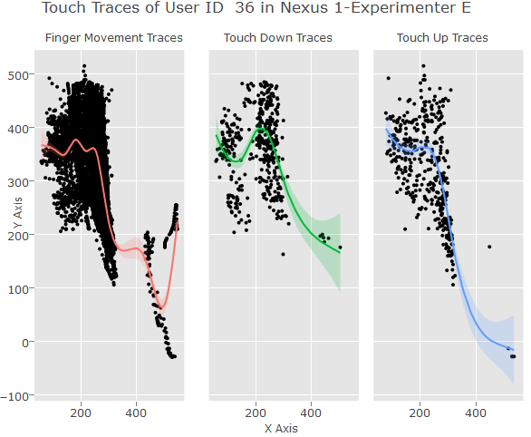
Touch Traces Analysis in Smartphone

Slide 10
Secure Your Data & Apps
The proposal has some limitations as in time to learn user behavior, additional storage & cost. We recommend the following to overcome:
Store sensitive documents in a security app and secure by pin.
Keep personal apps like e-mail, social media apps inside the security app and access from that app to keep data encrypted.
Other functionality like remotely lock the device, remote factory reset and phone location tracking if lost or stolen

Slide 11
Conclusion
Validation
Smartphone security can be achieved by continuously validating the touch traces of user’s touch traces.
Feature Extraction
Extracting more features is essential to improve the accuracy of authenticity so that the access of smartphone by unauthorized uses can be forbidden.
References
http://www.mariofrank.net/paper/touchalytics.pdf
Dataset - http://www.mariofrank.net/touchalytics/

Slide 12
aniranja@uncc.edu
niranjan9

