Slide 1
Real Estate Price Prediction
ML Case Study - Agent Mira

Slide 2
Summary
• Goal: Predict house prices using ML
• Data: 247K transactions (2020-2024)
• Best model: LightGBM (R²=0.53, RMSE=$157K)
• Deployed as REST API with multi-core support
• Size and sale timing are top predictors

Slide 3
Dataset
• 247,172 property sales
• Features:
- Location (4 cities)
- Size (800-4000 sqft)
- Bedrooms (1-5), Bathrooms (1-3)
- Year Built, Condition, Type
• Target: Price ($26K - $2.2M)

Slide 4
Data Quality
• Missing values handled:
- Year Built: 5.1%
- Condition: 4.3%
- Bedrooms: 3.4%
- Price: 2.2%
• Strategy: median for numeric, mode for categorical

Slide 5
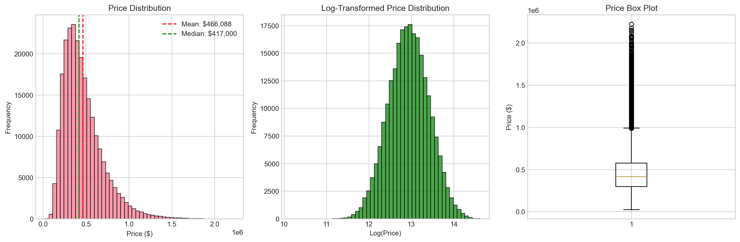
Price Distribution
Right-skewed | Mean: $466K | Median: $417K

Slide 6
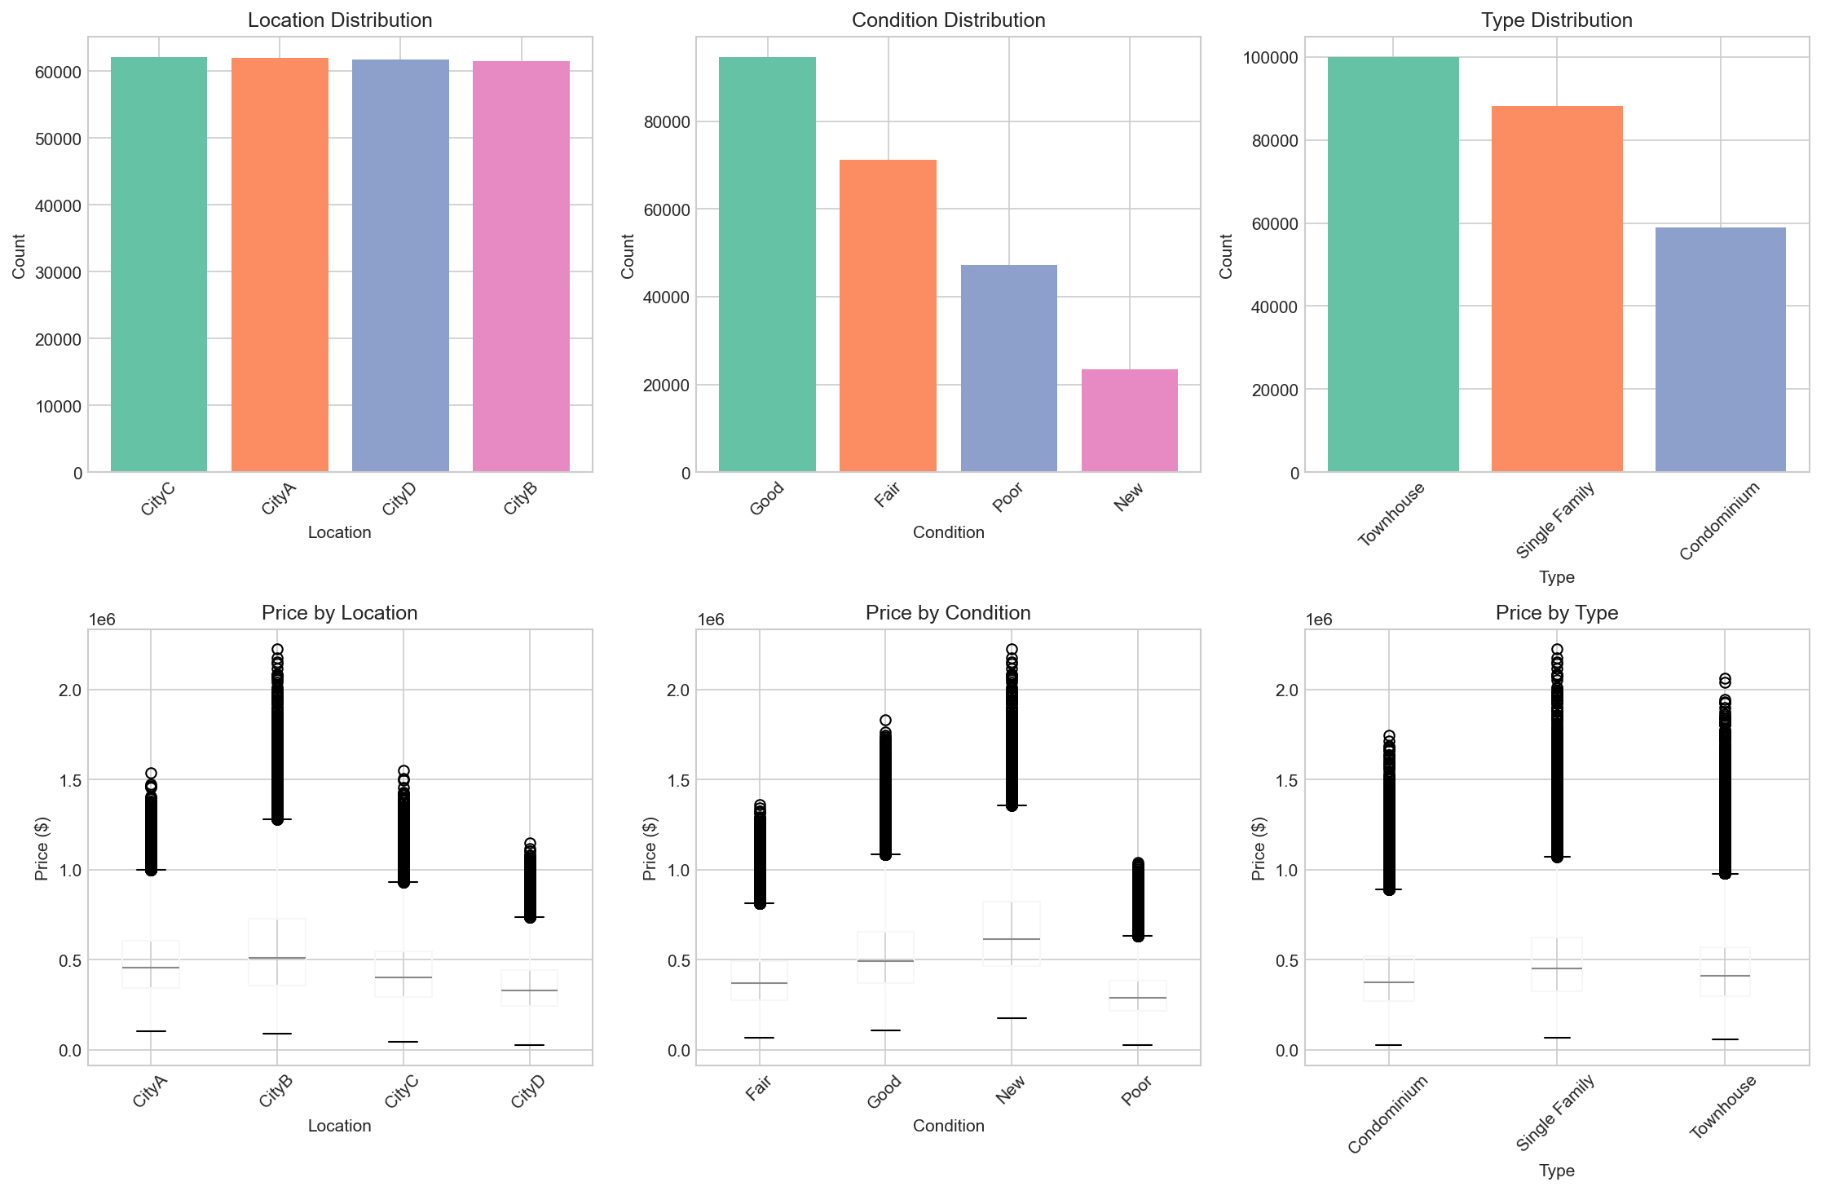
Categorical Analysis

Slide 7
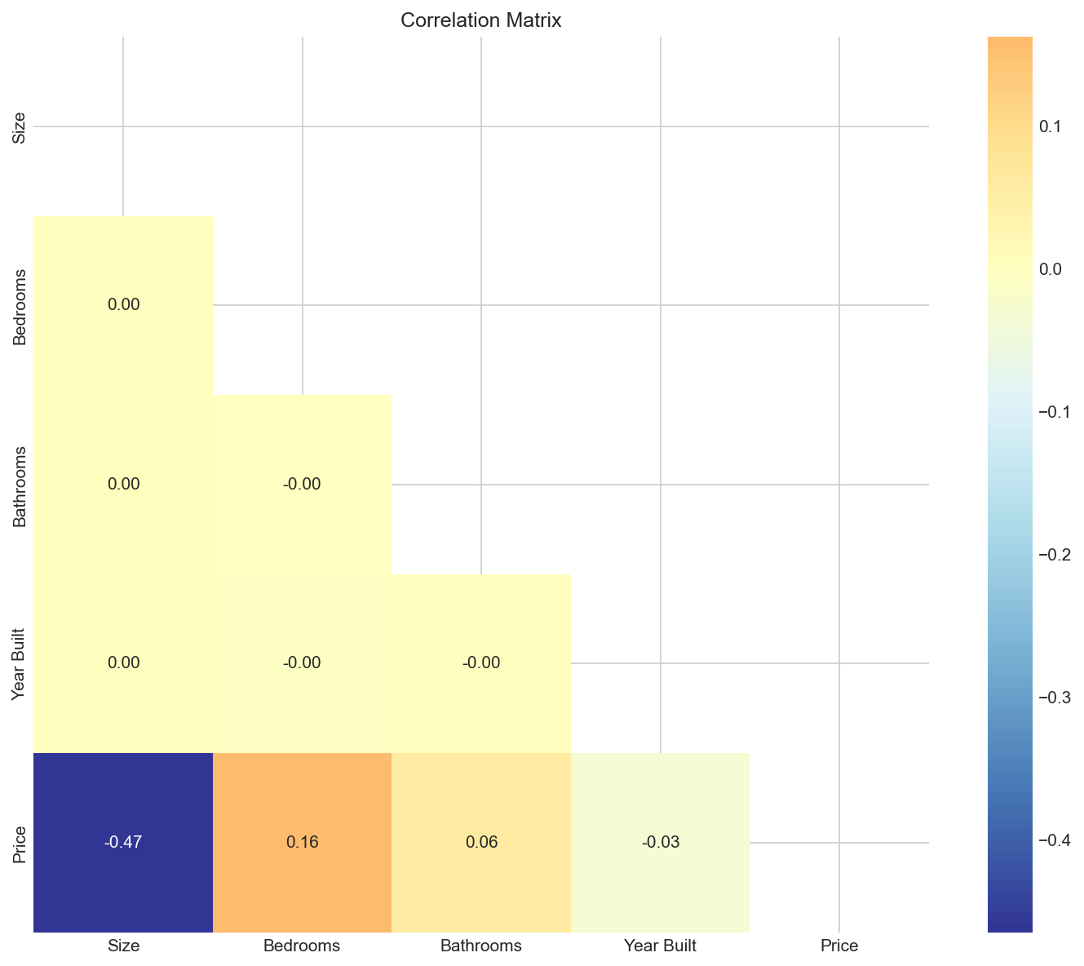
Correlations

Slide 8
Feature Engineering
• Created 12 features:
- property_age, total_rooms, bath_ratio
- size_cat (small/medium/large/xlarge)
- year_sold, month_sold, quarter
- is_new, decade
• One-hot encoding for categoricals
• StandardScaler for numerics

Slide 9
Model Comparison
Model | Val RMSE | R² | Time
LightGBM | $158K | 0.53 | 0.7s
XGBoost | $158K | 0.53 | 0.3s
GBM | $158K | 0.53 | 18.7s
RandomForest | $161K | 0.52 | 3.2s
Ridge | $163K | 0.50 | 0.01s

Slide 10
Best Model: LightGBM
• Test performance:
- RMSE: $157,307
- MAE: $117,716
- R²: 0.5317
• Tuned with GridSearchCV (5-fold CV)
• Params: lr=0.05, depth=4, n_est=200

Slide 11
Feature Importance
Rank | Feature | Score
1 | Size | 850
2 | year_sold | 469
3 | month_sold | 439
4 | total_rooms | 359
5 | property_age | 326

Slide 12
Multi-Core Processing
• Training: n_jobs for RF, XGB, LGBM
• GridSearchCV with parallel CV folds
• API: ThreadPoolExecutor for batch predictions
• Uvicorn with multiple workers

Slide 13
API Endpoints
• POST /predict - single property
• POST /predict/batch - multiple properties
• GET /health - status check
• GET /model/info - model details
• Swagger docs at /docs

Slide 14
Project Files
• src/eda.py - EDA and plots
• src/preprocessing.py - data pipeline
• src/model_training.py - model training
• api/app.py - FastAPI server
• main.py - orchestration
• models/ - saved model artifacts

Slide 15
Thank You
Questions?

