Slide 1


Introduction to Text Mining
Cory Lesmeister
Senior Quantitative Manager
Synovus Financial

Slide 2




My Background
Twelve years of analytical experience…
Eli Lilly & Company
Quantitative Market Research, Oncology
Lean Six Sigma Black Belt
Forecasting and Market Analytics
Clarity Solution Group, Consultant, Advanced Analytics
Customer/Account Retention Models, USAA
SAS Migration, Arizona Blue Cross and Blue Shield
Optical Character Recognition Pilot, McDonald’s
Synovus
Model Development Group
Everything not in the realm of the Dodd-Frank Act

Slide 3
Purpose & Agenda
Purpose - Provide an overview of the process of conducting text mining and walk-through a brief example using R.
Agenda:
Text Mining Overview, What and Why
Discuss Possible Use-Cases
Text Mining Workflow
Overview of R Packages
Example
Q & A

Slide 4
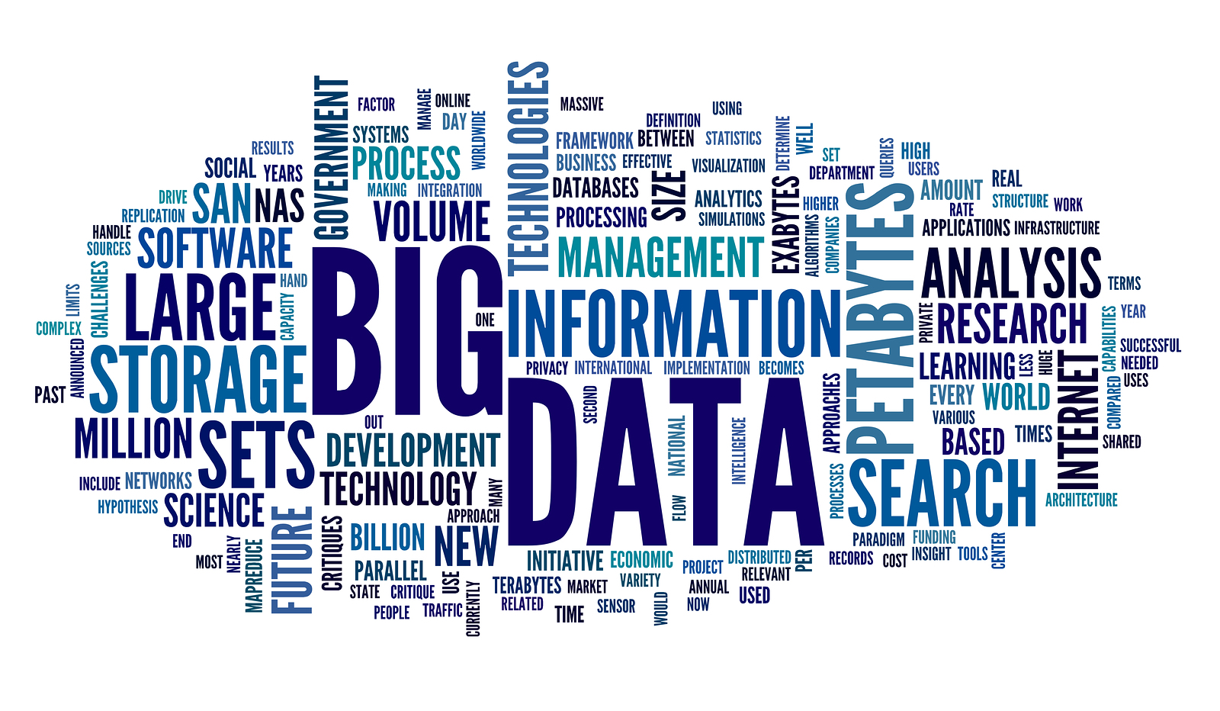
What is Text Mining and Why Do It?
A Definition
… also referred to as text data mining, roughly equivalent to text analytics, is the process of deriving high-quality information from text. High-quality information is typically derived through the devising of patterns and trends through means such as statistical pattern learning. Wikipedia
Why?
Inundation with vast amounts of unstructured and semi-structured data
Utilize for unsupervised learning
Can be configured for supervised learning
Hypothesis generation

Slide 5
Example Use Cases
Natural Language Processing (NLP) – train a machine to “read” text, e.g. Chatbots, Google Translate
Monitor social media for customer sentiment
Market Understanding
Identify Trends/Quantify Issues
Predictive Modeling

Slide 6
Generic Workflow
Extract
&
Clean
Text
Create
Corpus
Speech
Tagging,
optional
Transform,
optional
Tokenize
Nouns
Verbs
Words
N-grams
Sentences
Remove:
Numbers
Punctuation
Words
Whitespace
Stemming
Lemmatization
Analysis:
Term-Document Frequency
Classification
Sentiment
Topic Modeling
Clustering

Slide 7
Assessment of R Packages for Text Mining
Package | Pros | Cons
tm | The ‘original’ R library for text mining. Can create a corpus and transform text. Provides frequency statistics and some associations | Does not handle dataframes or ‘tidy’ data. Does not facilitate parts of speech tagging, nor does it do sentiment analysis
qdap | A jack-of-all-trades library. Handles advanced analysis including speech complexity and formality. Good visualization tools. Utilizes dataframes. | A complicated library to master. Some tasks are very resource intensive.
quanteda | An improved version of tm. Supports dataframes and easier/more intuitive analysis and visualization. | Several functions are still under development. Lacks advanced functions like qdap
tidytext | Operates on dataframes and is part of the ‘tidyverse’, which facilitates user-friendly coding and visualization. Great for sentiment analysis. | If you are not a fan of tidyverse then avoid at all costs. Lacks much of qdap’s functionality
cleanNLP | To be evaluated

Slide 8
The Data
Downloaded from the UCI Machine Learning Repository (Opiniosis Opinion Data Set)*
Extracted four text files of customer opinions on 2007 Toyota Camry
Objective – mine the text for possible trends and drivers of sentiment
All text files and R code are available for download on github https://github.com/datameister66/text
* Kavita Ganesan, ChengXiang Zhai, Jiawei Han. Opinosis: A Graph Based Approach to Abstractive Summarization of Highly Redundant Opinions. In Proceedings of the 23rd International Conference on Computational Linguistics (COLING 2010). Beijing, China.

Slide 9
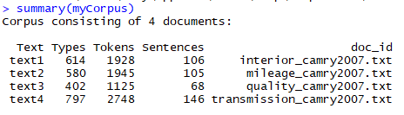
The Corpus
Number of words and punctuation per text document
Number of sentences per document
Document Names

Slide 10
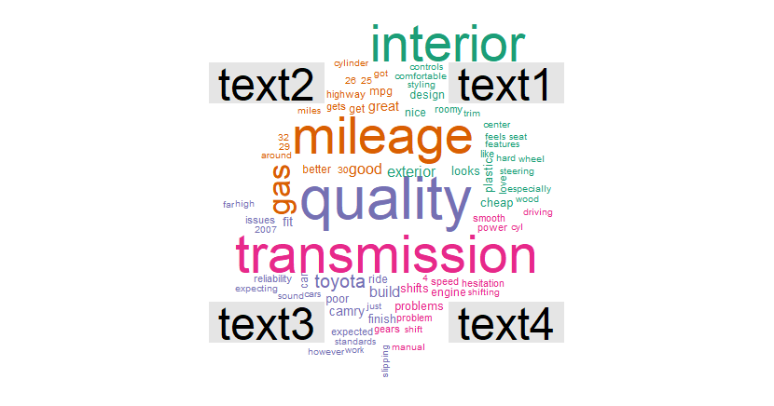
Wordcloud Grouped by Document
Interior described as both ‘nice’ and ‘cheap’
Gas Mileage looks positive
Quality might have potential issues
Transmission appears to have issues

Slide 11
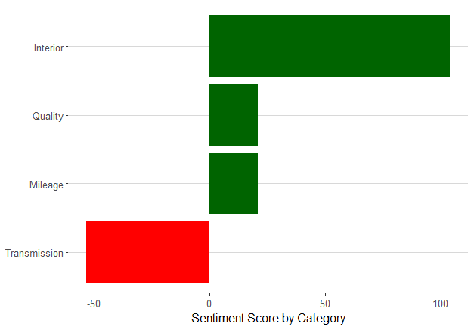
Plot of Customer Sentiment by Document Category

Slide 12
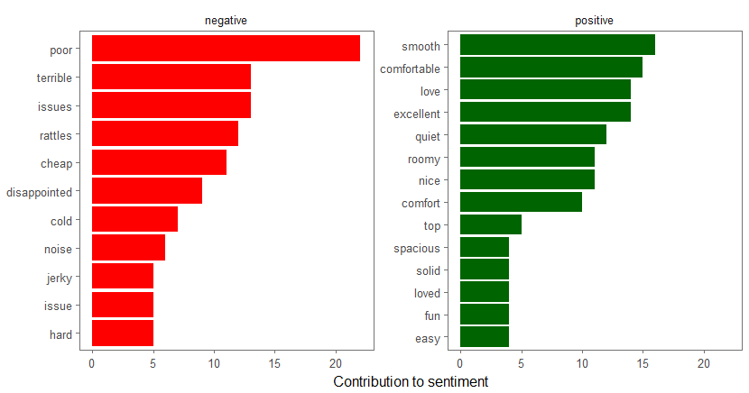
Word Score Contributions to Overall Sentiment

Slide 13
Recap
Text Mining Overview, What and Why
Discuss Possible Use-Cases
Text Mining Workflow
Overview of R Packages
Example
Questions?

