Slide 1
Managing Machine Learning Lifecycle with MLflow and Apache Airflow
MLCon Munich 2023

Slide 2


Agenda
01
02
03
What did we learn?
Apache Airflow on Cloud and Industry Architectures
Where to go next?

Slide 3
What did we learn?

Slide 4

What did we learn?
How to Install and Setup Airflow
Basic concept of DAGs and Tasks
How to use Operators
BashOperator
PythonOperator
Communication between tasks - XComs
How to use TaskFlows for Python Operators
Integration of Mlflow with Airflow for training
Integration of MLFlow training with Git commits

Slide 5
Apache Airflow on Cloud and Industry Architectures

Slide 6








Apache Airflow Operators
Take care of versions
Apache Airflow provides many prebuild operators for an easy integration with AWS that can be found here:
https://airflow.apache.org/docs/apache-airflow-providers-amazon/stable/operators/index.html
EMR
Athena
Lambda
ECS
Batch
Redshift
Glue
S3
…and more connectors
Notes:
Every experiment – we ask what worked and what did not? And what could be done differently in the future

Slide 7
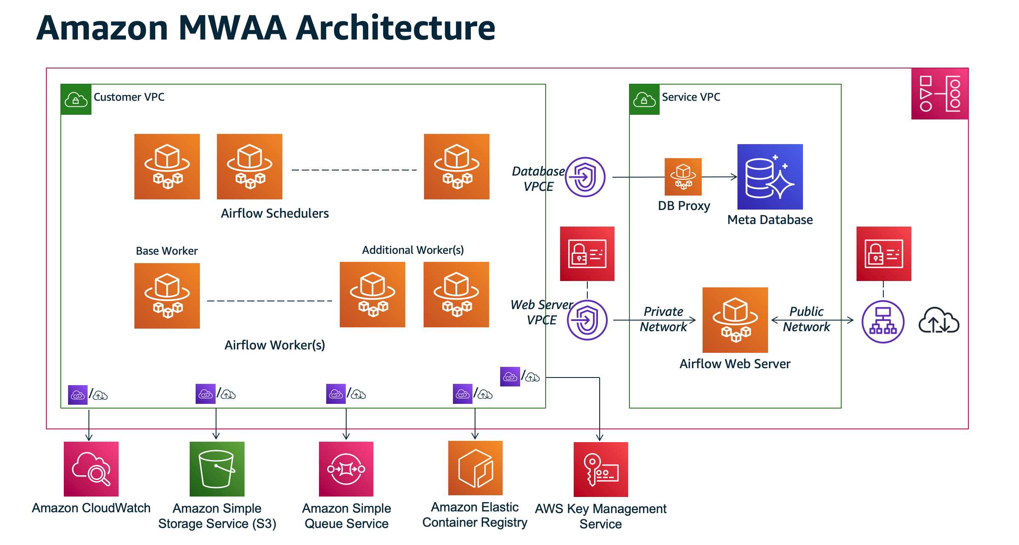
Apache Airflow use-case at Industry

Slide 8
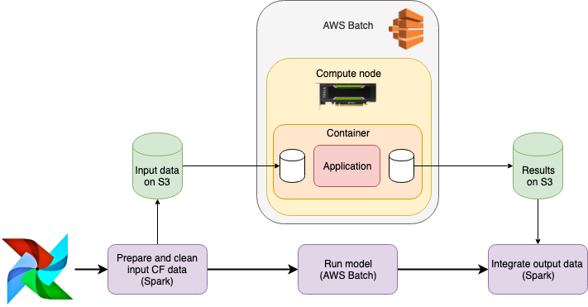
Apache Airflow with Batch GPU processing

Slide 9
Where to go next?

Slide 10
Where to go next?
Try to
Discover more Operators and provider packages
Understand branching of tasks (and control flow)
Find how to connect external databases and file stores
Discover cloud operators - MWAA
Try to orchestrate a use-case on your own
.
.
And then…you will know where to go next ☺

Slide 11
Questions?

