Slide 1
MLOps workshop with Mlflow
MLCon 2022: Beyond Notebooks

Slide 2


Agenda
01
02
Registering existing non-MLflow trained models
MLflow on cloud
03
04
Tips and Tricks from practise
What did we learn?

Slide 3
Registering existing non-Mlflow trained models
Beispielfolien

Slide 4
Registering non-Mlflow trained models
It can happen that the model was trained and later it was decided to register it on MLflow for model tracking
Solution: Mlflow Pyfunc module
How exactly?
Find the model generated .pkl or .bin saved in your system
Use Mlflow Pyfunc module for saving the existing model as MLflow model
Define the MLflow wrapper by inheriting the PythonModel class
This class must overwrite two methods: load_context and predict
(beyond the scope of this workshop)
Load this MLflow model in your python script
Add MLflow logging code
Follow the familiar steps:
Setup MLflow server
Setup a tracking URL
Setup Artifact store – storage space
Setup Backend store – relational DB

Slide 5
MLflow on cloud
Beispielfolien

Slide 6
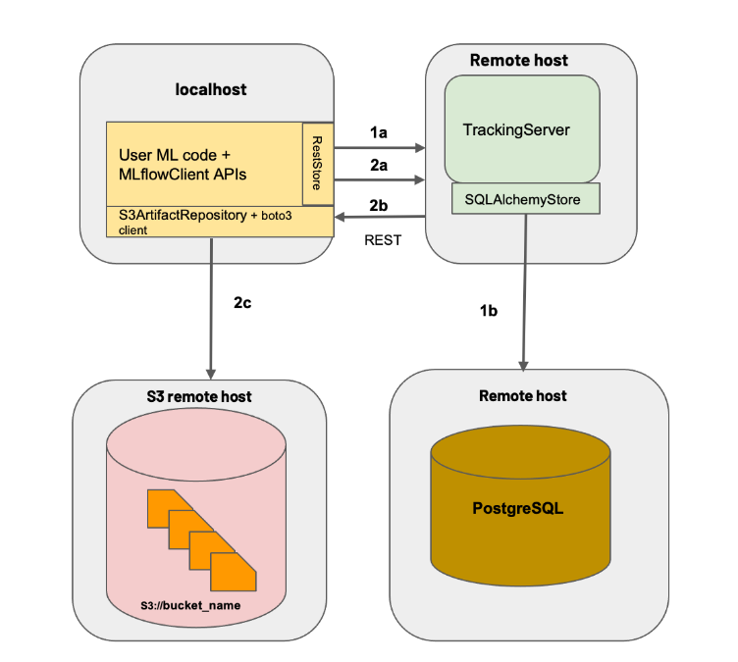
MLflow on cloud?
Generalized Architecture

Slide 7
MLflow on cloud?
Place where the ML code is present
Generalized Architecture

Slide 8
MLflow on cloud?
Here runs the the Mlflow server
Generalized Architecture

Slide 9
MLflow on cloud?
Generalized Architecture
A Database where the logged experiment data is saved

Slide 10
MLflow on cloud?
Generalized Architecture
Storage where the ML artifacts can be stored

Slide 11









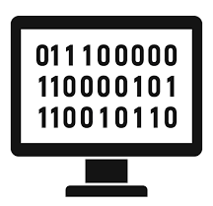
Example MLflow cloud architecture on AWS
Mlflow UI (dashboard) and Deployment
ECR
Artifacts and Registry
Inference Phase/ Automated training
S3 bucket
EC2
User
Or
Mlflow Dashboard viewer
Load
Balancer
Fargate MLflow server
RDS
Secrets
Manager
Fargate
Machine

Slide 12
MLflow Tips and Tricks
Beispielfolien

Slide 13
MLflow Tips and Tricks
You can always log extra artifacts of your model and save it in the model’s artifact store using mlflow.log_artifact(”path of file”)
You can log text files, images and interactive images too
You can also organize these artifacts within the customized sub-folders
Artifacts can be downloaded too
Nested runs can be logged, each having different set of logging parameters and metrics with mlflow.start_run(experiment_id=1, run_name=”first nested run", nested=True) Note: The parent run and the nested runs have different run-IDs
Analyse logged data within mlflow using pandas dataframe df = mlflow.search_runs(experiment_ids=["your_exprmnt_id"])
You can get the Mlflow run and experiment IDs programatically using the MlflowClient()

Slide 14
Bonus: Using mlflow for serving models
URL: Localhost:5000/invocation
for getting score/predictions
Send inference data as :
curl -d '{"dataframe_split": {"columns": ["x"], "data": [[1], [-1]]}}' -H 'Content-Type: application/json' -X POST localhost:5000/invocations
OR
# record-oriented DataFrame input (fine for vector rows, loses ordering for JSON records) curl http://127.0.0.1:5000/invocations -H 'Content-Type: application/json' -d '{ "dataframe_records": { {"a": 1,"b": 2,"c": 3}, {"a": 4,"b": 5,"c": 6} } }'
Get prediction as:
[1, 0]
Models can be served as Python functions
MLmodel file can declare how each model should be interpreted as a Python function
Mlflow has tools for running such models locally and exporting them to Docker containers or commercial serving platforms
Command used:
mlflow models serve -m runs:/<RUN_ID>/model --port 1234
Pass it some sample data and see the predictions
https://docs.databricks.com/mlflow/create-manage-serverless-model-endpoints.html#scoring-a-model-endpoint&language-python

Slide 15
What did we learn?
Beispielfolien

Slide 16

What did we learn?
Why MLflow?
Performing model training with Mlflow
Adding MLflow logger code
Setup Artifact store
Setup MLflow server
Setup tracking URL
Setup Backend store
MLflow registry - model version controlling
Logging non-Mlflow trained model
MLflow architecture on cloud
Extra – Mlflow Tips and Tricks :P

Slide 17
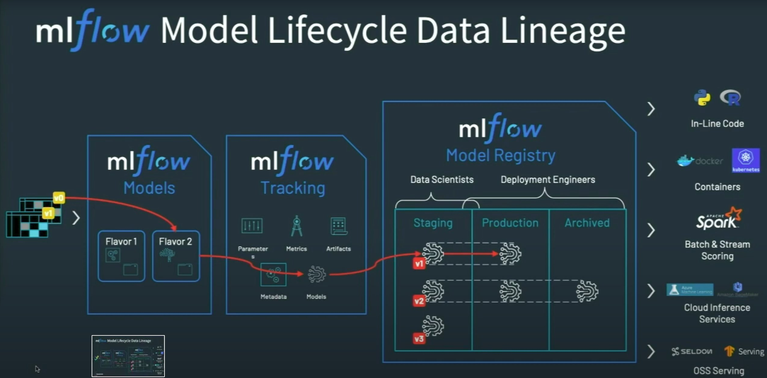
MLflow model Lifecycle

Slide 18
We are open to Questions…
Beispielfolien

