Slide 1
2008 Stock Market meltdown
Mean Variance Optimization (MPT) flaws highlighted in the data

Slide 2
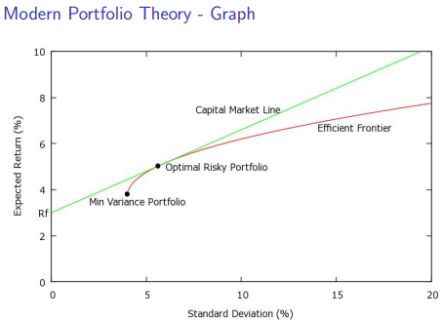
“In this world there is no such thing as a free lunch”
Nobel Prize winning Finance Professor Harry Markowitz improved on this quote by stating, “Diversification is the only free lunch in Finance.” It is achieved when constructing his Mean Variance Portfolio Optimization method on a group of stocks that maximizes portfolio returns while minimizing portfolio risk by choosing stocks with low or negative correlation.

Slide 3
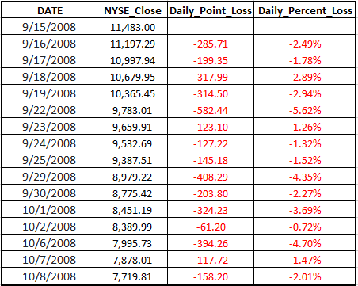
“This time is different”
The culmination of many factors: sub-prime mortgage defaults cascading into standard mortgage industry defaults which impacted the housing market along with numerous financial institutions failing caused the stock market and overall economy to slide into the Great Recession and this was reflected in falling stock returns in 2008

Slide 4
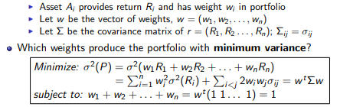
Diversification hypothesis: portfolios diversify risk
To minimize risk, investors assemble stocks into portfolios, where risk is defined as portfolio variance and the weights of the individual stocks in the portfolio are chosen to minimize portfolio variance, the formula is given below. This downturn was different since the Correlation matrix scores of stock returns spiked up and no longer gave the same diversification benefits and the hypothesis of portfolio diversification did not hold true in this extreme event.

Slide 5
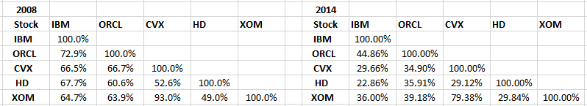
Comparison of correlation matrix: 2008 vs 2014
The two correlation matrices below show 2008 is much higher for a five-stock portfolio; the variance of daily stock returns was also higher. As a benchmark, the annualized standard deviation of SP 500 daily returns was 41% for 2014 and 11% for 2008.

Slide 6
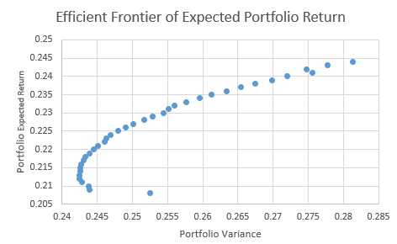
Efficient Frontier of Expected Portfolio Return
The chart below is an X-Y scatterplot showing the array of portfolio returns of different stock weights that all achieve minimum portfolio variance under normal stock market conditions

Slide 7
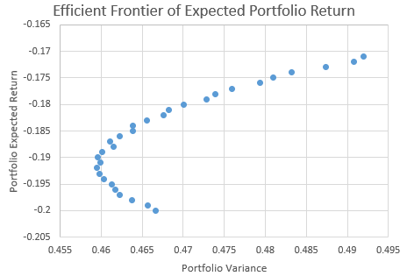
Efficient Frontier under market distress
The X-Y scatterplot chart below also shows the array of portfolio returns when variance has increased, and the portfolio expected returns has turned negative for the array of portfolio weights.

Slide 8
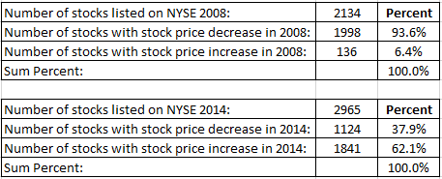
Another view of 2008 vs 2014
In the table below, the end of year returns for the NYSE exchange are shown. Almost 94% of all companies listed on the stock exchange were down for the year. When viewing the data at this angle it is easier to see why correlation scores spiked up.

Slide 9
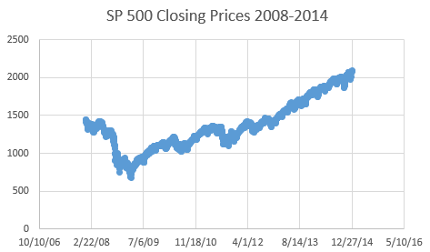
Efficient Market Hypothesis Questioned
The Efficient Market Hypothesis states that the stock market prices reflect all information available at the time, so how can such a dramatic price drop occur across many stocks and many industries all at once and how can it be prevented from happening again?

Slide 10
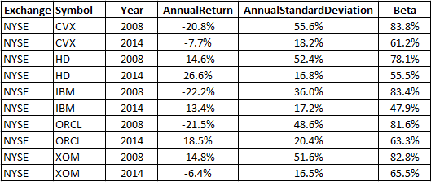
Another view of the correlation breakdown
The swift drop in market prices challenged the Efficient Markets hypothesis and the correlation between stocks and the SP 500 index, also known as Beta, challenged the Diversification hypothesis; Beta scores are shown below:

Slide 11
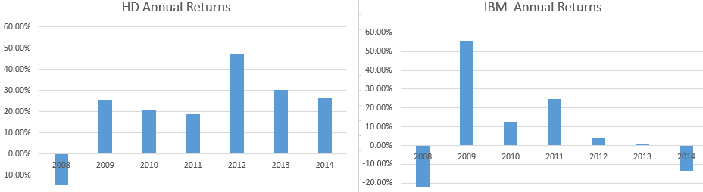
How Machine Learning can remedy market inefficiencies
One interesting solution is applying Machine Learning techniques to time series data to derive a better predictive model for predicting stock prices or using Natural Language Processing to perform sentiment analysis to predict the path of stock prices.

Slide 12
In Conclusion
It is only the beginning of the AI arms race and there are several different Machine Learning techniques that can be used to better predict the path of stock prices, which has long been known as one of the main weaknesses of the Mean Variance Optimization model. Machine Learning techniques can also be used to remedy the market inefficiencies to mitigate systemic risk that was a precursor to the stock market crash.

