Slide 1
Credit Card Scoring Story
Exploratory Data Analysis & Machine Learning Classification

Slide 2
Executive Summary
Project goal: leverage machine learning classification algorithm to derive a Credit Card score that correctly identifies good credit scores and bad credit scores
Data preprocessing: clean and standardize the data and view what features are given in the data set
Exploratory Data Analysis: make inferences between features and Good, Standard and Poor Credit scores
Machine Learning modeling: Six Classification models used to predict credit card scores

Slide 3
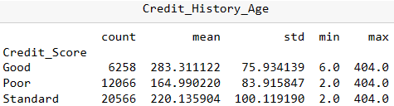
Data Preprocessing
Python scripts to scrub the data and view object types
Python scripts to view Descriptive Statistics of data columns
Python scripts to standardize and re-scale the raw data

Slide 4
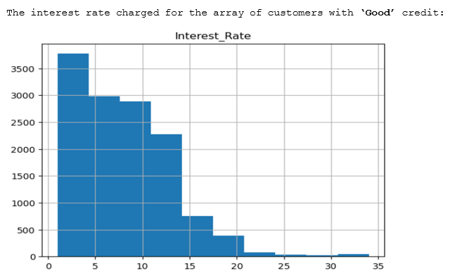
Setting the stage: What worked as expected
Not surprisingly, exploratory data analysis revealed lower interest rate charged to a credit card customer was associated with a ‘Good’ credit score and a higher interest rate was linked to a ‘Poor’ credit score:

Slide 5
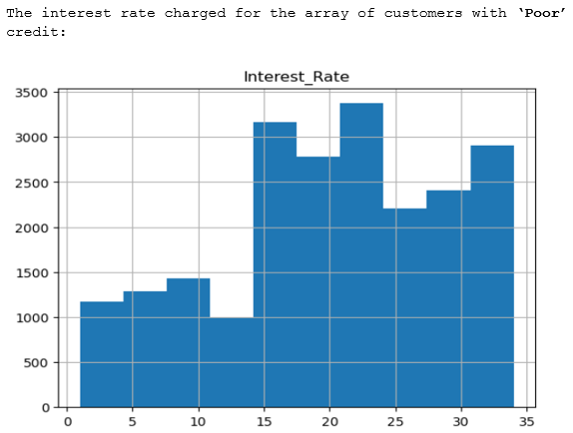
Metrics aligned with expectations
Conversely, ‘Poor’ credit scores were associated with a higher interest rate being charged:

Slide 6
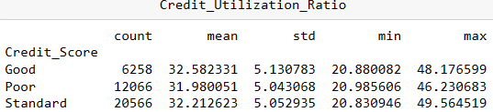
Plot twist: metrics not what was not expected
There were certain metrics that were not expected when viewing the records in the exploratory data analysis phase: the credit utilization ratio was the same for ‘Good’, ‘Poor’ and ‘Standard’ credit scores.

Slide 7
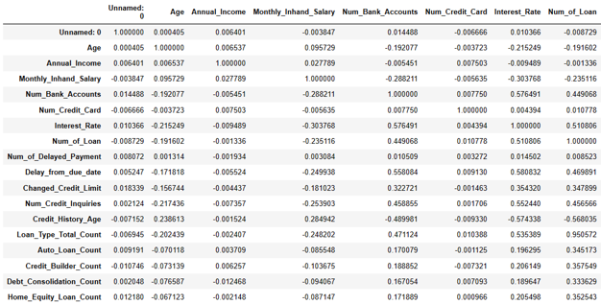
Exploratory data analysis: Correlation Matrix
The data story started to take shape after viewing individual X variable associations in a correlation matrix: as expected a higher credit history age is linked to a lower interest rate

Slide 8
Modeling: Six Machine Learning Classifiers
Since some metrics were as expected and others were counter intuitive it was now time to feed the cleaned data to six different Classification algorithms
Logistic Regression Classifier
Decision Tree Classifier
Gaussian Naive Bayes Classifier
K Neighbors Classifier
XGBoost Classifier
Random Forest Classifier

Slide 9
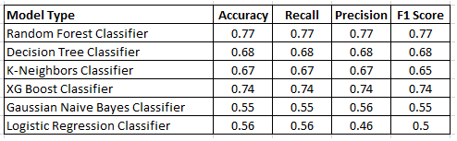
Classification Model Results
The challenge is to make predictions of credit score that correctly identify ‘Good’ credit scores as well as ‘Poor’ credit scores therefore the F1 Score was chosen as the best determinant of model prediction with the Random Forest Classifier returning the highest F1 Score

Slide 10
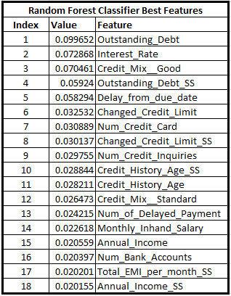
Best Features of the Random Forest Classifier
For the Random Forest Classifier below is output showing the features that were most influential determinants of credit score:

Slide 11
Hyperparameter tuning
The other classifier models also underwent hyperparameter tuning and only the Random Forest hyperparameter will be examined here since the Random Forest classifier scored the best at an accuracy of .77 when using n_estimator at 20
The cross-validation function returned these parameters as being optimal:
'criterion': 'gini', 'max_depth': 7, 'min_samples_leaf': 5, 'min_samples_split': 2, 'n_estimators': 20

Slide 12
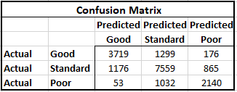
Confusion matrix
The confusion matrix is a 3x3 matrix table, with two axes representing the predicted class and the actual class for Good, Standard, and Poor. The rows of the table represent the actual classes, while the columns represent the predicted classes. The 3x3 cells in the table:

Slide 13
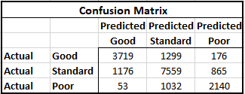
Concluding Findings: Confusion Matrix
Good: The Random Forest Classifier model correctly predicted 3719 "Good" credit scores (True Positives). The model incorrectly predicted 1299 "Good" credit scores as "Standard" and 176 as "Poor" (False Negatives).
Poor: The Random Forest Classifier model correctly predicted 2140 "Poor" credit scores (True Positives). The model incorrectly predicted 176 "Poor" credit scores as "Good" and 865 as "Standard" (False Negatives).

Slide 14
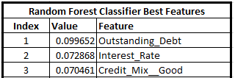
Concluding Findings: Best Features
It was reassuring that our human intuition coincided with the Machine Learning algorithm’s output for the Random Forest Classifier’s Best Features: Outstanding Debt, Interest Rate and a Credit Mix all scored high as determinants for predicting credit scores

Slide 15
Conclusion: F1 score as optimal metric
In concluding the modeling phase, the Random Forest Classifier greatly improved on the lowest ranking classifier, the Logistic Regression Classifier model: the Random Forest Classifier posted an Accuracy score of .77 versus .56 for the Logistic Regression Classifier, which corresponds to a 37.5% increase in credit scoring ability.
In the context of credit card classification, a high F1-score was chosen as the most important metric since it indicates that the model is able to correctly identify both good and poor credit scores. This is important because it allows lenders to make informed decisions about who to extend credit to while maximizing profit and minimizing risk.

