Slide 1
Amazon Customer Reviews Text Analysis
Using Python NLP and SQL

Slide 2
Executive Summary
Project goal: leverage machine learning classification algorithm to predict good and bad customer reviews in order to increase customer satisfaction across product categories.
Data preprocessing: clean and standardize the Review column data and ensure that the data can be loaded into a SQL database.
Exploratory Data Analysis: aggregate keyword counts and derive a dictionary of “good” and “bad” words.
Machine Learning modeling: Random Forest Classifier and Support Vector Machine Classifier and hyperparameter tuned Random Forest Classifier.

Slide 3
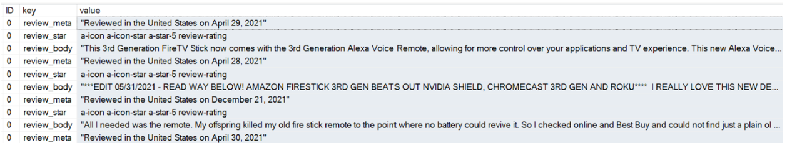
Data Preprocessing
Python script to extract list of dictionaries in Review column cell into a new CSV file
SQL scripts to import CSV files
Extracted and transformed Review column data shown below:

Slide 4
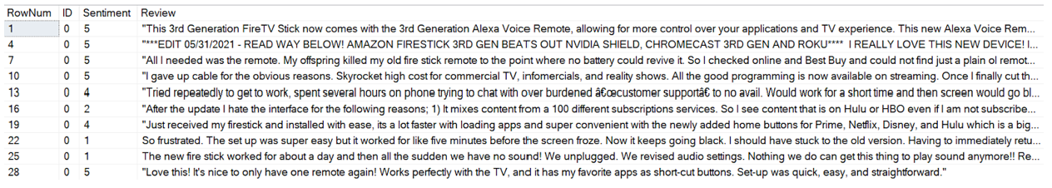
Second ETL transformation
The SQL script employed below uses a derived table to “query the query” and inserts the staging table info into a format with Sentiment score and its Review text on the same line that can now be queried more efficiently:

Slide 5
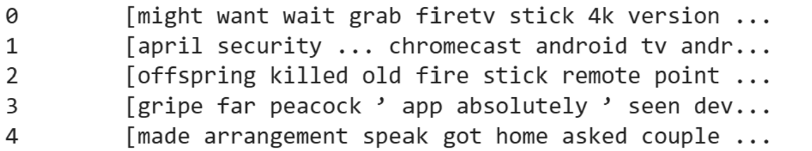
Python script to extract ‘keywords’
The RAKE-NLTK library provides a simple API for extracting keywords from text. The following output shows a new column, ‘keywords’ derived from the ‘Review’ column with the use of the “extract_keywords_rake” function:

Slide 6
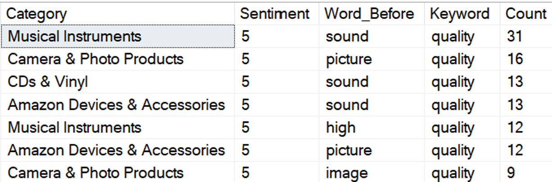
Exploratory Data Analysis using SQL
An early phase of the EDA phase was querying the Review data. Below is the output of a user defined function that returns the word before the “keyword” parameter being supplied along with Count, Sentiment and Category columns:

Slide 7
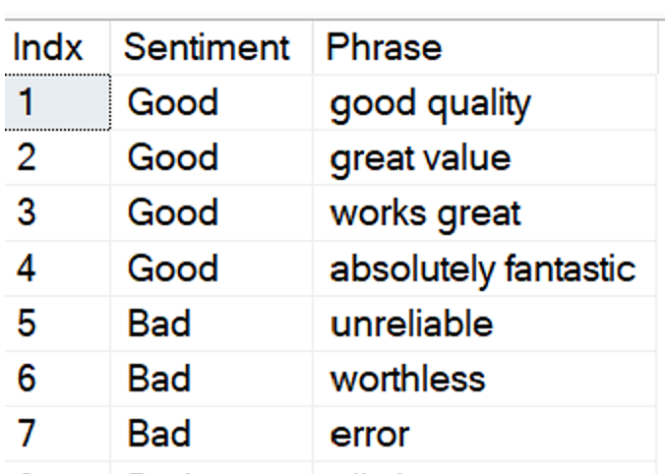
Exploratory Data Analysis using SQL
Below is output of key phrases that denote “good” or “bad” sentiment when scanning through the keywords column of the SQL table:

Slide 8
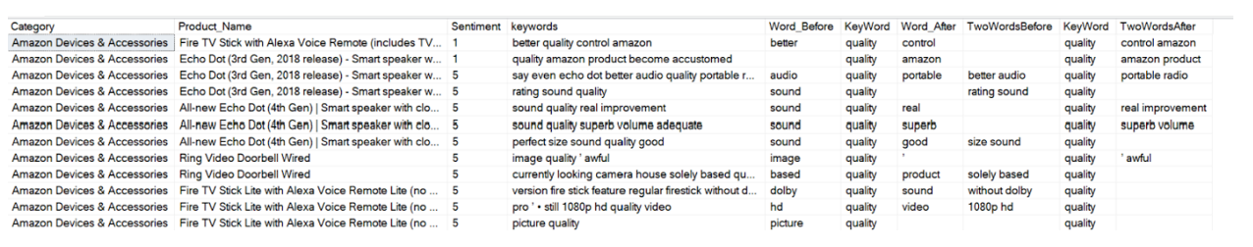
Marketing Research and Text Mining
For Marketing & Research this is a powerful SQL script to view and evaluate textual sentiment: “quality” is passed as a parameter and user defined functions return the two words before the parameter and user defined functions return the two words after the parameter.

Slide 9
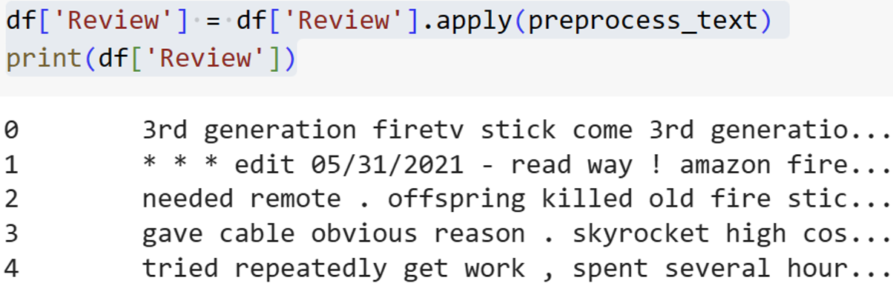
Pre-processing in Python
To facilitate text processing, one of the preliminary preprocessing steps is to implement the NLTK stopwords function, which is a script to eliminate common words such as ‘the’, ‘and’, etc. Below is the output of the Review column after all of the data wrangling and pre-processing has completed:

Slide 10
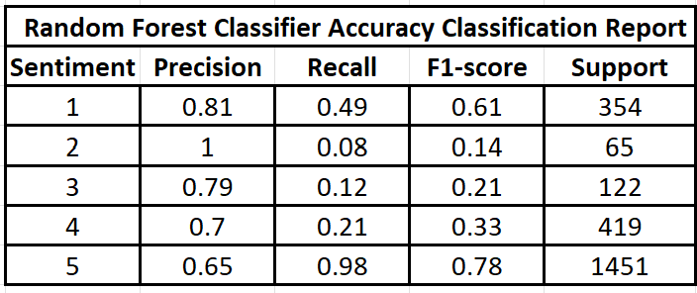
Machine Learning Model I: Random Forest Classifier
For the initial Natural Language Processing Machine Learning Text Classifier the Random Forest Classifier was executed. Overall Accuracy: 0.6532; this means it correctly predicts the sentiment of reviews about 65.3% of the time.

Slide 11
Machine Learning Model I: Random Forest Classifier
Sentiment 5: The precision is 0.65, which means that out of all reviews the model identifies as sentiment 5, 65% are correctly identified. The recall, however, is very high (0.98), meaning the model is able to correctly identify 98% of actual sentiment level 5 reviews. The F1-score is quite high (0.78), reflecting a good balance between precision and recall for this class.model is able to correctly identify 98% of actual sentiment level 5 reviews. The F1-score is quite high (0.78), reflecting a good balance between precision and recall for this class.
Sentiment 1: The model has a high precision (0.81), meaning that when it predicts a review as sentiment 1, it's correct 81% of the time. The recall is 0.49, which means the model only identifies 49% of all actual sentiment 1 reviews. The F1-score is the harmonic mean of precision and recall and is 0.61, reflecting a balance between precision and recall.
The classifier is performing quite well on classes 1 and 5, especially on class 5. It struggles more with classes 2, 3, and 4, likely because these classes are still underrepresented in the data. The second dataset of Amazon customer reviews were added for those sentiments 1 - 4 to even out the distribution to remedy the underrepresentation.

Slide 12
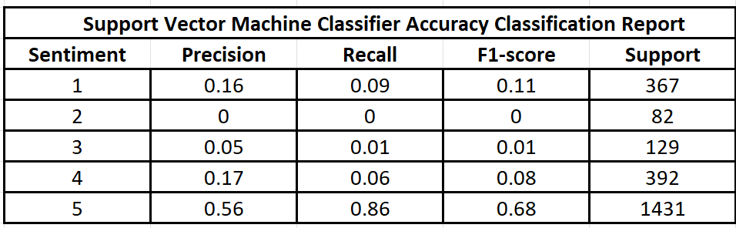
Machine Learning Model II: Support Vector Machines Classifier
To benchmark the results of the Random Forest Classifier, the Support Vector Machines (SVM) text classifier was also executed against the Amazon Customer Review dataset. Overall, the Classifier Accuracy is 0.6634 for the Support Vector Machines (SVM) text classifier and the Precision, Recall, F1-Score values are shown in the table below:

Slide 13
Machine Learning Model II: Support Vector Machines Classifier
Sentiment 5: The precision is 0.56, indicating that when the model predicts sentiment 5, it's correct 56% of the time. The recall is high at 0.86, meaning the model captures 86% of actual sentiment 5 reviews. The F1-score is relatively high at 0.68, reflecting a decent balance between precision and recall for this class.
Sentiment 1: The precision is 0.16, which means when the model predicts sentiment 1, it's correct 16% of the time. The recall is 0.09, meaning the model correctly identifies only 9% of actual sentiment 1 reviews. The F1-score is 0.11, reflecting a balance between precision and recall but suggesting that the model performs poorly for this class.

Slide 14
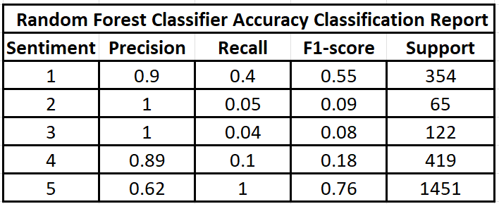
Hyperparameter Tuning Random Forest Classifier
When comparing the two model’s results it was clear the Random Forest Classifier could be improved by conducting Hyperparameter tuning.

Slide 15
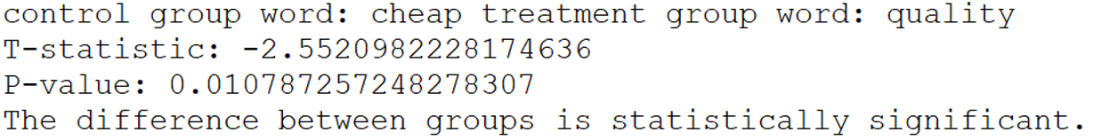
Marketing Research: AB Test for Good and Bad Dictionary Words
An AB Test was run for the words “cheap” and “quality”, where “cheap” can have two meanings; it can mean inexpensive or it can mean cheaply made which implies a lack of quality.
The AB Test for keywords “cheap” versus “quality” underscore the need to have humans read the text for ambiguity since cheap can have either good or bad connotations.

Slide 16
In Conclusion
Since the Amazon Customer Review data is text, it was appropriate to leverage both SQL and Python for the initial data wrangling and SQL was especially helpful at the EDA phase.
For textual data AB Tests were executed on pairs of words: "like" vs "love"; "cheap" vs "quality"; "horrible" vs "recommend“; and is one area for further research.
Python's Natural Language Processing libraries were very helpful in classifying and predicting for sentiments 1 and 5 which allows management to derive key insights where customers are satisfied and where they are not across all product categories in the dataset.

