Slide 1
Real Estate Data Science Application

Slide 2
Table of contents
01
02
03
04
Introduction
Data Gathering
The Intro of the Project
The Origin Of data
Data Preprocessing
Machine learning Pipeline
Data Cleaning & other Stuff
Use different algorithms to predict price

Slide 3
01
Introduction
The Intro of the project

Slide 4
Setting the Context
In the dynamic world of real estate, accurate property valuation is the key to unlocking profitable opportunities especially in Pakistan

Slide 5
The Challenge
The real estate market is complex, with numerous factors influencing property prices.
Traditional valuation methods are often too simplistic, failing to capture the full complexity of the real estate market."
According to a study by the National Association of Realtors, over 60% of homebuyers reported feeling uncertain about the true market value of properties they were considering

Slide 6
#Solution
By using the power of data science and machine learning, we can uncover hidden patterns and insights.
Our innovative approach combines advanced algorithms with comprehensive data analysis, delivering precise property price predictions.

Slide 7
Data Gathering
02

Slide 8
The Chosen City
Islamabad
The data is about properties of Islamabad different Popular Locations

Slide 9
Data Source
Our journey began with meticulous data gathering from Zameen.com
A leading real estate platform in Pakistan with over 1.5 million property listings

Slide 10
Data Scraping from Zameen.com
Data Source
Scraping Tools
Zameen.com
Python , BeautifulSoup & Selenium

Slide 11
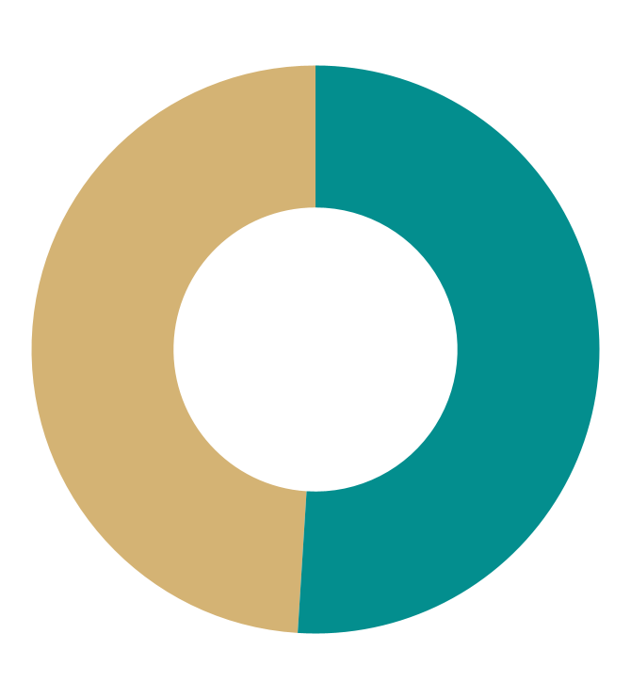
Data Scope
51%
49%
The extracted data consisted of approximately 6,000 rows and 51 columns, covering various aspects of the listed properties. Some of the key columns included:
Property Type (House, Flat, etc.)
Number of Bedrooms
Location (Area, Sector etc)
Price (Sale)
Other details like area size, amenities, etc.
Houses
Flats
* Follow the link to see the detailed properties for sales in Islamabad .Visit this link on Zameen.com
There are 3379 Record Initially
There are 3147 Record Initially

Slide 12
03
Data Preprocessing
Cleaning , Outliers Detection ,EDA

Slide 13
Data Cleaning
Extensive data cleaning applied on data points.
Prepared the data for accurate and reliable analysis.
Basic level cleaning in Google Sheet.
Advance level cleaning using python.
Features need to be cleaned are:
location
bedrooms
bathrooms etc

Slide 14
EDA
Through EDA, we gained a deep understanding of the data, uncovering trends, patterns, and potential outliers that could skew our analysis.

Slide 15
Outliers Detection
Robust outlier detection methods, such as IQR was applied to identify and address anomalies, enhancing the reliability of our analysis.
There are numbers of columns that have outliers making those more skewed.
Use different techniques to handle outliers like:
Trimming
Capping

Slide 16
Missing Values Imputation
Missing data is a common challenge in real-world datasets, which we addressed using advanced imputation techniques like K-Nearest Neighbors and other basic imputations Strategies like:
Impute by Mean
Impute by Median
Impute by Mode

Slide 17
Features
Engineering
Intelligent feature selection algorithms, such as Recursive Feature Elimination and some others were employed.

Slide 18
Top Features
1
Type
6
Kitchens
2
Location(Sector etc)
7
Parking Spaces
3
Area
8
Built In Type
4
Bedrooms
9
Luxury Score
5
Bathrooms
10
Floors

Slide 19
04
Machine Learning
Pipeline

Slide 20
Awesome words
Machine learning is the future of real estate
valuation.
(Michael Bourque)

Slide 21
Encoding and Scaling
We constructed a robust machine learning pipeline, integrating feature encoding and Scaling , and model training, ensuring reproducibility and scalability.
Use Different Encoders to see their effects on Models.
The Encoders are
Oridianl
One Hot
Target

Slide 22
Machine Learning Models
Linear Regression
1
4
Decision Tree
The Algorithms
Applied
K Nearest Neighbours
2
5
Xgboost
Random Forest
3
6
Multilayer Perceptron

Slide 23
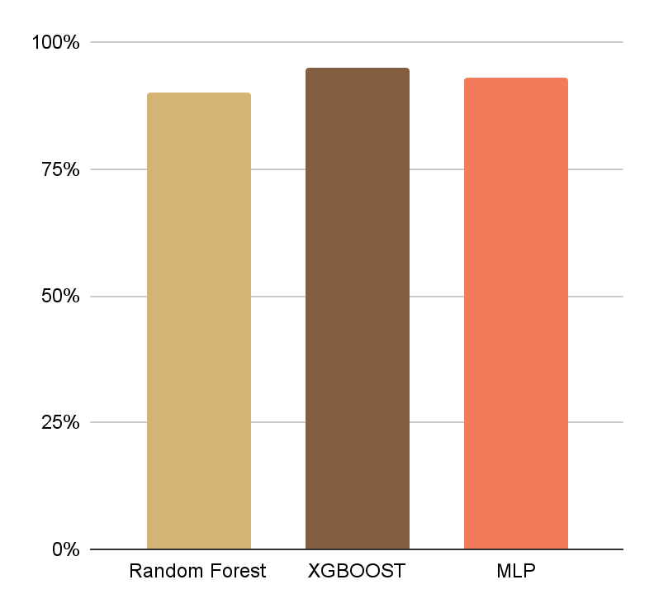
Top Models Accuracies
95%
93%
92%
XGBOOST
mean absolute error of 1.23
MLP
mean absolute error of 1.29
RANDOM FOREST
mean absolute error of 1.34

Slide 24
Flask App Deployment
To make our solution accessible and user-friendly, we deployed our application on Render. Here You can visit the website

Slide 25
Thanks!
Any questions?
mubashershahzad139@gmail.com
+92 3089340052
Please keep this slide for attribution

Slide 26
References
https://www.linkedin.com/posts/kiavi_michael-bourque-ceo-of-lendinghomeclosing-activity-6862071490108641280-0gX_/
https://www.zameen.com/

