Slide 1
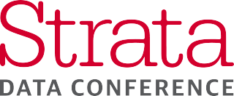
<SEAL>
XXXX (XXX) Brown Bag
Presenter: Andy Camara (afcamar) - XXX
Notes:
1

Slide 2
Agenda
Below Agenda will be discussed.
01
02
03
04
05
Context / Audience
Goals / Presenters
Special Topics
Takeaways
Questions / Artifacts

Slide 3
Conference Context & Audience
Wide variety of case studies, in-depth tutorials on best practices and strategies for building out or enhancing data processing architectures to meet development and operational needs.
Heavy open source community with large influence from bay area tech companies.
Common Theme (2017):
- Big Data Processing and Data Lakes
- All things Spark and Kafka
- Everyone uses AWS
Common Theme (This Year):
- All things Machine Learning
- Everyone wants to be a data scientist
- Amazon is still killing it

Slide 4





Personal Goals
01
Machine Learning (predication and forecasting)
02
Application & System monitoring product space
Specifically predication and forecasting techniques that can be leveraged by XXX efforts.
Solutions or techniques related to monitoring life-cycle for applications/services, systems and anything in between.
03
Time-Series Analysis
04
Apache Heron & Kafka best practices
All things related to performing analysis against time-series data that can positively influence decisions for XXXX and other projects alike.
Architecture and implementation practices related to Apache Heron (stream processing, predecessor to Storm) and Kafka (messaging platform).

Slide 5
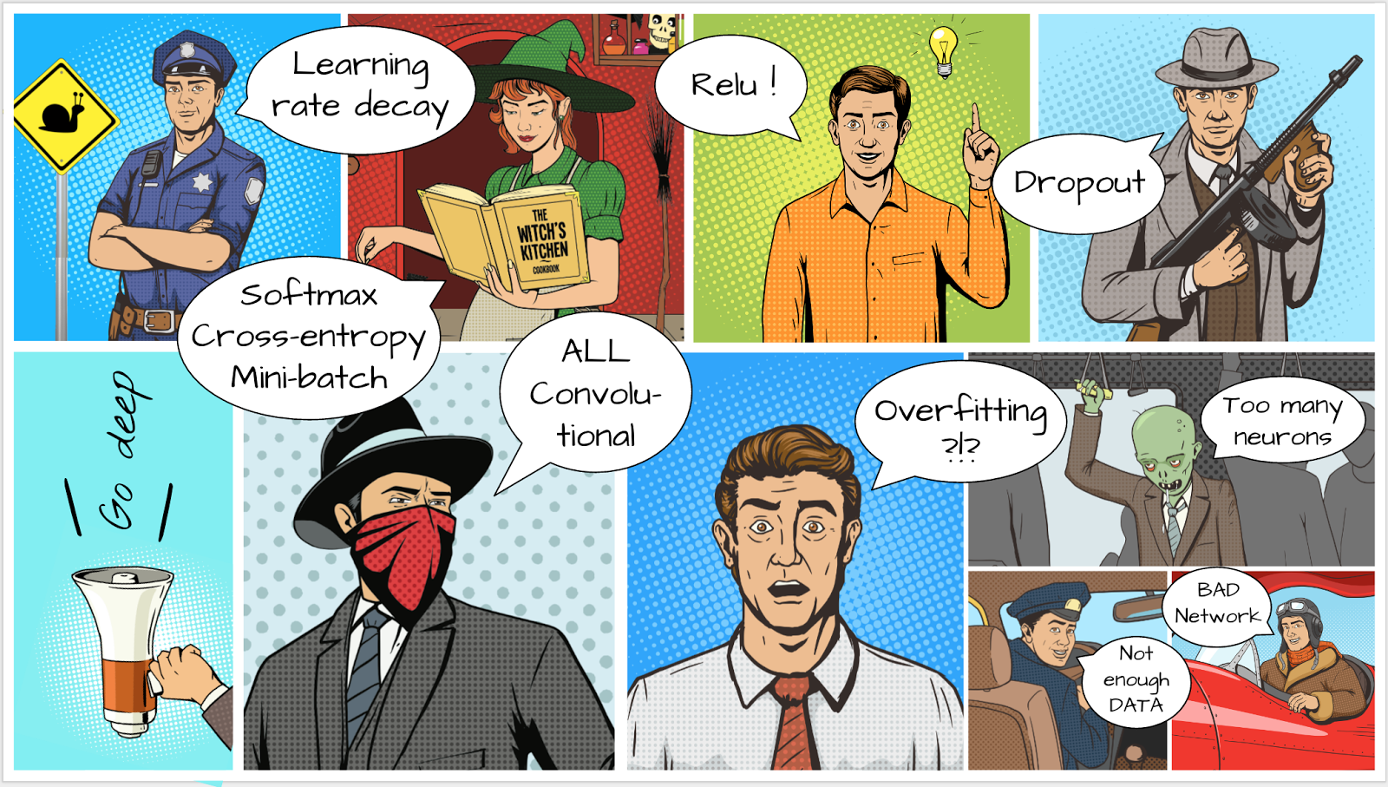
Special Topics & Technology Review
My personal take on interesting topics and solutions.

Slide 6
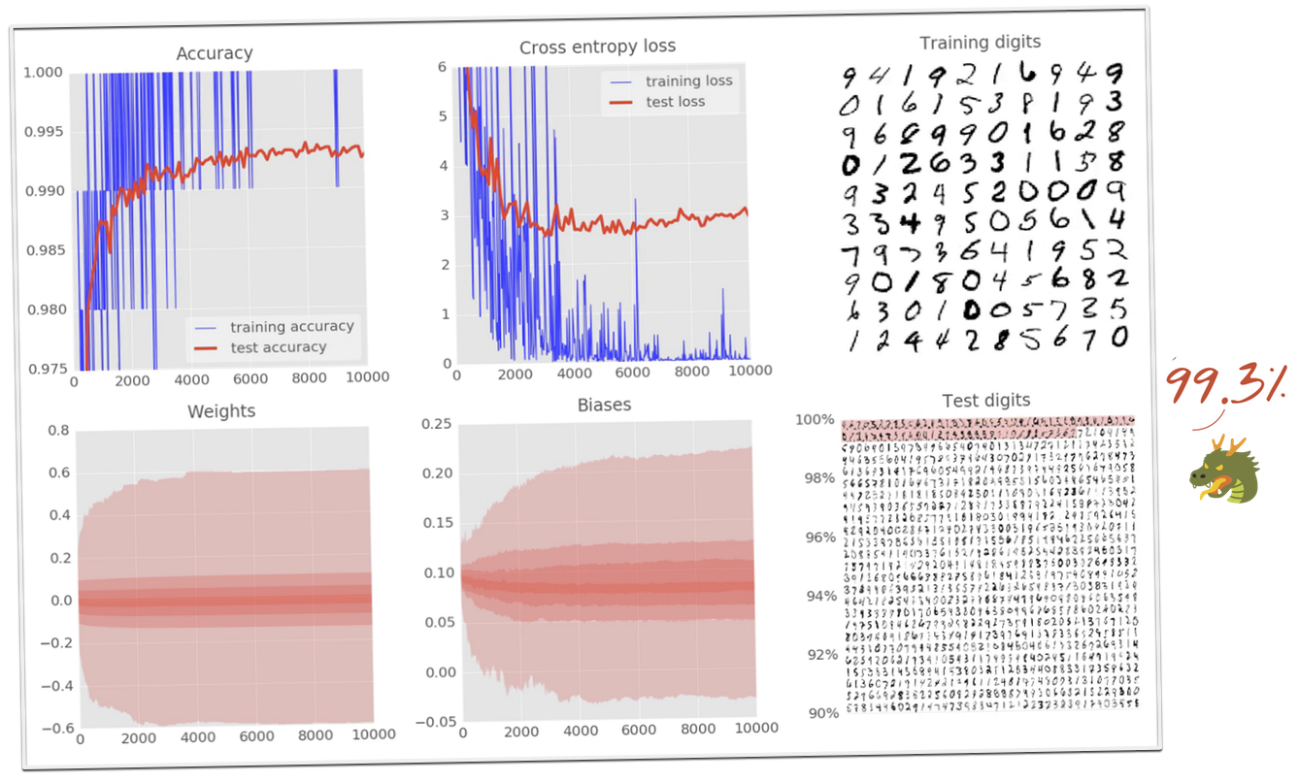
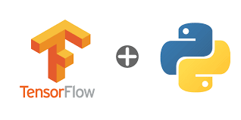
Special Topics (Tensorflow Workshop)
Covered a intro to machine learning, targeted for people that have no idea what they are doing or where to begin. Hands on Estimation/Prediction labs using several ML techniques to demonstrate iterative improvements and efficiencies...
- What is a neural network and how to train it
- How to build a basic 1-layer neural network using TensorFlow
- How to add more layers
- Training tricks: overfitting, dropout, learning rate decay...
- How to troubleshoot deep neural networks
- How to build convolutional networks
The 99% Accuracy Challenge
Instructor → https://github.com/martin-gorner
Tutorials → https://codelabs.developers.google.com/codelabs/cloud-tensorflow-mnist/
https://github.com/martin-gorner/tensorflow-rnn-tutorial

Slide 7
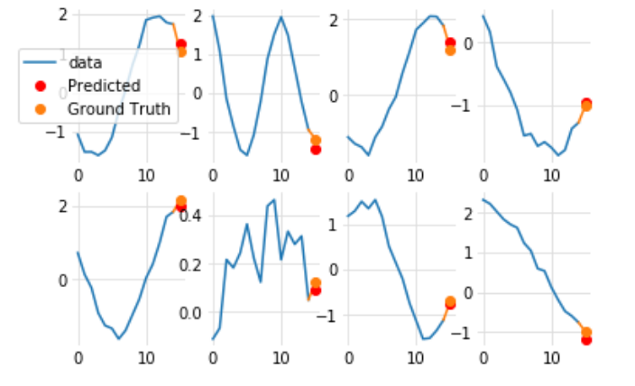
Special Topics (Tensorflow Workshop Cont.)
Covered a intro to machine learning, targeted for people that have no idea what they are doing or where to begin. Hands on Estimation/Prediction labs using several ML techniques to demonstrate iterative improvements and efficiencies...
- What is a neural network and how to train it
- How to build a basic 1-layer neural network using TensorFlow
- How to add more layers
- Training tricks: overfitting, dropout, learning rate decay...
- How to troubleshoot deep neural networks
- How to build convolutional networks
The 99% Accuracy Challenge
Instructor → https://github.com/martin-gorner
Tutorials → https://codelabs.developers.google.com/codelabs/cloud-tensorflow-mnist/
https://github.com/martin-gorner/tensorflow-rnn-tutorial

Slide 8

Special Topics (Clipper)
Covered a intro to machine learning, targeted for people that have no idea what they are doing or where to begin. Hands on Estimation/Prediction labs using several ML techniques to demonstrate iterative improvements and efficiencies...
- What is a neural network and how to train it
- How to build a basic 1-layer neural network using TensorFlow
- How to add more layers
- Training tricks: overfitting, dropout, learning rate decay...
- How to troubleshoot deep neural networks
- How to build convolutional networks
The 99% Accuracy Challenge
Instructor → https://github.com/martin-gorner
Tutorials → https://codelabs.developers.google.com/codelabs/cloud-tensorflow-mnist/
https://github.com/martin-gorner/tensorflow-rnn-tutorial

Slide 9

Special Topics (FB Prophet)
Covered a intro to machine learning, targeted for people that have no idea what they are doing or where to begin. Hands on Estimation/Prediction labs using several ML techniques to demonstrate iterative improvements and efficiencies...
- What is a neural network and how to train it
- How to build a basic 1-layer neural network using TensorFlow
- How to add more layers
- Training tricks: overfitting, dropout, learning rate decay...
- How to troubleshoot deep neural networks
- How to build convolutional networks
The 99% Accuracy Challenge
Instructor → https://github.com/martin-gorner
Tutorials → https://codelabs.developers.google.com/codelabs/cloud-tensorflow-mnist/
https://github.com/martin-gorner/tensorflow-rnn-tutorial

Slide 10
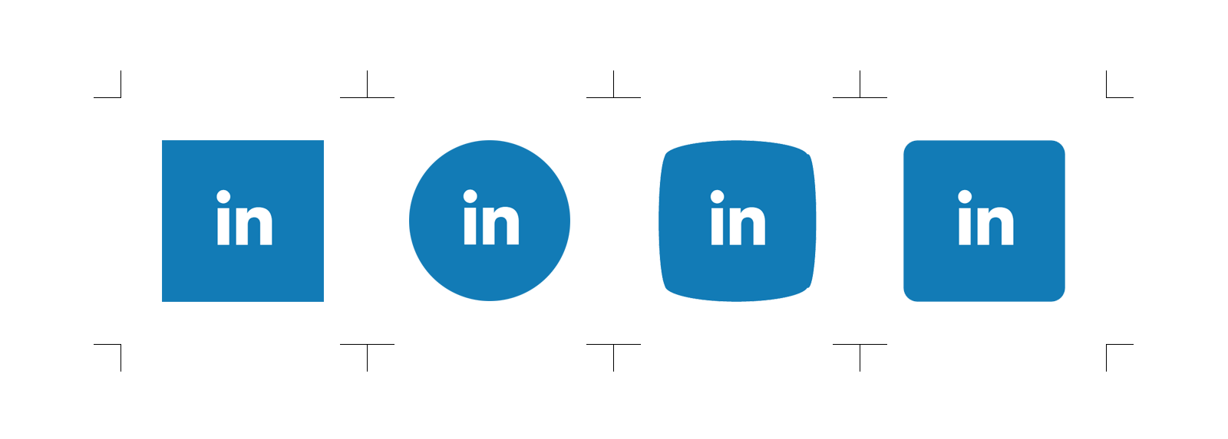
Special Topics (Cruise Control)
Covered a intro to machine learning, targeted for people that have no idea what they are doing or where to begin. Hands on Estimation/Prediction labs using several ML techniques to demonstrate iterative improvements and efficiencies...
- What is a neural network and how to train it
- How to build a basic 1-layer neural network using TensorFlow
- How to add more layers
- Training tricks: overfitting, dropout, learning rate decay...
- How to troubleshoot deep neural networks
- How to build convolutional networks
The 99% Accuracy Challenge
Instructor → https://github.com/martin-gorner
Tutorials → https://codelabs.developers.google.com/codelabs/cloud-tensorflow-mnist/
https://github.com/martin-gorner/tensorflow-rnn-tutorial

Slide 11
Questions ??
DO NOT FORGET TO CLONE PRESENTATIONS (60+ artifacts)!
$ git clone https://…

Slide 12
Fully Editable Vector Icons
Fully Editable Icons, You can copy, paste, recolor, resize and every thing you want

Slide 13
Fully Editable Vector Icons
Fully Editable Icons, You can copy, paste, recolor, resize and every thing you want

Slide 14
Fully Editable Vector Icons
Fully Editable Icons, You can copy, paste, recolor, resize and every thing you want

Slide 15
Fully Editable Vector Icons
Fully Editable Icons, You can copy, paste, recolor, resize and every thing you want

Slide 16
Fully Editable Vector Icons
Fully Editable Icons, You can copy, paste, recolor, resize and every thing you want

