Slide 1
Spark-PMoF: Accelerating Bigdata Analytics with Persistent Memory over Fabric
Jian Zhang, jian.zhang@intel.com
Haodong Tang, haoodong.tang@intel.com
Yuan Zhou, yuan.zhou@intel.com
March, 2019
Notes:
In memory data accelerator?

Slide 2
Agenda
Background and Motivation
Spark PMoF design
Spark PMoF implementation
Performance Evaluation
Other Usage Scenario
Summary & Next

Slide 3
Background and motivation
Notes:
First, lets take a look on what’s the challenges we are facing today, and why we are creating Spark PMoF.

Slide 4





Challenges of scaling Hadoop* Storage
BOUNDED Storage and Compute resources on Hadoop Nodes brings challenges
Data Capacity
Silos
Costs
Performance & efficiency
Typical Challenges
Data/Capacity
Multiple Storage Silos
Space, Power, Utilization
Inadequate Performance
Upgrade Cost
Provisioning and Configuration
*Other names and brands may be claimed as the property of others.
Notes:
Data volume is growing at an fast rate, often without consummate growth in computation needs. Storage as a critical component will continue to shape and be shaped by how businesses deploy the infrastructure for Big Data analytics
Traditional scale-out infrastructures might no longer adequate, as it starts to exhibit significant challenges in the areas of manageability, flexibility, and cost as the number and size of these deployments grow. There are multiple challenges faced today, like data capacity, data silos, cost and performance & efficiency.
As compute and storage are coupled, and storage needs are growing, usually the data/capacity is not enough.
As the value of big data grows within enterprises, so does the number and size of the workloads being deployed. This leads to multiple application clusters being created, and the resources become “siloed” in separate clusters.
It is difficult to ascertain the correct footprint up-front when planning the deployment of a new workload or cluster. To avoid further delays from re-configuring systems, people will often over-provision resources, which leads to wasteful space, power utilization.
Data growth is unpredictable and in many cases it can grow exponentially. So it is very possible to find that the workloads requires more processing/storage power even with over-provision, which leads to inadequate performance without expanding the cluster.
Last but not least, manageability cost: Reconfiguring, provisioning the system and updated software with be time consuming.
The next generation of scale-out infrastructure must provide flexibility and simplicity, allowing the users to focus on delivering higher-level revenue-generating services to their customers instead of low leveling of management of the infrastructure.

Slide 5

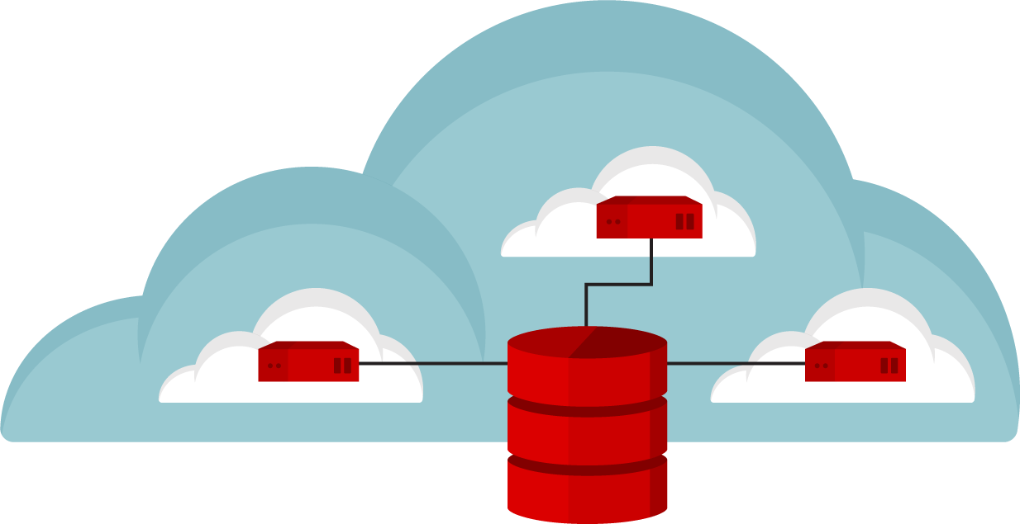
Discontinuity in bigdata infrastructure makes different solution
ON DEMAND ANALYTIC CLUSTERS
SINGLE LARGE CLUSTER
MULTIPLE SMALL CLUSTERS
Get a bigger cluster
for many teams to share.
Give each team their
own dedicated cluster,
each with a copy of
PBs of data.
Give teams ability to
spin-up/spin-down
clusters which can
share data sets.
Notes:
Those challenges lead to a discontinuity in bigdata infrastructure:
MULTIPLE TEAMS COMPETING: and sharing the same big data resources, leads to CONGESTION, and in busy analytic clusters; causing missed SLAs.
This make the customers to pick up different solutions:
#1： Lacks isolation： noisy neighbors hinder SLAs.； Lacks elasticity： single rigid cluster.
#2： No dataset sharing： Cost of duplicate storage； Still lacks elasticity； Can’t scale
#3, Give teams their own compute clusters, it HIT SERVICE-LEVEL AGREEMENTS
Share data sets across clusters instead of duplicating them, it avoid over provision.
By right-sizing de-coupled compute and storage, it ELIMINATE IDLE RESOURCES.
With spin-up/spin-down clusters, it increases AGILITY：

Slide 6
Benefits of compute and storage disaggregation
Independent scale of CPU and storage capacity
Rightsize HW for each layer
Reduce resource wastage
Single copy of data
Multiple compute cluster share common data repo/lake
Simplified data management
Enable Agile application development
In-memory cloning
Hybrid cloud deployment
Simple and flexible software management
Cost saving
Reduced provisioning overhead
Improve security
Snapshot service
Quick & efficient copies
Mix and match resources depending on workload nature and life cycle
Avoid software version management
Upgrade compute software only
Notes:
Decoupled mode allows separation of compute and storage. This enables users to rightsize hardware for each layer. For example, users can buy high CPU and memory configuration for the compute nodes, and the storage nodes can be optimized for capacity.
By decoupling compute and storage, multiple compute clusters running Hadoop, Spark, Kafka, MongoDB, Cassandra, or data science tools like TensorFlow can share access to a common data repository/data lake. This leads to cost savings in storage capacity. You could use an enterprise-grade shared storage with consistent performance and a rich set of data services for simplified data management and reduction in provisioning overheads. This could also help simplify and improve security by using shared storage data-at-rest encryption capabilities
The common data repository or data lakes could be cloud storage, and they you can enable agile application deployment by leverage cloud storage features like in-memory cloning, snapshot etc.
The hybrid deployment can delivers better SLA, you can provision different storage volumes based on different storage media to your workloads based on the workloads nature and life cycle
The last but not least, it simplifies software management.

Slide 7






Bigdata analytics with disaggregated storage
Batch
Streaming
Interactive
Graph Analytics
Machine Leaning
Batch
Streaming
Interactive
Graph Analytics
Machine Leaning
Provisioned Compute Pool
Shared Data Lake
Shared Data Lake
Replace HDFS with disaggregated storage
Serverless computing
Notes:
There could be multiple architecture choices for running bigdata analytics on disaggregated storage.
The shared data lake could be HDFS, remote HDFS, object storage system, or block storage system.
And for the compute service, serverless computing can be applied to deliver agile compute service provision and deployment, to scaling the efficiency of infrastructure applications (that evolved from bare metal → virtualization → containers→serverless ). So higher scale and abstraction is possible. The developer focuses on coding revenue-generating services to market and is freed from the burden of infrastructure management or DevOps.

Slide 8
Disaggregation leads to performance regression
Storage disaggregation leads to performance regression
Up to 10% for remote HDFS, Terasort performance is higher as usable memory increased
Up to 60% for S3 object storage (optimized results with tunings)
One important cause for the performance gap: s3a does not support Transactional Writes
Most of bigdata software (Spark, Hive) relies on HDFS’s atomic rename feature to support atomic writes
During job submit, commit protocol is used to specify how results should be written at the end of job
First stage task output into temporary locations, and only moving (renaming) data to final location upon task or job completion
S3a implements this with: COPY+DELETE+HEAD+POST
The gap in public cloud will be much smaller
It is not an on-premise configuration
Compute are running in side VMs/containers, while HDFS was running on elastic block volumes
Notes:
We have talked about all the benefits of running bigdata analytics on disaggregate storage, but how it performs?
Here is a performance comparison of on-premise deployment, with remote HDFS based disaggregated storage and object storage based disaggregated storage solutions.
The conclusion is there is a significant performance drop, even with lots of optimizations.

Slide 9
Solution: A new in memory data accelerator layer
Applications
Batch
Interactive
Streaming
Graph Analytics
Machine Leaning
…
A new in memory data accelerator layer to accelerate ephemeral data access
New HW technologies & products emerging delivers significant performance improvement, like persistent memory, RDMA, NVMe over fabrics, SPDK, persistent memory over fabrics
Bigdata I/O stack is not optimized for new technologies or HWs
The long I/O stack could hidden the hardware benefits
It requires a storage and network co-design to fully leverage those technologies or HWs address the bottlenecks
Data Processing & Analysis
Flink*
Storm*
DataFrame
ML Pipelines
SQL*
SparkR*
Streaming*
Mllib*
GraphX*
MR*
Giraph*
Spark Core
Resource Mgmt & Co-ordination
YARN*
k8s*
ZooKeeper*
Acceleration Layer
Alluxio*
Ignite*
Crail*
TBD*
High Speed Networking
Disaggregated
Storage
HDFS*
Ceph*
OSS*
Parquet*
Avro*
Hbase*
Notes:
This performance regression make us to think whether it is possible to further improve the performance of bigdata analytics workloads on top of disaggregated cloud storage?
Here comes the new solution: an in memory data accelerating layer to accelerate ephemeral data access like cache and shuffle.
New storage technology: DCPMM, NVMe, SPDK, PMoF has been adopted widely in modern storage systems
Ceph, PolarDB
However Bigdata storage is still using technology 10+ years ago
The long IO stack of Bigdata buried the H/W performance gain
HPC technology are commonly used in Bigdata and Deep Learning
RDMA, GPU/FPGA, IB

Slide 10
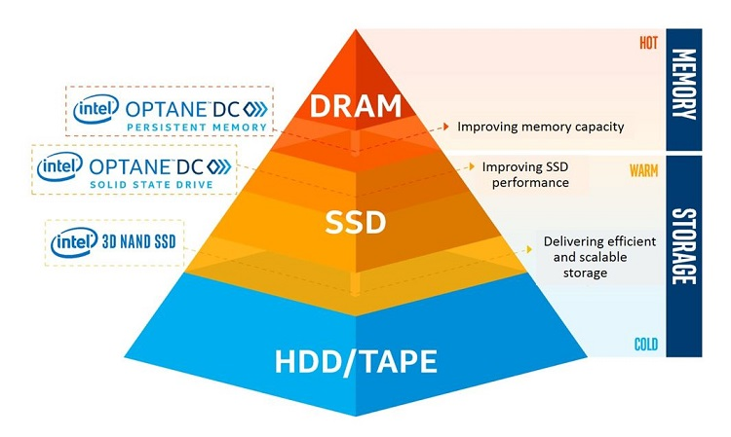
Persistent Memory and RDMA
RDMA: Remote Direct Memory Access
Accessing (i.e. reading from or writing to) memory on a remote machine without interrupting the processing of the CPU(s) on that system.
Zero-copy - applications perform data transfer without the network software stack involvement, data is being send received directly to the buffers without being copied between the network layers.
Kernel bypass - applications perform data transfer directly from userspace, no context switches.
No CPU involvement - applications can access remote memory without consuming any CPU in the remote machine.
Persistent Memory:
PMEM represents a new class of memory and storage technology architected specifically for data center usage
Combination of high-capacity, affordability and persistence.
Picture source: https://software.intel.com/en-us/blogs/2018/10/30/intel-optane-dc-persistent-memory-a-major-advance-in-memory-and-storage-architecture
Notes:
High-capacity persistent memory in the data center allows applications to run without incurring the latency penalty of going out to storage over the PCIe bus. As developers adapt software, this new memory class is designed to enable cost-effective, large-capacity in-memory database solutions; provide greater system uptime and faster recovery after power cycles; accelerate virtual machine storage; deliver higher performance to multi-node, distributed cloud applications; and offer advanced encryption for persistent data built into the hardware.
Remote
data transfers between nodes in a network
Direct
no Operating System Kernel involvement in transfers
everything about a transfer offloaded onto Interface Card
Memory
transfers between user space application virtual memory
no extra copying or buffering
Access
send, receive, read, write, atomic operations

Slide 11
IMDA Architecture
Batch
Streaming
Interactive
Graph Analytics
Machine Leaning
A new storage stack or component enabled with state-of-art technology
Light-weighted user space I/O based distributed data store
PMEM to enlarge compute storage with high performance and low cost
RDMA to avoid context switch, kernel bypass
PMEM mmap address as RDMA buffer to avoid memory copies
PMEM as off-heap memory to reduce GC overhead
Accelerate ephemeral data access: Shuffle and Cache.
We will focus on Shuffle optimization with PMoF in this work
In memory data accelerator as shuffle:
Spark PMoF: optimizing spark shuffle with Persistent memory over fabrics
in memory data accelerator
Ephemeral data
RDMA enabled Network
DRAM
PMEM
NVMe SSD
Provisioned Compute Pool
Shared Data Lake with s3a object storage
Notes:
This is picture shows the architecture of the in memory data accelerator, and its position in the bigdata on cloud software stack.
I

Slide 12
Spark PMoF Design

Slide 13
Shuffle
Input
A HDFS file
Intermediate Data
Each Map’s output
Shuffle (Random Partition)
Output
A HDFS file
9
2
1
2
1
2
1
1
2
1
1
2
2
load
sort
9
Local
8
1
5
load
1
5
6
5
5
5
6
5
sort
8
Local
6
5
2
load
2
9
8
8
9
sort
6
5
Local
Decompression
Compression
Decompression
Compression
Read Remote via Network
Write Local, can use shuffle service to cache the data.
https://github.com/intel-hadoop/HiBench/blob/master/sparkbench/micro/src/main/scala/com/intel/sparkbench/micro/ScalaSort.scala
Notes:
A high-level shuffle process:
Map: input -> splits input data (three splits), and run map task (three map tasks). Each map tasks will process the input data with user defined mapping and write to memory buffer (partition), and when buffer is full, it will spill (sort & combine) the data to disk. Once map tasks completed, it will merge all the temp files to generate output file, which will be pulled by reduce task.
Reduce tasks: copy the data, merge it (sort), reduce and final output.

Slide 14
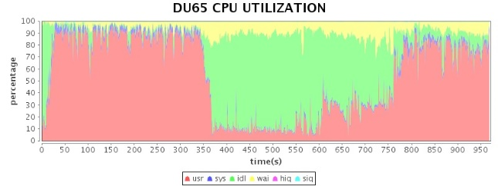
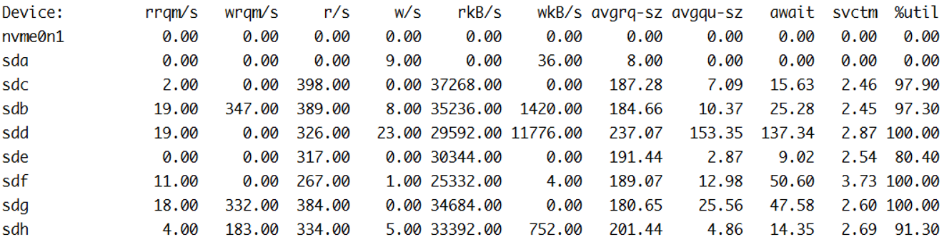
Spark Shuffle Bottlenecks – Disk
Spark Shuffle (nWeight – a Graph Computation Workload)
Context: Iterative graph-parallel algorithm, implemented with GraphX, to compute the association for 2 vertices in 2-3 hops distance in the graph. (e.g. recommend a video for my friends’ friends)
H/W Configuration: 1+4 cluster / E5 2680 v2@2.8GHz / 192GB DDR3 1600 MHz / 11 HDD, 11 SSD, 1 PCI-E SSD (P3600)
S/W Configuration: Redhat 6.2 / Spark 1.4.1 / Hadoop 2.5.0-CDH5.3.2/Scala 2.10.4
Benchmark Analysis:
Significant IO bottleneck in Shuffle
Notes:
Spark Graphx and pregel
Caculate 2 vertices associations in nhops distances

Slide 15
Spark Shuffle Bottlenecks - CPU
Spark Shuffle (TeraSort)
Context: TeraSort samples the input data and uses map/reduce to sort the date into a total order.
H/W Configuration: 1+6 cluster / E5 2699 v4@2.20GHz / 188GB Memory /4x 1T HDD , 1x 400G SSD per node
S/W Configuration: CentOS 7/ Spark 2.2 / Hadoop 2.7.3
Benchmark Analysis:

Slide 16
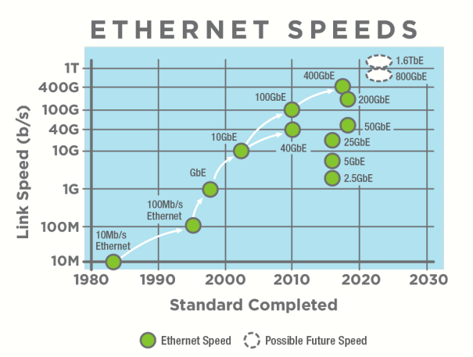
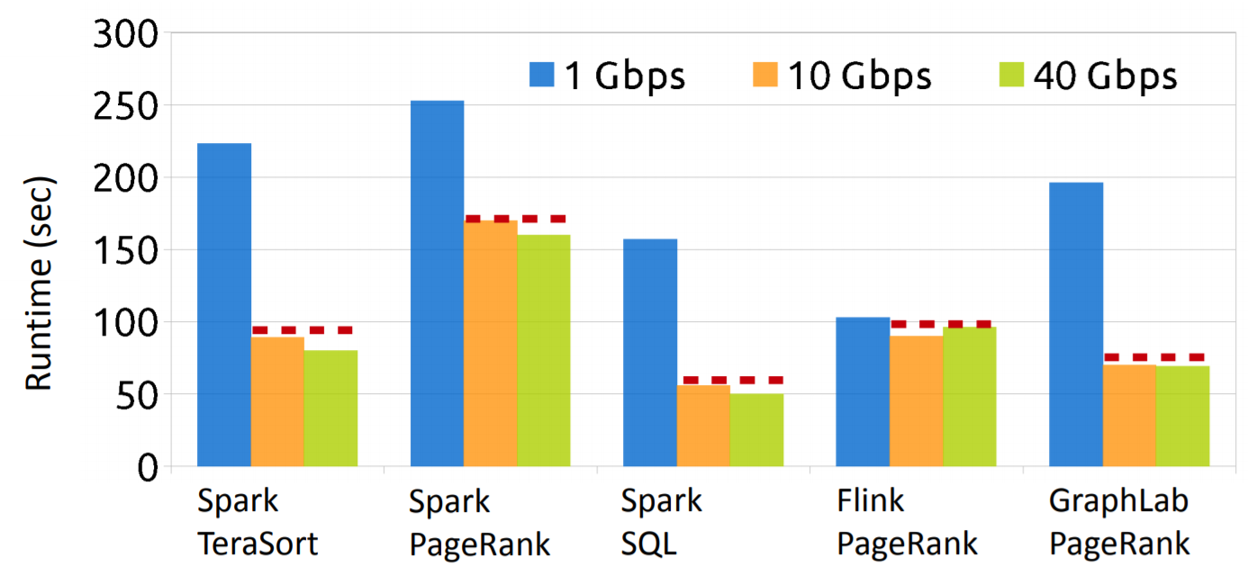
Simply upgrade your HW might not be able to address the bottlenecks
Network interconnects have evolved
Bandwidth from 1Gbps to 100Gbps.
Message RTT latency reduced by an order of magnitude (82us -> 2.4us).
BigData Application cannot benefit from new HW
Network consecutive evolving doesn’t result in application consecutive speedup.
* From Crail project (https://www.openfabrics.org/images/eventpresos/2017presentations/109_Crail_BMetzler.pdf)
*: https://ethernetalliance.org/the-2018-ethernet-roadmap

Slide 17
Spark-PMoF Design
Shuffle write
Worker
Worker
Executor JVM #1
Executor JVM #1
Shuffle read
Shuffle Manager
Shuffle Manager
PMEM
1
1
obj
Heap
Shuffle
Writer(new)
obj
Shuffle
Reader(new)
Heap
Shuffle
Writer
Shuffle
Reader
bytebuffer
Off-heap
bytebuffer
PMEM
Off-heap
2
User
2
3
User
Kernel
Spark.Local.dir
Kernel
3
Shuffle file
4
Shuffle file
Drivers
SSD HDD
NIC
PMEM
RDMA NIC
1. Serialize obj to off-heap memory
2. Write to local shuffle dir
3. Read from local shuffle dir
4. Send to remote reader through TCP-IP
Lots of context switch
POSIX buffered read/write on shuffle disk
TCP/IP based socket send for remote shuffle read
Serialize obj to off-heap memory
Persistent to PMEM
Read from remote PMEM through RDMA, PMEM is used as RDMA memory buffer
No context switch
Efficient read/write on PMEM
RDMA read for remote shuffle read

Slide 18
PMoF Design
A new PMoF shuffle manager
Implements both sort & sort bypassmergesortshuffle
Leveraging PMDK libpmemobj library for write with efficient JNI wrapper
Transactional write support ensure high data consistency
Failover support: support multiple executor processes to get multiple PMEM namespace in devdax mode and also be able to re-open the same device when failover
External sorter: support data spill to PMEM device
RDMA
Using HPNL (high performance network library) for RDMA networking
Pmof Shuffle Manager
JNI
HPNL
PMDK: libpmemobj
DCPMM
RNIC

Slide 19
HPNL: High performance network library for bigdata applications
HPNL: high performance network library
Zero-copy approach
The HPNL buffer allowed to be directly used by application without copying data between HPNL buffer and application buffer.
Thanks to RDMA, it supporting user-space to kernel-space zero-copy.
Threading model
Implements the Proactor model.
Interrupt + polling approach to optimize HPNL thread.
Supports thread binding to specific core.
HPNL interface
C/C++ and Java interface.
Supports send, receive, remote read, remote write semantics.
Pluggable buffer management interface.
Capable of using Persistent memory as RDMA buffer.
Open Source
HPNL is Under internal opensource process, expected to be opensourced in Q2.
Client1
Client2
Client
ClientN
HPNL interface
Demultiplexer
Epoll + fi_wait
CQService
CQService
CQService
EQService
Buffer mgr.
Buffer mgr.
Buffer mgr.
User callback
User callback
User callback
libfabric
libfabric
libfabric
Server
Core
Core
Core
HPNL: A high performance light weighted network library for bigdata application, OFA 2019
Notes:
Comments: I/O part -> Proactor model. ➔ networking programming model, ASIO also used this.
Zero-copy approach
The HPNL buffer allowed to be directly used by application without copying data between HPNL buffer and application buffer.
Thanks to RDMA, it supporting user-space to kernel-space zero-copy.
Threading model
Implements the Proactor model. //programming model
Interrupt + polling approach to optimize HPNL thread. //CQ Demultiplexer, fi_cq_read from libfabrics
Supports thread binding to specific core. //CQService to specific core
HPNL interface
C/C++ and Java interface.
Supports send, receive, remote read, remote write semantics. //core dir. & dispatcher
Pluggable buffer management interface. // reactor.h? Put, get (list based buffer)
Capable of using Persistent memory as RDMA buffer. //in the Java wrapper - regRmaBufferByAddress

Slide 20
Spark Shuffle Network Traffic - Netty
task
task
By default, spark shuffle uses Netty to transfer block data across different executors.
needs 2+2*n times network transfer per task.
Send request to get blocks’ stream ID
task
Read block data from disk, establish stream
Send stream blocks’ stream ID
Establish stream
Send requests to get block in the stream
Lookup block
Send blocks data to reducer
Get blocks data

Slide 21
Network Traffic in Shuffle Stage – HPNL (RDMA RMA)
task
Use RDMA RMA semantics to read remote data in shuffle read phase.
Needs 2+n times network transfer per task.
Use off-heap memory as RDMA buffer on one side, and use PMEM as RDMA buffer on the other side.
Leverage RDMA to achieve kernel bypass.
task
Send request to get blocks’ s MR (memory region) and Rkey
task
Read block data from disk, look up MR and Rkey
Send blocks’ MR and Rkey
Get blocks data
RDMA read remote block data according to MR and Rkey
Lookup block

Slide 22
Shuffle Write Traffic – PMEM Based Shuffle
Map task
Provision pmem name space in advance
Serialized data write to an offheap buffer, once hit threshold (4MB), create a block via libpmemobj on pmem device with memcopy
Append write, only write once
No index file, mapping info stored in pmem object metadata
Libpmem based, kernel bypass
Reduce use memcopy to read the data
N x
KV in memory
PMEM Shuffle Writer
MAP
Partition [0]
Partition [1]
Partition[2]
Partition[n]
JNI
PMDK(libpmemobj c)
Persistent Memory Device
(devdax/fsdax mode)
Notes:
N Map task

Slide 23
Spark-PMoF Implementations
SortShuffleManager->registerShuffle()
PMoFShuffleManager
<= bypassMergeThreshold
optimized serialized shuffle?
yes
no
yes
BypassMergeSortShuffleHandle
BaseShuffleHandle
SerializedShuffleHandle
BaseShuffleHandle
getWriter()
getWriter()
getWriter()
getWriter()
BypassMergeSortShuffleWriter
SortShuffleWriter
UnsafeShuffleWriter
PmemShuffleWriter
PMDK
Filesystem
PMEM
RDMA to another Executor
NettyReader
RDMAShuffleReader
ShuffleBlockResolver

Slide 24
Spark PMoF Performance

Slide 25
Benchmark configuration
3 Node cluster
Hardware:
Intel® Xeon™ processor Gold 6140 CPU @ 2.30GHz, 384GB Memory
1x Mellanox ConnectX-4 40Gb NIC
Shuffle Devices：
1x 1T HDD/NVMe for shuffle
4x 256GB DCPMM for shuffle
4x 1T NVMe for HDFS
Software:
Hadoop 2.7
Spark 2.3
Fedora 27 with WW26 BKC
Hadoop NN
Spark Master
Hadoop DN
Spark Slave
Hadoop DN
Spark Slave
Hadoop DN
Spark Slave
1x NVMe
1x NVMe
1x NVMe
Workloads
Terasort 1TB:
hibench.spark.master yarn-client
hibench.yarn.executor.num 12
yarn.executor.num 12
hibench.yarn.executor.cores 8
yarn.executor.cores 8
spark.shuffle.compress false
spark.shuffle.spill.compress false
spark.executor.memory 60g
spark.executor.memoryoverhead 10G
spark.driver.memory 80g
spark.eventLog.compress = false
spark.executor.extraJavaOptions=-XX:+UseG1GC
spark.hadoop.yarn.timeline-service.enabled false
spark.serializer org.apache.spark.serializer.KryoSerializer
hibench.default.map.parallelism 200
hibench.default.shuffle.parallelism 1000
1x HDD
4x DCPMM
1x HDD
4x DCPMM
1x HDD
4x DCPMM
4x NVMe
4x NVMe
4x NVMe
1x40Gb NIC
*Other names and brands may be claimed as the property of others.

Slide 26
Spark shuffle with PMoF - End-to-end time
Spark-PMoF is ~9.35x faster than Spark with HDD as shuffle device, ~16% faster than Spark with NVMe as shuffle device, 50% faster than NVMe for stage 1.
Expected to have higher benefit with larger dataset
Optimization headroom: RDMA registration is time consuming. 250GB memory registration consumes 20 (+/- 10) seconds

Slide 27
Spark shuffle with PMoF – stage 2
Spark-PMoF showed ~4% performance benefit than Spark with NVMe as shuffle device (for stage 2), which depends on the ratio of the time that shuffle read IO (disk/network) consumes in a single task.
But 1300+ latency reduction (read block time)
For latency sensitive workload, RDMA can significant improve the performance.

Slide 28
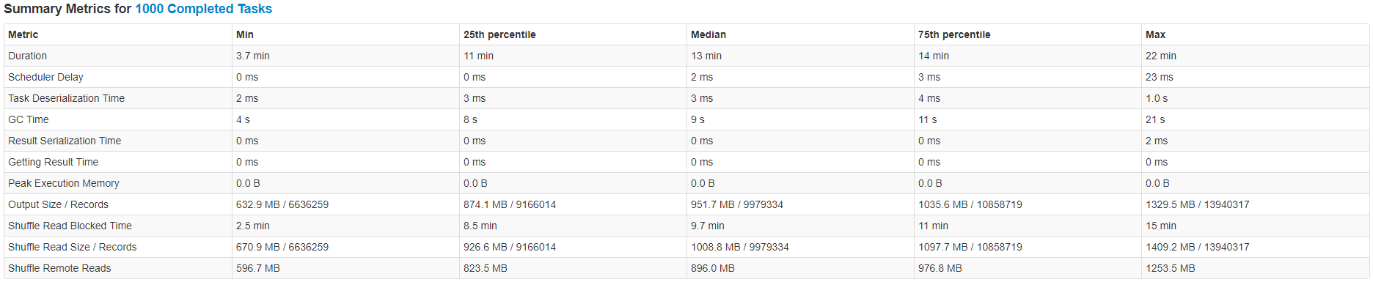
Stage 2 performance breakdown (HDD+TCP/IP)

Slide 29
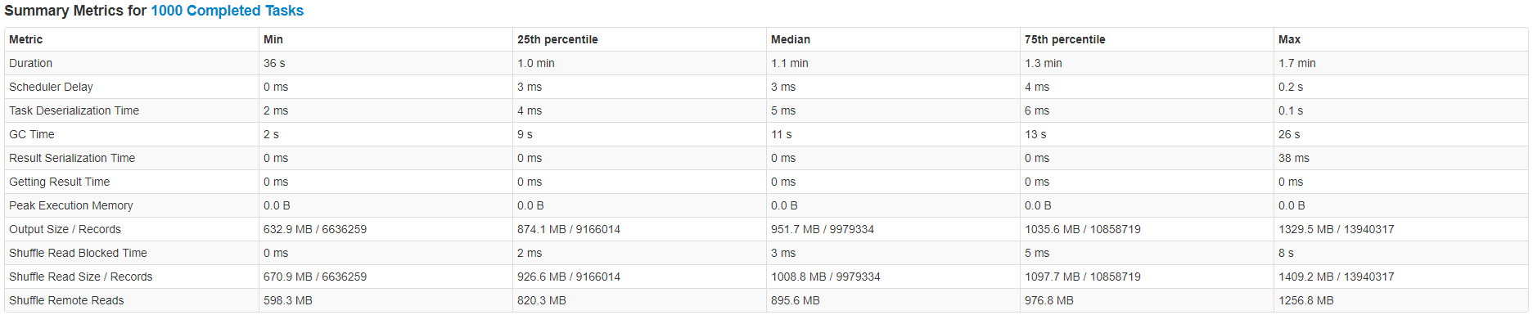
Stage 2 performance breakdown (PMEM+RDMA)

Slide 30
Spark PMoF with shuffle intensive workloads
Modified terasort
Shuffle intensive workloads, removed sort
Profiling showed majority of the CPU% were spend on TimSort(), and the shuffle read part is only a small portion of the task.
We modified terasort workload to explore more performance benefit for shuffle intensive workloads.
81x speedup compared with HDD, 2x speedup compared with NVMe.
Lower is better

Slide 31
Resource utilization
Spark PMoF significant reduced system utilization
Higher user%, higher performance
System% CPU reduced from ~11% to ~3%

Slide 32
Other Usage Scenario

Slide 33
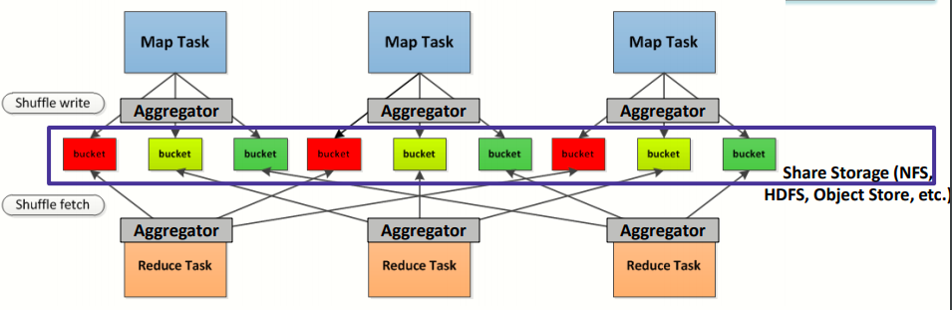
Independent Shuffle solution
Elastic Deployment with compute and storage disaggregation requires independent shuffle solution
Shuffle I/O are decoupled from a specific network/storage.
Shuffle read and write can be implemented using configurable network transports and backend storage
* Source: Li Yue & Du Junping, PM Summit 2019

Slide 34
Next: Spark PMoF components integration with external shuffle cluster
Executer 0
HPNL based NM
Executer 1
Shuffle read
Shuffle read
Executer 0
Shuffle read
Executer 1
New Shuffle Manager
New Shuffle Manager
HPNL based NM
Shuffle write
HPNL based NM
Shuffle write
Shuffle read
Shuffle read
Shuffle read
HPNL based NM
Shuffle write
Shuffle read
Shuffle write
Shuffle read
Spark shuffle
Spark shuffle
Shareded storage(Alluxio/crail/etc)
PMEM optimized Shuffle writer
PMEM optimized shuffle writer
PMEM optimized Shuffle writer
HPNL based NM
SSD/NVMe/DCPMM
SSD/NVMe/DCPMM
Disaggregated storage
External shuffle cluster
Lots of on-going efforts making HCFS as shuffle: [Spark-1529, Spark-3685, SPARK-25299]
And lots of customized solutions
Integrate Spark PMoF independent components including PMEM writer and HPNL based network messenger to improve external shuffle performance and scalability

Slide 35
Summary

Slide 36
Summary
Bigdata analytics on public cloud is becoming increasingly popular, disaggregated storage leads to performance regressions.
A new high performance, low latency In Memory Data Accelerator will be needed to close the performance gap and improve scale out capabilities
Leveraging persistent memory and RDMA, Spark PMoF enables a high performance, low latency shuffle solution to accelerate spark shuffle, and delivers 9.35x performance improvement for terasort compared with traditional HDD based shuffle and brings three orders of magnitude reduction in shuffle block ready latency
Spark PMoF components integration to external shuffle services to be explored

Slide 37
Notices and Disclaimers
No license (express or implied, by estoppel or otherwise) to any intellectual property rights is granted by this document.
Intel disclaims all express and implied warranties, including without limitation, the implied warranties of merchantability, fitness for a particular purpose, and non-infringement, as well as any warranty arising from course of performance, course of dealing, or usage in trade.
This document contains information on products, services and/or processes in development. All information provided here is subject to change without notice. Contact your Intel representative to obtain the latest forecast, schedule, specifications and roadmaps.
The products and services described may contain defects or errors known as errata which may cause deviations from published specifications. Current characterized errata are available on request.
Intel, the Intel logo, Xeon, Optane, Optane DC Persistent Memory are trademarks of Intel Corporation in the U.S. and/or other countries.
*Other names and brands may be claimed as the property of others
© Intel Corporation.
Notes:
Template 5 - SSG Technical Collateral:
Recommended use: for technical collateral created by SSG.
Found here: http://legal.intel.com/Marketing/Pages/Notices-Disclaimers-Examples.aspx
IF APPLICABLE, add the FTC Optimization Notice: http://legal.intel.com/Marketing/Pages/Performance-disclaimer.aspx#GetHelp
In addition, on the pages where the claims are made: Use footnotes for specific claims (especially if you quote a number, e.g. ‘25% faster’). At the bottom of the page (or in the same viewing plane), include all of the following: (FOOTNOTE NUMBER) As measured by [List Which Test Used to support this claim] § Software and workloads used in performance tests may have been optimized for performance only on Intel microprocessors. Performance tests, such as SYSmark and MobileMark, are measured using specific computer systems, components, software, operations and functions. Any change to any of those factors may cause the results to vary. You should consult other information and performance tests to assist you in fully evaluating your contemplated purchases, including the performance of that product when combined with other products. § Configurations: [describe config + what test used + who did testing]. § For more information go to http://www.intel.com/performance.

Slide 38
Legal Information: Benchmark and Performance Disclaimers
Performance results are based on testing as of Feb. 2019 and may not reflect all publicly available security updates. See configuration disclosure for details. No product can be absolutely secure.
Software and workloads used in performance tests may have been optimized for performance only on Intel microprocessors. Performance tests, such as SYSmark and MobileMark, are measured using specific computer systems, components, software, operations and functions. Any change to any of those factors may cause the results to vary. You should consult other information and performance tests to assist you in fully evaluating your contemplated purchases, including the performance of that product when combined with other products. For more information, see Performance Benchmark Test Disclosure.
Configurations: see performance benchmark test configurations.

Slide 39


Rate today ’s session
Session page on conference website
O’Reilly Events App

