Slide 2


The New Frontier
Marsh’s data voyage into public Cloud
Stephen Dantu
SVP and Head Big Data Capabilities
Anand Raman
Big Data Practice Leader

Slide 3
New World
Sharing economy is a global disruptor.
Entirely data driven.
How do mature enterprises transform to play in it?
Notes:
Why do enterprises have to go new frontiers?? Bcos we are operating in a new world where Shared Economy is disrupting traditional models; and is insanely data driven – to the extent that I have to sometimes think twice on how much exploratory shopping that I do on the web and avoid the ads chasing me around...
While we talk about B2C models, B2B is not very different... and hence how do mature enterprises transform to play powerfully in the New World...

Slide 4
Data agility is a pre-requisite

Slide 5
Transform legacy data infrastructure overnight
Notes:
Data Agility cannot happen without transforming your data infrastructure, literally Overnight....

Slide 6


Stephen Dantu
Seasoned, hands-on, data and analytics leader
Expertise in robust data platforms and cutting edge analytics
Currently the Head of Big Data Capabilities at Marsh
An analytics evangelist promoting the cause of democratizing data!
Notes:
To talk about this kind of transformation of a 113 year old insurance company, I'd like to invite on stage my friend Stephen Dantu.
Dantu has been a part of this transformation journey previously at Mastercard and now with Marsh and McLennan Insurance.

Slide 7



About Marsh
Marsh, a wholly owned subsidiary of Marsh and McLennan companies, is a global leader in insurance broking and risk management.
A cloud-based digital broker platform for the affinity market.

Slide 8

Demand Side Change
Now
New risks from gig/sharing economy, cyber/IoT
Digital native businesses & tech savvy consumers
On-demand
mindset
Rapid investment in InsurTech
Growth in alt capital, reinsurance expansion
Online retailers
& big tech players entering market
Supply Side Change

Slide 9
Rethinking how we deliver insurance
in the digital age.

Slide 10

The digital broker

Slide 11



Small Commercial
Consumer
Digital
Affinity
Distribution
Broker
Agent
Digital
Direct
Digital
MGA
MGA
Carriers
Product & Capital

Slide 12

Delivering insurance your way.
CLICK 2 PROTECT
Seamless
Integration
Choice of
Global Coverage
Access to
On-demand Insights
Continuous Innovation
Through Emerging Tech

Slide 13
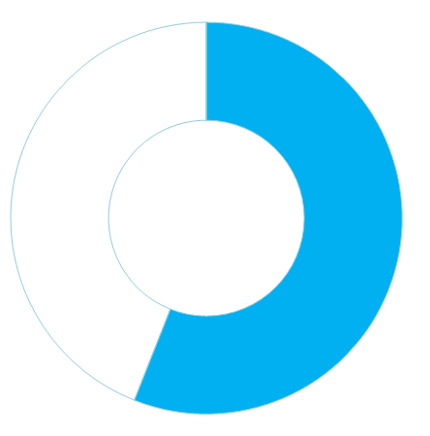
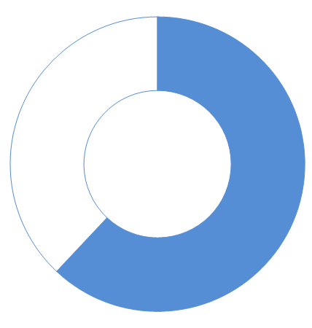

Cloud adoption
Already Started
Migrating
Top Reason:
Speed and Agility
Top Concern:
Security and Compliance
56%
62%
62%

Slide 14
Clear articulation of why cloud?
Core to our digital strategy
Agility/speed to market and scale
API driven enterprise
Risks of not using cloud
Cloud risk mitigation...as the risks are real!

Slide 15
Migration strategy
Build:
Cloud native / Cloud first for all new applications & data
Optimize and Enrich:
Get the most of your cloud implementation
Migrate and Sunset:
Migrate legacy apps and data during enhancements

Slide 16
Multi-layered and ring-fenced approach to data security
RBACs (Role Based Access Controls):
Implement fine grain access controls
Control Network Access:
Access data only via an approved VPC interface
Restrict public access
Protect Sensitive Information:
Encryption/Anonymization
RBACs
Control Network Access
PII/SPI
Data (Encrypted at Rest)

Slide 17
Build a data governance framework before you migrate data into the cloud
Data Supplier: Provides data and metadata
Data Steward: Determines the data fit and classification
Data Custodian: Executes data protection rules and implements data hygiene
Data Supplier
Data Steward
Data Custodian

Slide 18
Metadata and data catalogs
Capture metadata from day 1
Provide easy access to metadata to your users
Capture data lineage
Capture data profiles and stats on all important elements

Slide 19
Data migration strategy
Lift and shift
Leverage hierarchical structures vs. star schema
Data encryption in motion and at rest; multi-layered data protection
Automated controls for sensitive/personal information (encryption, anonymization)
Clearly defined data layers (landing zones, sand box, curated)

Slide 20
A quick recap
1
Build your business case for the cloud and obtain buy in
2
Create your data migration strategy
3
Lead with security and ring-fencing
4
Create and enforce data governance
5
Capture metadata from day 1

Slide 21
How do you migrate and transform legacy data infrastructure to the cloud?
Notes:
Identifying candidate workloads
Determining the optimum target data model
Technology and people readiness
Manual transformation, and optimization for target platform
Validation, testing, and performance

Slide 22
Without breaking current operations.
Notes:
Identifying candidate workloads
Determining the optimum target data model
Technology and people readiness
Manual transformation, and optimization for target platform
Validation, testing, and performance

Slide 23
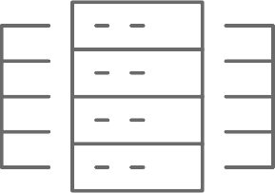
Total re-engineering
Migrating “as is”
Quantity
Agility
But….
Redundancy
Garbage In/Out
Quality
But…
Feasibility
Risk
Time/Cost/Effort
Transfer and transform
Notes:
Everyone is aware about these two approaches and not able to pick one over the other.
It is very important to create a fine balance between the two popular approaches!
The Impetus Workload Transformation solution helps attain both agility and reliability, making the existing workloads work best in the new environment. A fine balance overcomes the challenges of either of the approaches and creates a win-win situation for end-to-end data warehouse modernization pursuit.

Slide 24
Manual migration is long and error-prone.

Slide 25
Instantly move ETL and analytical workloads from Teradata/Netezza to Spark – Cloud or on-premise

Slide 26
Three solution stories.
Notes:
Let’s look at some solutions provided to real-life enterprise challenges using Impetus workload transformation.

Slide 27
A multinational retail chain saved millions by migrating from Teradata to Hadoop.
Impetus workload transformation accelerator performed over 80% automated conversion of BTEQ scripts and associated SQL queries. Massive new analytics capabilities possible now.
Notes:
Walmart
Challenge
Optimize and reduce the current cost of the legacy data warehouse and build a data lake for faster ETL processing and use of advanced analytics while reducing time to analytics
Impetus Solution Using WT
Impetus workload migration accelerator performed 70% automated conversion, which included 71 BTEQ scripts and associated SQL queries
Data mining seamlessly migrated into a scalable Hadoop environment offering
Reduced latency over aggregation of sales history data without compromising on cost requirements
A scalable solution to handle data growth of up to 100-200% per year
Supported ad-hoc reporting over ~ 3.5 TB of data

Slide 28
Teradata to Hadoop for a US Fortune Global 20 Telco.
The Impetus accelerator automatically converted Teradata BTEQ, mLoad, TPT and FExp scripts into Hadoop scripts. Accomplished with verification in months.
Notes:
Verizon
Challenges
Teradata capacity was chocking
Higher maintenance cost
Impetus Solution
Cell level validatioAssessed legacy workloads & provided recommendations to free 20% of the Teradata capacity
Automated conversion of Teradata BTEQ scripts, mLoad, TPT and FExp scripts into equivalent Hadoop scripts
n to ensure all data matches after data migration and processing
Ensured converted scripts are executed in defined SLA
Best practice recommendations in the areas of schema optimization, storage, and audit

Slide 29
Big mortgage securitization company migrated and transformed 40 Netezza instances to AWS.
Automatically translated SQL and stored procedures into Spark SQL / Hive QL. Ingested data from S3 to Redshift for reporting / analytics and replicated Netezza snapshotting process on AWS.
Notes:
Fannie Mae
Challenges
Consumption SLA were not met due to constrained EDW capacity
High cost of ownership
Impetus Solution
Assessed the existing workloads and provided recommendations to position them in Hadoop
Migrated historical data and developed a reliable mechanism for incremental updates
Automatically translated consumption queries (i.e., SQL,
Stored Procedures, Shell, Scheduler) into Spark SQL/Hive QL
Ingested data from S3 to Redshift for reporting/analytics
Replicated Netezza snapshotting process onto AWS
Used Autosys and Oozie as on-premise/cloud orchestrators

Slide 30
4 Step Process
ASSESS
TRANSFORM
VALIDATE
EXECUTE
Notes:
Self-service data-driven Assessment
Profile existing inventory of workloads
Get comprehensive recommendations about offload-able entities, best-suited target query engine and more…
Transformation of workloads to big data
Migrate schema, data, views
Optimize data model
Translate, Optimize and Transform Business logic
Edit transformed queries online through notebook-based editor
Transform more through in-built UDF library
Predict query performance on target
Validation of transformed workloads
Auto-verify that data, tables, views have been successfully moved
Execute cell-by-cell data validation
Certify transformed queries both semantically and syntactically
Execution of transformed scripts
Execute transformed queries on any standard big data environment
Choose best-suited target query execution engine as Hive QL or Spark SQL
Execute transformed business logic as Java, Scala, Python code, Shell scripts etc.
Generic
Automated metadata harvesting and publishing
Monitoring, audit logs
Drag and drop based extensible, repeatable, verifiable framework

Slide 31
A Grammar-driven translation engine that learns
Syntax IN (Grammar)
Syntax OUT (Grammar)
SQL, PLSQL, TSQL
Spark SQL
Stored Procedures, BTEQ
Hive QL
Workload Migration
Intelligent Translation Engine
(Configuration driven, Extensible, Self Learning)
ETL – Ab Initio, Informatica, Datastage
Spark Scala, Java, Shell, NiFi/Sqoop, etc
Reports - Oracle Reports, SSRS, MS, BO etc.
Tableau, Cognos, Kyvos, etc.
Analytics -SAS etc.
SparkR, PySpark, H2O, etc.

Slide 32
Single Source of Truth
New world demands new approaches
Transformation of data infrastructure
Data availability—“Delivering Insurance Your Way”
Leveraging cloud optimally and securely
Notes:
New world economy demands new approaches from enterprises
Starts with the transformation of your data infrastructure – everything from data ingestion to meta data creation to analytics in real or near-real time
Ensure Data availability
Leveraging Cloud

Slide 33
Q&A See us at booth 1109 for a demo
Stephen Dantu
SVP and Head Big Data Capabilities
Anand Raman
Big Data Practice Leader

