Slide 1
Sunday-pointpoint
Ning Lu

Slide 2
Sunday Coding
This is an R Markdown presentation. Markdown is a simple formatting syntax for authoring HTML, PDF, and MS Word documents. For more details on using R Markdown see http://rmarkdown.rstudio.com.
Bold movement
When you click the Knit button a document will be generated that includes both content as well as the output of any embedded R code chunks within the document. sdsdsd

Slide 3
Slide with Bullets
Bullet 1
Bullet 2
Bullet 3
Bullet 2
Bullet 3

Slide 4
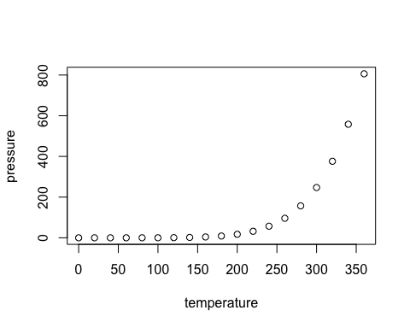
Slide with Plot

