Slide 1
BUILT-IN TOOLS
Extending Agents with the
AgentCore Browser Tool
Web automation as a first-class agent capability — from a deterministic pipeline to a hybrid LLM agent.
AgentCore Browser Tool · Labs 3 & 4
1
Notes:
Welcome. In 45 minutes we'll turn 'a browser' into an agent capability. We build up from Lab 3 — a deterministic, scheduled pipeline using the AgentCore Browser tool — to Lab 4, where we add an LLM (Nova Act) and a Strands agent that orchestrates the tools. By the end you'll know the built-in tool architecture, how to drive the Browser tool, and how to combine tools into a richer app.

Slide 2
WHAT YOU'LL LEAVE WITH
Three takeaways
Built-in tool architecture
01
How AgentCore exposes managed tools (Browser, Code Interpreter) that agents call — isolated, observable, no infra to run.
Integrate the Browser tool
02
Drive a real headless Chrome from your runtime to retrieve data and act on the web — two ways: deterministic Playwright and LLM-driven Nova Act.
Combine tools into richer apps
03
Wrap the browser work as tools and let a Strands agent orchestrate — reasoning where it helps, deterministic code + guardrails where it matters.
AgentCore Browser Tool · Labs 3 & 4
2
Notes:
These map exactly to the session's stated takeaways. Keep coming back to #3 — combining tools is the payoff; the browser alone is useful, but the browser plus reasoning plus a safety net is a capable application.

Slide 3
HOW WE'LL SPEND 45 MINUTES
Agenda
5m
Why browser automation is an agent problem
8m
AgentCore built-in tool architecture
12m
Lab 3 — deterministic Browser-tool pipeline + demo
15m
Lab 4 — hybrid: Nova Act + guardrail + Strands + demo
5m
Combine, operate, and Q&A
AgentCore Browser Tool · Labs 3 & 4
3
Notes:
Two demos anchor the talk — Lab 3 and Lab 4. If we're short on time, the Lab 4 demo is the one to protect; it shows the browser tool combined with an LLM and an orchestrator.

Slide 4
THE PROBLEM
Most business automation is brittle
The old way
What we actually want
Hand-written scripts and RPA macros that replay clicks
Break the moment a page, selector, or layout changes
No isolation, no audit trail, hard to schedule
An LLM that 'has a browser' is powerful but non-deterministic and costly per step
A managed browser as a callable tool — no infra to run
Deterministic where the task is known and measurable
LLM reasoning only where a human judgment is needed
Isolation, session replay, and idempotency built in
AgentCore Browser Tool · Labs 3 & 4
4
Notes:
Frame the tension: deterministic automation is cheap and reproducible but brittle to change; a pure LLM browser agent adapts but is slow, costs a model call per step, and is hard to audit. AgentCore's built-in Browser tool plus the right driver lets us choose per-field. That's the whole session.

Slide 5
TAKEAWAY #1
AgentCore built-in tool architecture
Your agent runs in AgentCore Runtime and calls managed tools over a control plane. The tools run in isolated micro-VMs — you don't provision or patch anything.
AgentCore Runtime
Browser
Managed headless Chrome. Navigate, read, click, fill, submit. Session replay.
Serverless host for your agent
Session isolation + identity
OpenTelemetry → CloudWatch
Any framework (Strands, ADK…)
Code Interpreter
Sandboxed code execution for data + logic.
Knowledgebase
Existing Kb
This session zooms into the Browser tool (orange) — the others compose the same way.
AgentCore Browser Tool · Labs 3 & 4
5
Notes:
Key mental model: the agent doesn't run Chrome; it calls a Browser tool that runs in a dedicated micro-VM in AgentCore. Same pattern for Code Interpreter. Tools are isolated, observable, and framework-agnostic. Today we integrate the Browser tool specifically.

Slide 6
TAKEAWAY #2
The Browser tool, up close
Managed & serverless
Micro-VM isolation
Session replay + live view
A real headless Chromium spun up on demand — no image to build, no fleet to run.
Each session gets isolated CPU/memory/filesystem; memory-sanitized on teardown.
Every action recorded — an auditable trail for side-effecting web work.
Browser profiles
Reduced CAPTCHA + JS-rendered
Long sessions
Persist auth/cookies across sessions — log in once, reuse the profile.
Handles modern SPAs and dynamic content the way a human browser does.
Default 15 min, up to 8 hours for large batches.
AgentCore Browser Tool · Labs 3 & 4
6
Notes:
These are the properties that make a browser usable in production automation. Session replay and micro-VM isolation are the enterprise story; browser profiles solve 'how do I stay logged in without a human'. Everything we build sits on top of these.

Slide 7
INTEGRATING THE TOOL
Two ways to drive it
Deterministic — Playwright / CDP
Agentic — Amazon Nova Act
Attach Playwright to the session over CDP
Fixed selectors — do exactly this
Fast, cheap, 100% reproducible
Best for known, stable pages → Lab 3
Plain-English act() instructions
Reads the page, decides, clicks
~90% reliable; a model call per step
Best for variable / unknown UIs → Lab 4
client = BrowserClient(region); client.start()
ws, hdr = client.generate_ws_headers()
browser = pw.chromium\
.connect_over_cdp(ws, headers=hdr)
with NovaAct(cdp_endpoint_url=ws,
cdp_headers=hdr) as nova:
nova.act("pick the gluten-free dish")
page = nova.page # same session
AgentCore Browser Tool · Labs 3 & 4
7
Notes:
Same Browser tool, two drivers. This is the core design lever of the whole talk. Lab 3 uses Playwright — deterministic. Lab 4 uses Nova Act for one field that needs judgment, on the SAME session. You pick the driver per task, not per app.

Slide 8
ONE EXAMPLE ACROSS BOTH LABS
Google Sheet → Google Form
The task
Read attendee rows from a Sheet and submit each as one response to a registration Form — every day, unattended, no duplicates.
Lab 3
Lab 4
Deterministic Browser-tool pipeline. Known fields, fixed selectors, scheduled, idempotent. No LLM.
Form gains a Food Option with no sheet column — the dish must be reasoned. Add Nova Act + a guardrail + a Strands agent.
AgentCore Browser Tool · Labs 3 & 4
8
Notes:
One concrete, relatable task carries both labs so the audience never loses the thread. Lab 3 = the deterministic version. Lab 4 = the same task after the form gains a field that can't be looked up. That single change is what motivates the LLM.

Slide 9
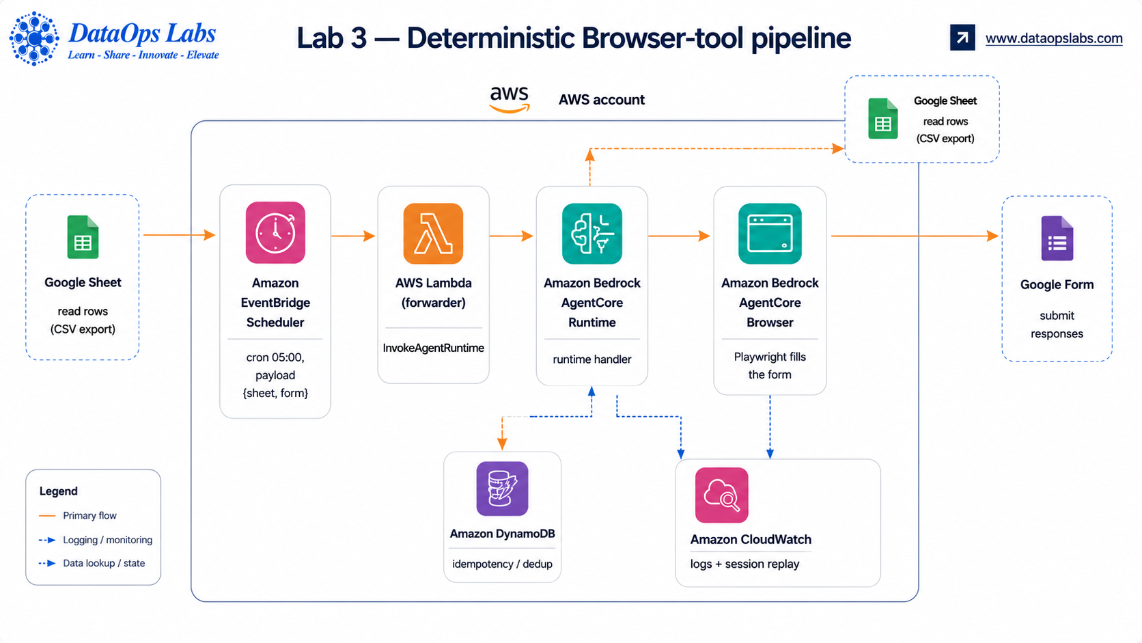
Architecture: scheduled Browser-tool pipeline
LAB 3 — DETERMINISTIC
AgentCore Browser Tool · Labs 3 & 4
9
Notes:
Walk the flow left to right: a schedule delivers the payload to a thin Lambda, which invokes the runtime; the runtime reads the sheet and drives the Browser tool with Playwright, guarded by a DynamoDB dedup table; everything lands in CloudWatch with session replay. No model anywhere. This is the reproducible, cheap baseline.

Slide 10
LAB 3 — THE FILL
Locate by visible label, act via ARIA role
# match the human-readable question, not brittle IDs
def _item(page, title):
return page.locator('div[role=listitem]') \
.filter(has=page.get_by_text(title,
exact=True)).first
def choose_radio(page, title, value):
_item(page, title) \
.get_by_role('radio', name=value).click()
choose_radio(page, 'T-Shirt Size', 'M')
# click Submit → verify 'response recorded'
The rule of thumb
Find questions by their visible title (get_by_text, exact)
Act through ARIA roles: textbox / radio / checkbox
Survives Google changing internal entry.* IDs
Validate option values before clicking — fail loudly, never submit a dropped answer
AgentCore Browser Tool · Labs 3 & 4
10
Notes:
The durability trick: never target Google's internal field IDs. Locate by the label a human reads, then act by ARIA role. This survived every form change we hit. Deterministic doesn't mean fragile if you anchor on semantics.

Slide 11
LAB 3 — COMPOSABILITY + SAFETY
One payload, and no double-submits
The only variable: the payload
Idempotency — DynamoDB
{
"sheet": { "id": "…", "gid": "…" },
"form": { "public_id": "…" },
"region": "us-east-1"
}
# reserve BEFORE submit (conditional put)
put_item(pk = form + '#' + email,
ConditionExpression=
'attribute_not_exists(pk)')
Retarget any form/sheet with a config change — no code
Delivered by EventBridge as the schedule input
Already there → skip as duplicate
Submit fails → release the marker, retry next run
Safe against EventBridge at-least-once re-delivery
AgentCore Browser Tool · Labs 3 & 4
11
Notes:
Two ideas that make daily runs safe: (1) the whole job is one payload, so it's composable; (2) a reserve-before-submit dedup key means re-runs and re-deliveries never double-submit. This is the difference between a demo and something you can schedule.

Slide 12
LIVE DEMO
Lab 3 — deterministic run
make browser-test
One row through a real AgentCore Browser session → PASS
$
make run-local LIMIT=2
Read the sheet, fill 2 rows, show submitted / duplicates / failed
$
make deploy · make invoke
Register the runtime, fire it in the cloud
$
CloudWatch
Session replay + logs — StartBrowserSession, fills, confirmation
$
Expected: { submitted, duplicates, failed } — dedup skips anyone already registered.
AgentCore Browser Tool · Labs 3 & 4
12
Notes:
DEMO checklist. Keep it tight. If the live run is slow, talk over the CloudWatch session replay from a prior run. The point to land: this is a real browser filling a real form, scheduled and idempotent, with zero LLM.

Slide 13
REAL-WORLD GOTCHA
Two IAM gates for the Browser tool
The toolkit's auto-created runtime role can run the container but cannot start a browser — the first invoke fails AccessDenied.
StartBrowserSession
1
bedrock-agentcore:*Browser*
Create the managed browser session
Automation stream
2
(same wildcard covers it)
Connect Playwright/Nova Act to the session's CDP WebSocket
AgentCore Browser Tool · Labs 3 & 4
13
Notes:
Save your audience an hour: granting Start isn't enough — connecting to the automation stream is a second action. Grant bedrock-agentcore:*Browser* to the runtime execution role. We hit both gates in sequence; this slide is the shortcut.

Slide 14
LAB 4 — THE LEAP
A field with no data to fill it
Form gains: “Food Option”
Deterministic code can't
Chicken Pizza
Veg Pasta
Mediterranean Quinoa Salad
Tofu Scramble Burrito
The sheet has a dietary preference, not a dish
Mapping 'Gluten-Free' → the right item is a judgment
A hardcoded lookup breaks when the caterer changes the menu
This is exactly what an LLM is for — read the live menu and reason
No column in the sheet says which dish.
AgentCore Browser Tool · Labs 3 & 4
14
Notes:
This is the pivot of the whole session. One new field turns a lookup into a judgment. You could hardcode a preference→dish table, but it's brittle and wrong the moment the menu changes. So we reach for the LLM — but only for this one field.

Slide 15
LAB 4 — HYBRID
Three brains, one browser session
Deterministic Playwright
Nova Act (LLM)
Guardrail (code)
Name, email, phone, size, time — fixed selectors
Reads the live menu, picks the dish for the diet
Checks the pick isn't unsafe for the diet
Orchestrated by a Strands agent
One AgentCore Browser session; Nova Act owns it and exposes its Playwright page
The Strands agent calls a process_registrations tool, then reports — deployed as one entrypoint
Idempotency (DynamoDB) carries over unchanged from Lab 3
AgentCore Browser Tool · Labs 3 & 4
15
Notes:
Lab 4 = Lab 3 plus judgment plus a safety net plus orchestration. Critically, all three share ONE browser session: Nova Act owns it, and we reuse its Playwright page for the deterministic fields. The Strands agent sits on top and turns the run into a reasoned report.

Slide 16
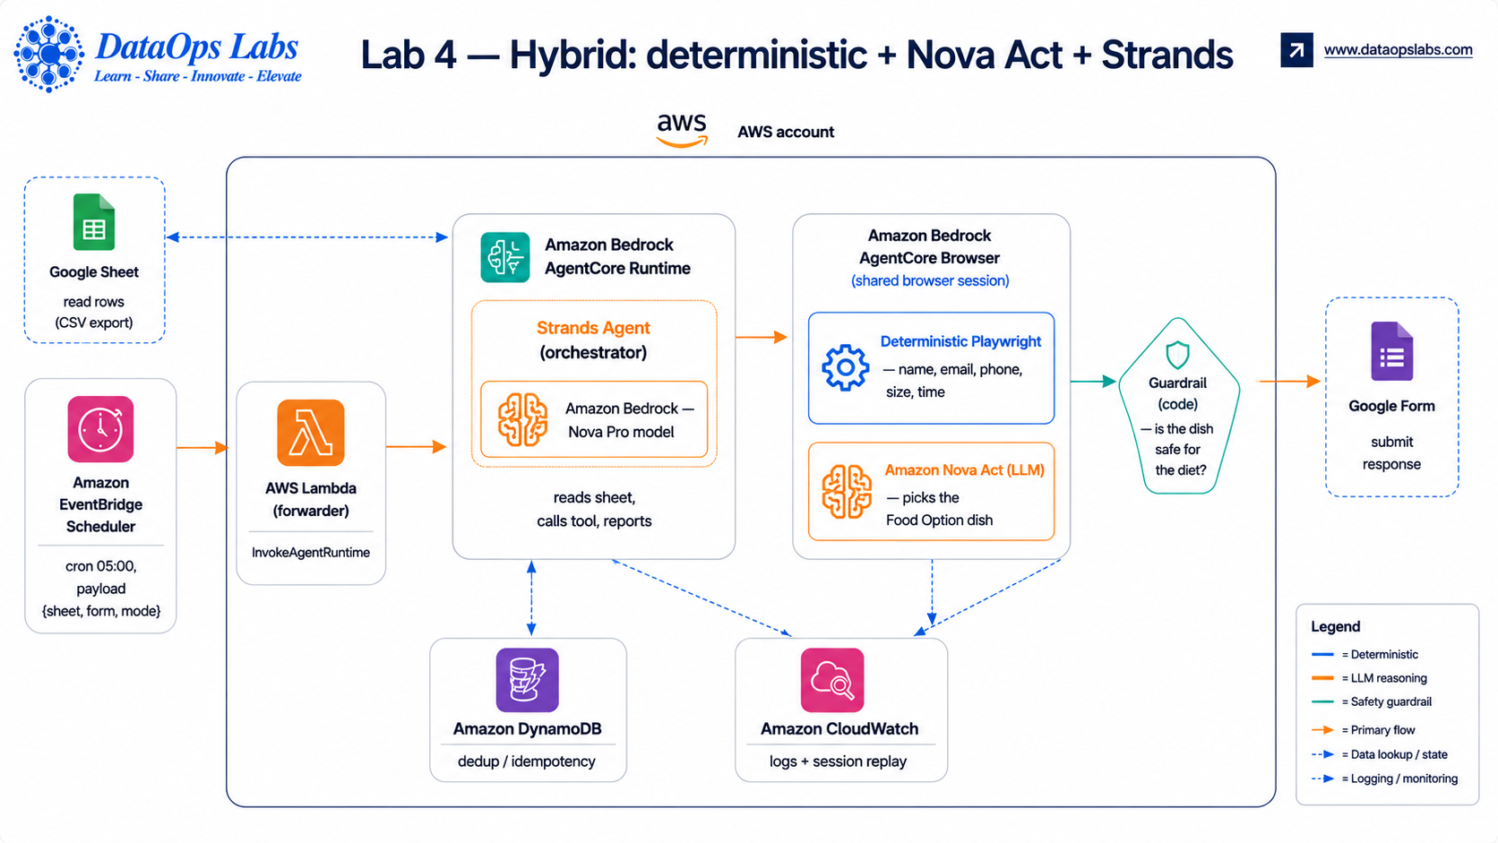
Architecture: scheduled NovaAct + Browser
LAB 4 — LLM + Deterministic
AgentCore Browser Tool · Labs 3 & 4
9
Notes:
Walk the flow left to right: a schedule delivers the payload to a thin Lambda, which invokes the runtime; the runtime reads the sheet and drives the Browser tool with Playwright, guarded by a DynamoDB dedup table; everything lands in CloudWatch with session replay. No model anywhere. This is the reproducible, cheap baseline.

Slide 17
LAB 4 — THE LLM STEP
Nova Act picks the dish
# LLM reads the live options and reasons
nova.act(
"On the Food Option question, select the"
"dish most appropriate for a "+diet+" diet."
)
item = read_selected_radio(page)
if not guardrail_ok(diet, item): # safety net
fail_row(); release_dedup()
From a real run (CloudWatch)
Gluten-Free → "Pizza crust has gluten… burrito tortillas have wheat… quinoa is naturally gluten-free" → selects Mediterranean Quinoa Salad.
Screenshot → Nova model → action → screenshot. ~90% reliable. One model call per step — reserved for the one field that needs it.
AgentCore Browser Tool · Labs 3 & 4
16
Notes:
Show the act() call — plain English, no selectors. Then show the actual reasoning we captured: the model talked itself through gluten in each dish and picked the quinoa salad. That's the capability you're buying. And it's bounded — one field, one call.

Slide 18
LAB 4 — THE SAFETY NET
The guardrail: LLM judgment, deterministic floor
The LLM can be confidently wrong
ITEM_TAGS = {'Tofu Scramble Burrito':
{'gluten'}, …}
FORBIDDEN = {'Vegan': {'meat','dairy',
'egg'}, 'Gluten-Free': {'gluten'}, …}
def guardrail_ok(diet, item):
return not (ITEM_TAGS[item]
& FORBIDDEN[diet])
Vegan attendee → Nova Act picked "Veg Pasta" (usually egg/dairy). Or claimed a burrito is gluten-free (wheat tortilla).
Code tags each dish and rejects picks that violate the diet — it doesn't hardcode the answer.
Modes:
off trust the model warn submit + flag strict block unsafe picks, retry next run
AgentCore Browser Tool · Labs 3 & 4
17
Notes:
This is the moral of the series. The LLM makes the judgment; deterministic code enforces a safety floor. It doesn't re-specify the answer — it tags dishes and blocks clear violations. Great teaching moment: run strict mode live and watch it catch the vegan-pasta pick.

Slide 19
TAKEAWAY #3
Combine tools with a Strands agent
from strands import Agent, tool
@tool
def process_registrations():
return run_pipeline(payload) # browser work
agent = Agent(
model=BedrockModel("us.amazon.nova-pro-v1:0"),
tools=[process_registrations])
agent("Process registrations and report.")
The composition pattern
Wrap browser work as a @tool
Agent sequences tools + writes a report
LLM at the orchestration layer — once per run, not per row
Native to AgentCore Runtime; one deploy
Browser tool actuates · Nova Act reasons on one field · guardrail verifies · Strands orchestrates — a richer app than any single tool.
AgentCore Browser Tool · Labs 3 & 4
18
Notes:
This is takeaway #3 made concrete. You wrap the browser pipeline as a tool and let a Strands agent orchestrate. The model runs once per invocation to sequence and report — not once per row. That's how you combine tools without paying LLM cost everywhere.

Slide 20
LIVE DEMO
Lab 4 — hybrid agent run
export NOVA_ACT_API_KEY=…
Local auth (runtime uses IAM instead)
▸
payload {"mode":"agent"}
Strands agent orchestrates; Nova Pro model
▸
make run-local
Watch Nova Act reason through the Food Option per diet
▸
CloudWatch
Agent → process_registrations tool → Nova Act picks → summary
▸
Watch for: Gluten-Free → Mediterranean Quinoa Salad, and strict mode catching Vegan → Veg Pasta.
AgentCore Browser Tool · Labs 3 & 4
19
Notes:
DEMO checklist for Lab 4. The magic moment is the CloudWatch trace of Nova Act's think()/act() reasoning. If live is flaky, replay a prior run. Optionally flip GUARDRAIL=strict to show the safety net firing.

Slide 21
DEPLOY & OPERATE
From laptop to a daily job
Deploy
Auth
Model
make deploy → register runtime
make runtime-policy → grant browser/DDB/model
make deploy-lambda · make schedule
Local: NOVA_ACT_API_KEY
Runtime: IAM via a Nova Act workflow definition
AgentCore role, not keys in the container
Agent mode needs a Bedrock model
Nova Pro works out of the box
Anthropic models need model access + billing
EventBridge (05:00) → forwarder Lambda → InvokeAgentRuntime → Browser tool. Idempotent, so daily + re-delivery are safe.
AgentCore Browser Tool · Labs 3 & 4
20
Notes:
The operational reality. One entrypoint, a handful of make targets, account auto-detected. Auth is the key design choice: API key locally, IAM in the runtime — no secrets in the container. And a real caveat: agent mode needs a Bedrock model your account can actually reach.

Slide 22
LESSONS FROM THE BUILD
Gotchas worth stealing
Read the full sheet
Two browser IAM gates
Match labels, not IDs
gviz CSV stops at the first blank row — use export?format=csv
Grant bedrock-agentcore:*Browser* (start + automation stream)
Locate questions by visible title; forms rename internal IDs
Model access ≠ availability
Idempotency before scheduling
Guardrail the LLM
Anthropic on Bedrock needs a valid payment instrument first
Reserve-before-submit or re-delivery double-submits
It will be confidently wrong — verify its pick deterministically
AgentCore Browser Tool · Labs 3 & 4
21
Notes:
A rapid-fire 'save yourself the pain' list — every one of these cost us a debugging cycle. If the audience remembers only these six, they'll ship faster than we did.

Slide 23
RECAP
You can now extend agents with the Browser tool
Architecture
Managed, isolated built-in tools your agent calls — no infra to run.
1
Integrate
Drive the Browser tool two ways: Playwright (deterministic) or Nova Act (agentic).
2
Combine
Wrap browser work as tools; a Strands agent orchestrates, a guardrail keeps it safe.
3
Labs 3 & 4 + workflow_info.md + ImplementationPlan.md · make it your own
AgentCore Browser Tool · Labs 3 & 4
22
Notes:
Close by restating the three takeaways, now proven. Point them at the repo: Labs 3 & 4, the workflow_info deep-dive, and the ImplementationPlan for a step-by-step. Invite questions — the browser IAM gates and the deterministic-vs-LLM choice usually spark the best ones.

