Slide 1
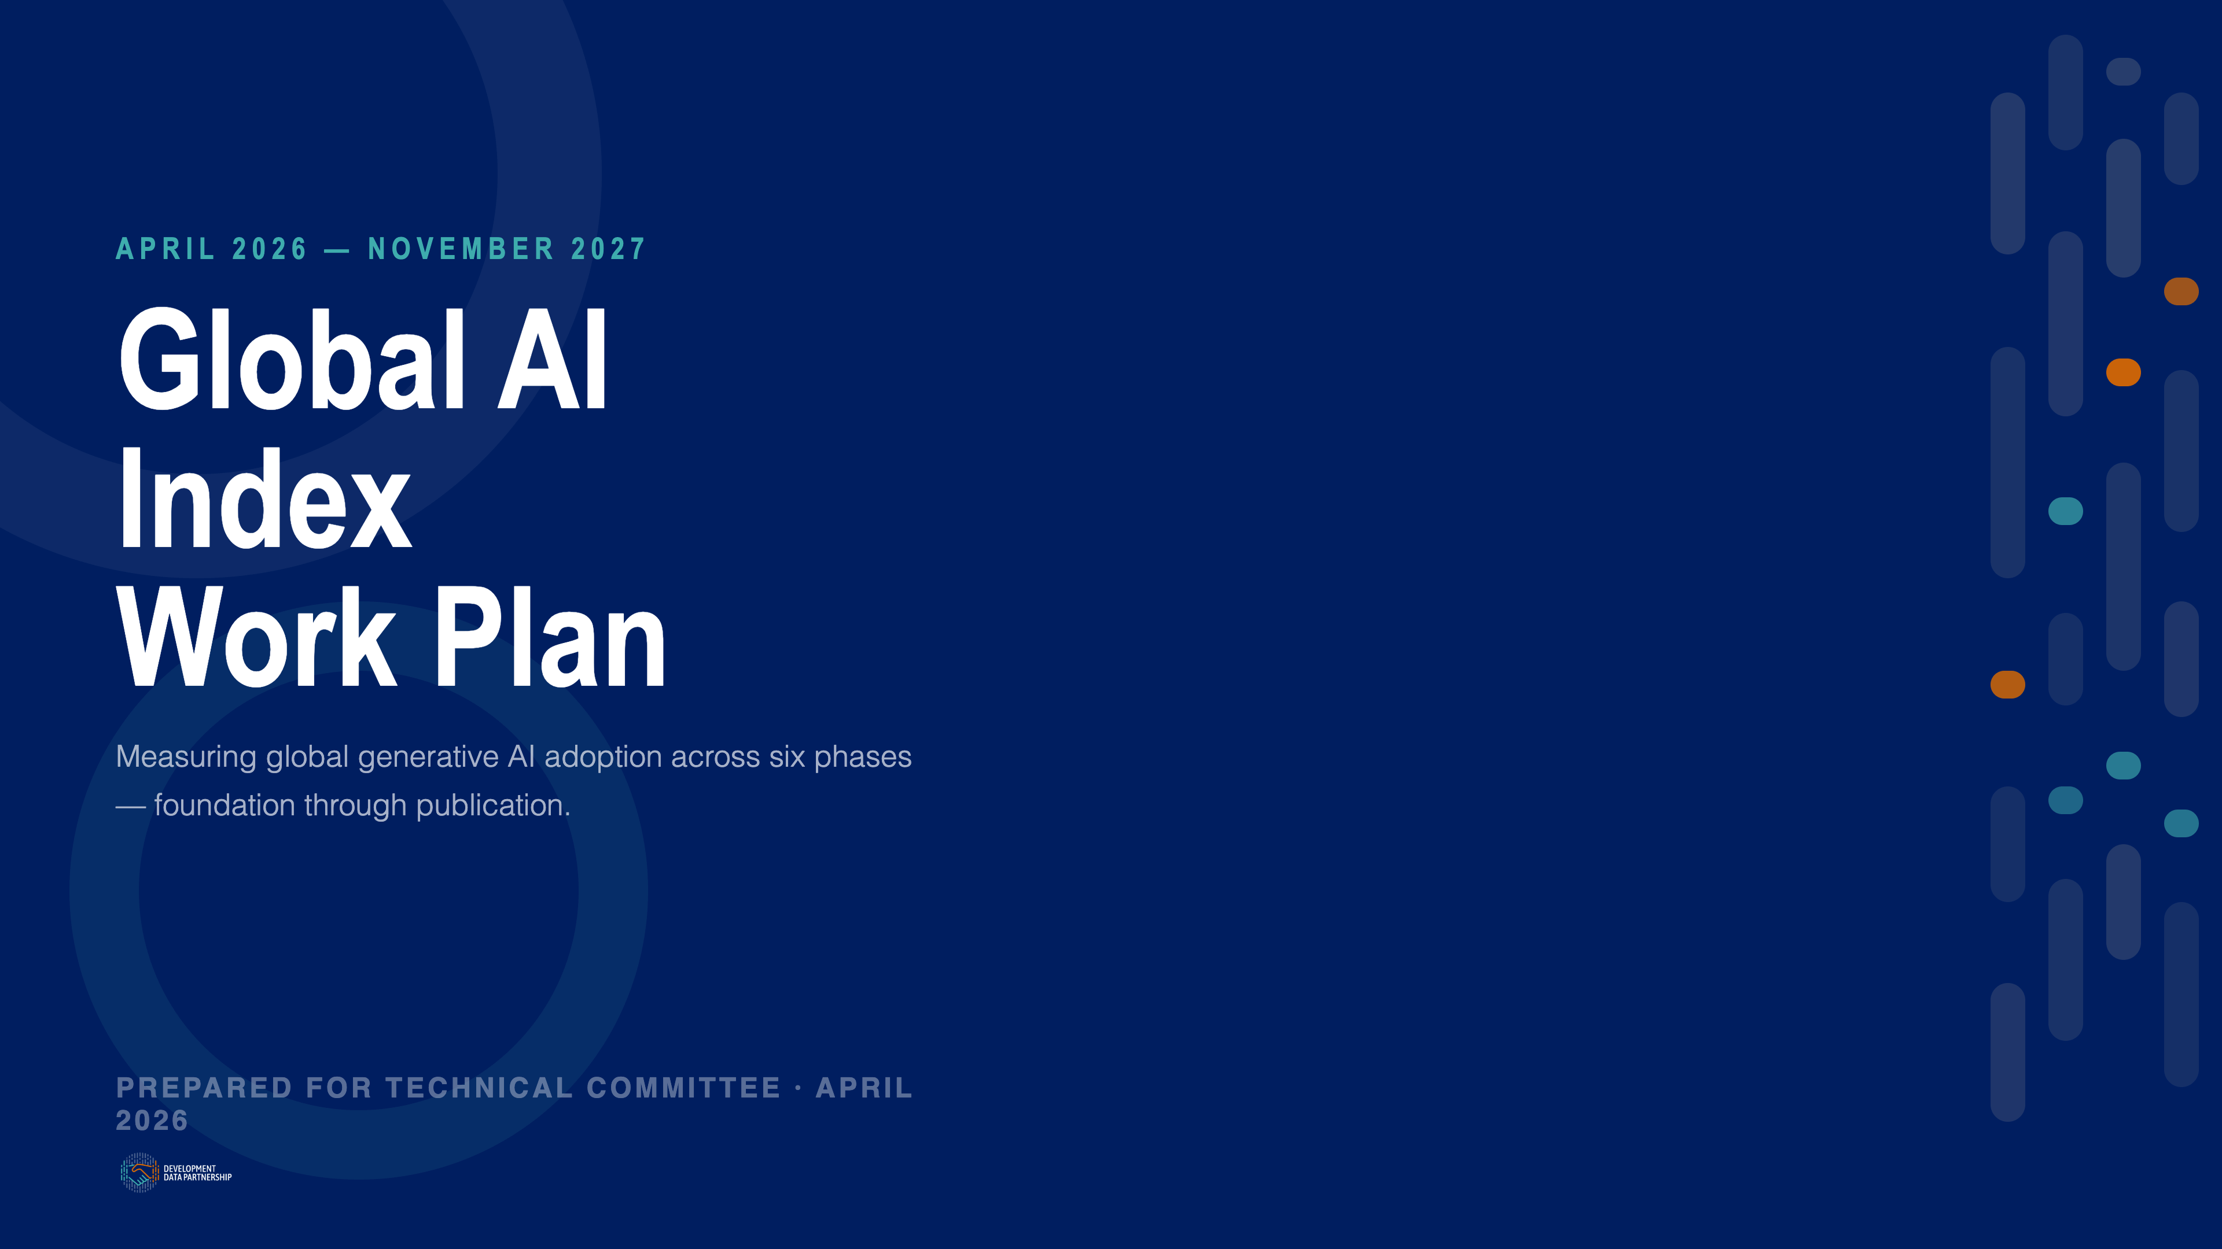
Notes:
Welcome. This deck walks the Technical Committee through the full Global AI Index work plan — six phases from now through November 2027.

Slide 2
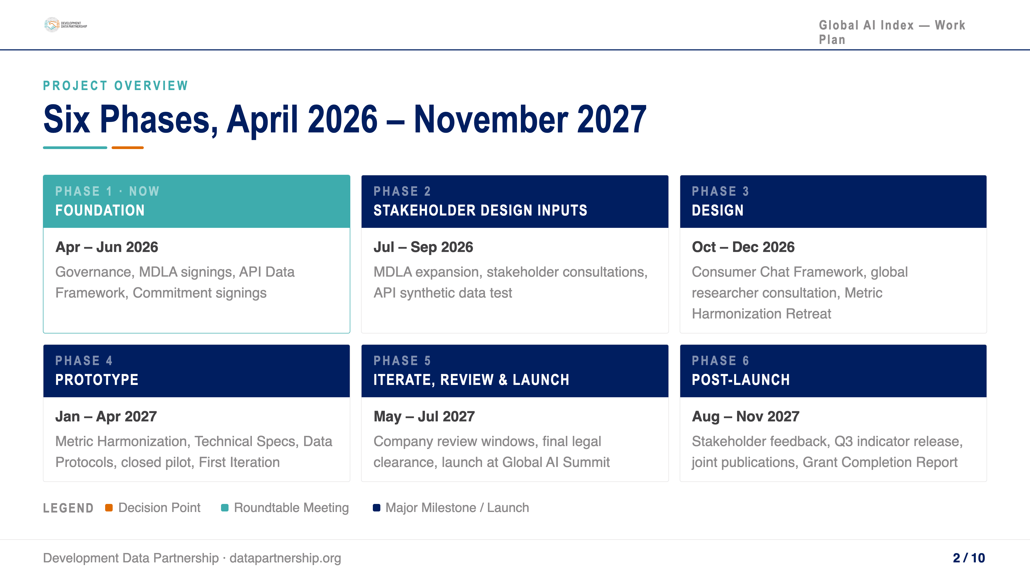
Notes:
The project is organized into six phases. We're currently in Phase 1. Each phase builds on the last, culminating in the joint launch at the 2027 Global AI Summit.

Slide 3
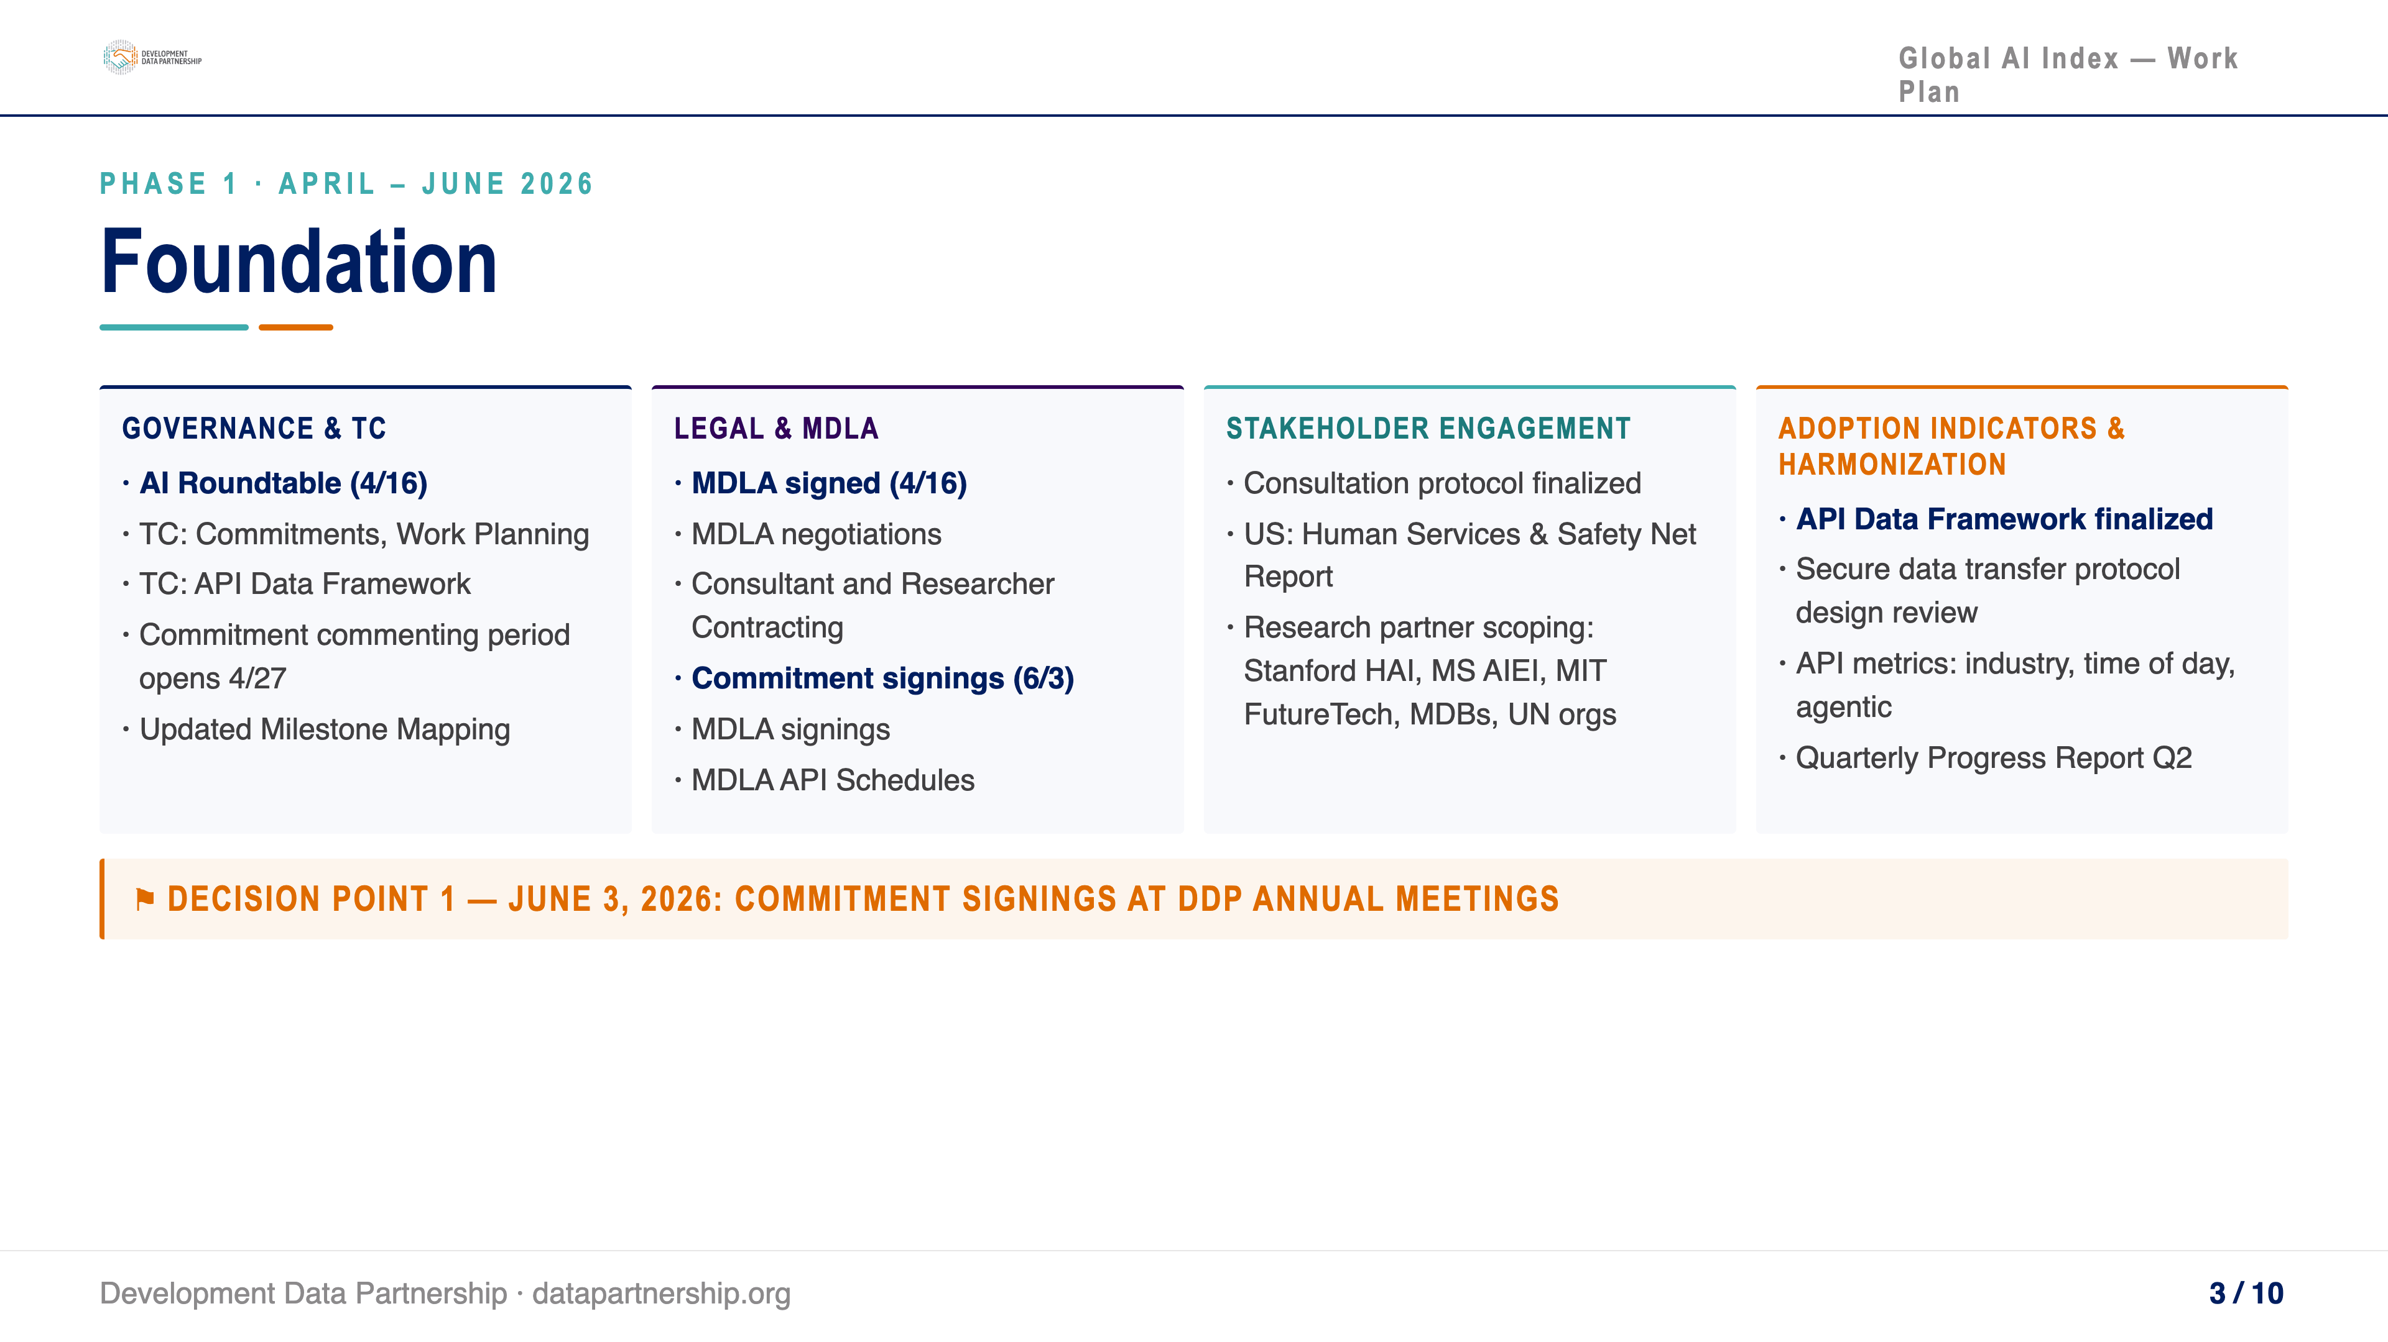
Notes:
Phase 1 runs April through June 2026. Our immediate priorities are the Anthropic MDLA signed this month, finalizing the API Data Framework, and reaching Commitment signings by June 3 at the DDP Annual Meetings.

Slide 4
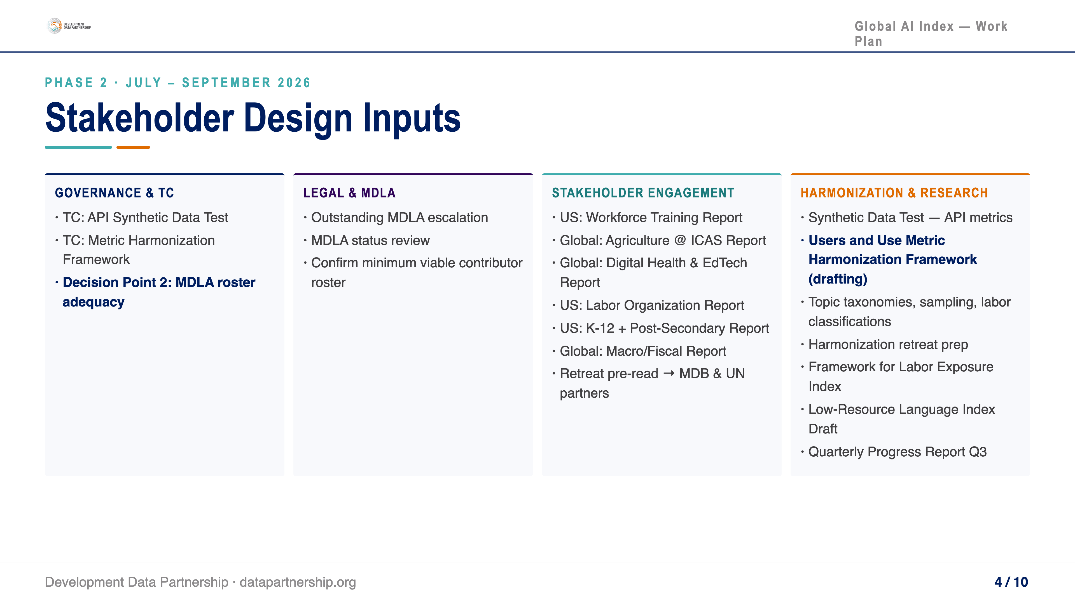
Notes:
Phase 2 runs July through September 2026. Focus shifts to expanding the MDLA roster, running stakeholder consultations that feed into framework design, and completing the API synthetic data encryption test.

Slide 5
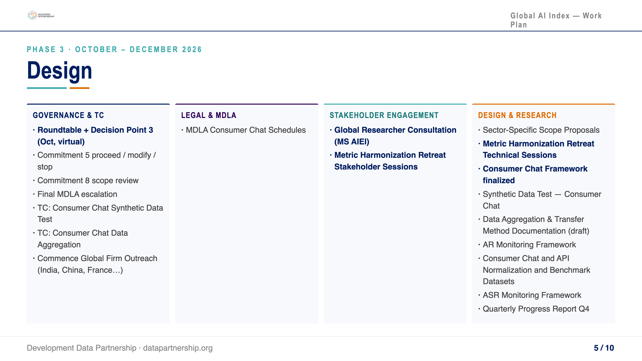
Notes:
Phase 3, October through December 2026, is where design solidifies. The Consumer Chat Framework gets finalized, and the Metric Harmonization Retreat brings all threads together.

Slide 6
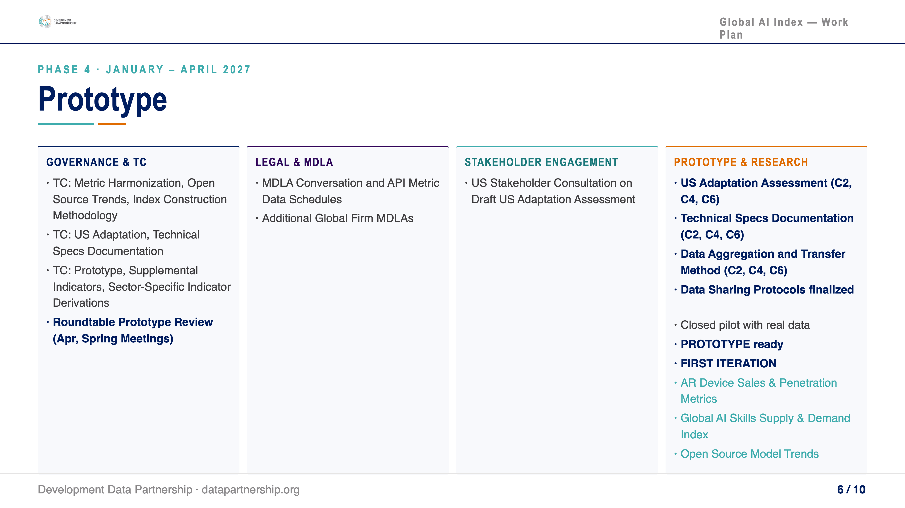
Notes:
Phase 4, January through April 2027, moves into prototype territory. We finalize technical specs, run the closed pilot with real data, and present the Prototype to the Roundtable at the Spring Meetings.

Slide 7
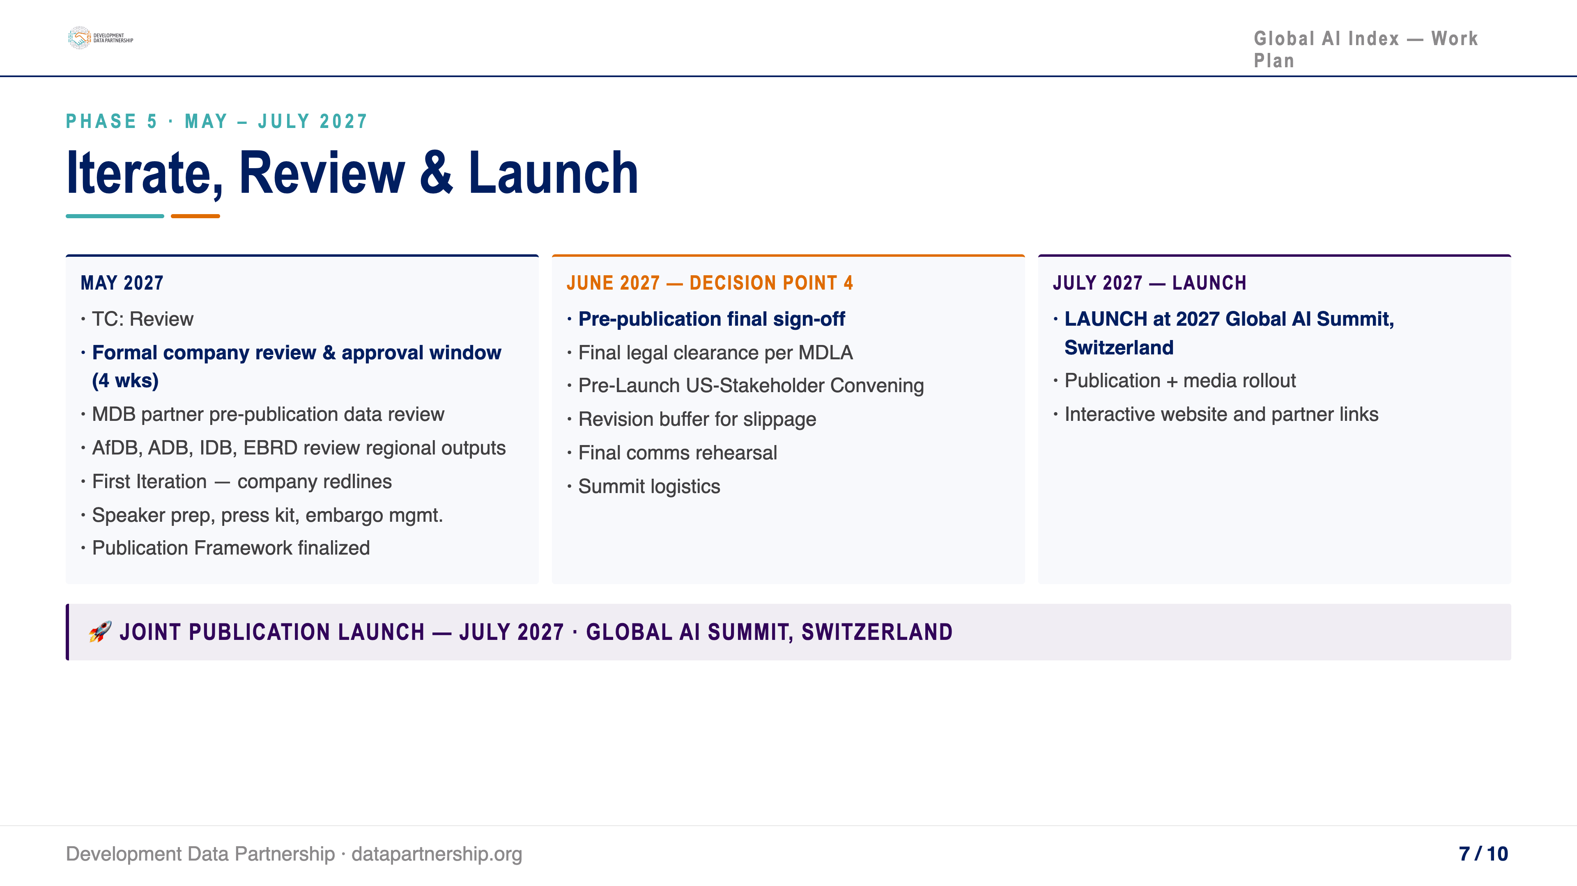
Notes:
Phase 5 is the home stretch — company review windows, final legal clearance, and launch at the 2027 Global AI Summit in Switzerland in July.

Slide 8
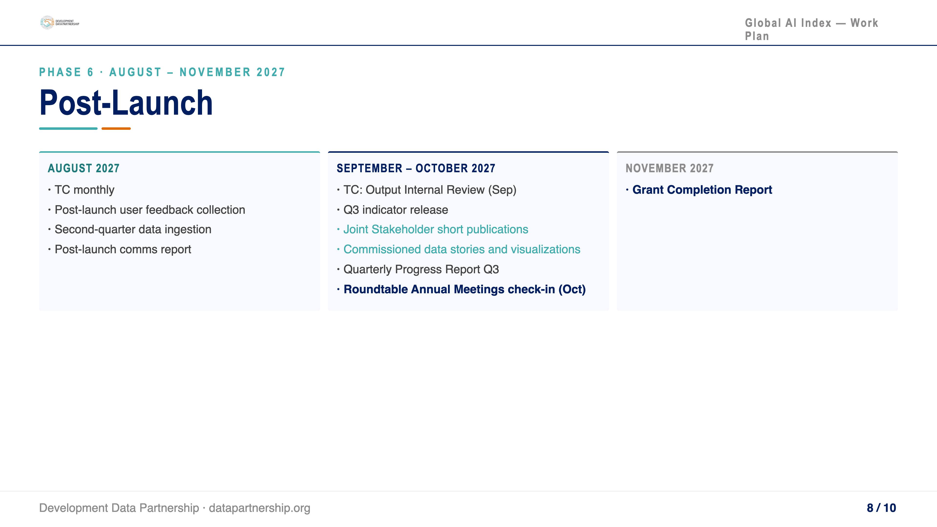
Notes:
Post-launch, Phase 6 focuses on data ingestion, quarterly indicator releases, joint stakeholder publications, and the Grant Completion Report in November.

Slide 9
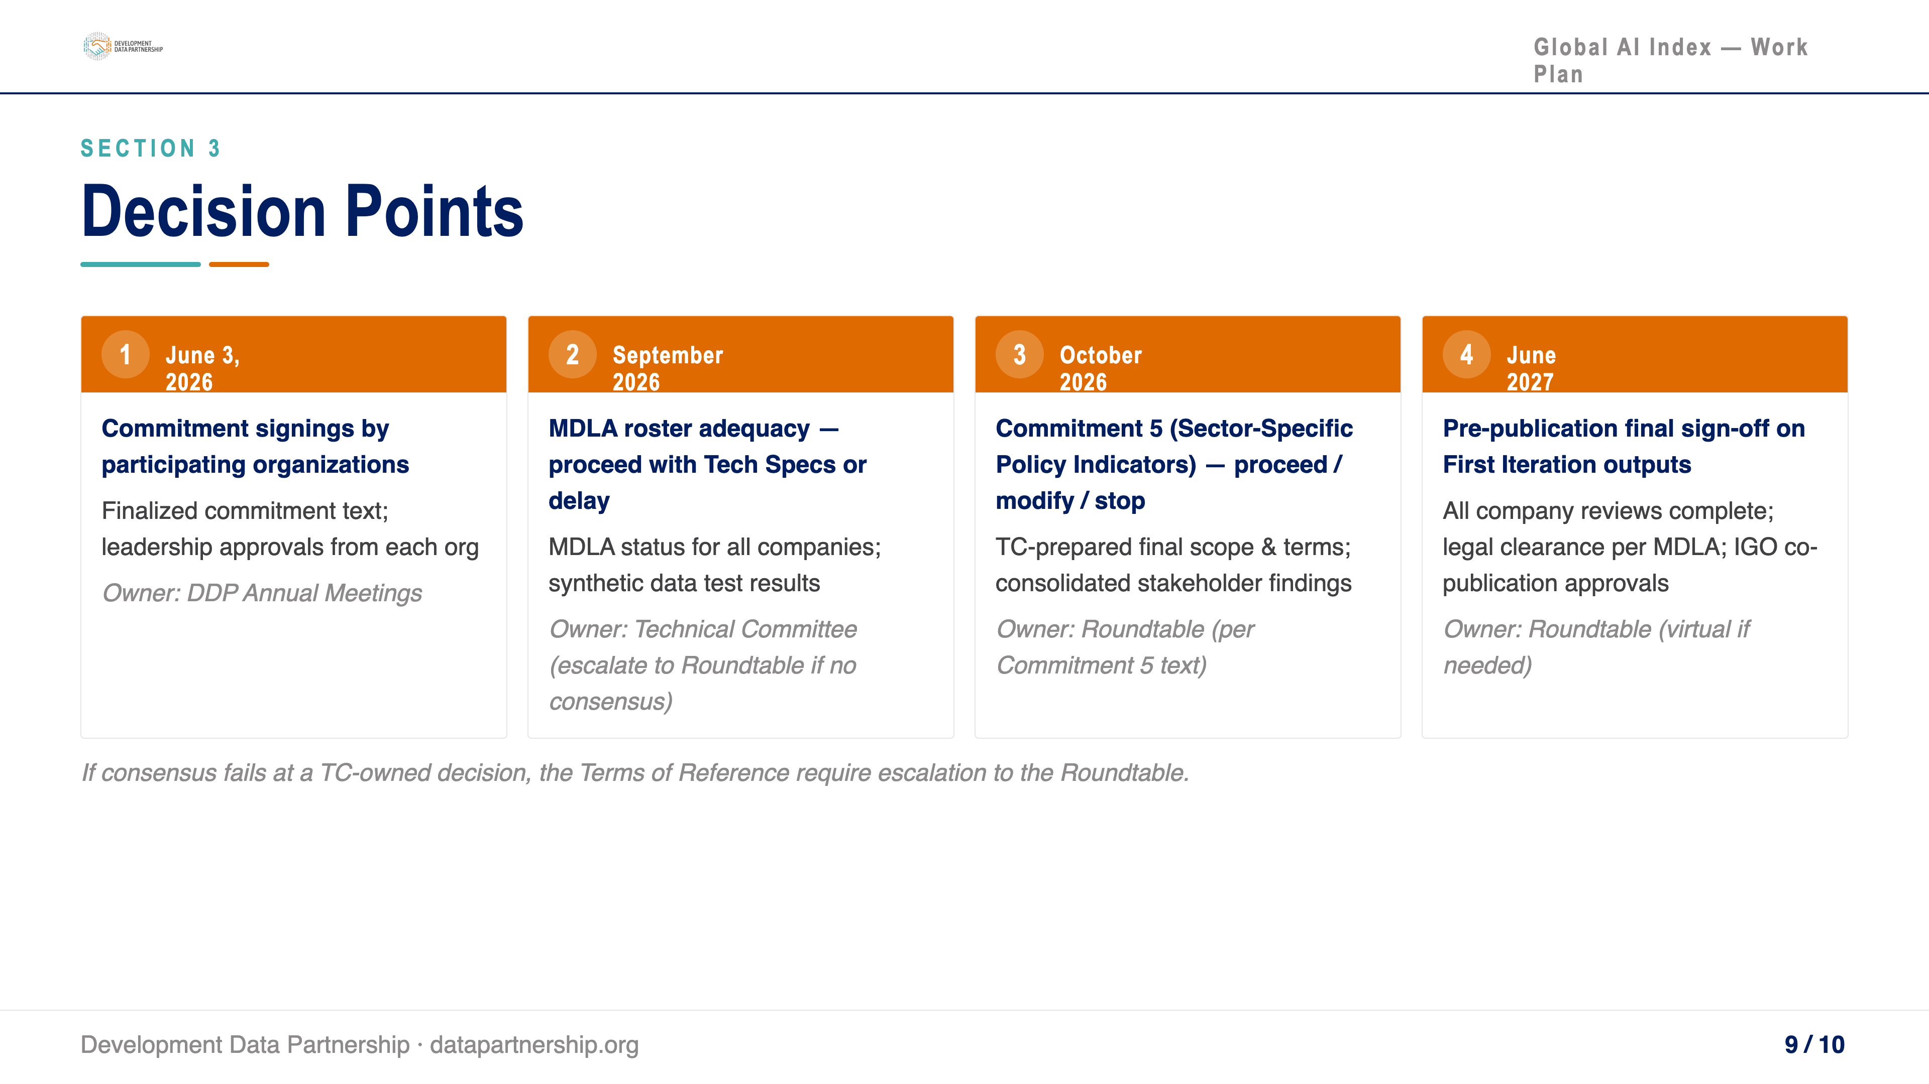
Notes:
Four decision points gate the project. The first is June 3 — Commitment signings. The TC owns Points 1 and 2; the Roundtable owns Points 3 and 4. Any TC deadlock escalates to the Roundtable.

Slide 10
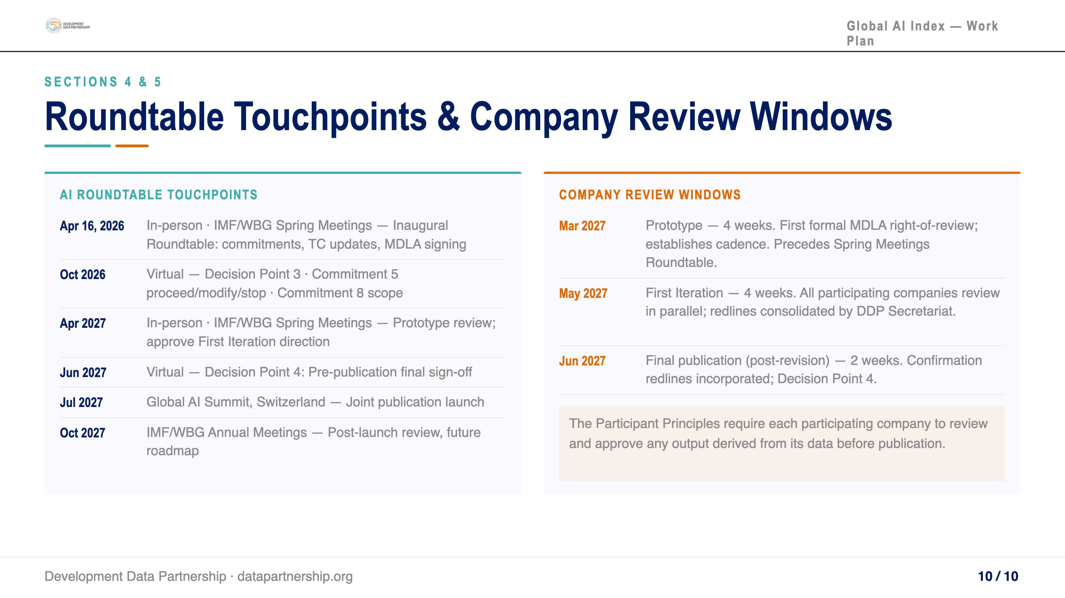
Notes:
The Roundtable meets six times across the project. Three in-person meetings leverage IMF/WBG venues. Company review windows are structured so concerns surface before each governance checkpoint.

