Slide 1
Synthetic Data Pipeline for
Pose Estimation (Milestone 3)
Group: Nathan Pichette, William Stern, Stephane Baruch, Hanibal Alazar
Faculty Advisor: Dr. Ryan White

Slide 2
Goal and motivation
Create a program that can generate synthetic training data for training pose estimation for satellites in space where the user can modify different parameters such as lighting, satellite, and motion and create a benchmark neural network model using this data to estimate poses.

Slide 3
Approach
The user can easily generate a lot of satellite training data for use in neural networks.
The user can configure things like the type of satellite, the flight path of the satellite, lighting, background, and various other things
The user can generate a lot of videos for use in machine learning at one time.

Slide 4

Algorithms and tools
Blender
Bpy
Toml
Ensurepip
Neural network libraries (Tensorflow or Pytorch)

Slide 5
Novel features
This program will allow for easy and automated creation of synthetic animated satellite data.
Our system lists satellite position data that can be used to verify the machine learning algorithms output.
Our program can also be used to test low light conditions previously unworkable with a past iteration of a similar system

Slide 6
Technical Challenges
Porting to different OS and working with different types of hardware
Working with blenders custom version of python
Learning neural networks

Slide 7
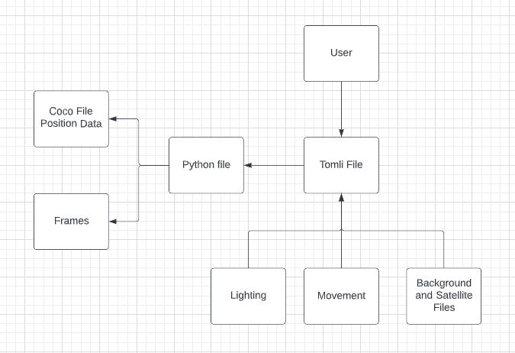
Design

Slide 8

Evaluation
Survey Dr. White’s machine learning team they will grade the ease of use and quality of output on a scale of 1-5
We will also evaluate the success of our synthetic data generation system based on the accuracy of how often the neural network that we create is able to predict the pose.

Slide 9
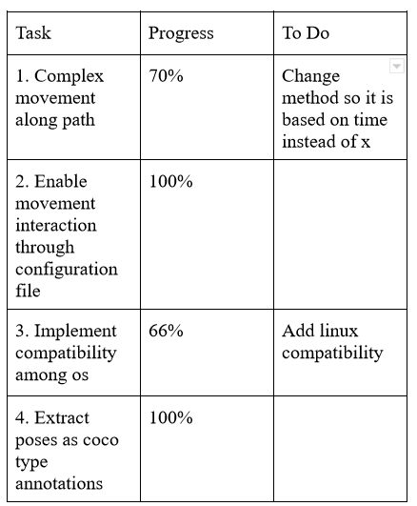
Progress Summary

Slide 10
Milestone 4
Finish adding compatibility with linux
Verify that the rotation and position angles are actually correct.
Meet with Dr. White’s team to get their opinions and test functionality for users.
Start learning neural networks
Add another function for flightpath in TOML file so we can support non-linear changes in x.

Slide 11
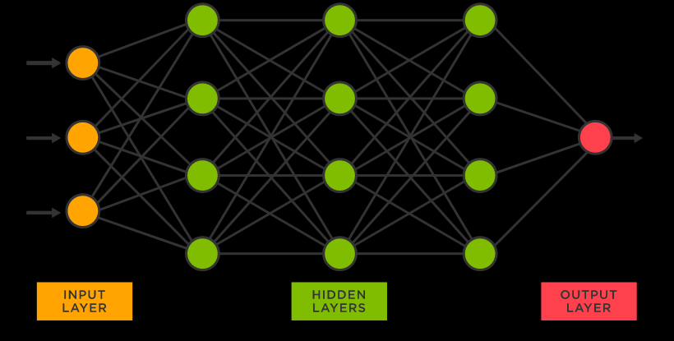
Milestone 5
Implement a neural network that can estimate the pose of the satellite based on the synthetic data that we have been generating.
Generate a variety of data using different variables for training and testing

Slide 12
Milestone 6
Improve neural network
Prepare to hand off the project to Dr. White’s team
Create poster for Senior Design Showcase
Implement, test, and demo which features/modules
Test/demo of the entire system
Conduct evaluation and analyze results
Create user/developer manual
Create demo video

Slide 13
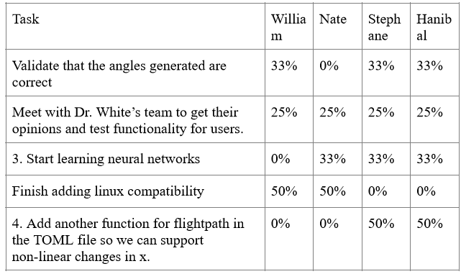
Milestone 4 Matrix

Slide 14
Thank You!
Questions?

