Slide 1

Taurus: An Intelligent Data Plane
Alexander Rucker
Tushar Swamy, Muhammad Shahbaz, and Kunle Olukotun

Slide 2
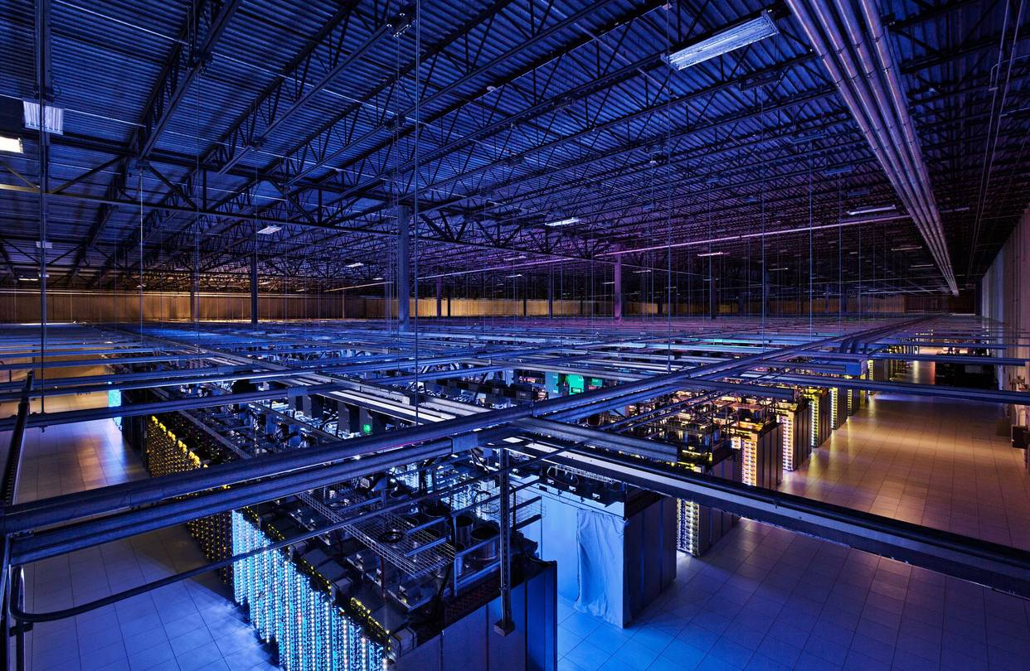






Managing networks is hard!
Cloud Computing
Internet of Things (IoT)
Augmented and Virtual
Reality (AR/VR)
Notes:
- Many application domains
Cloud computing needs availability
AR/VR network needs to be low latency
IOT is very large scale
Not feasible for humans to manage, too many heuristic and ad-hoc solutions – we should use more data driven algorithms

Slide 3
Approaches to manage networks are …
Control Plane
Intelligence
Slow but intelligent
OR
Data Plane
Switch or NIC
Fast yet dumb
Notes:
Existing approaches can be divided into two categories:
Slow and intel at Control Plane
Fast but dumb at the Data Plane

Slide 4

Approaches to manage networks are …
Characteristics:
Operates on packet scale
Low latency: ns
High throughput: Tbps
Uses heuristics: hash, …
Examples:
Congestion control
Load balancing (ECMP, RSS)
Queue scheduling
Data Plane
Switch or NIC
Fast yet dumb
Packets In
Packets Out
Notes:
High perf constraints force us to use simple heuristics
Can’t do more complex operations at the data plane

Slide 5
Approaches to manage networks are …
Control Plane
Intelligence
Slow but intelligent
OR
Data Plane
Switch or NIC
Fast yet dumb

Slide 6
Approaches to manage networks are …
Control Plane
Intelligence
Slow but intelligent
Examples:
Anomaly detection
Automation
Recommendation
Packet
Digest
Flow
Rule
Data Plane
Switch or NIC
Characteristics:
Can do machine learning
Operates on flows
Millisecond latency
Low throughput
Packets In
Packets Out
Notes:
- Distinction between packet and flow level
- Anomaly detection may miss packets at Control Plane
- Can do more complicated stuff but cant meet line rate and TP requirements

Slide 7
Approaches to manage networks are …
Control Plane
Intelligence
Slow but intelligent
OR
Data Plane
Switch or NIC
Fast yet dumb

Slide 8
Approaches to manage networks are …
Control Plane
Intelligence
Slow but intelligent
OR
Data Plane
Switch or NIC
Fast yet dumb

Slide 9
Network management should be …
Control Plane
Intelligence
Data Plane
Switch or NIC
Fast and intelligent
Notes:
We should have fast and intelligent systems that can operate at the packet granularity

Slide 10



What does “Intelligence” mean?
Networks are becoming autonomous (Self Driving Networks)
Machine learning (ML) will play a key role in the future of networks [1,2,3]
Security
Control
Analytics
Notes:
Start with ML Inference == Intelligence

Slide 11
ML Inference: Neural Networks
Inputs
Outputs
Notes:
- Let’s look at one of the more popular classes of ML algorithms
- What is a neural network?
- Weighted heuristic

Slide 12
ML Inference: Neural Networks
Inputs
Outputs
Notes:
Let’s focus on one neuron

Slide 13
ML Inference: Single Neuron
x0
W0
*
+
x1
W1
*
G(z)
+
+
x2
W2
*
Activation
+
x3
W3
*
Input
Features
B
Neuron
Weights and Bias
Notes:
Elem wise mult
Additions

Slide 14
Can match-action tables perform ML inference?
Packet
Parser
Match-Action
Tables
Traffic
Manager
Packets In
Packets Out
Notes:
- Why no MAT for ML:
Too many operations: Arithmetic intensity is too high
Not enough intermediate storage in PHV
Let’s revisit the neuron example and see what we would need to support

Slide 15
ML Inference: Single Neuron
x0
W0
*
+
x1
W1
*
G(z)
+
+
x2
W2
*
Activation
+
x3
W3
*
Input
Features
B
Neuron
Weights and Bias
Map: Element-wise
multiplication
Reduce: Addition
using a tree
Notes:
Mult looks like a map
Additions look like a reduction
We should support Map and Reduce parallel patterns

Slide 16
Taurus: An Intelligent Data Plane
Packet
Parser
Match-Action
Tables
Map Reduce
Unit
Match-Action
Tables
Traffic
Manager
Packets In
Packets Out
Notes:
Mention that this is VLIW + SIMD
We are NOT replacing MAT.
How do we build Map Reduce hardware

Slide 17
Building blocks of Taurus: Map-Reduce
Compute Units
Memory Units
Data In
CU
MU
CU
Data Out
MU
CU
MU
Data In
CU
MU
CU
Data Out
Notes:
- Reconfigurable grid of compute and memory units based on Plasticine architecture

Slide 18
Building blocks of Taurus: Map-Reduce
Data In
CU
MU
CU
Data Out
MU
CU
MU
Data In
CU
MU
CU
Data Out
Notes:
Single neuron can be built with mem + compute unit
Tiles are to scale out to larger, more complex algorithms

Slide 19
Compute unit design
Taurus CUs are array based:
Functional Units (FUs)
Pipeline Registers (PRs)
STAGE 0
STAGE 1
STAGE 2
LANE 0
FU
PR
FU
PR
FU
PR
CU
LANE 1
FU
PR
FU
PR
FU
PR
LANE 2
FU
PR
FU
PR
FU
PR
LANE 3
FU
PR
FU
PR
FU
PR
Notes:
Stages- > pipeline parallelism
Lanes -> parallel operation
- Leads to map operations
- Takeaway: lots of parallelism leads to faster execution

Slide 20
Reduction network condenses vectors to scalars
STAGE 0
STAGE 1
STAGE 2
LANE 0
FU
PR
FU
PR
FU
PR
LANE 1
FU
PR
FU
PR
FU
PR
LANE 2
FU
PR
FU
PR
FU
PR
LANE 3
FU
PR
FU
PR
FU
PR
Notes:
- Cross lane connections allows for a reduction tree

Slide 21
Taurus: An Intelligent Data Plane
Packet
Parser
Match-Action
Tables
Map Reduce
Unit
Match-Action
Tables
Traffic
Manager
Packets In
Packets Out
Notes:
- Pipeline is a collection of DSAs

Slide 22
Example: Anomaly Detection
Packet
Parser
Match-Action
Tables
Map Reduce
Unit
Match-Action
Tables
Traffic
Manager
Packets Out
Packets In
Packet
Read local features
(e.g., IP address)
Retrieve out of
network events
(e.g., failed
logins per IP)
Apply learned anomaly detection
Select a port or action
(e.g., drop if score == 1)
Send packet
to destination
Notes:
Spend more time here

Slide 23
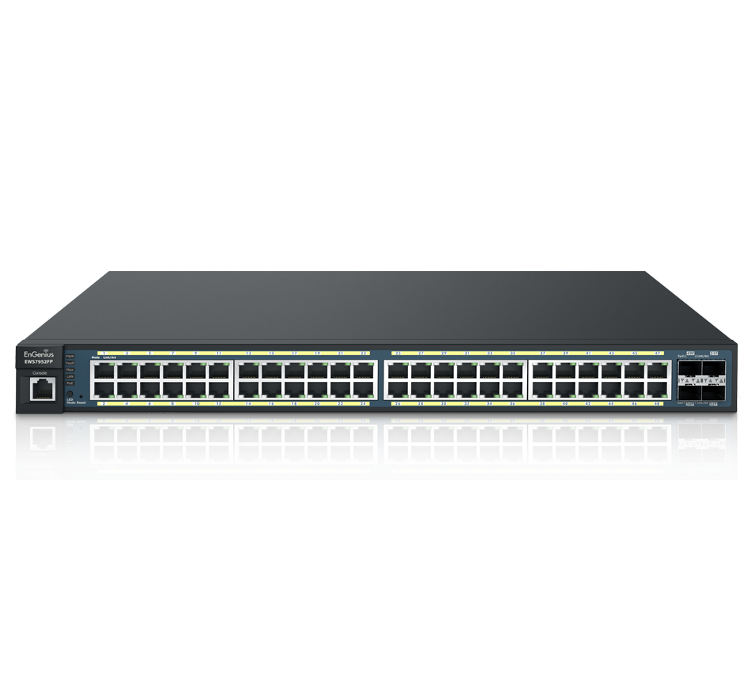
Evaluation: Anomaly Detection in Switches
Taurus examines every packet at every switch
Additional latency is less than port to port latency
Area
Power
Model
TP (GPkt/s)
Lat (ns)
+%
+%
SVM
1
68
6.1
1.1
DNN
1
362
11.7
2.0
*Overheads are calculated relative to a 300 mm² chip with 4 reconfigurable pipelines, each drawing an estimated 25 W
Notes:
- Simple networks not large CNNs
- Two key things: meeting line rate and area increase is minimal
- Get all this perf for little area and power

Slide 24
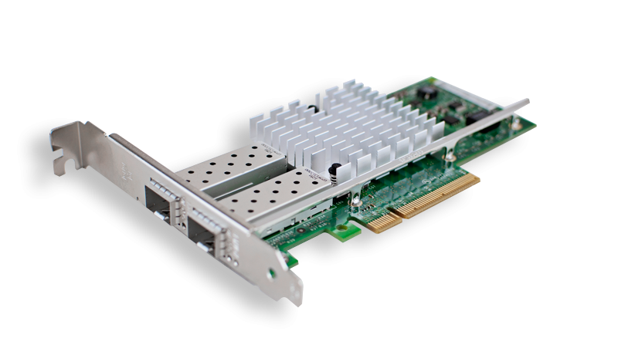
Evaluation: Congestion Control at the NIC
Indigo Congestion Control LSTM Network [7]
Taurus updates every 12.5 ns (software updates every 10 ms)
Area
Power
Model
TP (GPkt/s)
Lat (ns)
+%
+%
LSTM
0.08
380
23.6
4.1
*Overheads are calculated relative to a 300 mm² chip with 4 reconfigurable pipelines, each drawing an estimated 25 W
Notes:
- Taurus data plane is also applicable to end host
- Took work that relies on CPU because of lack of NIC HW
- Show that Taurus is needed for us scale events - allows for more fast reaction
Talk: Go from ms to ns

Slide 25
Conclusion
Taurus: An Intelligent Data Plane
Introduces map and reduce to PISA
Designed to run ML inference inside a data plane
Provides orders of magnitude improvement
Notes:
Given this arch, looking forward to new ML algos
Taurus extends programmability footprint. RMT/PIFO just makes existing HW programmable. We add new forward looking functionality for ML

