Slide 1

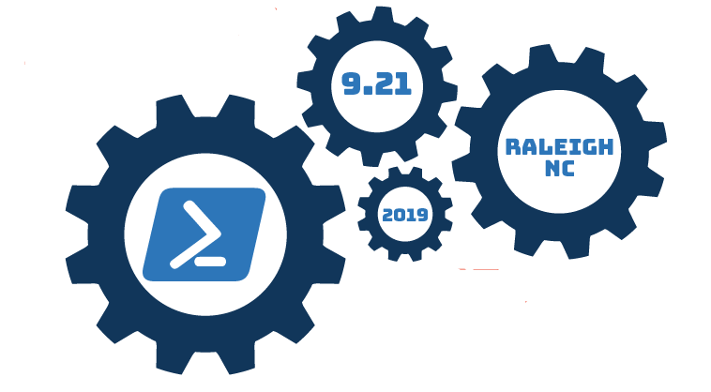
Using Dbatools To Automate Database Migrations

Slide 2


Slide 3

whoami
Joshua Corrick (@joshCorr)
https://Corrick.io/blog
Systems Engineer
Accidental DBA
Passionate about PowerShell
Major Contributor to Dbatools

Slide 4
Who are you?

Slide 5
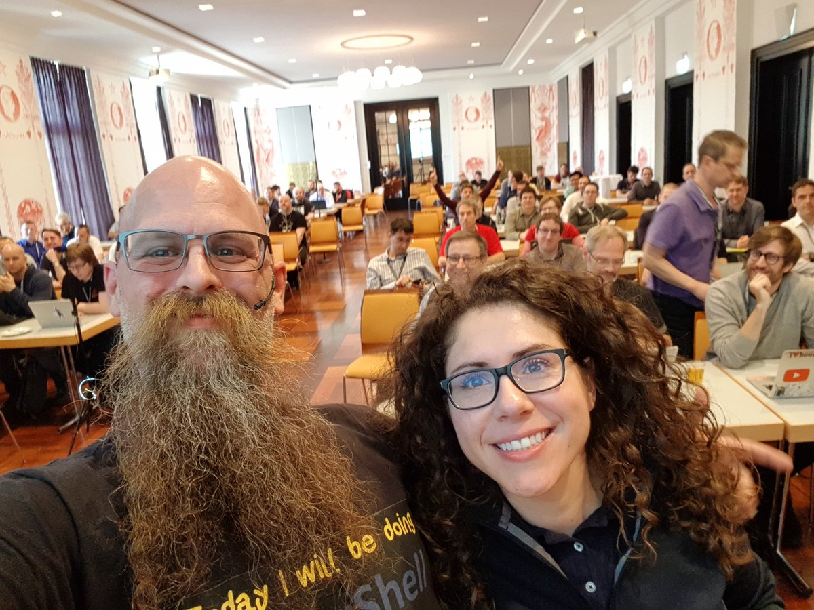
What is Dbatools?
A tool set for managing MS SQL Servers
It is written in PowerShell and is an open sourced module
https://Dbatools.io
Written by @cl (Chrissy LeMaire), @sqldbawithbeard (Rob Sewell) and a handful of others
https://twitter.com/sqldbawithbeard/status/986235166560419841
Notes:
Benevolent Dictator for Life..

Slide 6

But isn’t there something already?
Yup..
Sqlcmd – not PowerShell
Minishell - SQLPS.exe
SQLServer Snapin
SMO
SQLServer Module (2014-present)
https://github.com/ashleymcnamara/Developer-Advocate-Bit/blob/master/This_Is_Fine_Bit_Flat.png
Notes:
SQLCMD tool originally designed for interacting with the database only, used OBDC driver. Minishell was not a fan favorite as it was restrictive and buggy (based on PowerShell2.0). Snapins were a PowerShell 2.0 method. SQL Management Objects (SMO) objects are the preferred objects used by SSMS for any custom plugins (Also used by PowerShell). SQLServer Module was buggy, Slowly developed, Invoke-SQLCmd was slow, and buggy. (Although it has gotten better last release 13 hours ago, but 2 months before).

Slide 7
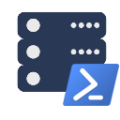
What make Dbatools different?
Community built (~160 contributors)
Open to user review (on Github)
Code Signed (only by Chrissy)
Codifying best practices
Focus on ease of use
Automates all the things
Notes:
Community built means that actual product users create the tools they need. The code is not compiled (like the SQLServer module) so security teams may review each cmdlet. By writing cmdlets like Test-DbaPowerPlan it reminds the community of best practices. One of the best things to automate is Database migrations
dbatools aims to support as many configurations as possible, including
PowerShell v3 and above
Windows, macOS and Linux
SQL Server 2000 - 2017
Express - Datacenter Edition
Clustered and stand-alone instances
Windows and SQL authentication
Default and named instances
Multiple instances on one server
Auto-populated parameters for command-line completion (think -Database and -Login)

Slide 8
Demos
Getting Dbatools
Migrate some Databases
Migrate some more Database
Talk about a bit of the internals
Some Offline Alternatives

Slide 9
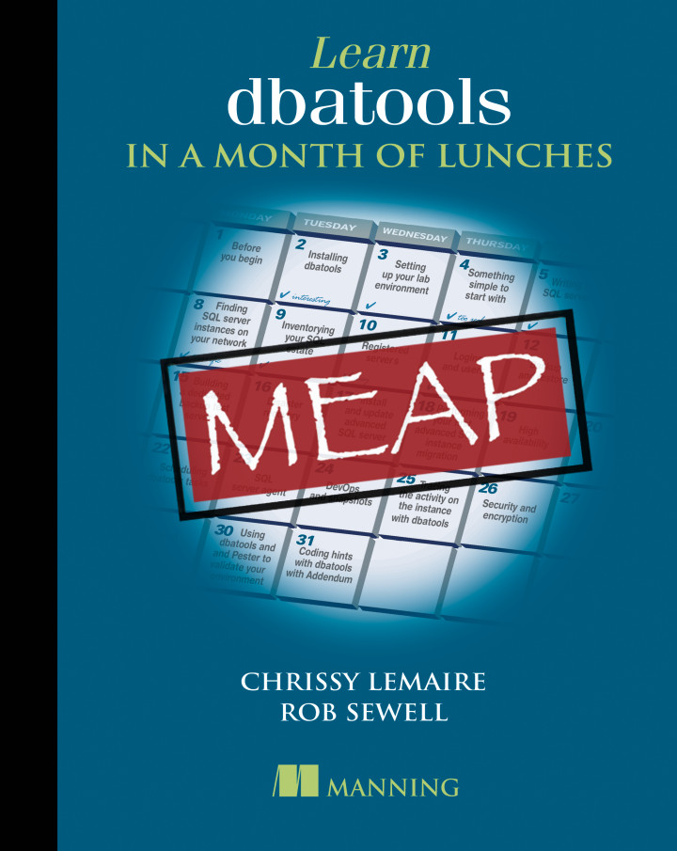
Resources
Dbatools.io
Dbatools.io/Github
Aka.ms/sqlslack
#Dbatools
#Dbatools-Dev
“Dbatools in a month of lunches”
Manning MEAP
https://github.com/sqlcollaborative/community-presentations

