Slide 1
Creating and Maintaining Successful Open Source Projects
Chrissy LeMaire & Rob Sewell

Slide 2
About_Author
Chrissy LeMaire
PowerShell MVP
Creator of dbatools.io
Open source advocate for over 20 years
Rob Sewell
PowerShell advocate
Creator of dbareports.io
Bell ringer

Slide 3
Agenda
Stats
Technical
Documentation
People
Challenges
Rewards
Notes:
No code

Slide 4
dbatools stats – since April 2016
52 contributors to GitHub Repository
275 ★ on GitHub
650 Slack members
14 conference speakers
20+ public presentations in 14 countries
15,000 ScriptCenter downloads
12,000 website downloads
7,000 PowerShell Gallery downloads
*
**
Notes:
That’s about 1/3 of contributors as PowerShell itself!

Slide 5
Technical bits

Slide 6
If you build it...
Build something cool first
Notes:
This sorta goes under people but….
Solve people’s problems
But make sure you LOVE what you’re working on
Use a popular programming language
And try to build it for backwards compat so that adoption is widespread and appreciated by the unfortunate

Slide 7
choosealicense.com
GNU GPL is old school cool but restrictive
MIT is permissive and very popular
Notes:
Decide on a license and include it in your repo
We picked GPL to start to be a little more protective
PowerShell itself is licensed under MIT
MIT is 44%
Diff variations of GPL is 25%
BSD

Slide 8

Make your project fun & accessible
Hype your project with a website,
a cool logo, presentations, and some stickers
Notes:
Oh, and name it too
Presentations help you find contributors
Pre-record webinars if you want Guerillatalks will support you with that how to deal with questions how to deal with being shy not everyone can do it - its ok

Slide 9
GitHub
Share your code on GitHub
Notes:
Talk about Microsoft’s open source direction
GitHub’s default license is restrictive – which is a good thing
“Without a license, the default copyright laws apply, meaning that you retain all rights to your source code and no one may reproduce, distribute, or create derivative works from your work.” - https://help.github.com/articles/licensing-a-repository

Slide 10
GitHub Organizations
We eventually grew into a GitHub organization
We needed more robust repo management
Turns out many people trust repos in orgnization more than they do standalone developer repos

Slide 11
Open source PowerShell project?
Make it a module & the root of your repo
Use a unique PowerShell prefix
Include an easy installer

Slide 12
GitHub lesson learned
Point your auto-installer to your website
iex (iwr https://git.io/vS5Ky)
vs
iex (iwr https://dbatools.io/in)
Notes:
GitHub’s stats don’t show you how many people downloaded your zips ☹ Only releases and forks
dbatools.io/in redirects to GitHub repo’s install.ps1
install.ps1 even includes a link to dbatools.io/zip which then redirects back to the master git zip

Slide 13
We were missing out on PS stats too!
PowerShell v3 - 15%
PowerShell v4 - 42%
PowerShell v5 - 42%
PowerShell v6 – .07%
Notes:
dbatools.io/in redirects to GitHub repo’s install.ps1
install.ps1 even includes a link to dbatools.io/zip which then redirects back to the master git zip

Slide 14
PowerShell Gallery
Share your code on PowerShell Gallery
* You don‘t have to wait until it‘s perfect

Slide 15
Slack
dbatools took off after joining Slack
We piggyback on SQL Server Community Slack
640+ people have joined
Great place for providing tech support
Greater place for you and your fellow developers to hang out and discuss design

Slide 16
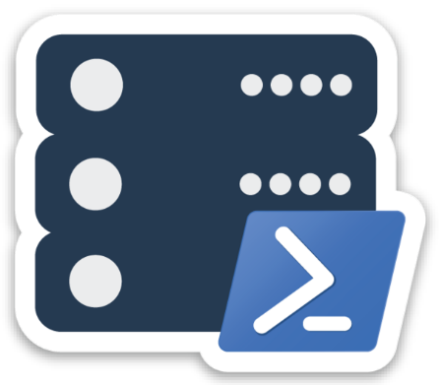
Vendors we use
Registrar: google.com/domains
Hosting: wordpress.com with custom domain
CloudFlare: pretty DNS, cool API, easy SSL
Stickers: StickerMule has best rep
Logos: 99designs.com
Notes:
I don’t actually use wordpress.com but I would if I didn’t have an SSD VPS with KnownHost
Custom domains for Wordpress.com is 2.99 to 8.95 a month – bluehost and many others are slow
CloudFlare is free and protects against DDOS

Slide 17
Documentation

Slide 18
Your audience
End-users
Contributors

Slide 19
End-users
PowerShell Help
Pester tests can ensure each command is properly documented
WordPress is awesome for online documentation
Auto-redirects and shortlinks are easy
Can add media like screenshots and videos
Link to GitHub source of command
Searchable
Case-insensitive
Add link for –Online

Slide 20
Developer docs
Assume your developers don‘t know GitHub
dbatools.io/firstpull
dbatools.io/firstpullvideo
GitHub.com‘s built-in wiki is useful for developer-centric docs
contributing.md is important
Notes:
Some people learn dif, so I gave them two different ways to learn.
Also, for people who download the slides:
https://www.smashingmagazine.com/2013/01/starting-an-open-source-project/
DEVELOPER GUIDE Even if you’ve laid out the code in a logical manner and have decent end-user documentation, contributions are not guaranteed to start flowing. You’ll need a developer guide to help get contributors up and running as quickly as possible. A good developer guide covers the following: How to get the source code Yes, you would hope that contributors would be familiar with how to check out and clone a repository, but that’s not always the case. A gentle introduction to getting the source code is always appreciated. How the code is laid out Even though the code and directory structures should be fairly self-explanatory, writing down a description for posterity always helps. How to set up the build system If you are using a build system, then you’ll need to include instructions on how to set it up. These instructions should include where to get build-time dependencies that aren’t already included in the repository. How to run a build These are the steps necessary to run a development build and to execute unit tests. How to contribute Spell out the criteria for contributing to the project. If you require unit tests, then state that. If you require documentation, mention that as well. Give people a checklist of things to go over before submitting a contribution.

Slide 21
contributing.md
The PowerShell team has a great contributing.md
Our contributing.md contains
Encouragement
Reasons to contribute
Ways to contribute
Where to find us
How we like people to add new commands
How we do bug triage

Slide 22
People
Treat all your contributors as if they are the most valuable resource, and they will respond by becoming your most valuable resource ~ Eric S. Raymond

Slide 23
Incentivise contributions
dbatools:
Ensures each developer adds their name to each command they create
Links each developer‘s blog/Twitter/LinkedIn on their command‘s Help page
Has a team page with pictures and backlinks
Highlights presentations on the website

Slide 24
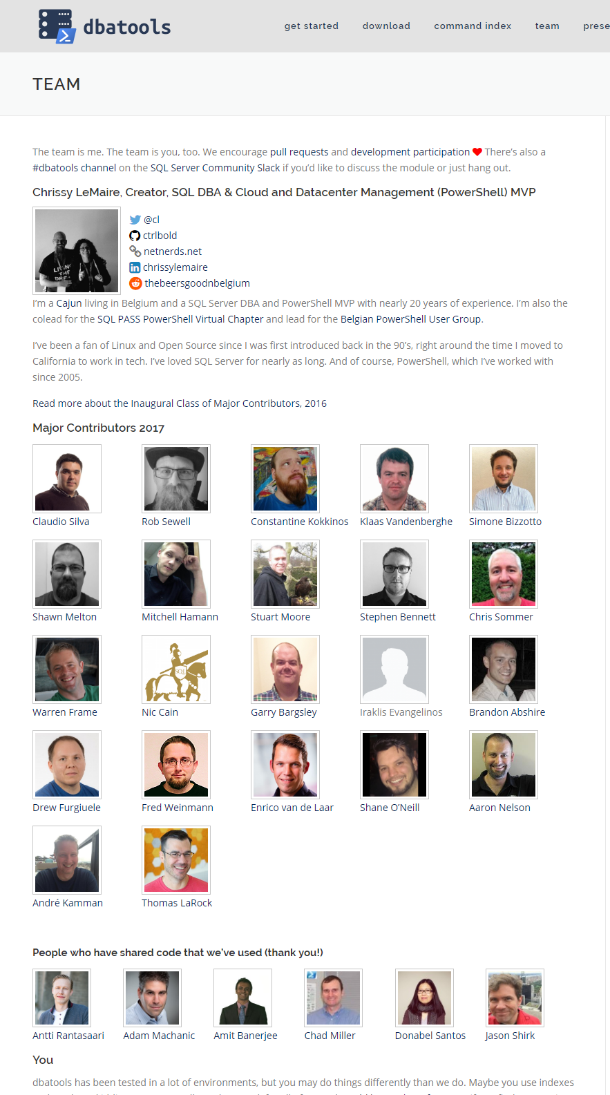
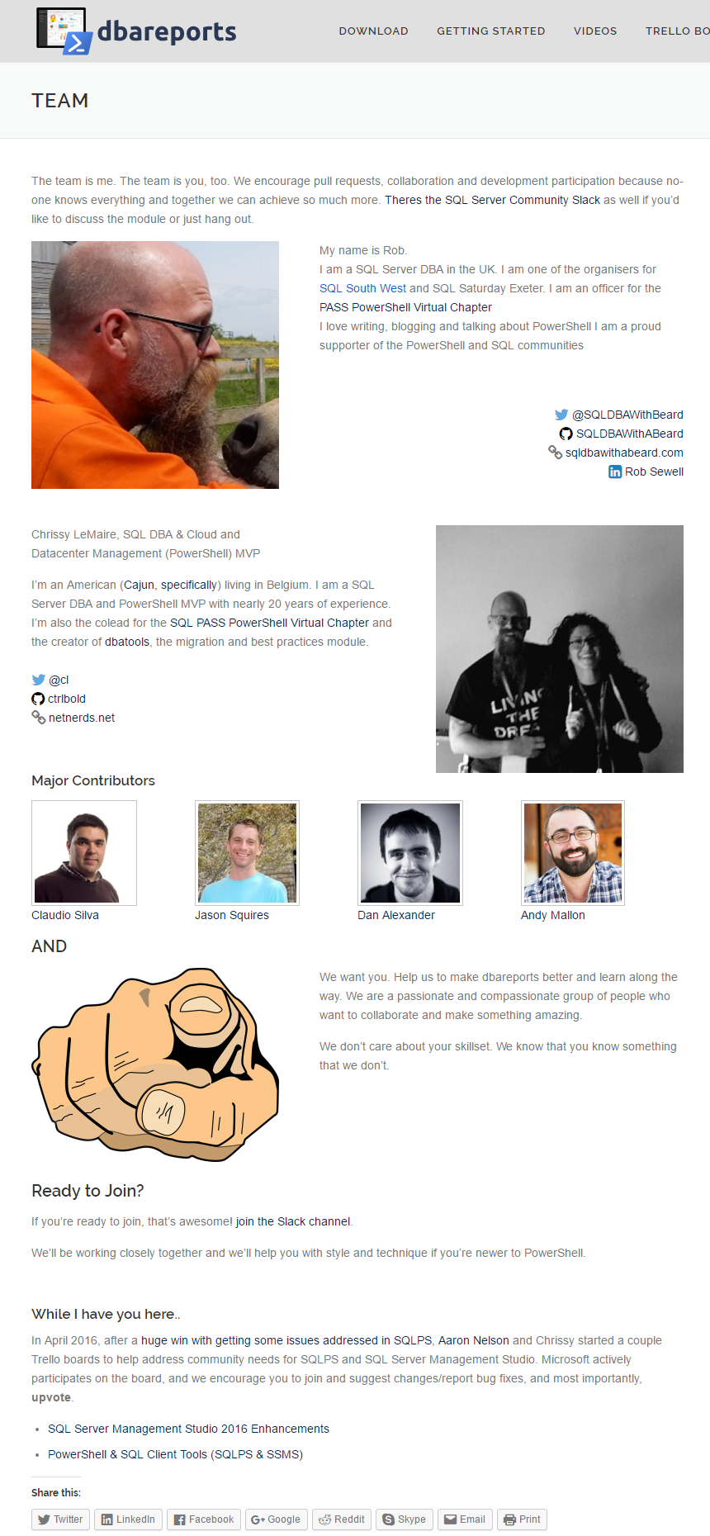
Give your major contributors a face

Slide 25
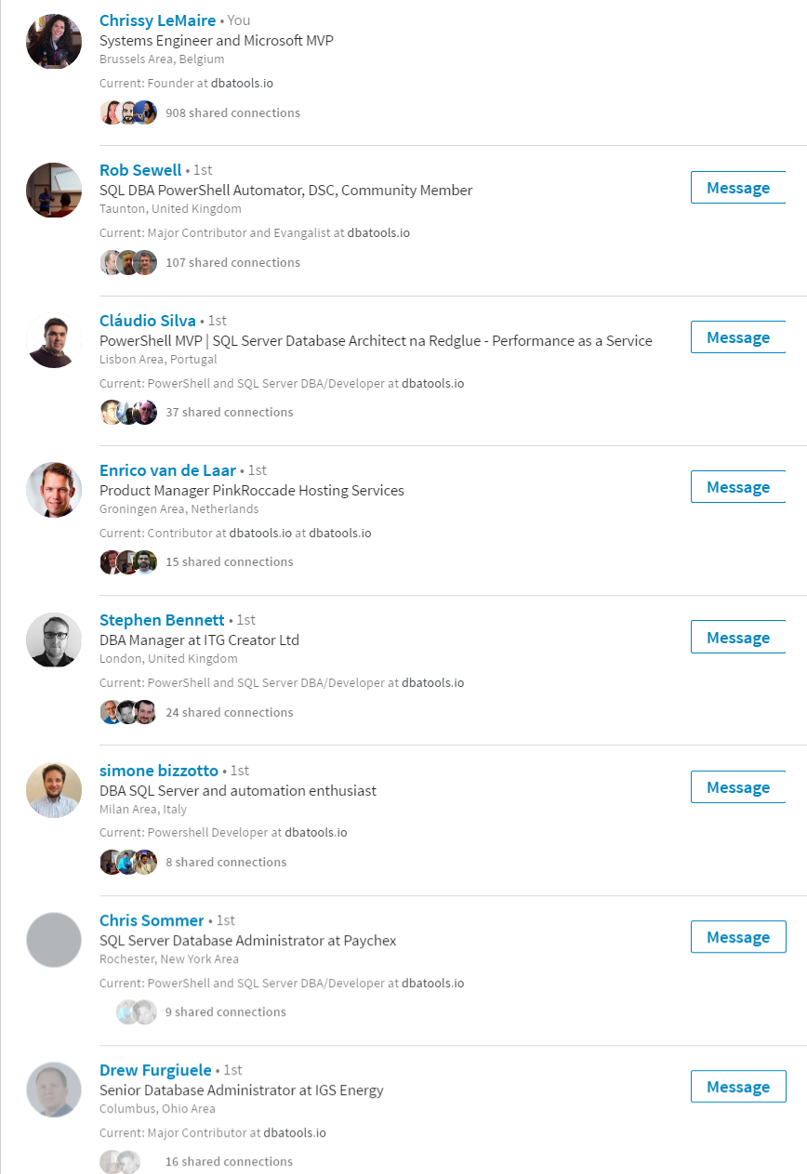
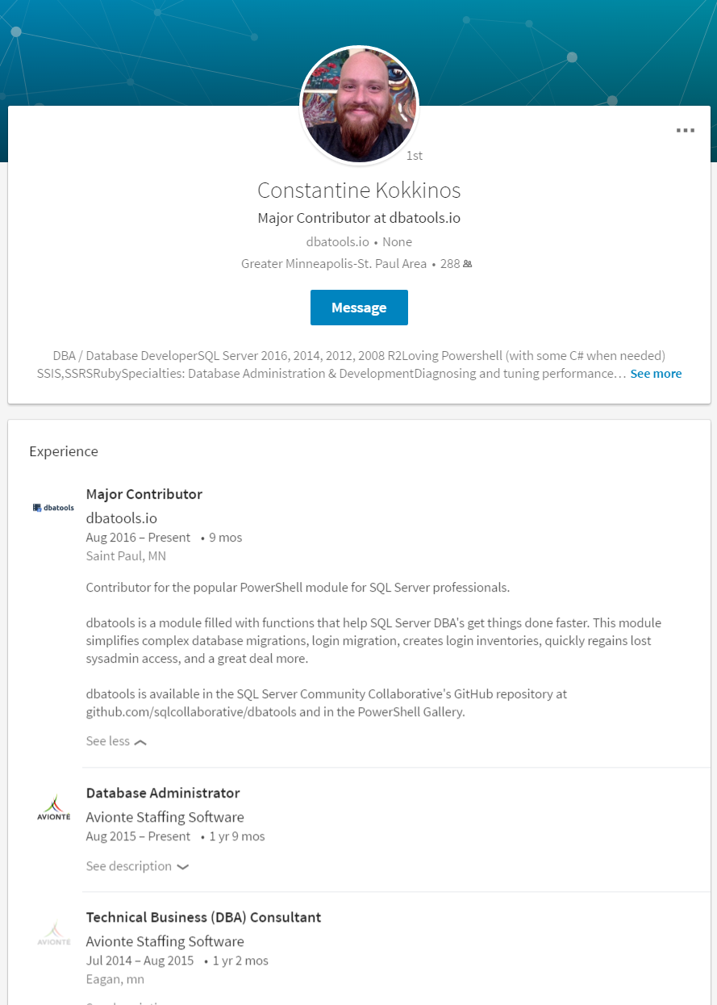
Give them career opportunities
Notes:
I was surprised at our developers’ interest in having dbatools on their linkedin
Being a major contributor also lets them speak with authority at conferences

Slide 26
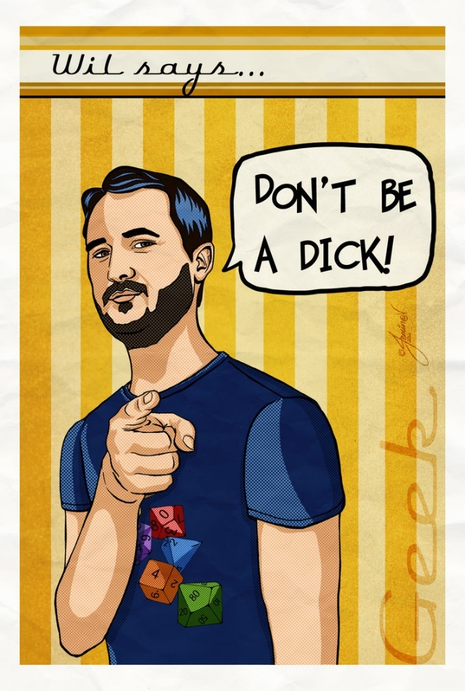
Be nice
Notes:
But it goes further than that

Slide 27
Be nice
"..be really, abnormally, really, really kind & don’t be mean" ~ Max Kanat-Alexander
Notes:
being nice is a tenant of our code reviews
Encourage your team to be nice & enforce kindness

Slide 28
But be firm
It’s tempting to allow the diminishment of quality to avoid hurt feelings
Protect your brand – if you don’t like something, don’t allow it

Slide 29
Look for strengths
Dan
CK
Garry
Stuart
Notes:
Note that I asked Stuart “not all contributors come to you”.

Slide 30
Understand that people will leave
Unexpected events
Expected events
Work obligations
Loss of interest
Burnout
Notes:
Which brings us to….

Slide 31
Challenges Maintainers Face
“My condolences, you’re now the maintainer of a popular open source project” ~ Daniel Bachhuber
Notes:
https://runcommand.io/2016/06/26/my-condolences-youre-now-the-maintainer-of-a-popular-open-source-project/

Slide 32
Contributor vs. Maintainer
Contributing is a form of short-term participation.
Maintaining is taking long-term ownership over a particular aspect of a project. In this equation, maintaining is greater than contributing both in level of reward, but also effort, commitment, and emotional involvement.
Notes:
From: https://danielbachhuber.com/2016/06/26/my-condolences-youre-now-the-maintainer-of-a-popular-open-source-project/

Slide 33
Feelings, particularly hurt feelings
Deal with hurt feelings directly & immediately
Validate their right to feel hurt
Be supportive, not dismissive
Try to understand why they feel the way they do
Don‘t take it personally
Create a universal style guide
It helps clarify style
But it also helps ensure developers don‘t feel treated unfairly by your requirements / code reviews
Notes:
it might be hard for you to deal with someones hurt feeling - maybe reach out ot one of your other contributors

Slide 34
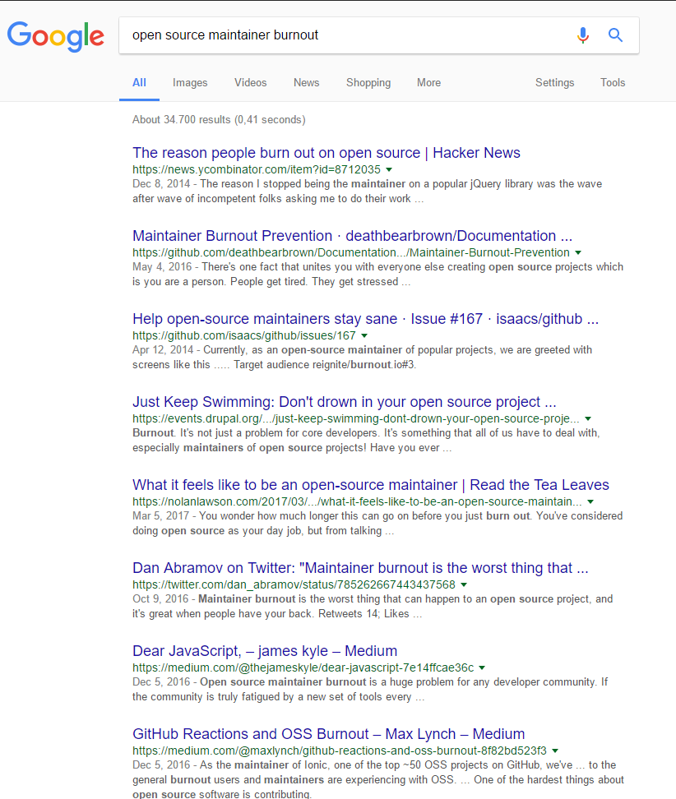
Burnout

Slide 35
Burnout
Absence of progress
Issue and PR pile-up
Guilt
Notes:
https://medium.com/@oleg008/fighting-burnout-with-open-source-ba87559ad844

Slide 36
Rewards
“Need a good quote here” ~ Chrissy LeMaire
Notes:
Jk on the quote, need a good one

Slide 37
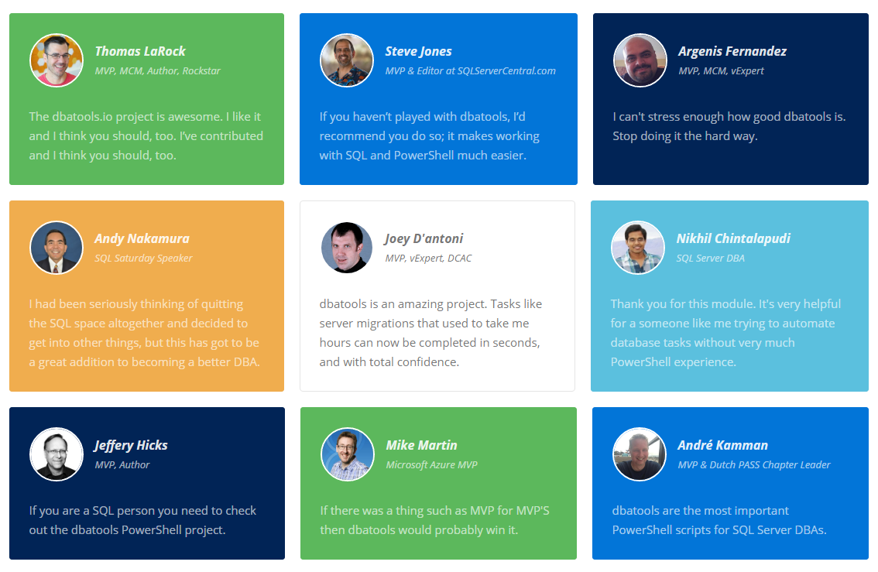
Positive reinforcement

Slide 38
Knowledge & Skills
PowerShell
SQL Server
GitHub
DevOps

Slide 39
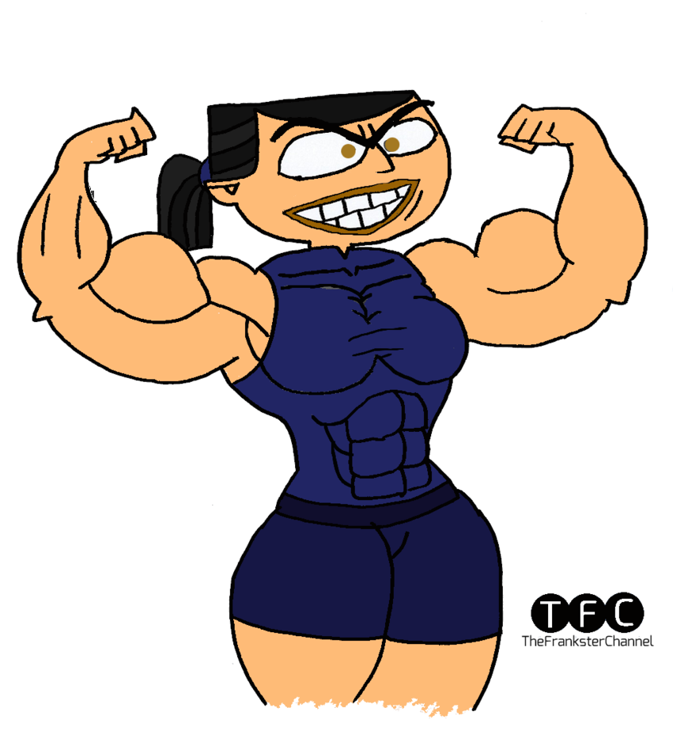
Personal Satisfaction & Confidence

Slide 40
Reputation & Opportunities
Consulting
Book writing
Presentations and pre-cons
Enterprise license agreements
Notes:
People often ask “how can open source developers make money?”

Slide 41
Summary
Make something awesome
License and share it
Be nice
Reap the rewards of OSS maintenance

Slide 42
References
Open Source Community, Simplified
Maintaining Open Source Projects
How to maintain a successful open source project
Leadership, Guilt and Pull Requests
The legacy of Pieter Hintjens
Notes:
Contributing Template: https://github.com/contribute-md/
Enforcing contribution stuff: https://gitmagic.io/

Slide 43
Next Steps...
Now: 15 min break
Grab a coffee
Stay here to enjoy next presentation
Change track and switch to another room
Ask me questions or meet me in a breakout session room afterwards

Slide 44
Questions?

Slide 45
Versioning
At some point, understand
branching, versioning & release tagging
semver.org
Notes:
http://nvie.com/posts/a-successful-git-branching-model/ too

Slide 46
Localization
Localization is challenging, but if you’ve got contributors from around the world, you’ve got native speakers who can help.
Notes:
But ultimately, make it easy to install and update

Slide 47
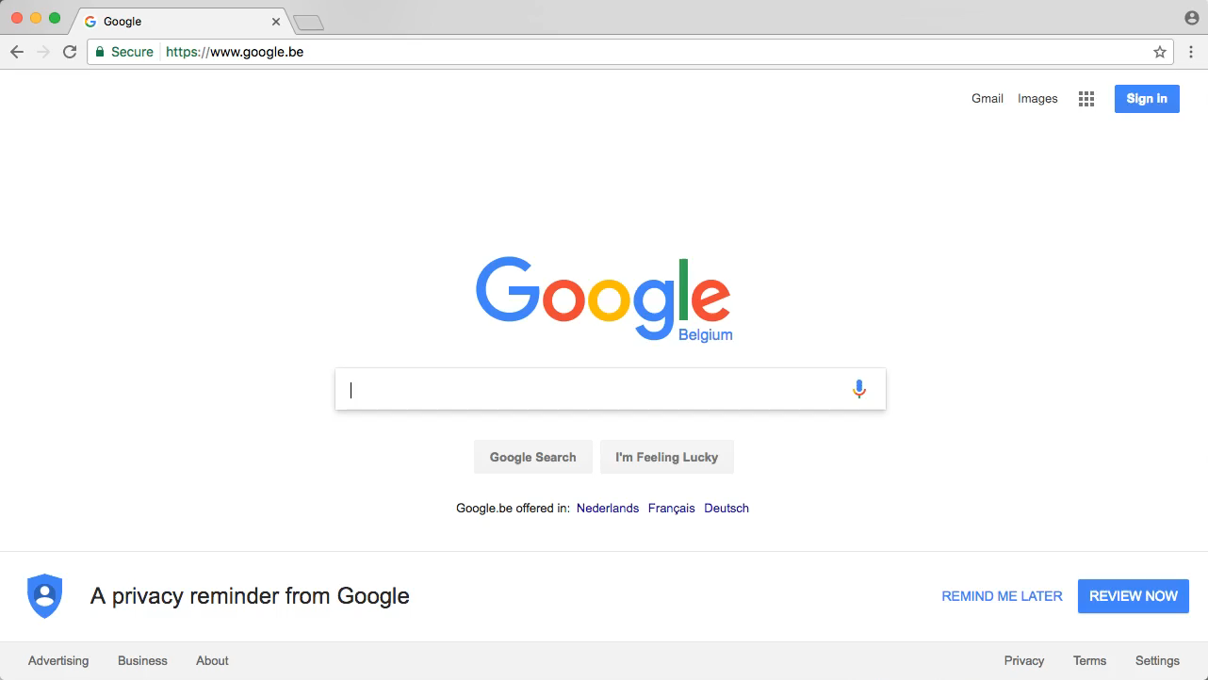
End-user docs & WordPress

