Slide 1
Making PowerShell Useful
Real-Life Examples of Powershell in Action

Slide 2



Who am I?
Email: mrrobsewell@outlook.com
Profile:
Rob Sewell
Twitter: sqldbawithbeard
Blog:
sqldbawithabeard.com
Notes:
Just to show you how to contact me – You don’t need any more than that

Slide 3
Why use PowerShell?
AUTOMATE EVERYTHING
I read a post by @SQLBrit The Best DBAs Automate everything
I automate as much as is feasibly possible mostly through PowerShell
Backups and restores through Dev/SAT/FAT/UAT/Live environments
Daily Backup Checks, Drive Space Checks, Service Running Checks, File Space Checks, Failed Agent Job Checks, SQL Error Log Checks, DBCC Checks and more
The Answer?
WARNING – PowerShell is not the ONLY resource you should use
Notes:
Automation is the use of machines, control systems and information technologies to optimize productivity in the production of goods and delivery of services
In the October 2009 issue of TechNet Magazine, Microsoft says, "It's safe to say that the single most important skill a Windows administrator will need in the coming years is proficiency with Windows PowerShell."

Slide 4
Demo

Slide 5










Please Visit Sponsors & Enter Raffles

Slide 6
Where Can I Find Out More?
Windows PowerShell Reference on MSDN
http://powershell.org/
Hey Scripting Guy
Powershell Magazine
Script Center
Pluralsight
Laerte Junior
Simple Talk
DBA Stack Exchange
PowerShell Gallery
Your favourite Search Engine
Your favourite Social Media
Powershell Slack Channel
#pstweetchat – every 1st Friday
http://sqlps.io/vote Your Input to Microsoft for SQLPS
http://sqlps.io/ssms Your Input to Microsoft for SSMS

Slide 7
Hopefully
You have learnt
You can use Powershell
How to create a function
CTRL + J
How to pass on Knowledge to your team
Source Control
Script Analyser and Pester
Where to go for more help

Slide 8
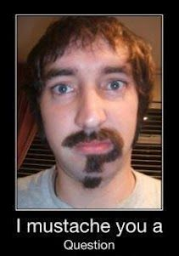
Questions

Slide 9
Contact Me
Email: mrrobsewell@outlook.com
Profile:
Rob Sewell
Twitter: sqldbawithbeard
Blog:
sqldbawithabeard.com
Notes:
Just to show you how to contact me – You don’t need any more than that

Slide 10
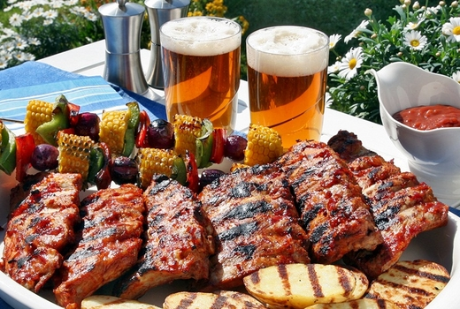
Coming up Next
Awesome Raffle Prizes
Free Beer and BBQ from 17:00

