Slide 1

The 6 P’s Powershell Profile Prepares Perfect Production Purlieu
Rob Sewell @sqldbawithbeard http://sqldbawithABeard.com
Notes:
I will be tweeting links as we go

Slide 2
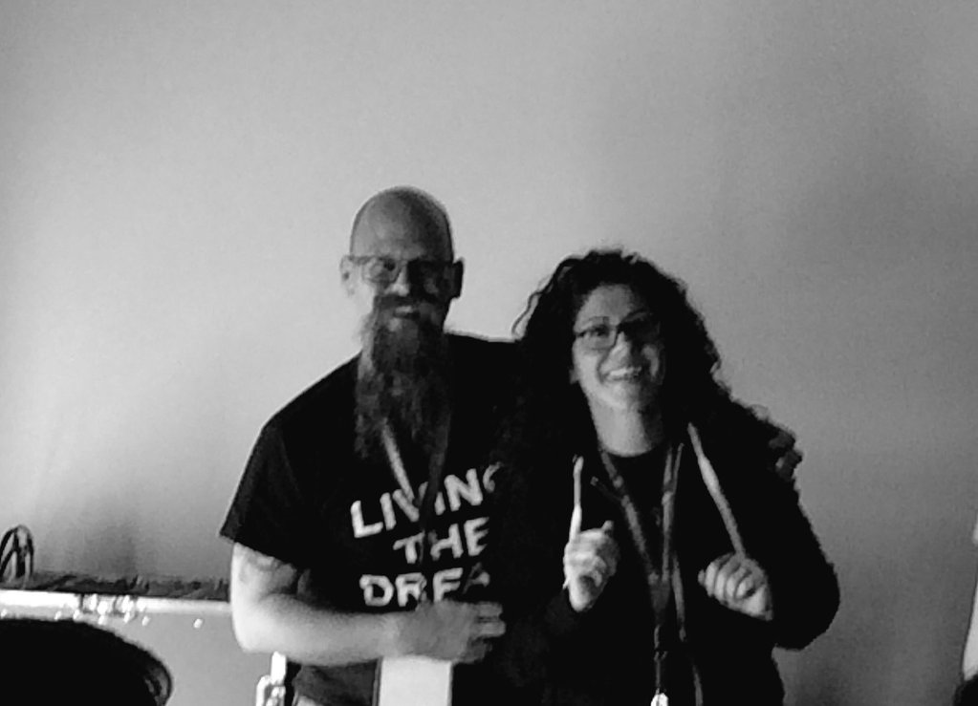
Speaker Questionnaire
Name : Rob
Occupation : DBA
Interests : PowerShell, Automation And SQL (PaaS geddit?)
Website : sqldbawithAbeard.com
Twitter : @sqldbawithbeard
Interesting Fact : Has a Beard
Speaker : SQL Saturdays, SQL Relay, PowerShell Conference EU
Community : SQL South West , SQL Saturday Exeter , PowerShell Virtual Chapter Officer, contributor to dbatools
http://sqlsouthwest.co.uk
Thanks
@fatherjack
@Mrs_Fatherjack
http://dbatools.io
Thanks
@cl
http://powershell.sqlpass.org
Thanks
@sqlvariant
@cl
@laerteSQLDBA

Slide 3
So What’s A Purlieu?
Definition of purlieu
an outlying or adjacent district
a frequently visited place : haunt
http://www.merriam-webster.com/dictionary/purlieu
Notes:
For the purposes of this Presentation it is the place that you work – IE your PowerShell CMD or ISE window

Slide 4
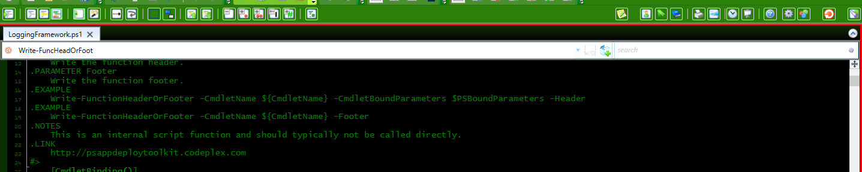

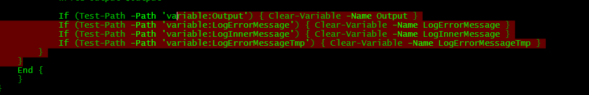


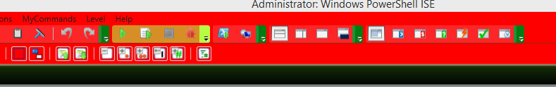
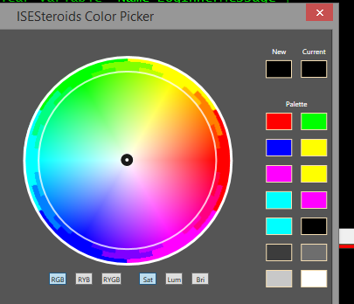
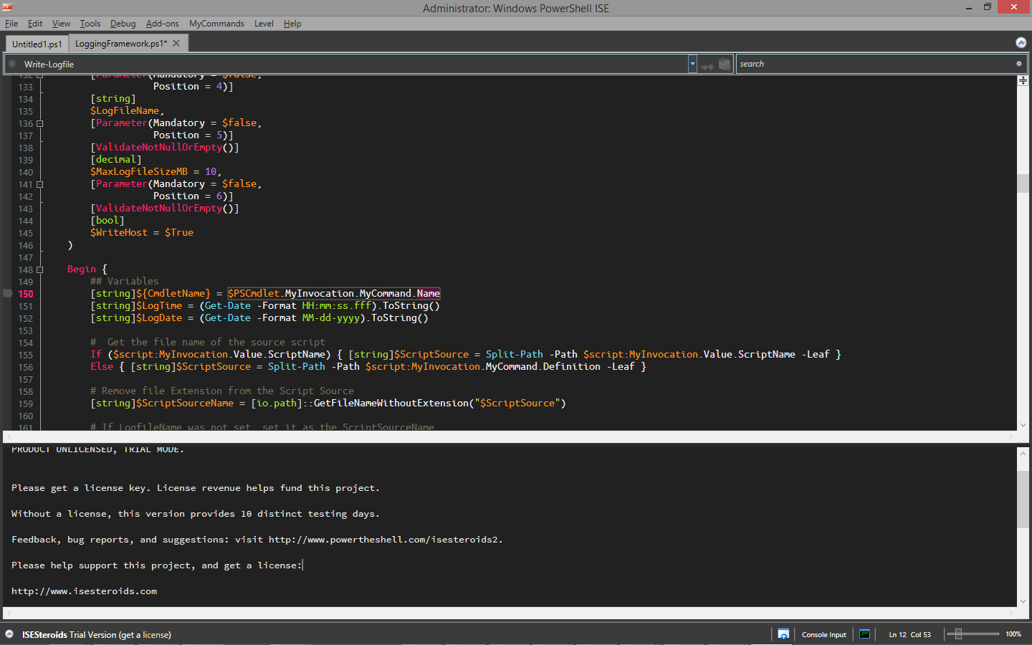
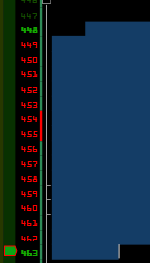

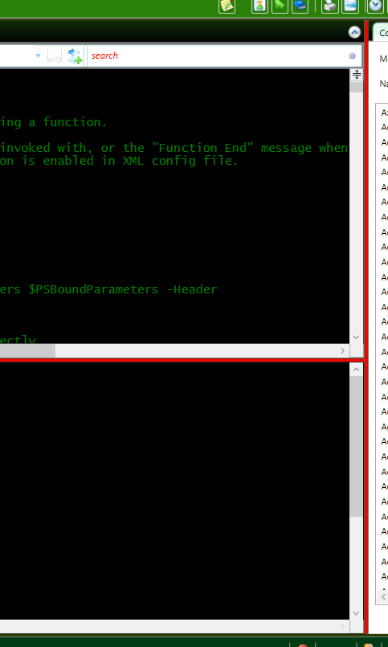

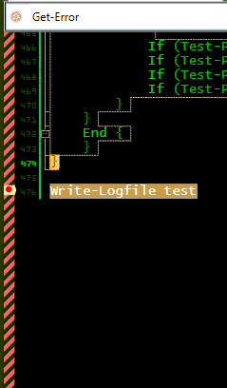
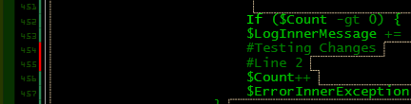

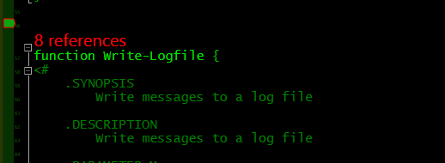
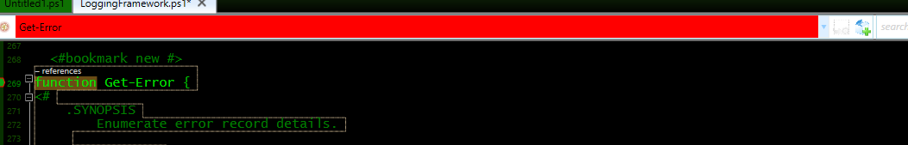

The 6 P’s
Proper Preparation Prevents Pretty Poor Performance
Images from http://brandonpadgett.com/powershell/isesteroids-theming/
Notes:
The army have a ruder version!
Your PowerShell profile loads every time you open PowerShell or PowerShell ISE
Powershell.exe –noprofile to start without a profile.
Do this when you are developing and testing code
Use your profile to create the environment that you want to work in
It could be the colours as shown or functions or shortcuts – There are a lot of options!
Use your profile delivered by GPO to create the environment you want your team to work in
There are many tools and add-ins you can use but make them work for you like Brandon has done with ISESteroids here

Slide 5
But there are 6 Profiles
Current User, Current Host – console $Home\Documents\WindowsPowerShell\Microsoft.PowerShell_profile.ps1
Current User, All Hosts $Home\Documents\Profile.ps1
All Users, Current Host – console $PsHome\Microsoft.PowerShell_profile.ps1
All Users, All Hosts $PsHome\Profile.ps1
Current user, Current Host – ISE $Home\Documents\WindowsPowerShell\Microsoft.PowerShellISE_profile.ps1
All users, Current Host – ISE $PsHome\Microsoft.PowerShellISE_profile.ps1
$Home\Documents\WindowsPowerShell\Microsoft.PowerShellISE_profile.ps1
Notes:
There are 6 Profiles as described above enabling you to control the environment in a various of manners
However in general and for this presentation we will only be focusing on two – The Current User Current Host for ISE and for the console

Slide 6
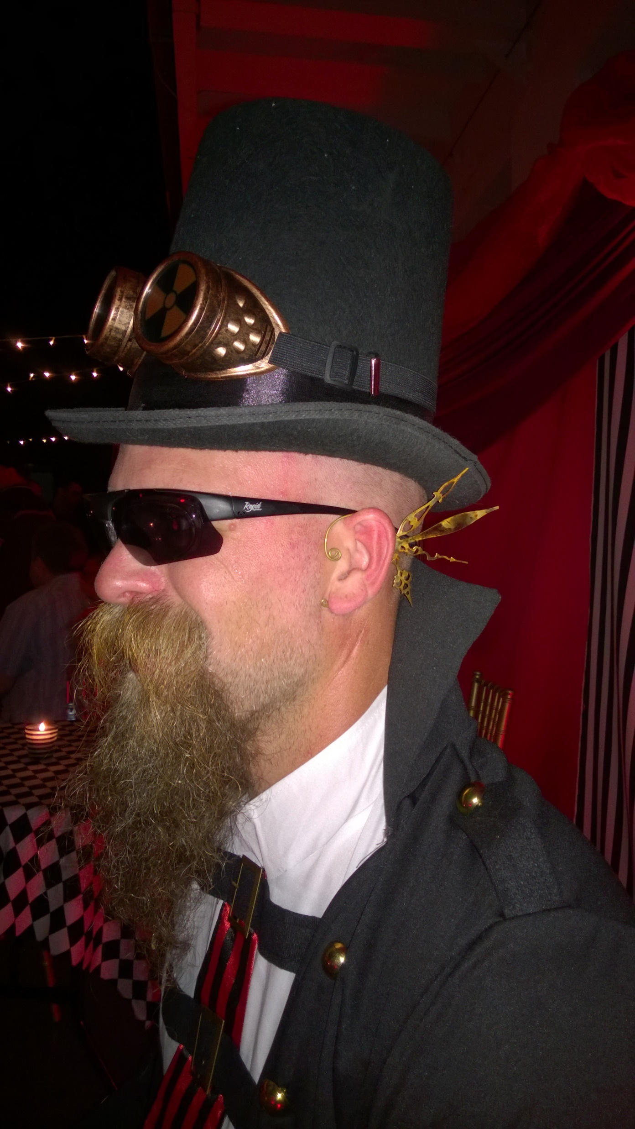
MUST BE TIME
FOR A DEMO

Slide 7
You Want to Learn More?
Obviously the rest of the sessions in todays PowerShell Track
@sqldbawithbeard
Notes:
Come to the rest of todays sessions
Use google, facebook, twitter, slack, PowerShell User Group (Manchester and London)

Slide 8


PowerShell VC of PASS
PowerShell for SQL Server
Wed, Sep 13
Need to Speed: Pragmatic Problem Solving with PowerShell Claudio Silva
http://sqlps.io/m3
Join the Conversation
@SQLPowerShell
Trello: sqlps.io/vote Slack: sqlps.io/slack
Need to catch up on the changes to SQL PowerShell in 2016?
Recording of July 2016 VC Meeting
Presented by: The PowerShell VC Team
http://sqlps.io/july2016video
Thurs, Aug 18
PowerShell, SQL and Power BI - Reducing your Context Switching
Rob Sewell
http://sqlps.io/m2
On YouTube
sqlps.io/video
• 21 Videos already posted
• New Videos posted every month
• Subscribe to be notified when we post new videos
PowerShell.SQLPASS.org
PowerShell@sqlpass.org
Notes:
Virtual Chapter of Pass – Fast growing, great presenters, videos on Youtube, interacting with Microsoft via Trello,Slack and Connect to bring improvements to the sqlserver module

Slide 9

Questions?
http://www.menshairforum.com/talk/Thread-Beard-Facts-and-Beards-Meme-Facial-Hair-Manly-Knowledge
Notes:
Ask A Question

Slide 10

Thank You
@sqldbawithbeard
http://sqldbawithabeard.com
https://uk.linkedin.com/in/robsewellsqldba
mrrobsewell@outlook.com

Slide 11
We Just Wanted To Say
Thank You for Investing in SQL Powershell
THANK YOU

