Slide 1

SQLSERVER:\ Using the SQL Server Provider with PowerShell
Rob Sewell @sqldbawithbeard http://sqldbawithABeard.com
Notes:
I will be tweeting links as we go

Slide 2
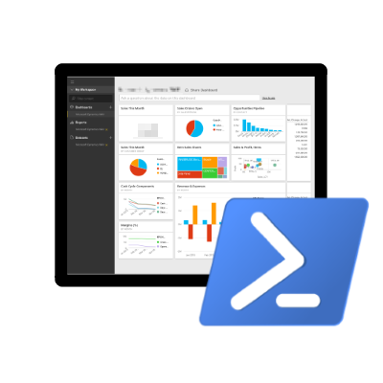

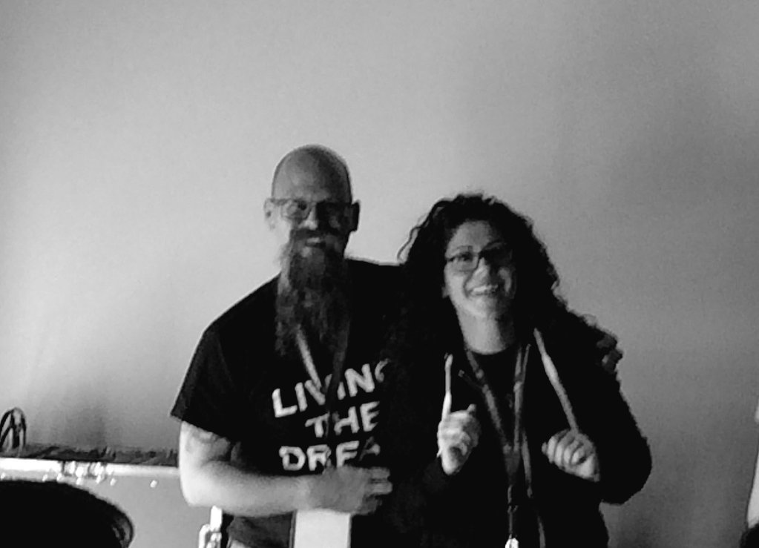
Speaker Questionnaire
Name : Rob
Occupation : DBA, Automator, Do-er
Interests : PowerShell, Automation And SQL (PaaS geddit?)
Website : sqldbawithAbeard.com
Twitter : @sqldbawithbeard
Interesting Fact : Has a Beard. (Still) Plays Cricket
Speaker : SQL Saturdays, SQL Relay, PowerShell Conference EU
Community : SQL South West , SQL Saturday Exeter , PowerShell Virtual Chapter, Organiser for PowerShell Conference EU 2017, Officer, Lead for dbareports, contributor to dbatools
https://dbatools.io
@psdbatools
https://dbareports.io
@psdbareports

Slide 3
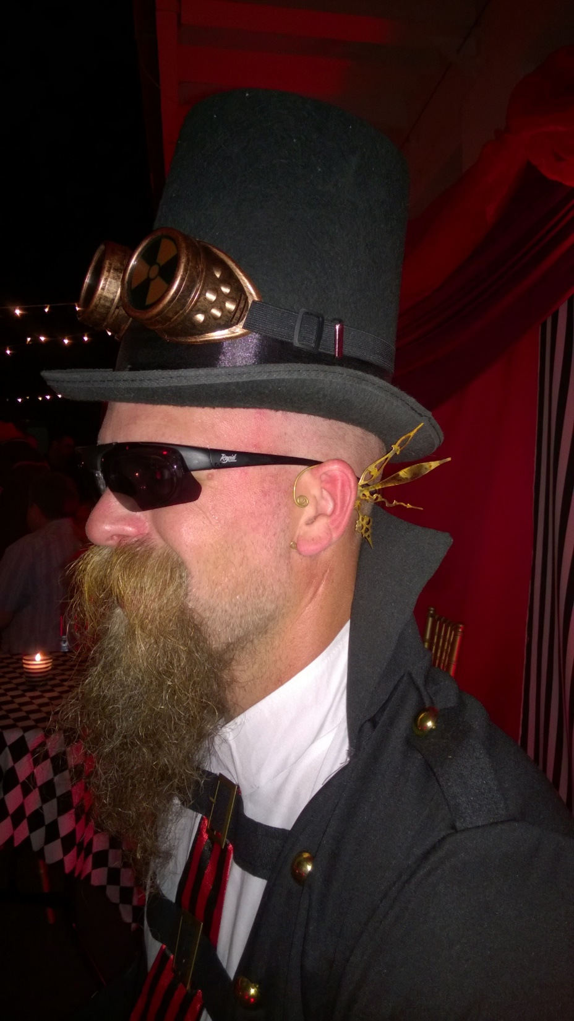
MUST BE TIME
FOR A DEMO

Slide 4
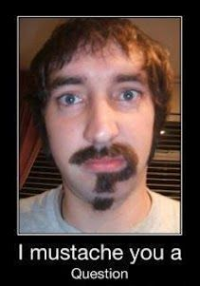
Questions ?

Slide 5
THANK YOU SO MUCH
Here are some cool free things
PASS PowerShell Virtual Chapter https://sqlps.io add /video for Youtube channel
SQL Community Slack https://sqlps.io/slack
dbatools – Amazing PowerShell module for DBAs https://dbatools.io
dbareports – SQL PowerShell SSRS PowerBi & Cortana https://dbareports.io
SQL Collaborative Git Hub Organisation https://github.com/sqlcollaborative
Influence Microsoft
sqlserver PowerShell module https://sqlps.io/vote
SSMS https://sqlps.io/SSMS
PowerShell PowerBi integration https://sqlps.io/powerbi
Rob Sewell @sqldbawithbeard http://sqldbawithAbeard.com

