Slide 1

Using Power BI with my DBA Database
http://sqldbawithabeard.com
@sqldbawithbeard

Slide 2














SQLSaturday #467 Sponsors

Slide 3
Who is this Beardy Bloke then?
An Enterprise SQL DBA who loves PowerShell Automation Azure and SQL
Member of SQL South West User Group in Exeter
Member of SQL Saturday Exeter Committee – March 12th 2016
SQL Community Volunteer at various events
Speaker at User Groups and other events
Blogger and Twitterer No ‘A’ in my Twitter handle ☺
This Presentation and Scripts can be found here http://1drv.ms/1iaQtmR
http://sqldbawithabeard.com

Slide 4


What Problem are we Solving?
Notes:
This is a problem I face every year but today we are not going to talk about this one ☺

Slide 5
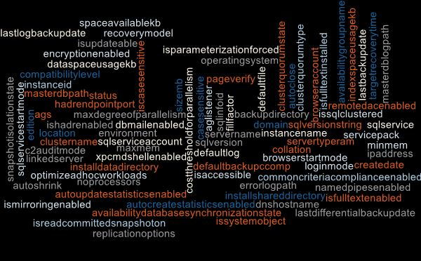
Questions
Managers
PMs
Developers
Compliance
Auditors
DBAs
Change Managers
How Many?
Where Are?
What Is?
Which?
When?
Notes:
Compliance want to know how many Server 2003 or SQL 2005 or XPCMDShellEnabled
Project Managers and the project team want to know which servers and databases for their systems, how big, what settings etc
Systems Team, Change Managers want to know which servers and which clients are in which Data Centre for maintenance work (UPS replacement for example)

Slide 6
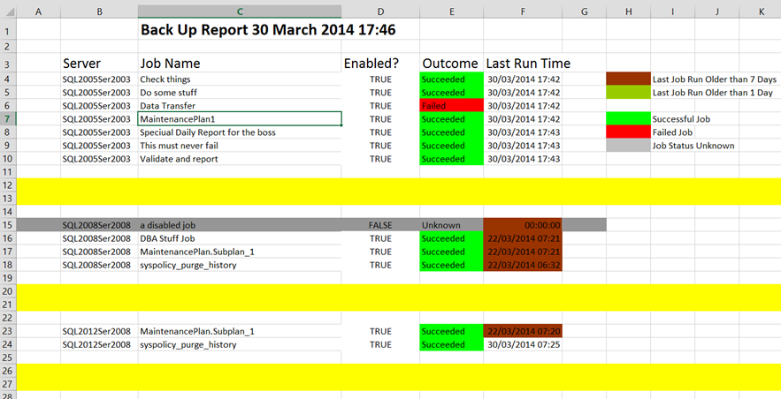
Replace The Old Ways
Notes:
It’s time to move on from the Old Ways of doing things.
I loved my Excel sheet with RAG for every agent job generated every day but in this modern world do we need to be emailing or saving files on shares to get our information

Slide 7
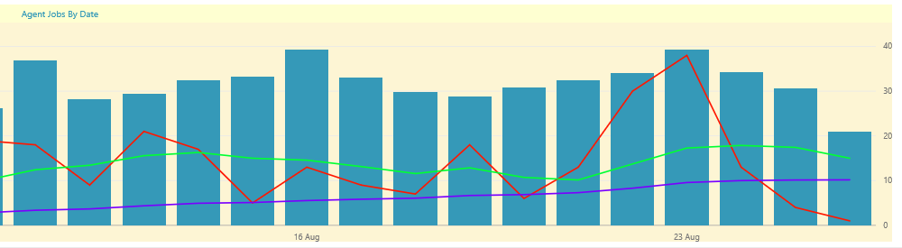
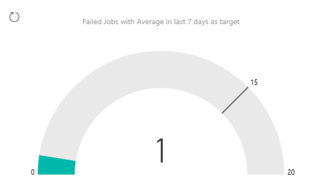
Instant Views For The DBA Team
Notes:
We – The DBA Team want good visualisations of exactly the information that we want to see including averages to see our improvement.
Here we see a rolling 30 day average for failed jobs (Blue) Rolling 7 day average (green) Failed Jobs (Red) and a gauge showing the failed jobs today against the average
But also we can show the number of SQL 2000 instances going down or other goals or objectives that we have a team have been set

Slide 8

Help Yourself
Notes:
Self-Service – Enable the Requestors to get what they want when they want
Reduce the load on the DBA Team

Slide 9




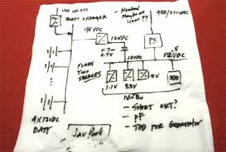
SOLUTION
REQUIREMENTS
Local Knowledge
Notes:
What do we need to build our solution to this problem?
Powershell – to gather our information
SQL Server – to store the information and ensure that it is kept available and backed up (and in control of the DBA Team
Power Bi – to create the reports and view/share them
Local Knowledge – Whether you keep your instances in a CMS or in a text file or on the back of a napkin you will need to know where they are

Slide 10
How To Do It

Slide 11
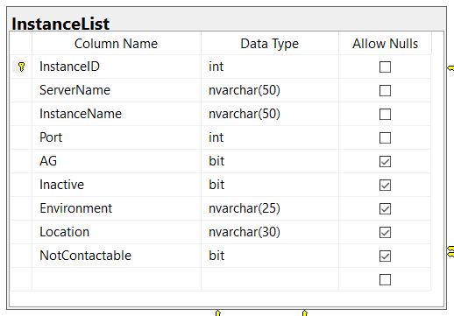
The Manual Part
Notes:
Enter this information into this table
Ensure Policies, Procedures and Processes include this step for new instances and also that the Inactive flag is set when instances are removed

Slide 12
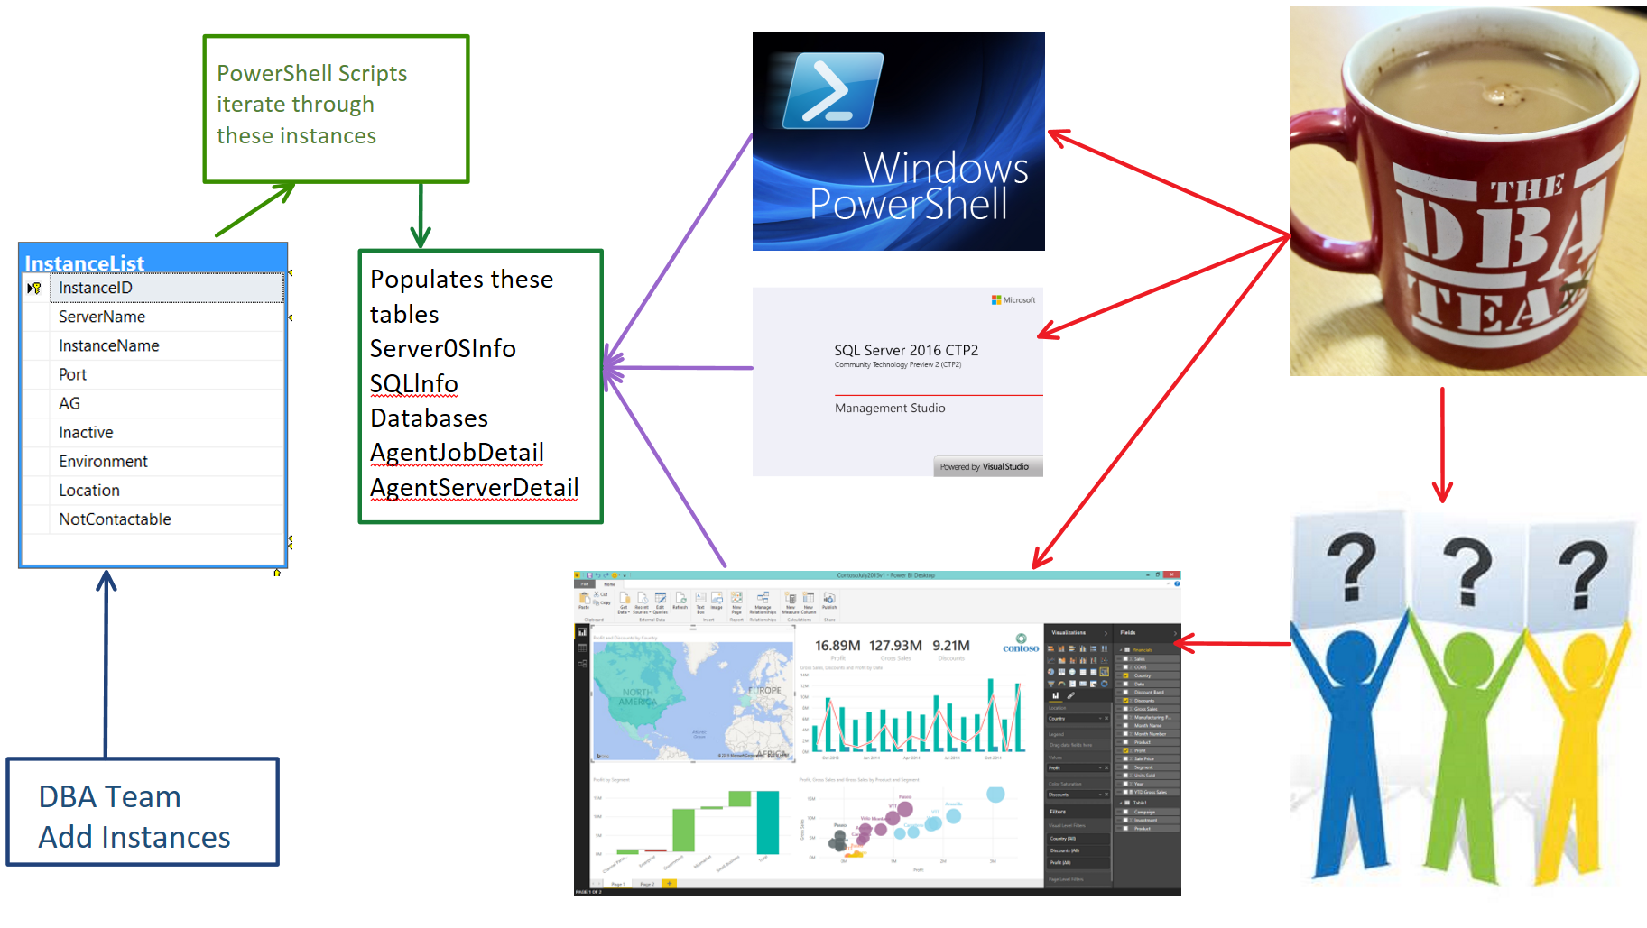
Notes:
DBA – Fills in instances
Agent Jobs run every night to gather the information regularly (Agent Job Databases, every night, Server, SQL every week
Now the DBA Team can use powershell to gather information – My Find-Database function queries this (and we use Excel too so the information is available locally in the case of disaster)
The DBA Team can use TSQL too. The information is pretty up to date and we have the date checked column to see when last checked
They can then answer questions quicker (No need to connect to a server)
They can quickly identify instances which need action (Policies not set (Max mem, Min mem Adhoc workload enabled etc)) and target them with powershell
BUT – Now we can let them ask their own questions ☺ and have access to the data they require when ever they want.

Slide 13
Demo

Slide 14

Questions

