Slide 1

New PowerShell
Commands for SQL Server
Rob Sewell @sqldbawithbeard http://sqldbawithABeard.com
Notes:
I will be tweeting links as we go

Slide 2
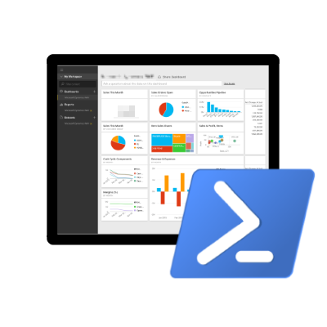

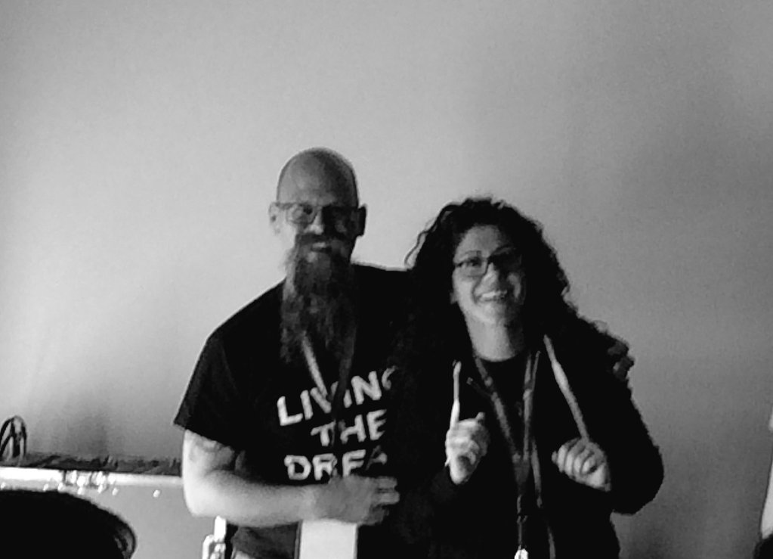
Speaker Questionnaire
Name : Rob
Occupation : DBA, Automator, Do-er
Interests : PowerShell, Automation And SQL (PaaS geddit?)
Website : sqldbawithAbeard.com
Twitter : @sqldbawithbeard
Interesting Fact : Has a Beard. (Still) Plays Cricket
Speaker : SQL Saturdays, SQL Relay, PowerShell Conference EU
Community : SQL South West , SQL Saturday Exeter , PowerShell Virtual Chapter, Organiser for PowerShell Conference EU 2017, Officer, Lead for dbareports, contributor to dbatools
https://dbatools.io
@psdbatools
https://dbareports.io
@psdbareports

Slide 3
What Happened?
Up until June 29th 2016 there were only 46 Cmdlets for SQL Server (Sharepoint has more than 700) There were warnings when loading the SQLPS module, it took seconds to load and it changed your directory
Then
Microsoft got a dedicated PowerShell resource for the SQL Server team - Matteo Taveggia
The Community also provided input, suggestions and priorities
https://blogs.technet.microsoft.com/dataplatforminsider/2016/06/30/sql-powershell-july-2016-update/
“The July update for SSMS includes the first substantial improvement in SQL PowerShell in many years. We owe a lot of thanks for this effort to the great collaboration with our community. “
Rob Sewell @sqldbawithbeard http://sqldbawithABeard.com
Notes:
I will be tweeting links as we go

Slide 4
25 New Cmdlets
Rob Sewell @sqldbawithbeard http://sqldbawithABeard.com
Notes:
I will be tweeting links as we go

Slide 5
25 New Cmdlets
Add-SqlAzureAuthenticationContext Add-SqlColumnEncryptionKeyValue Complete-SqlColumnMasterKeyRotation Get-SqlColumnEncryptionKey Get-SqlColumnMasterKey Invoke-SqlColumnMasterKeyRotation New-SqlAzureKeyVaultColumnMasterKeySettings New-SqlCertificateStoreColumnMasterKeySettings New-SqlCngColumnMasterKeySettings New-SqlColumnEncryptionKey New-SqlColumnEncryptionKeyEncryptedValue New-SqlColumnEncryptionSettings New-SqlColumnMasterKey New-SqlCspColumnMasterKeySettings | Remove-SqlColumnEncryptionKey Remove-SqlColumnEncryptionKeyValue Remove-SqlColumnMasterKey Set-SqlColumnEncryption Get-SqlAgent Get-SqlAgentJob Get-SqlAgentJobHistory Get-SqlAgentJobSchedule Get-SqlAgentJobStep Get-SqlAgentSchedule Get-SqlErrorLog Set-SqlErrorLog
Rob Sewell @sqldbawithbeard http://sqldbawithABeard.com
Notes:
I will be tweeting links as we go

Slide 6
A New Module Name
Good bye SQLPS
Import-Module sqlserver
The two modules can be imported alongside each other – so scripts that use SQLPS will still work BUT SQLPS will not be updated. The sqlserver module will be updated with every release of SSMS
If you use the community module SQLPSX which has a sqlserver module you will need to
Import-Module SQLPS –Prefix x
To avoid conflicts
Rob Sewell @sqldbawithbeard http://sqldbawithABeard.com
Notes:
I will be tweeting links as we go

Slide 7
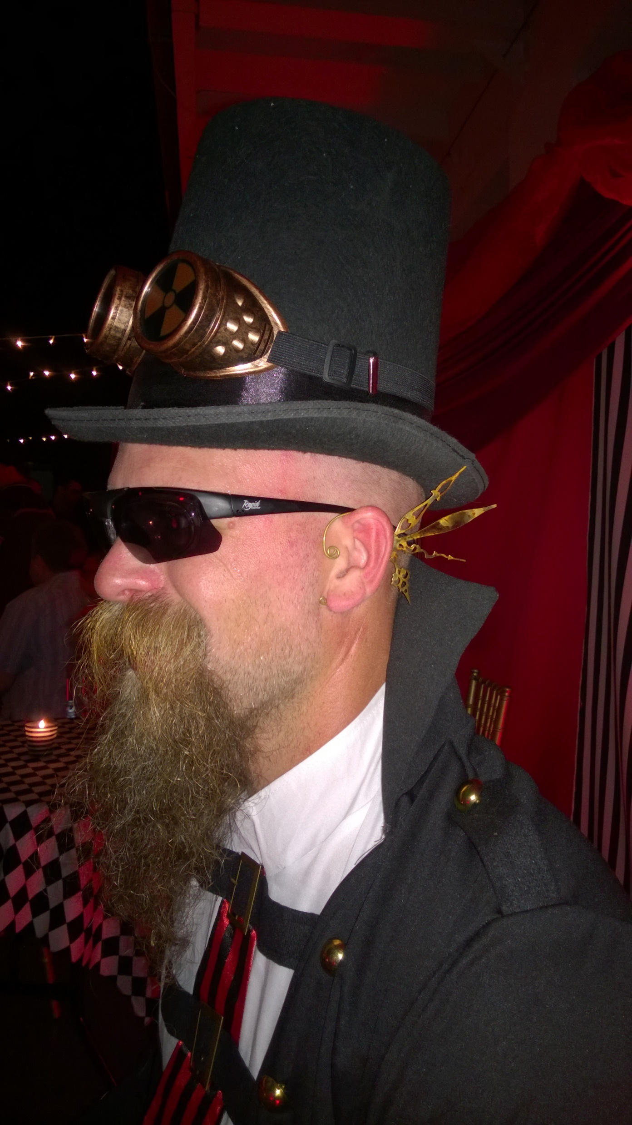
MUST BE TIME
FOR A DEMO

Slide 8
You Want to Learn More?
It’s PowerShell 10th Anniversary November 14th
Whole (American) day of live (ish) Channel 9 sessions
https://blogs.msdn.microsoft.com/powershell/2016/11/08/join-the-powershell-10th-anniversary-celebration/
@sqldbawithbeard
Notes:
Come to the rest of todays sessions
Use google, facebook, twitter, slack, PowerShell User Group (Manchester and London)

Slide 9


PowerShell VC of PASS
PowerShell for SQL Server
Need to catch up on the changes to SQL PowerShell in 2016?
Recording of July 2016 VC Meeting
Presented by: The PowerShell VC Team
http://sqlps.io/july2016video
Join the Conversation
@SQLPowerShell
Trello: sqlps.io/vote Slack: sqlps.io/slack
Wednesday, November 16th
Automate Operational Readiness and Validation Testing of SQL Server with PowerShell and Pester Mike F Robbins
http://sqlps.io
On YouTube
sqlps.io/video
• 21 Videos already posted
• New Videos posted every month
• Subscribe to be notified when we post new videos
PowerShell.SQLPASS.org
PowerShell@sqlpass.org
Notes:
Virtual Chapter of Pass – Fast growing, great presenters, videos on Youtube, interacting with Microsoft via Trello,Slack and Connect to bring improvements to the sqlserver module

Slide 10

Questions?
http://www.menshairforum.com/talk/Thread-Beard-Facts-and-Beards-Meme-Facial-Hair-Manly-Knowledge
Notes:
Ask A Question

Slide 11

Thank You
@sqldbawithbeard
http://sqldbawithabeard.com
https://uk.linkedin.com/in/robsewellsqldba
mrrobsewell@outlook.com

Slide 12
We Just Wanted To Say
Thank You for Investing in SQL Powershell
THANK YOU

