Slide 1


PowerShell
SQL Server
Slides and Demo - https://github.com/SQLDBAWithABeard/Presentations
Rob Sewell @sqldbawithbeard http://sqldbawithABeard.com
Notes:
I will be tweeting links as we go

Slide 2
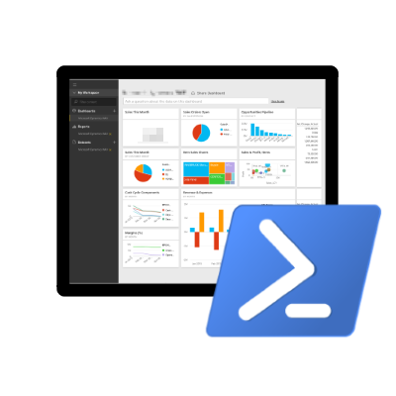
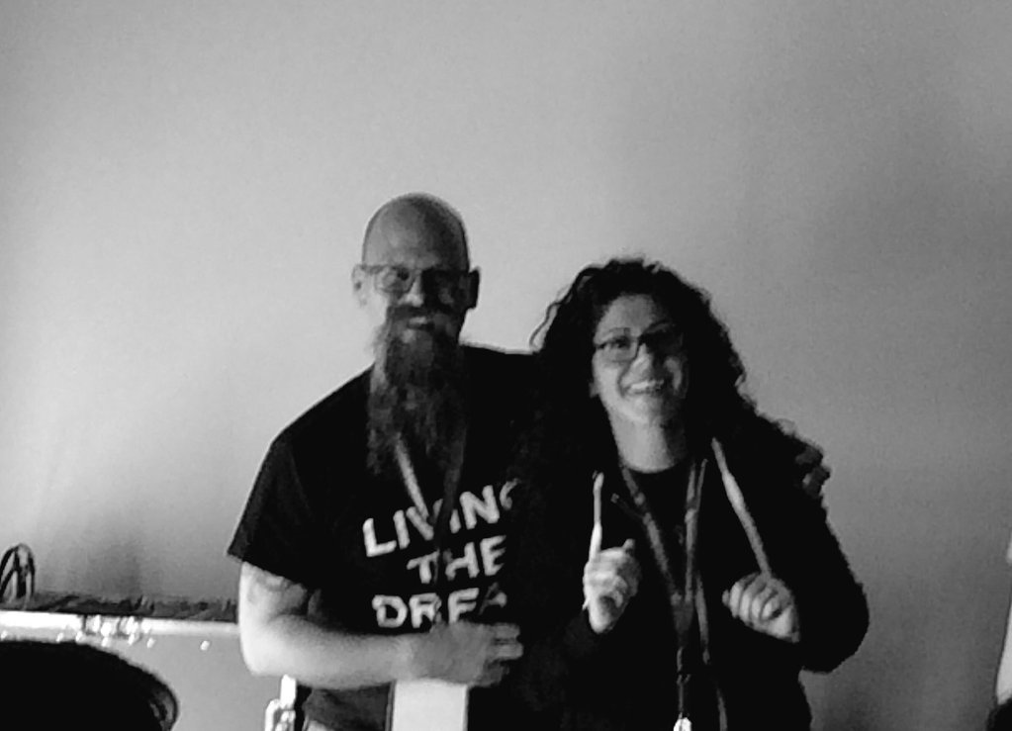
Speaker Questionnaire
Name : Rob
Occupation : DBA
Interests : PowerShell, Automation And SQL (PaaS geddit?)
Website : sqldbawithAbeard.com
Twitter : @sqldbawithbeard
Interesting Fact : Has a Beard
Speaker : SQL Saturdays, SQL Relay, PowerShell Conference EU
Community : SQL South West , SQL Saturday Exeter , PowerShell Virtual Chapter Officer, Lead for dbareports, contributor to dbatools
http://powershell.sqlpass.org
Thanks
@sqlvariant
@cl
@laerteSQLDBA
https://dbareports.io
@psdbareports

Slide 3

















PREMIER SPONSOR
GOLD SPONSORS
SILVER SPONSORS
BRONZE SPONSORS
SUPPORTERS

Slide 4
What Happened?
Up until June 29th 2016 there were only 46 Cmdlets for SQL Server (Sharepoint has more than 700) There were warnings when loading the SQLPS module, it took seconds to load and it changed your directory
Then
Microsoft got a dedicated PowerShell resource for the SQL Server team - Matteo Taveggia
The Community also provided input, suggestions and priorities
https://blogs.technet.microsoft.com/dataplatforminsider/2016/06/30/sql-powershell-july-2016-update/
“The July update for SSMS includes the first substantial improvement in SQL PowerShell in many years. We owe a lot of thanks for this effort to the great collaboration with our community. “
Rob Sewell @sqldbawithbeard http://sqldbawithABeard.com
Notes:
I will be tweeting links as we go

Slide 5
25 New Cmdlets
Rob Sewell @sqldbawithbeard http://sqldbawithABeard.com
Notes:
I will be tweeting links as we go

Slide 6
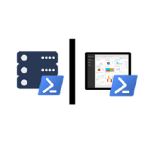
Community Has Taken up the Baton
SQL Server Community Collaborative
https://github.com/sqlcollaborative/

Slide 7

MUST BE TIME
FOR A DEMO

Slide 8


PowerShell VC of PASS
PowerShell for SQL Server
Wed, Oct 19
Hacking SQL Servers on Scale using PowerShell Scott Sutherland http://sqlps.io/m4
Join the Conversation
@SQLPowerShell
Trello: sqlps.io/vote Slack: sqlps.io/slack
Need to catch up on the changes to SQL PowerShell in 2016?
Recording of July 2016 VC Meeting
Presented by: The PowerShell VC Team
http://sqlps.io/july2016video
On YouTube
sqlps.io/video
• 21 Videos already posted
• New Videos posted every month
• Subscribe to be notified when we post new videos
PowerShell.SQLPASS.org
PowerShell@sqlpass.org
Notes:
Virtual Chapter of Pass – Fast growing, great presenters, videos on Youtube, interacting with Microsoft via Trello,Slack and Connect to bring improvements to the sqlserver module

Slide 9

Questions?
http://www.menshairforum.com/talk/Thread-Beard-Facts-and-Beards-Meme-Facial-Hair-Manly-Knowledge
Notes:
Ask A Question

Slide 10
We Just Wanted To Say
Thank You for Investing in SQL Powershell
THANK YOU

Slide 11

Please give us your feedback:
sqlrelay.co.uk/feedback
Thank you

