Slide 1
Jason1 / PO.DAAC
Interface Architecture
Final
October 4, 2007

Slide 2
Overview
Problem Statement
Organization
Requirements
Data Flow Diagram
State Diagram

Slide 3
Problem Statement
Current State
  The customer is not happy with the performance of the system. Specifically, products are not available to the public in a timely manner
  The customer must contact some one at PO.DAAC to learn a products status.
Desired State
  Products are made available to the public within 1 work day of their release by the customer.
  Customer can determine the state of a Jason 1 product on-line.

Slide 4
Organization - PO.DAAC
Pat Liggett
PO.DAAC Manager
Emily Law
Operations
Kelly Perry
Science Liaison
Sean Hardman
Development
Chris Finch
Systems Engineer
Jessica Hausman
Data Engineer
Starts Ma 20, 2007
Charles Thompson
Tools & Services
Development
Thomas Huang
Development
Eric Rigor
Data Engineer
John Diehl
Software Engineer

Slide 5
Organization - Jason 1
Jason Project
CNES
Angel Badea
GDS Manager
Shailen Desai
GDR QA
Nicholas Picot
GDR QA

Slide 6
Level 4 Requirements
The Jason1/PO.DAAC interface shall make Jason 1 products available to the public via PO.DAAC.

Slide 7
Level 5 Requirements
CNES shall post Jason 1 products to the Jason 1/CNES staging area.
NASA shall post Jason 1 products to the Jason 1/NASA staging area.
CNES shall notify the Jason 1 / PO.DAAC Interface System when a Jason 1 product is approved for delivery.
NASA shall notify the Jason 1 / PO.DAAC Interface System when a Jason 1 product is approved for delivery.

Slide 8
Level 5 Requirement
Jason 1 / PO.DAAC Interface System shall transfer a Jason 1 product to PO.DAAC when both CNES and NASA have notified the system the product is ready for delivery.

Slide 9
Data Flow Diagram
Initial Entry
Jason 1
Product
CNES
OCEANIDS
CNES
Staging Area
CNES
Restricted Access
FTP Site
Acknowledgement
Jason 1
Product
NASA
INGEST
(exploder)
NASA
Staging Area
NASA
Restricted Access
FTP Site
Both INGEST and OCEANIDS remove the product from The Staging Area.

Slide 10
Data Flow Diagram
Product Release
Jason 1
Product
CNES
Check
Product
Status
CNES
Jason 1 Product
Ready Message
Make
Jason 1
Product
Available
to the public
Product Ready Message Error
NASA
Check
Product
Status
NASA Jason 1
Product Ready &
Submission Package
Jason 1
Product
Product Ready Message Error

Slide 11
State Diagram
CNES Posts
Jason 1 Product
NASA Posts
Jason 1 Product
CNES Staged
OCEANIDS
NASA Staged
INGEST
Ready for Review
No Action
CNES Accepts
Product
NASA Accepts
Product
CNES Approved
Check Status
NASA Approved
Check Status
NASA Accepts
Product
Product Accepted
Make Available to public
CNES Accepts
Product

Slide 12
Software Overview
The INGEST and OCEANIDS process are automatically invoked when the products are posted to the Staging Area.
New software will be developed to track the movement of a product through the system.
The new software will use a catalog to track the movement of a product through the system.
The new software will use a web page to display the status of all products in the system.

Slide 13
Software Overview
The new software will allow a user to move a product through the system.
A program will examine the restricted access area to determine if new products need to be added to the catalog database table.

Slide 14
Catalog Content
The catalog will contains the following fields:
  Cycle (Digits XXX)
  Version (Char X)
  Author (Char “CNES” / “NASA”)
  NASA approves (Boolean)
  CNES approves (Boolean)
  GDR Released (Date)
  SGDR Staged (Boolean)
  SGDR Released (Date)

Slide 15
Application Constraints
Access to the web page shall be restricted to individuals with access to the staging area.
Ability to update the Catalog database table shall be restricted to the PO.DAAC data engineer.

Slide 16
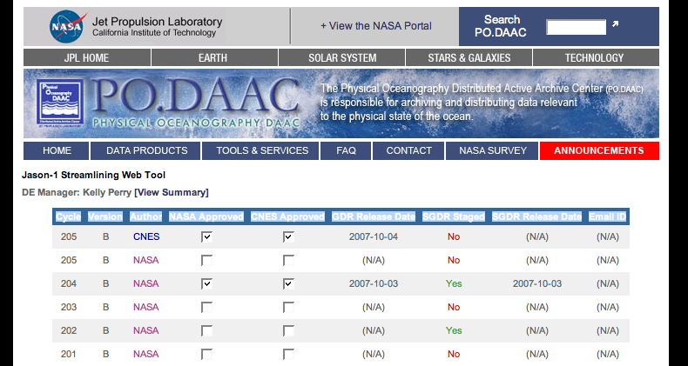
Web Page Layout

Slide 17
Web Page Description
This page displays the status of the products in the staged area.
When a product is delivered by either CNES or NASA, it’s status will become Staged and have a date associated with the staging.
When a product is approved for release by either CNES or NASA, it’s status will be changed to Approved and a date associated with the approval.

