Slide 1
The PO.DAAC Reporting Website
Lei Pan and Kelly Perry
Jet Propulsion Laboratory
California Institute of Technology
4800 Oak Grove Drive
Pasadena, California 91109
lei.pan@jpl.nasa.gov

Slide 2
The Problems with the Existing Tool
Not Web-based hence not WYSIWYG
  Uses emails and Perl scripts
PO.DAAC report load and content changed now
  More reports of different contents
The email-based tool not powerful enough potentially
  Unwanted features (e.g., deleting/over-writing stuff)
  Lack of automated report processing and generating
Not easy to maintain or expand
  Perl scripts are hard to understand (depending on who you talk to!)

Slide 3
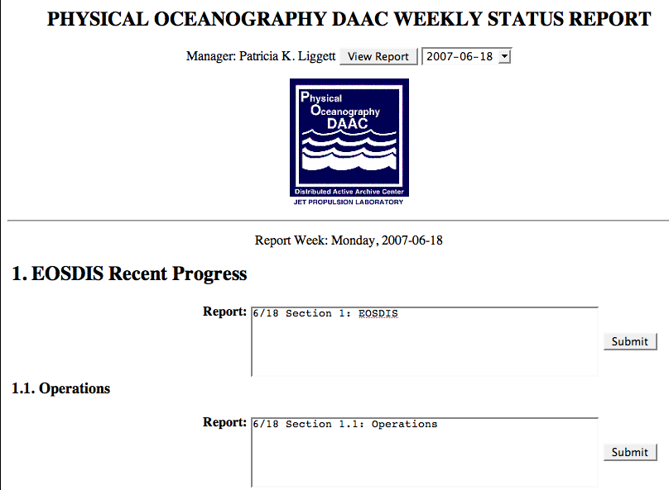
The New Tool
A Web Site
  Dynamic web contents
  34 pages of code managed by Subversion
Manager Menu
  To view the entire report given a week
Developers’ Input
  To type in weekly report and submit
Definitions
  Use its Monday to refer to a week
  (For now) only allow reporting for the week starting previous Monday

Slide 4
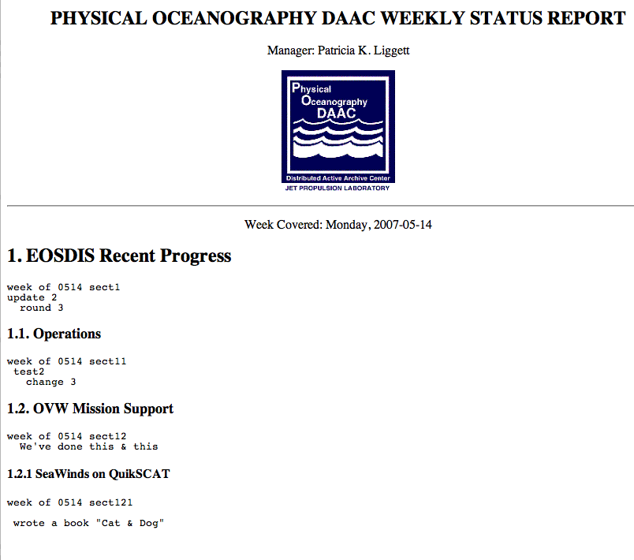
The New Tool (2)
Generated Report
  The entire report in html
  (Future) different reports compiled in MS Word

Slide 5
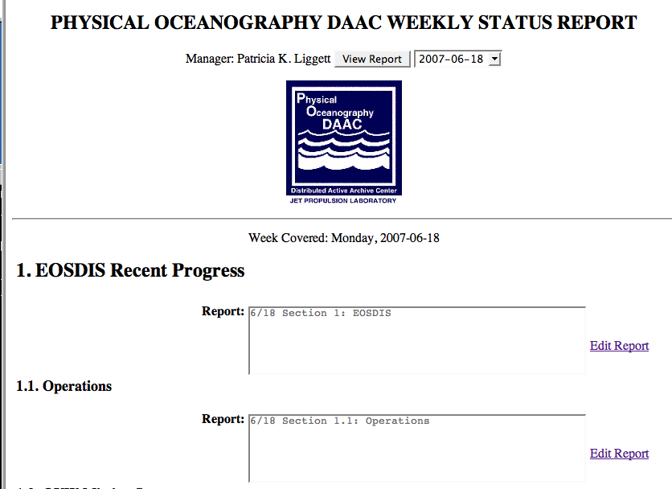
The New Tool (3)
Manager Menu
  To view the entire report given a week
Developers View Reports
  And can come back to edit

Slide 6
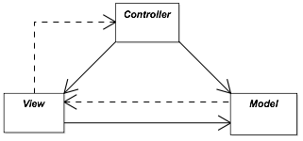
Web Technology: JSP, MVC, and Spring Framework
Why not Java Applets?
  Java version and installation (e.g., JPL’s Workforce Central v5.2 requires Java roll back from JRE 1.6)
  Java graphics (e.g., Applet’s redrawing with POET)
JSP (Java Server Pages)
  Dynamic html page generated on the server side
  Dynamic part written in Java -- powerful, easy to understand
  Multithreaded, fast (CGI is multi-process, high overhead)
MVC (Model-view-controller pattern)
  Decouples data access and business logic from data presentation and user interaction -- separation of concerns
  The controller is an intermediate component
The Spring Framework
  Open source, layered application framework (MVC, OO, JDBC, lightweight)
Why need a database?
  Dynamic contents, atomic transactions

Slide 7
Future Work
In the next two to three weeks:
Define and finalize the sections
  Need Pat’s input and feedback
Allow editing of two previous weeks
  Work in progress (next slide)
Separate the sections into different forms
  To avoid race condition (next slide)
Roll out for small group testing
Automatic report preprocessing (long term)
  Use Apache POI -- Java API to Microsoft format files
Other requests or suggestions (long term)?

Slide 8
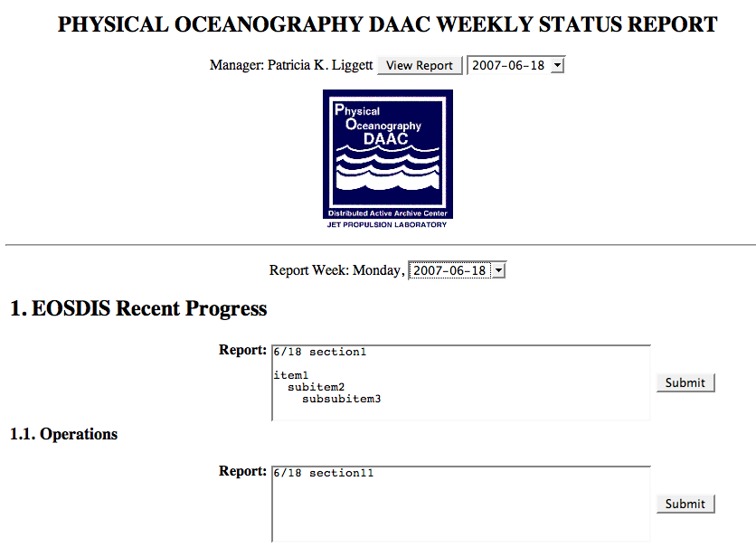
Work in progress: Allow Editing Two Previous Weeks
Freedom to report for this week or last week
  For weeks starting previous Monday or the Monday before the last
Need to use JavaScript -- dynamic html on the client side
Could have
race condition
today !!!

