Slide 1
Techniques of the Predictor: Generalizing to Complex Populations
Adrian Mackenzie, Sociology, Lancaster
Notes:
“La ingeniería de eq de fases comprende la aplicación del conocimiento fenomenológico del comportamiento de sistemas homogéneos y multifásicos, y su predicción mediante herramientas termodinámicas, con la finalidad de contribuir al desarrollo de procesos químicos. El diseño del equilibrio de fases es un nexo entre los requerimiento de un dado proceso y las actividades académicas de medición y modelado de datos experimentales.
[…] Esta disponibilidad (de simuladores computacionales) hace necesario estudiarla, con la finalidad de alcanzar un uso más fehaciente y efectivo de éstos, a través del desarrollo de criterios generales que faciliten la comprensión del potencial y limitaciones del proceso químico.”
Pereda, tesis doctoral, PLAPIQUI/UNS 2003, pp 4.1.

Slide 2

Observers, predictors, populations
‘Though obviously one who sees, an observer is more importantly one who sees within a prescribed set of possibilities, one who is embedded in a system of conventions and limitations’ [@Crary_1991,6].
Predictor: an independent variable and a person who predicts within a prescribed set of possibilities
Population and governmentality:

Slide 3
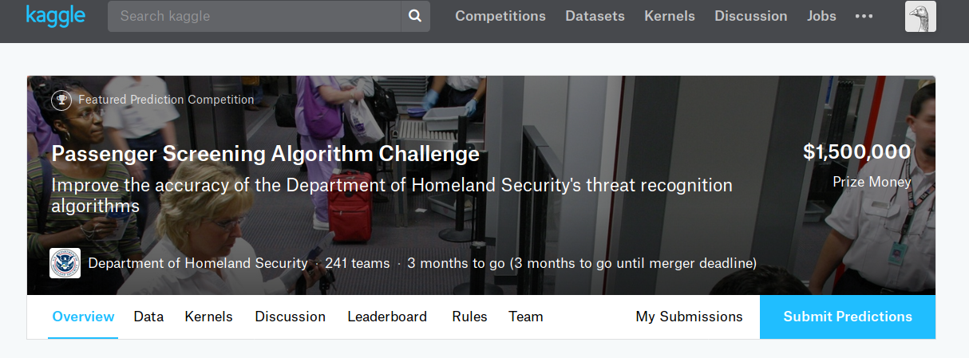
Generalized prediction

Slide 4
> Currently, TSA [U.S. Transportation Security Administration] purchases updated algorithms exclusively from the manufacturers of the scanning equipment used. These algorithms are proprietary, expensive, and often released in long cycles. In this competition, TSA is stepping outside their established procurement process and is challenging the broader data science community to help improve the accuracy of their threat prediction algorithms. Using a dataset of images collected on the latest generation of scanners, participants are challenged to identify the presence of simulated threats under a variety of object types, clothing types, and body types. Even a modest decrease in false alarms will help TSA significantly improve the passenger experience while maintaining high levels of security. [Passenger Screening Algorithm Challenge, Kaggle](https://www.kaggle.com/c/passenger-screening-algorithm-challenge)

Slide 5

The premise of specificity
“It is not appropriate to set up governance structures for machine learning per se. While there may be specific questions about the use of machine learning in specific circumstances, these should be handled in a sector-specific way, rather than via an overarching framework for all uses of machine learning; some sectors may have existing regulatory mechanisms that can manage, while in others there may not be these existing systems” [@RoyalSociety_2017,12].

Slide 6
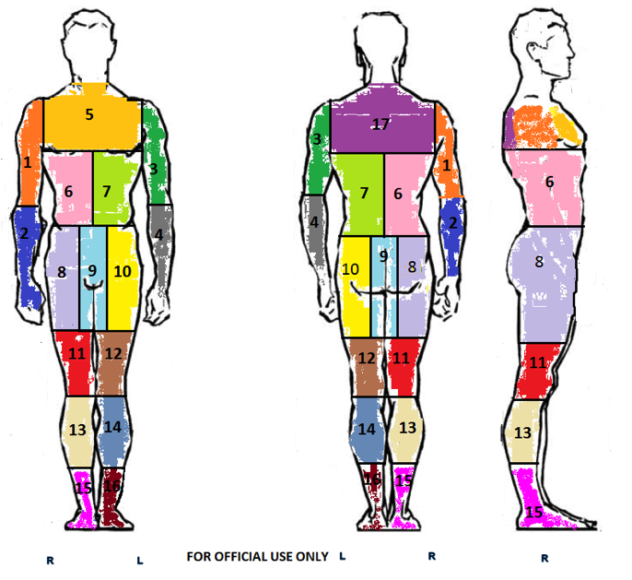

Slide 7
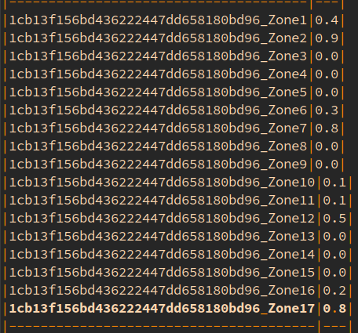
Body zone threat prediction

Slide 8
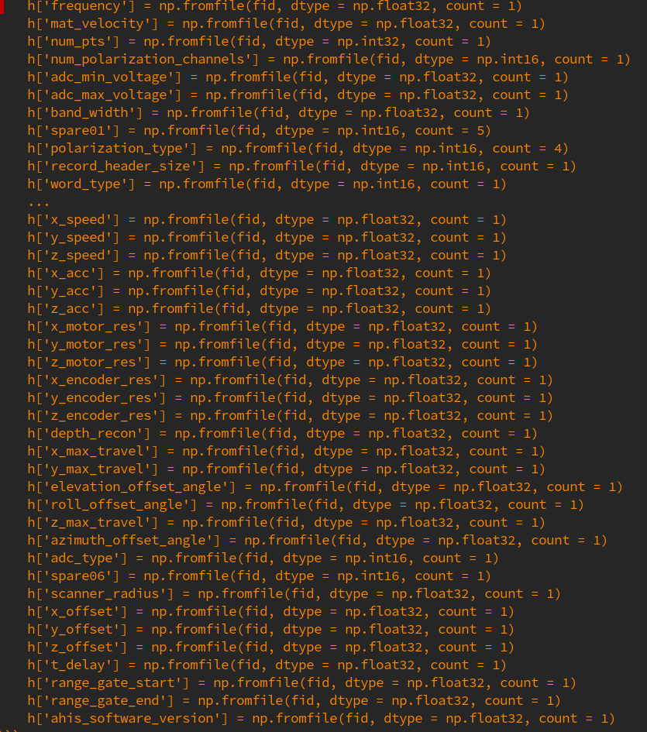

Slide 9
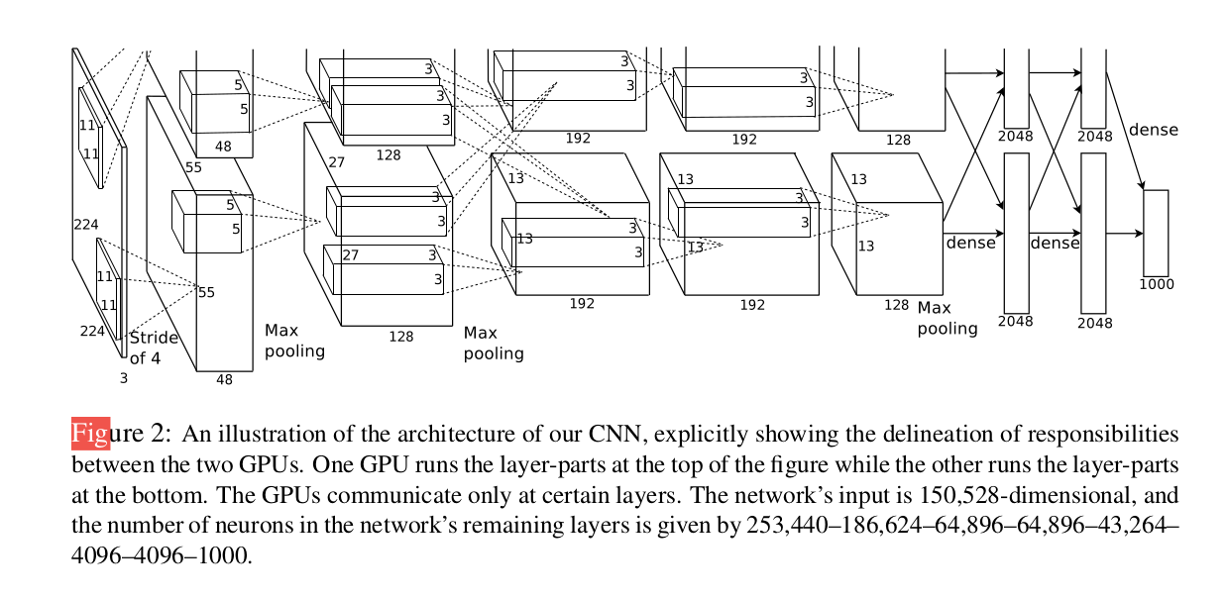
> Machine learning can carry out tasks of such complexity that the desired outputs could not be specified in programs based on step-by-step processes created by humans [@RoyalSociety_2017,19].

Slide 10
‘Convnet trainer’
> So far I have run training against the first three threat zones (1-3), I am currently seeing validation accuracy in the 92-96% range. ... So while it appears we may be getting some predictive value, much work would be needed to drive those accuracy numbers higher. [Convnet trainer](https://www.kaggle.com/jbfarrar/preprocessing-pipeline-and-convnet-trainer/notebook)

Slide 11
Implications
Generalization of prediction
  1. generalization of predictors (data + people)
  2. generalization of prediction (abstraction & mobilization of techniques)
The premise of specificity
  Specificity of generalization rather than specificity of site/sector/circumstances?

