Slide 1
things, in their fundamental truth, have now escaped from the space of the table
Foucault, The Order of Things, 239

Slide 2
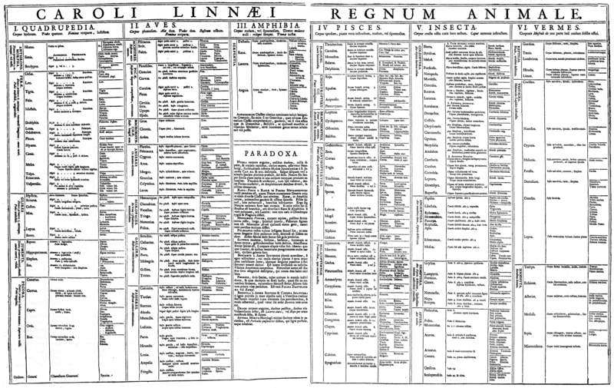
The classical 'big' table (1735): classification

Slide 3
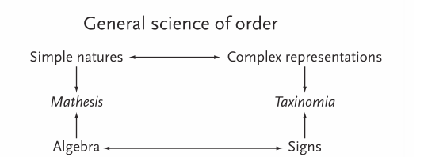
Diagrammatic composition of differences and identity
Foucault, The Order of Things

Slide 4
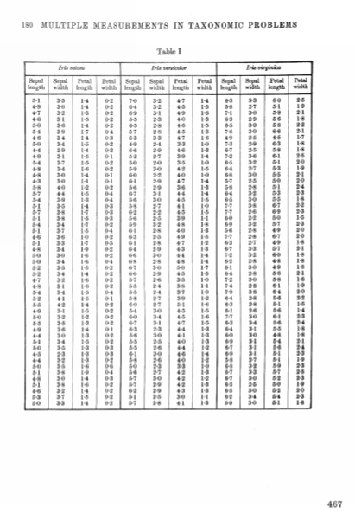
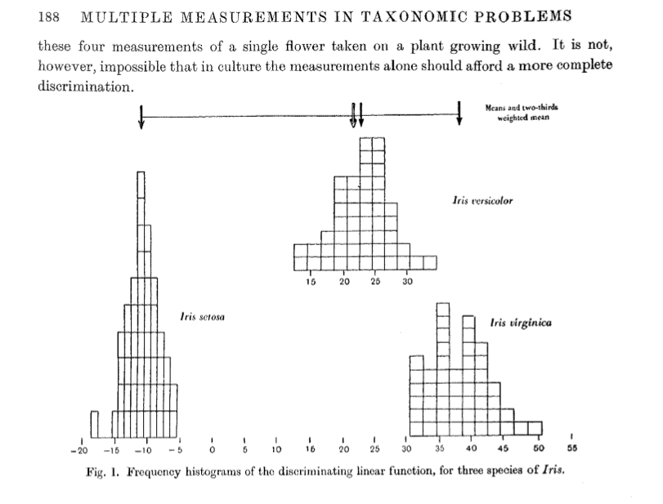
The persistence of the table

Slide 5
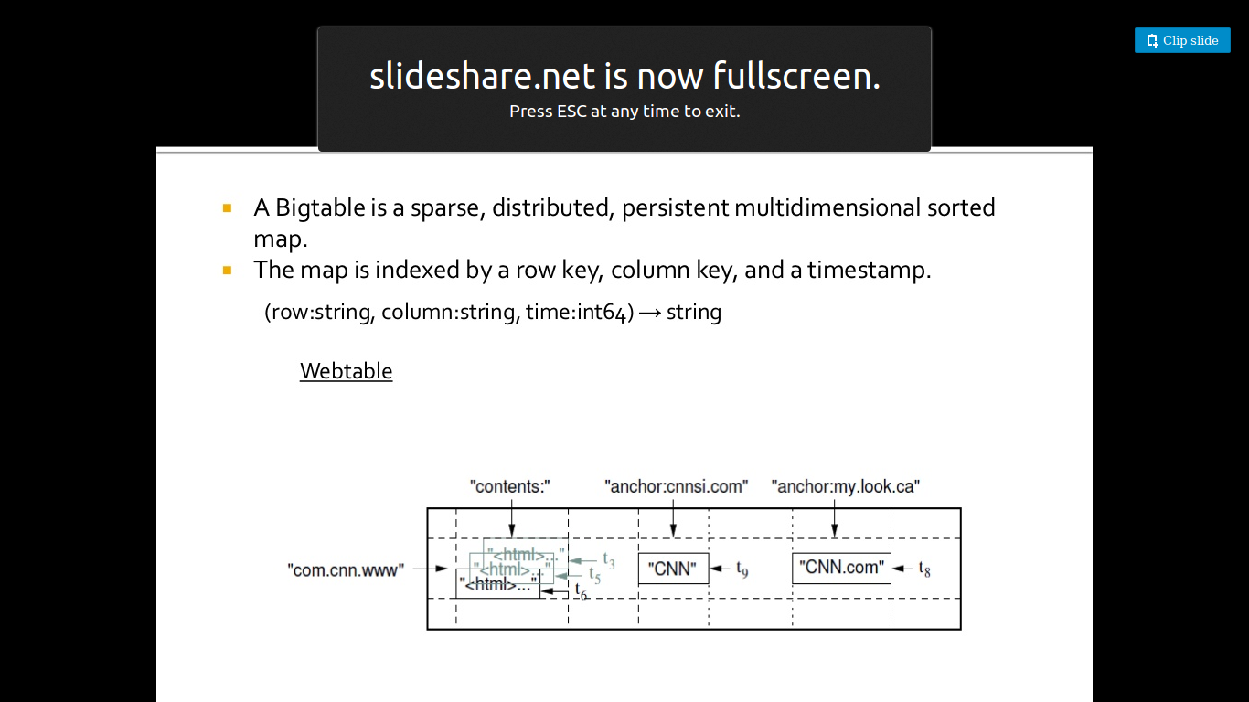
Big table (c.2006): classification

Slide 6
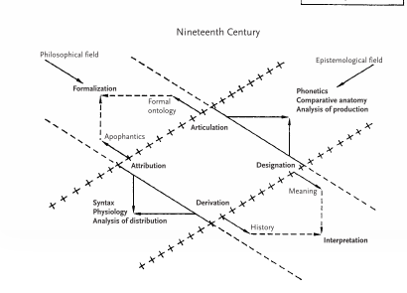
Diagonal movements and relations

Slide 7
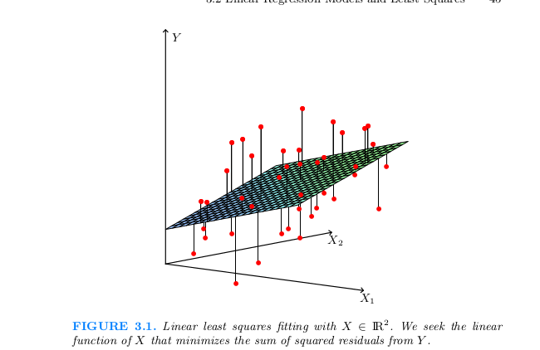
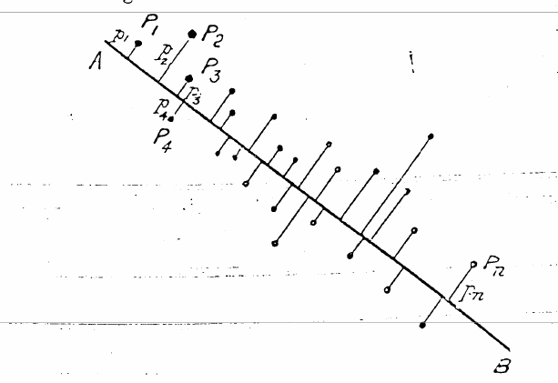
Diagonal movements and relations

Slide 8
Obscure verticality: functions
'In order to discover the fundamental groups into which natural beings can be divided, it has become necessary to explore in depth the space that lies between their superficial organs and their most concealed ones, and between these latter and the broad functions that they perform.' (249)

Slide 9
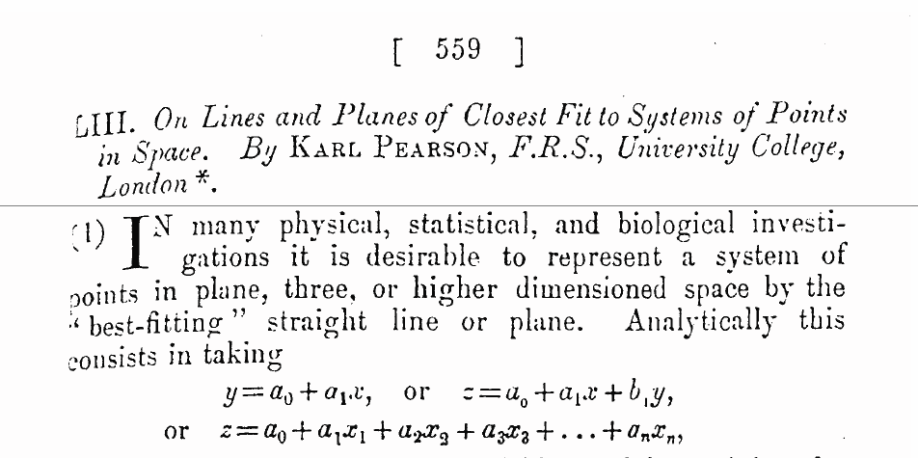
Diagrammatic composition of differences and relations
Karl Pearson, 1901, original article on PCA (Principal Component Analysis)

Slide 10
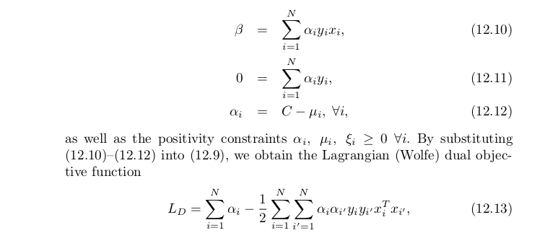
Re-surfacing depth

Slide 11
Diagonals and power: vectorisation

Slide 12
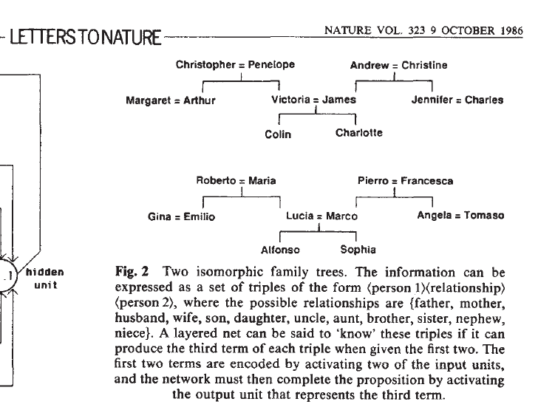

Slide 13
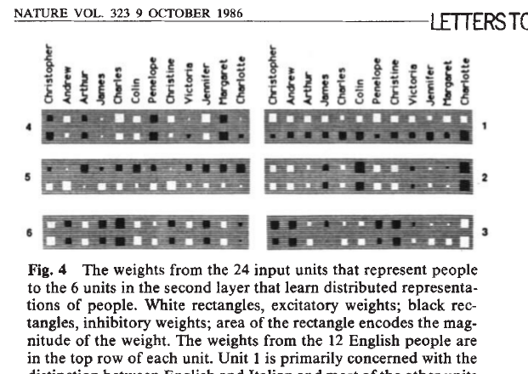

Slide 14
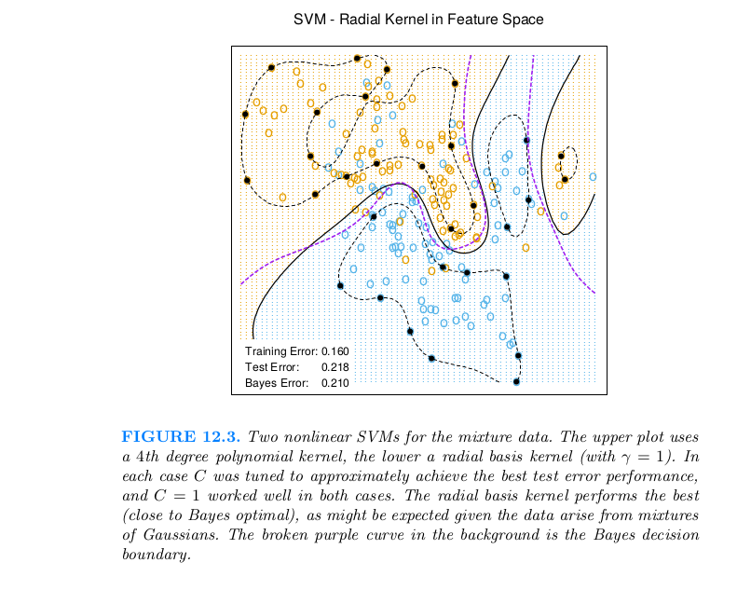
Diagonals and power: decision surfaces

Slide 15
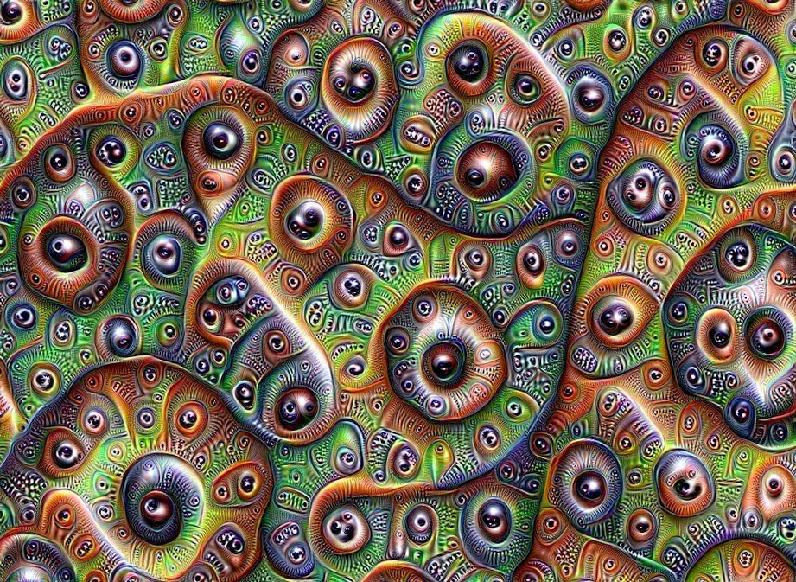
Diagonals and power: layers

Slide 16
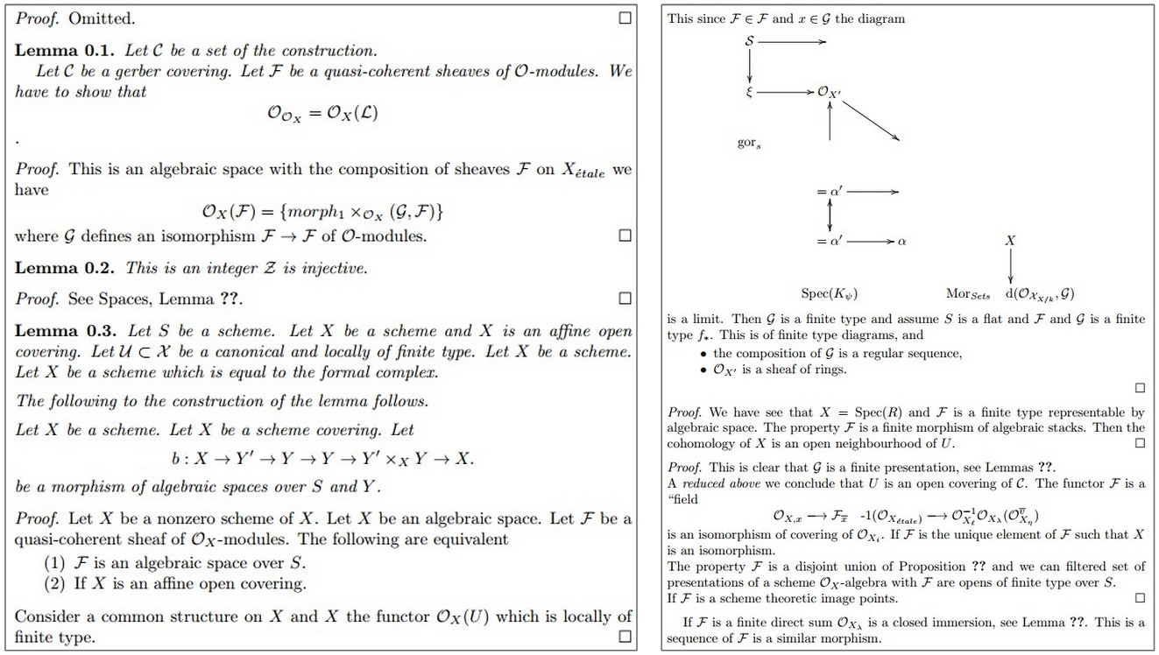
Diagonals and power: layers

Slide 17
