Slide 1

Kotlin for Data Science
Thomas Nield
@thomasnield9727

Slide 2
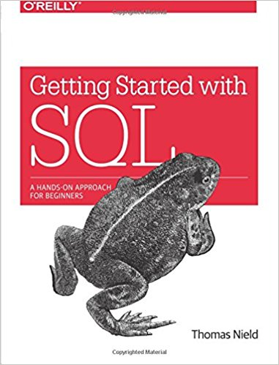
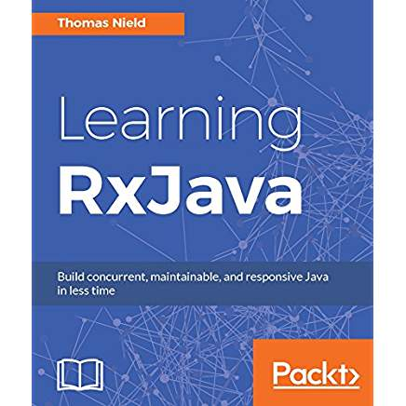
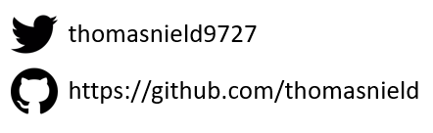
Thomas Nield
Business Consultant at Southwest Airlines
Author
Getting Started with SQL by O'Reilly
Learning RxJava by Packt
Trainer and content developer at O’Reilly Media
OSS Maintainer/Contributor
RxKotlin TornadoFX RxJavaFX
Kotlin-Statistics RxKotlinFX RxPy

Slide 3

Agenda
Kotlin for Data Science
What is Data Science?
Challenges in Data Science
Why Kotlin for Data Science?
Example Applications
Getting Involved

Slide 4
What is Data Science?
A Quick Overview

Slide 5
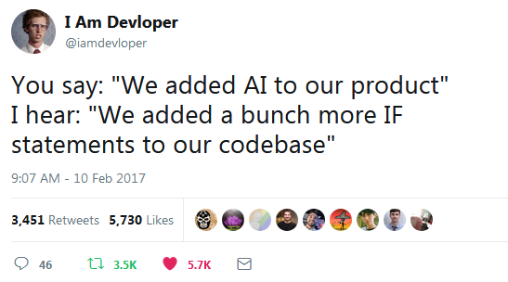
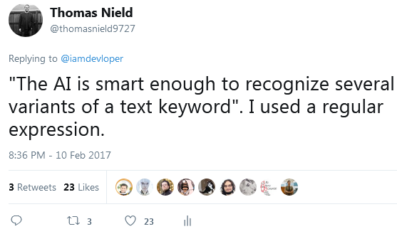
Not Data Science

Slide 6


What is Data Science?
Data science attempts to turn data into insight.
Insight can then be used to aid business decisions or create data-driven products.
A strong data science professional has some mix of programming/hacking, math/statistics, and business domain knowledge.
Math/Statistics
Modeling and
ML
Analysis and research
Programming/
Hacking
Data
Engineering
Domain
Knowledge

Slide 7
Data Science Tooling
SAS
SPSS
Math/Statistics
MAPL
MATLAB
Julia
Knime
R
Modeling and
ML
Analysis and research
Excel
Swift
Scala
Alteryx
Tableau
.NET
Python
Memos
Programming/
Hacking
Spark
SQL
Domain
Knowledge
Data
Engineering
Web/Mobile/Desktop Apps
Hadoop
Communication
Kafka
C/C++
Java
PowerPoint

Slide 8
Data Scientist Archetypes
A Subjective Categorization
The Statistician – Summarizes data using classic statistical methods and probability metrics.
The Mathematician – The individual who solves a problem by converting it into sea of numbers, often in the form of vectors and matrices.
The Data Engineer – An architect of “big data” solutions who can create reusable pipelines of data transformations and share it through reusable API’s.

Slide 9
Data Scientist Archetypes
A Subjective Categorization
The ML Scientist – A more advanced mathematician who leverages machine learning, neural networks, and other forms of AI modeling.
The Programmer – A trained software developer who likely knows Scala, Java, or Python, and often creates code from scratch tailored to specific business problems.
The Bard – The person who crafts communications about data findings with leaders and stakeholders, often telling stories with memos, charts, PowerPoints, infographics, spreadsheets, and other visual tools.

Slide 10
What is a Model?
Cocktail of Math and Code
What is a model? – A code representation of a problem, often mathematical in nature, that offers a solution in some form.
Examples of models:
A linear programming system that finds optimal values for business decision variables.
Machine learning model that clusters customers based on their attributes.
AI that parses, interprets, and links legal documents.
Neural network that identifies images in some way.

Slide 11
Data Science Challenges

Slide 12
MODEL ≠ PRODUCT

Slide 13
Data Science Challenges
Models Are Not Products
A current struggle in data science is putting models into production.
A model is often a hacky Python or R script that simply does not plug into a large enterprise technology ecosystem (which is often built on Java or .NET).
Models often use dynamically typed languages with tabular data structures, as well as procedural code which is difficult to modularize, evolve, and refactor.
If a model starts to break down and produce errors, it can bring into question the data scientist’s credibility.

Slide 14
Data Science Challenges
Models Are Not Products
Models often need to be rewritten from scratch as software:
Software engineers often need to rewrite a model from Python or R to Java.
The model needs to be “opened up” so its inner workings can be presented in frontend software.
The engineer may even have to introduce production data to the model, as the model may only have been tested with static data sets!
The production code also needs to be architected for scalability, refactorability, code reuse, and testing.

Slide 15
Twitter
“There was only one problem — all of my work was done in my local machine in R. People appreciate my efforts but they don’t know how to consume my model because it was not “productionized” and the infrastructure cannot talk to my local model. Hard lesson learned!”
- Robert Chang, Data Scientist at Airbnb (formerly Twitter)
SOURCE: https://medium.com/@rchang/my-two-year-journey-as-a-data-scientist-at-twitter-f0c13298aee6

Slide 16
Stitch Fix
“Data scientists are often frustrated that engineers are slow to put their ideas into production and that work cycles, road maps, and motivations are not aligned. By the time version 1 of their ideas are put into [production], they already have versions 2 and 3 queued up. Their frustration is completely justified.”
- Jeff Magnusson, Director of Data at Stitch Fix
SOURCE: http://multithreaded.stitchfix.com/blog/2016/03/16/engineers-shouldnt-write-etl/

Slide 17
Slack
“The infinite loop of sadness.”
- Josh Wills, Director of Data Engineering
Data
Engineering
Data
Science
Operations
Business
SOURCE: https://twitter.com/dwhitena/status/718137568777207808

Slide 18
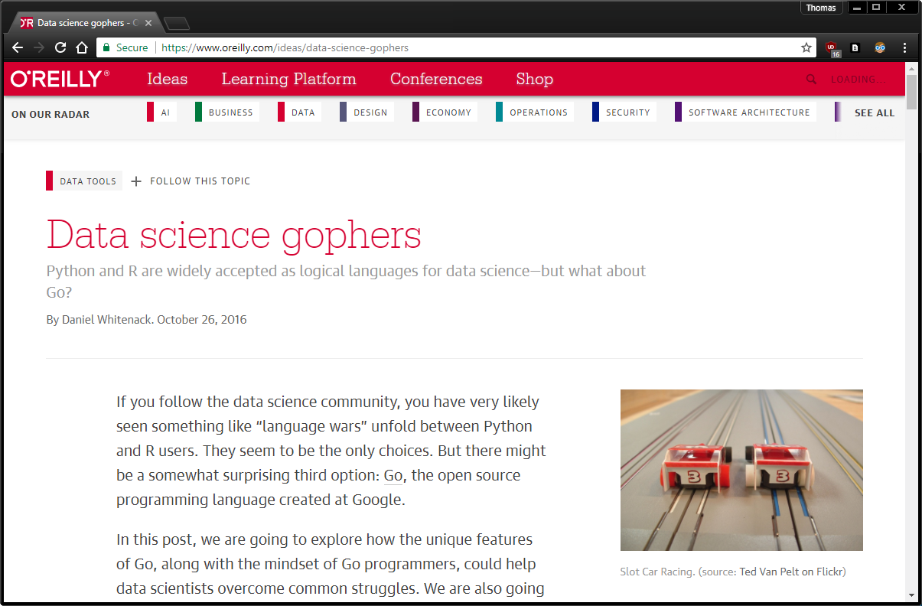
Recommended Reading
Data Science Gophers
https://www.oreilly.com/ideas/data-science-gophers

Slide 19
Why Kotlin for Data Science?

Slide 20

What is the Solution
Kotlin, of course!
Data scientists who code often need the following:
Rapid turnaround, quick iterative development
Easy to learn, flexible code language
Mathematical and machine learning libraries
Experienced software engineers often want the following:
Static typing and object-oriented programming
Production-grade architecture and support
Refactorability, reusability, concurrency, and scaling
Kotlin encompasses all the qualities above, and can provide a common platform to close the gap between data science, data engineering, and software engineering.

Slide 21
One language, One Codebase, One Platform
Data Engineer
Software Engineering/
Dev Ops
Data Scientist

Slide 22
Kotlin vs Python
Static vs Dynamic
Python is a powerful, flexible platform with a simple syntax and rich ecosystem of libraries.
Dynamic typing makes Python flexible for ad hoc analysis, but it is challenging to use in production.
Dynamic types allow improvised data structures to be defined at runtime.
Dynamic typing can quickly create difficulties in maintaining, testing, and debugging codebases, especially as the codebase grows large.

Slide 23
Kotlin vs Python
Static vs Dynamic
Kotlin, like Scala, embraces immutability and static typing.
Data structures are explicitly defined and enforced at compile time, not runtime.
While static typing is traditionally verbose, Kotlin manages to make it concise in a Pythonic manner.
Kotlin may not have as many mainstream data science libraries like Python, but it has comparable ones in the Java ecosystem:
Apache Spark ND4J DeepLearning4J ojAlgo!
Apache Hadoop Weka Apache Commons Math Koma
TensorFlow Java-ML Kotlin Statistics H20
Apache Kafka Krangl Komputation EJML

Slide 24
Kotlin vs Scala
Pragmatism vs Features
Scala has seen success in adoption on the data science domain, arguably due to Apache Spark and other “big data” solutions.
However, Scala might have some challenges going forward.
Apache Spark is being interfaced in other languages like Python and R to make it accessible.
Computation engines and libraries are increasingly moving back to C/C++, and away from JVM.
Plethora of features = Good or overwhelming?

Slide 25
Kotlin vs Scala
Pragmatism vs Features
Scala not taking significant share from Python may present an opportunity for Kotlin.
Kotlin might be able to finish what Scala started, establishing an engineering-grade coding platform for data science.
Kotlin has easier interoperability with Java.
Kotlin encompasses many of the best ideas from Scala, but strives to be simpler in its features and be more accessible (e.g. “Pythonic”).
While computation engines are unlikely to be dominated by Kotlin implementations, Kotlin can be effective in interfacing with them.

Slide 26
Weaknesses of Kotlin
For Data Science
Platform Drawbacks
Not Dynamically Typed – Data structures have to be explicitly defined, which can add additional steps in working with data.
Numerical Efficiency – Boxing of numbers might hurt performance without ND4J or other low-level computation libraries.
Libraries and Tooling
Ad Hoc Analysis – Casually exploring data without a clear objective may be challenging without data frame libraries like Krangl.
Libraries – Breadth of data science libraries, while decent, does not match Python or R.
Documentation – Java libraries use Java (not Kotlin) in their documentation.

Slide 27
Strengths of Kotlin
For Data Science
Platform Strengths
Accessibility – Easy to learn and intuitive, few esoteric features.
Minimal boilerplate, fast turnaround – “Pythonic” productivity
Interoperability with Java – Plugs into enterprise Java ecosystems
Language Features
Data classes – No more tuples or improvised data structures at runtime.
DSL – Create streamlined languages for domain-specific logic.
Static Typing – Benefits of OOP and static typing, without the verbosity.
Nullable Types – Helpful asset in data wrangling.
Function Syntax – Flexible, expressive function features including extensions.
Lambdas and Pipelines – Practical functional programming constructs.

Slide 28
Example Applications

Slide 29
Linear Programming
A Word Problem
You have three drivers who charge the following rates:
Driver 1: $10 / hr
Driver 2: $12 / hr
Driver 3: $15 / hr
From 6:00 to 22:00, schedule one driver at a time to provide coverage, and minimize cost.
Each driver must work 4-6 hours a day. Driver 2 cannot work after 11:00.

Slide 30

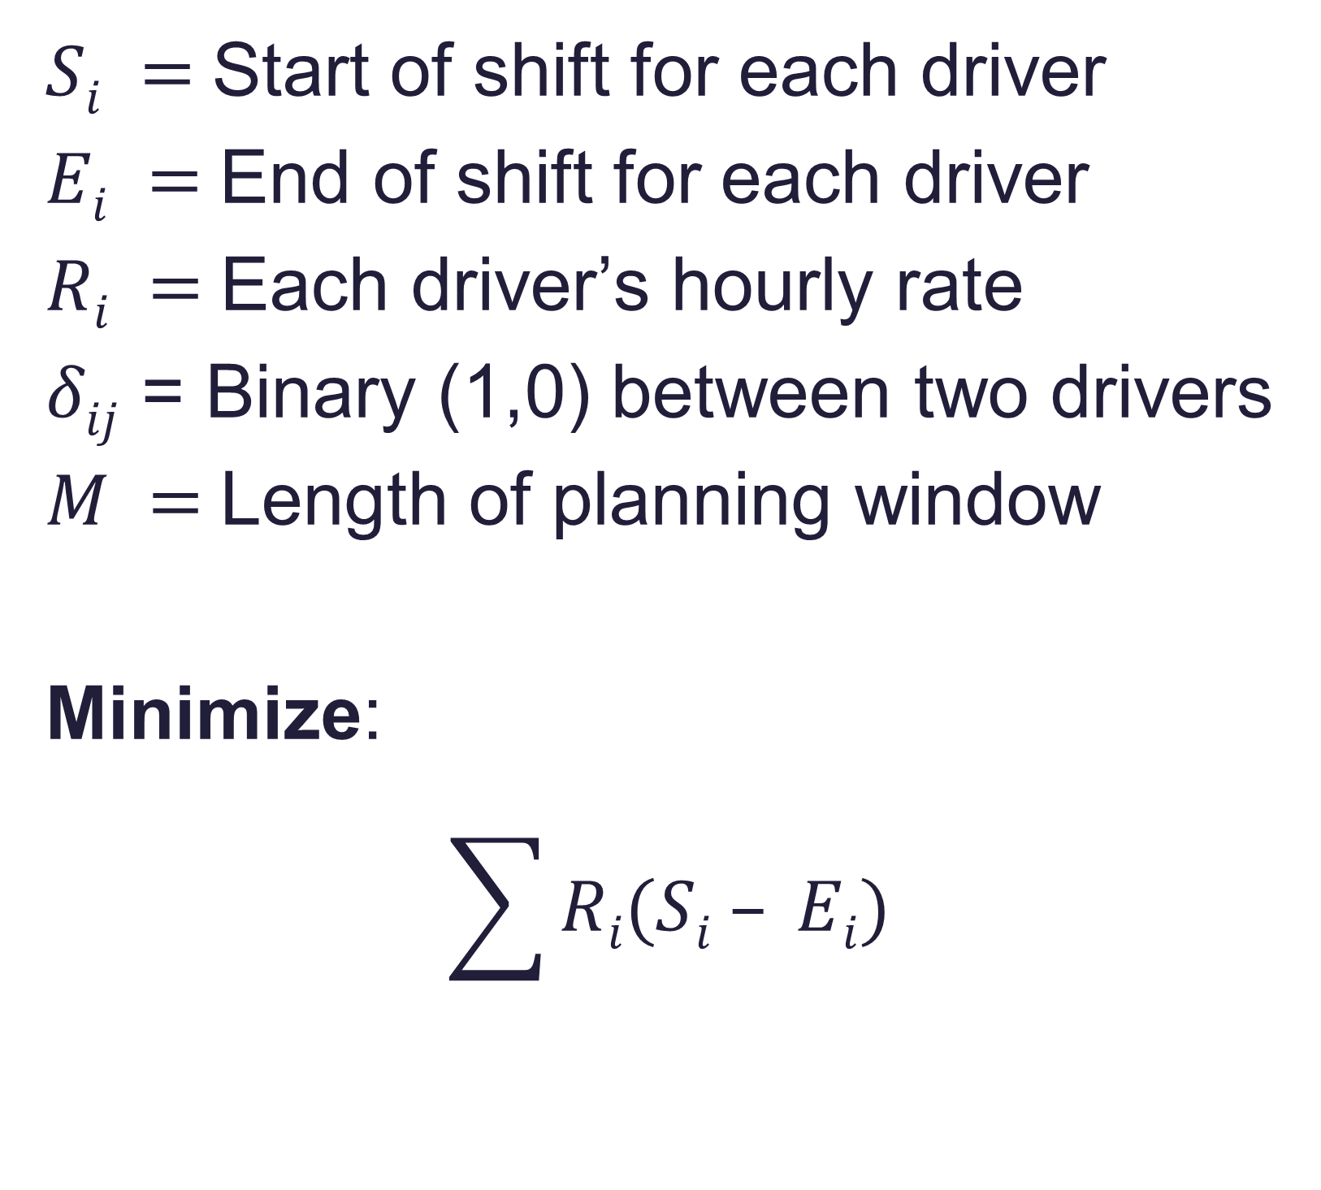
Stay Calm
Math = Powerful Apps
$Si =$Start of shift for each driver
$Ei =$End of shift for each driver
$Ri =$Each driver’s hourly rate
$δij$ = Binary (1,0) between two drivers
$M =$Length of planning window
Minimize:
$$\sum{Ri(Si – Ei) }$$
Constraints:
$$4≤Ei −Si≤6$$
16 = $\sum{Si – Ei }$
$$E2 <= 11$$
$$Si >= Ej − Mδij$$
$$Si >= Ei − M(1−δij)$$

Slide 31
Data-Driven Apps
Endless Possibilities
Just the subject of linear programming alone opens up a large domain of apps:
Schedule generation (e.g. classrooms, transportation, staff)
Operations and resource planning (e.g. factory planning)
Blending problems (e.g. financial portfolios, food/drink ingredients)
Kotlin makes it easier than ever to make a model a polished product.
Kotlin is capable of solving a wide breadth of problems for many data science topics .

Slide 32
Getting Involved

Slide 33
Getting Involved
Help Bring Kotlin to Data Science
To help bring Kotlin into the data science domain, learn the area(s) that interest you.
Apache Hadoop Apache Spark Data mining
Mathematical Models Machine Learning Data wrangling
Statistical Models Linear programming Optimization
Create some data-driven Kotlin projects and share them!
OSS Libraries Blog articles Apps

Slide 34
Getting Involved
Help Bring Kotlin to Data Science
Never stop researching, learning, and advocating
Although it is incredibly difficult to achieve, never stop striving for that “unicorn” status.
Keep struggling to learn math, statistics, machine learning, etc… and find ways to make what you learn useful.
Introduce data-driven features into your apps, and blog how you did it.
If you work on a data science team, propose using Kotlin as a possible solution especially when production needs arise.

Slide 35
Practical Advice
Using Kotlin for Data Science
Utilize object-oriented programming, functional programming, and DSL’s when doing modeling.
Rather than working exclusively with matrices, data frames, and piles of numbers, use classes and functional pipelines to keep things organized and refactorable.
Avoid getting procedural and have a well-planned domain of classes, functions, and DSL’s to feed numbers and functions into your modeling library.

Slide 36
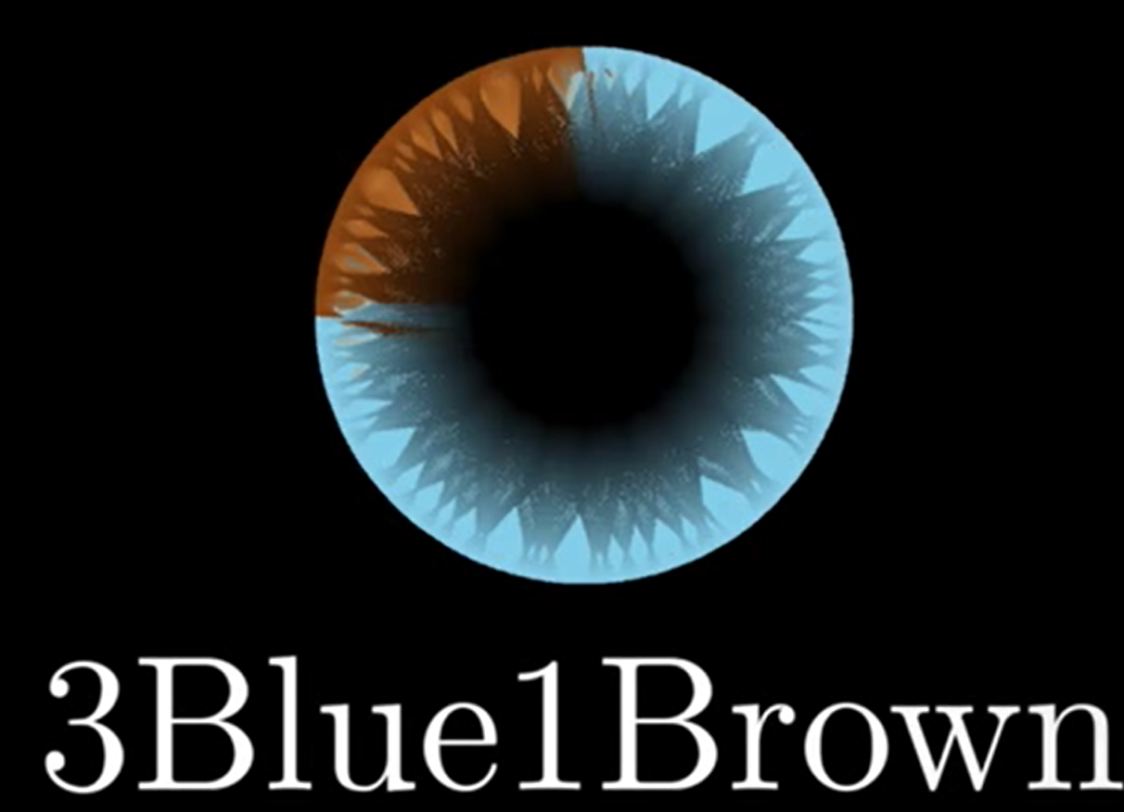
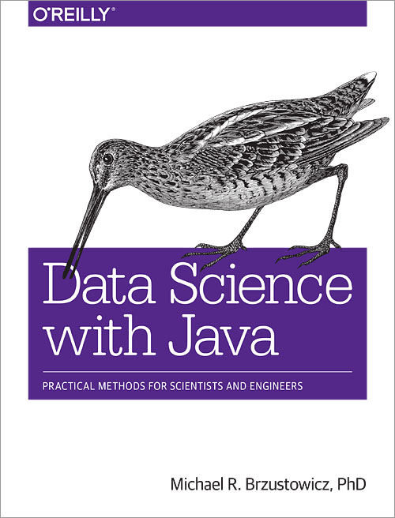
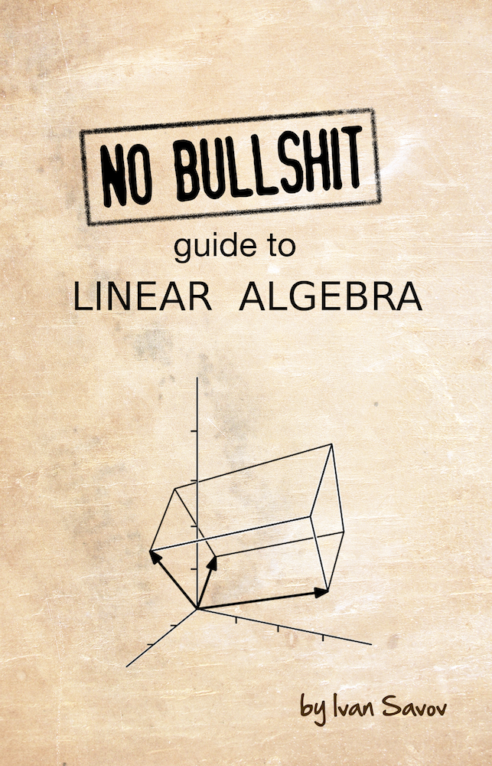
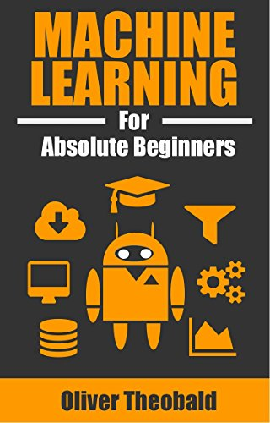
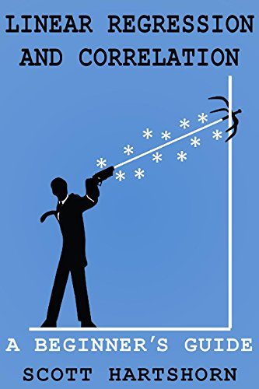

Excellent YouTube Channel!
Resources
To Learn Data Science
Never rely on one resource!

