Slide 1
Issues in Logic-based Repairing of Knowledge Graphs
Patrick Lambrix, Ying Li
QKG 2026

Slide 2
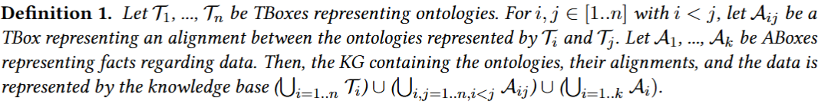
Background
Knowledge graphs can represent and operate on data in a graph-structured way.
A KG can be represented using a description logic knowledge base (KB).
Notes:
application scenarios that involve searching, integrating, managing data from diverse source, In this work, we use a DL kb to represent a KG, which may contain…..

Slide 3
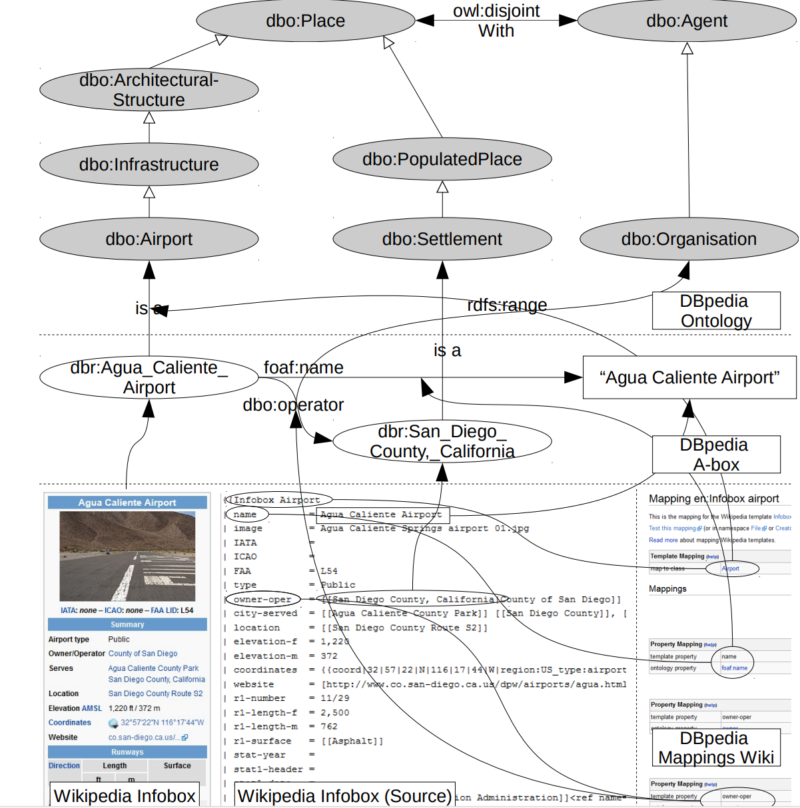


Background
Knowledge graphs
Incorrect TBox/ABox assertions
semantic defets (logical problems)
e.g., inconsistency
modeling defects
statements that are not correct in the domain
DBpedia T-box
3
Paulheim, Heiko. “Data-Driven Joint Debugging of the DBpedia Mappings and Ontology - Towards Addressing the Causes Instead of the Symptoms of Data Quality in DBpedia.” Extended Semantic Web Conference (2017).
Notes:
DBpedia is created by extracting information from the infoboxes on Wikipedia pages and then are mapped to the dbpedia onto. Using those mappings, an A-box for the ontology T-box is automatically extracted using the DBpedia extraction framework. However, during the generation and extraction process, errors can be introduced at various steps: e.g., if incorrect information when forming the ontology may generate incorrect Tbox axioms or if wrong mappings used during extraction

Slide 4
Background
KGs may contain different types of defects. Using such defective KGs can lead to deriving incorrect statements or missing valid conclusions.
The quality of knowledge graphs in terms of their correctness and completeness is crucial for developing high-quality semantically enabled applications.

Slide 5
Background
Dealing with defects has different steps:
Detection: finding the defects
Localization: finding where the defects are
Repair
removes incorrect information
removes correct information as well
Scientific_Event
Conference
Tutorial
5

Slide 6
Motivation
Preserve correct knowledge as much as possible to alleviate the negative effects of removing incorrect knowledge when repairing.
Add missing correct knowledge in a more advanced way than just adding this missing knowledge.
Notes:
In this work, discuss ways that can solve the issues related to correctness and completeness when creating repairing systems.

Slide 7
Preference relations
Definition 2. KB K1 is more complete than KB K2 iff
all correct knowledge in K2 can also be derived in K1.
there is correct knowledge in K1 that cannot be derived in K2.
Definition 3. KB K1 is less incorrect than KB K2 iff
all incorrect knowledge in K1 can also be derived in K2.
there is incorrect knowledge in K2 that cannot be derived in K1.
Notes:
As we discuss quality in terms of correctness and completeness in this work. we instead use preference relations to compare KGs with respect to correctness and completeness. Essentially, KG1 is more complete/incorrect than KG2, if allcorrect/incorrect information in KG2 can be derived in KG1, but there is additional correct/incorrectinformation in KG1 that is not derivable in KG2.

Slide 8
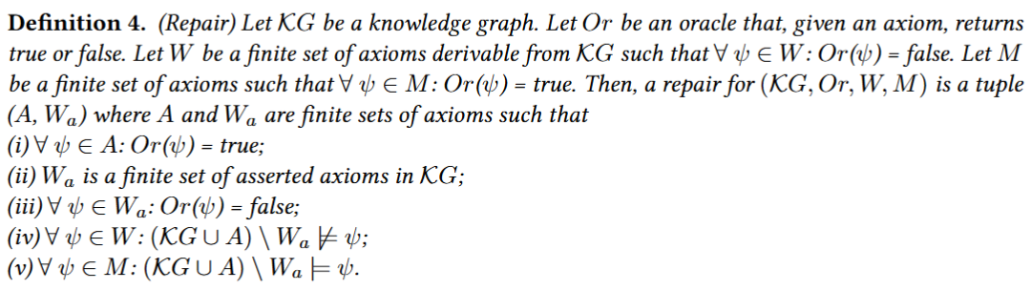
Problem formulation
Domain expert
a set of incorrect axioms
a set of missing axioms
A: a set of correct axioms to add to the KG
𝑊𝑎 : a set of incorrect asserted axioms to remove from the KG
8

Slide 9
Preference relations
Definition 2. KB K1 is more complete than KB K2 iff
all correct knowledge in K2 can also be derived in K1.
there is correct knowledge in K1 that cannot be derived in K2.
Definition 3. KB K1 is less incorrect than KB K2 iff
all incorrect knowledge in K1 can also be derived in K2.
there is incorrect knowledge in K2 that cannot be derived in K1.
Definition 5. (more complete and less incorrect repairs) Let (𝐴₁, 𝑊𝑎₁) and (𝐴₂, 𝑊𝑎₂) be two repairs for (K𝐺, 𝑂𝑟, 𝑊, 𝑀 ). Let K𝐺₁ = ((K𝐺 ∪ 𝐴₁) ∖ 𝑊𝑎₁) and K𝐺₂ = ((K𝐺 ∪ 𝐴₂) ∖ 𝑊𝑎₂). Then, repair (𝐴₁, 𝑊𝑎₁) is more complete than repair (𝐴₂, 𝑊𝑎₂) iff K𝐺₁ is more complete than K𝐺₂. Further, (𝐴₁, 𝑊𝑎₁) is less incorrect than repair (𝐴₂, 𝑊𝑎₂) iff K𝐺₁ is less incorrect than K𝐺₂.
Notes:
we can make use of Defs 2 and 3 to compare the quality of repairs

Slide 10
Domain expert validation
Domain expert involvement is essential.
Different types of oracles.
Error rates up to 30% can still be beneficial.
10

Slide 11
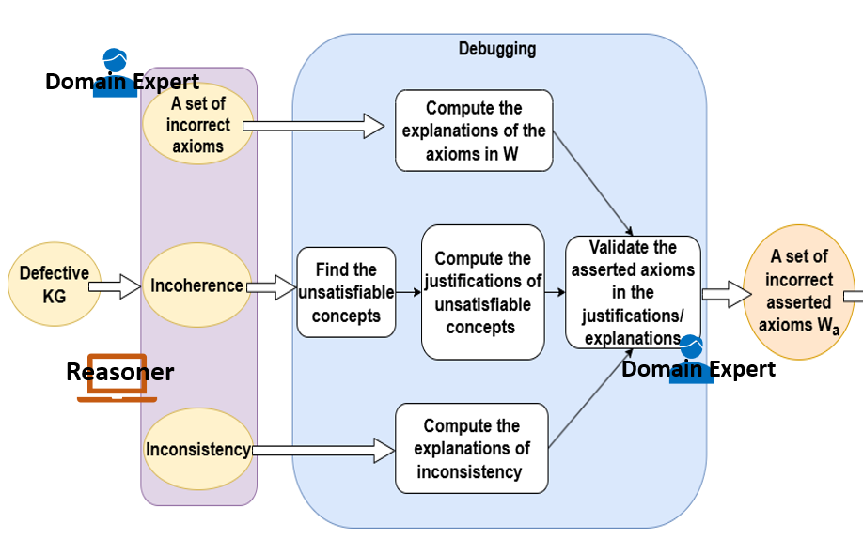
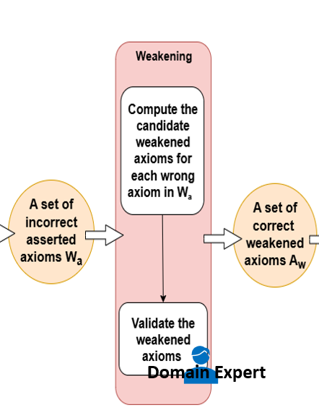
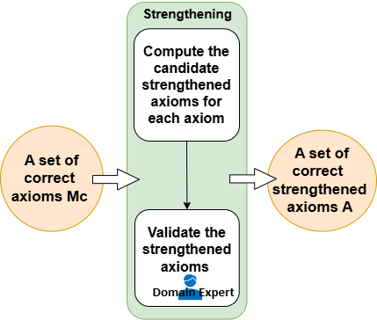
A framework for building KG repair systems
The framework uses basic operations:
Debugging: find the incorrect asserted axioms in the KG
Removing: remove the incorrect asserted axioms from the KG (less incorrect)
Weakening: Find correct weakened axioms of the incorrect axioms
(correct information that would be removed when removing incorrect information)
Strengthening: Find correct strengthened axioms of the weakened axioms
(additional correct knowledge to add, more complete)
11
Notes:
do not provide implementations. Indeed, the operations can be implemented in different ways and differentalgorithms may be needed for different description logics.

Slide 12
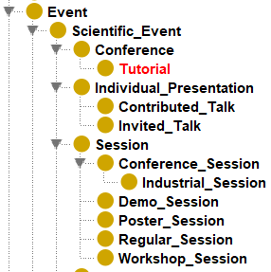
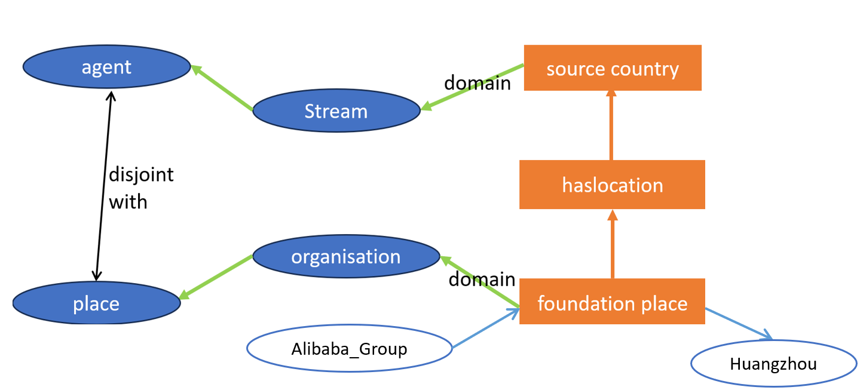
Debugging and removing
Find a set of incorrect asserted axioms such that when these axioms are removed from the KG, given defects can not be derived anymore.
Tutorial ⊑ Conference
haslocation ⊑ source country
12
Notes:
Can either be modelling defects which take the form of incorrect axioms, i.e., given some wrong statements, during debugging we will compute which axioms can derive these wrong statements and then ask the domain expert to validate which are the incorrect one among them.
Or semantic defects such as inconsistency, for example, when use a reasoner to do reasoning on this small kg, it will detect inconsistency, because here this instance belongs to two disjoint concepts at the same time. During debugging, we can ask the domain expert to validate these axioms and find out this incorrect axiom is the reason that leads to the inconsistency.
The actual reason cause the defect

Slide 13
Weakening - finding correct weaker axioms
Find correct information that would be removed when removing
wrong information
super-concepts
Tutorial ⊑ Conference
⊑ Scientific_Event
replaced by its sub-concepts
replaced by its super-concepts
13
Notes:
After debugging, we can remove the incorrect axioms that cause the defect, but unfortunately, it will remove the correct axioms as well…….To alleviate this problem, We may try to replace the incorrect asserted axioms with their weaker versions instead of just removing them.

Slide 14
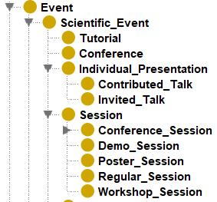
Strengthening - finding correct stronger axioms
Find additional correct information (not derivable from the KG yet)
super-concepts
sub-concepts
Tutorial ⊑ Scientific_Event
Tutorial ⊑ Individual_Presentation
⊑ Scientific_Event
replaced by its super-concepts
replaced by its sub-concepts
14
Notes:
Further, we want to apply strengthening to find additional correct knowledge to. If we have a correct weakened axiom to add, it can be replaced by its correct stronger version.

Slide 15
Combinations of basic operations
Choices regarding
processing axioms all at once or one at the time
in which order to perform the operations
when to update the KG
15
Notes:
There are choices to be made when using and combining the basic operations, i.e., Each of these choices may have an influence on the completeness and correctness of the repaired ontology.

Slide 16
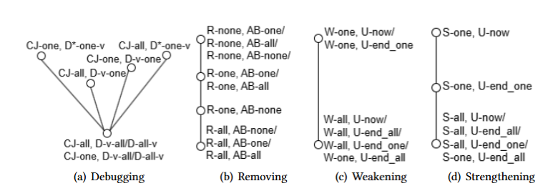
Hasse diagrams for combination operators
CJ: Compute the justifications for (one at a time/ all at once)
D: Validate the axioms (all asserted axioms/one hitting set)
R: remove wrong axioms (one at a time/ all at once/none)
AB: add back wrong axioms (none/one/all)
W: weaken (one at a time/all at once)
U: update the KG
S: Strengthen (one at a time/all at once)
U: update the KG
16
Using operators higher up in the diagrams leads to more complete KGs and more validation work.
Notes:
To show the different choices, we have defined different operators. To compare and show the influence between these choices in a more intuitive way, we have developed Hasse diagrams. In general, using operators higher up in the diagrams leads to more complete ontologies and more validation work.

Slide 17
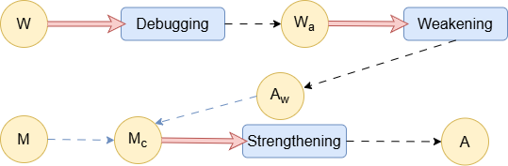
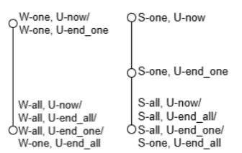
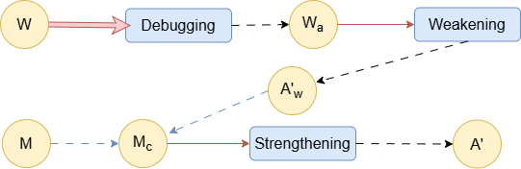
(a)
(b)
17
Notes:
An example of how the basic operations and combination operators can be used to define a repairing workflow
where the basic operations then still need to be instantiated with specific algorithms.
These are 2 possible variation of a linear workflow of KG repair. Both begin with debugging all incorrect axioms in 𝑊 at once. However, instead of weakening and strengthening all axioms at once as the a, b applies the weakening and strengthening one axiom at a time. Using the Hasse diagrams, we can then conclude that the workflow in b) removes the same asserted incorrect axioms, but leads to a more complete KG than the workflow in a)

Slide 18
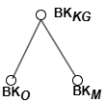
Different autonomy levels - choices
Ownership - background knowledge (BK)
Background knowledge can be used during the computation of repair solutions
The whole KG is used to compute solutions (BK_{𝐾𝐺})
Only a single ontology or alignment is used for computation (BK_{O,} BK_{M} )
Leads to a more complete KG
18
Notes:
Until now, we have treated all the axioms in the same way. However, in practice, the situation may be more complex….. In a kg With several networked ontologies,…..owner Mayans to retain different levels of autonomy and may not allow others to change….also, the data can be owned by different
organizations, may have access control over their data……. A first choice relates to

Slide 19
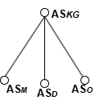
Different autonomy levels - choices
Ownership - final repair (AS)
Which axioms to retain for the final repair
Axioms belonging to all parts of the KG are retained (AS_{𝐾𝐺}).
Only axioms within a specific ontology, alignment or data set are retained ( AS₀, AS_{𝐷}).
Leads to a more complete KG
19
Notes:
Another choice relates to……in the most general case……. Incorrect axioms in the Kg may lead to removing and adding axioms in any ontology or dataset…….

Slide 20
Different autonomy levels - choices
Refutability
Which axioms are refutable
In many KG repair systems, ontologies are deemed correct and only ABox statements are refutable. (BK_{𝐾𝐺}, AS_{𝐷}).
Alignment repair: the ontologies are correct and require that the repair only contains mappings. (BK_{𝐾𝐺}, AS_{M})
20
Notes:
The autonomy levels and operators can also be used to deal with cases regarding refutability, for instance, which axiom are deemed to be correct and which are refutable

Slide 21
Developing repair systems
which basic operations to use and develop implementations for these
which combination operators to use
whether the steps can be interleaved and, in that case, how
21
Notes:
By comparing these different choices and the influences on the resulting KG, it provides us insights that when develop a repair system, we need to decid on………..

Slide 22
Conclusion
CHOICES MATTER for the quality of the repaired KGs,
Regarding how to combine operators
Regarding how to cooperate between owners of different parts of the KG
This framework serves as a template for developing repair systems with specific properties regarding correctness and completeness of the repaired KGs.
22
Notes:
Take away of this talk …….

