Slide 1
PERDIEMO
THE FINTECHERS 2026
PerDiemo agent
Close my trip to Munich.
Travel Expense forms are dead.
9 card payments matched. Per diems calculated by the Labour Code.
1 payment is outside the trip dates, so I left it out.
YOUR AGENTIC TRAVEL EXPENSE SAAS
✓ CZK 7,997.40
sent to Martin
Notes:
Shown while we walk up. Expense forms are dead. Just talk and snap, get your money back. The amount is the real result of the Prague to Munich demo trip in PerDiemo.

Slide 2




Meet Martin. IT Consultant.
30 business trips a year.
15
receipts lost
2 days
of work spent on expense forms
CZK 24,000
lost. Half his, half his company's.
Every year.
500 managers like Martin: CZK 12 million a year.
Notes:
0:00–0:30. Meet Martin. Manager and founder of PerDiemo. 30 business trips a year. Every year he loses about 15 receipts and spends two working days on expense forms. That's 24,000 crowns lost every year: half is his own money he never claims back, half is company money paid for paperwork, not work. A company with 500 managers like Martin loses 12 million crowns a year. And somewhere, an accountant re-checks every one of Martin's 30 trips by hand. Expense management is still a mess.
Basis (for Q&A): 15 hours x ~800 CZK/hour senior manager cost incl. levies = ~12,000 CZK; 2 unclaimed trips (Germany per diem EUR 50/day, decree 489/2025) + 15 lost receipts x ~400 CZK = ~12,000 CZK. Martin's own estimate.

Slide 3



USE CASE 1
ENTREPRENEUR
Entrepreneur: 40 trips a year, zero Excel
PAIN POINT
SOLUTION
BENEFIT
• 3 business trips a month, about 40 a year
• PerDiemo uses AI model to parse plain-language input
• Hours of valuable time saved
• Business trip complied with legislation
• Trips live in the calendar
• Trip description becomes a legally compliant PDF or Excel
• Manual Excel after every trip
Notes:
Use case 1: an entrepreneur with about 40 trips a year. Today: manual Excel after every trip. PerDiemo turns a plain-language trip description into a legally compliant PDF or Excel.

Slide 4
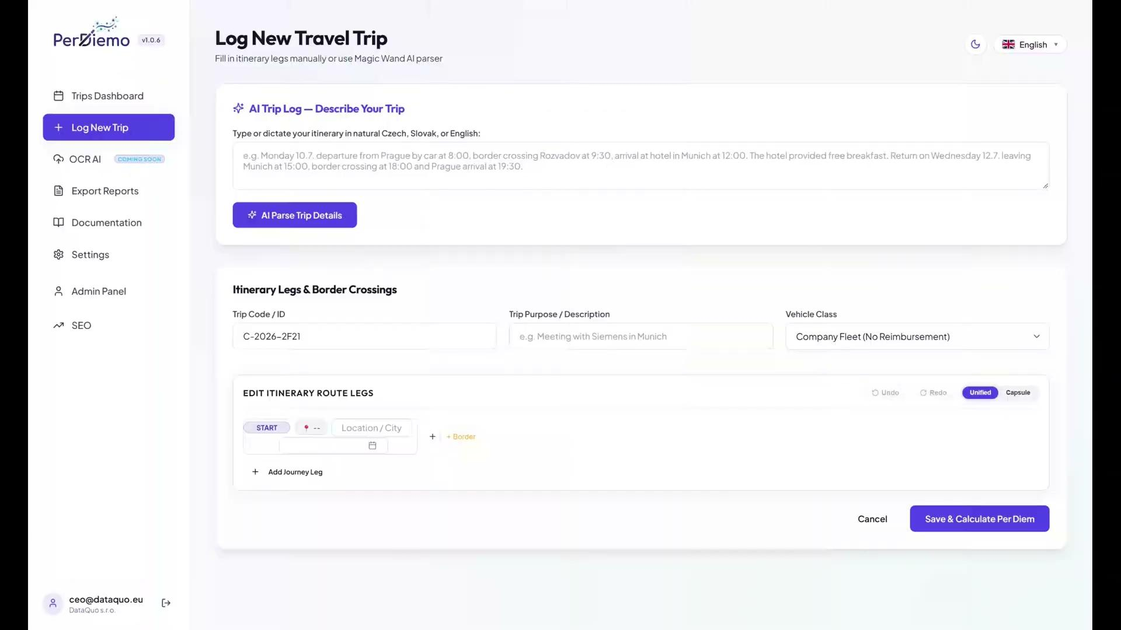
USE CASE 1
ENTREPRENEUR
Notes:
Use case 1: an entrepreneur with about 40 trips a year. Today: manual Excel after every trip. PerDiemo turns a plain-language trip description into a legally compliant PDF or Excel.

Slide 5
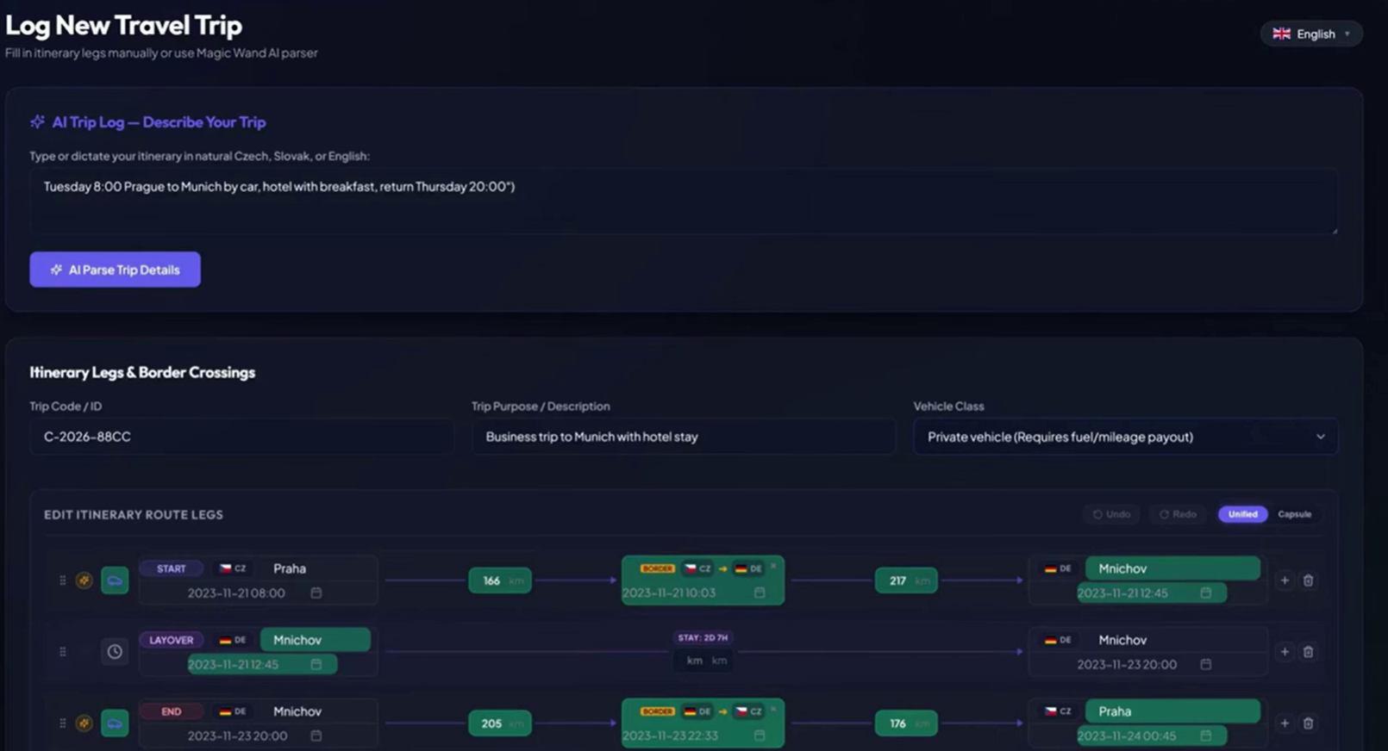
SLIDE 05 / 12 • LIVE DEMO
SHOW, DON'T TELL
Live demo: from one message to the payout
1
Ask in chat: "Close my trip to Munich"
2
Card payments matched to the trip
3
Compliance check: 8 passed, 1 flagged
4
"Why only 8 of 9?" The agent explains the rule
5
Per diems calculated by the Labour Code
6
Exact amount paid out to the employee
AI reads. Rules decide.
Notes:
0:40–2:20. Live demo, one end-to-end flow. Start in the chat, not with a button, so "zero clicks" holds. Key line at the explanation step: AI reads, rules decide. Backup: screen recording if the wifi or the demo fails.

Slide 6




THE FINTECHERS 2026
USE CASE 1
Entrepreneur
Hackathon demo
USE CASE 2
Corporate card
Three use cases, one agent.
USE CASE 3
Card + receipts

Slide 7
USE CASE 2
CORPORATE CARD
Employee pays with a corporate card on a business trip
PAIN POINT
SOLUTION
BENEFIT
• Unclear card transactions must be turned into a trip
• Transactions processed automatically, non-compliance flagged
• Trips created automatically from payments
• Transactions get enriched: merchant and category
• AI prompts plus deterministic calls to the trips engine
• Manager approves, or the AI copilot fixes issues per trip
Notes:
Use case 2: the employee pays with a corporate card. Card transactions are enriched with merchant and category, processed automatically and non-compliance is flagged. AI prompts plus deterministic API calls to the trips engine. The employee gets trips created from payments; the manager approves or lets the AI copilot fix issues.

Slide 8
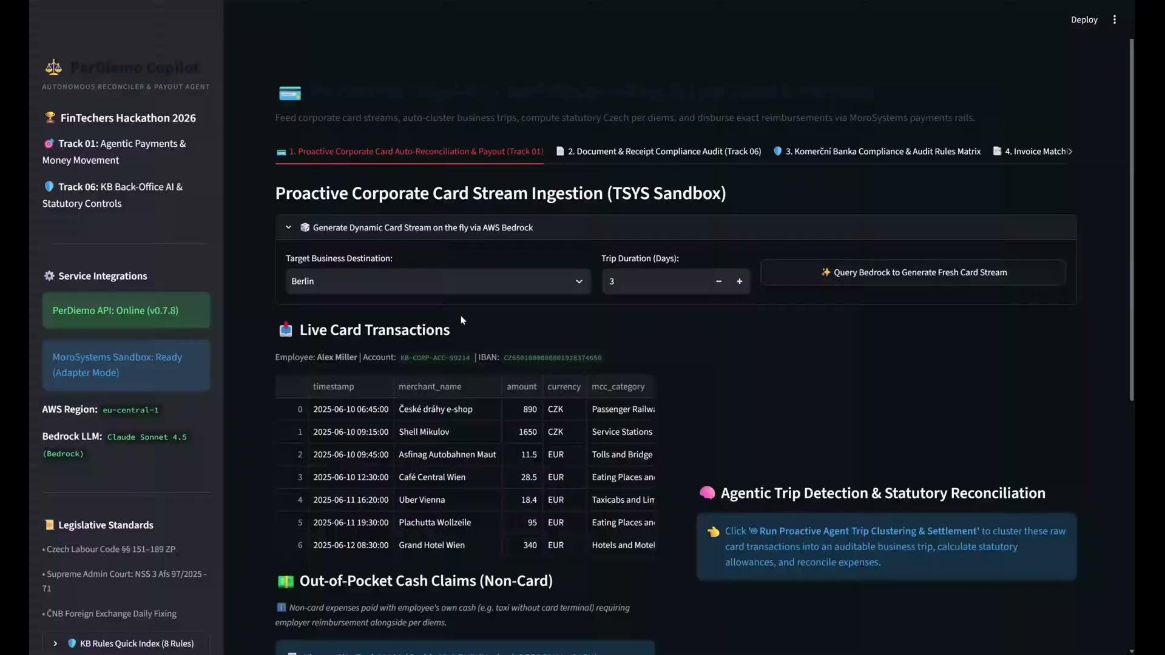
USE CASE 2
CORPORATE CARD
Notes:
Use case 2: the employee pays with a corporate card. Card transactions are enriched with merchant and category, processed automatically and non-compliance is flagged. AI prompts plus deterministic API calls to the trips engine. The employee gets trips created from payments; the manager approves or lets the AI copilot fix issues.

Slide 9
SLIDE 06 / 12 • BUSINESS CASE
LARGE COMPANIES
Corporate cards already see the payments. We close the trip.
Corporate card
payments from the bank
PerDiemo
agent + Labour Code engine
Manager
money back, by law
WHO PAYS
CFOs of companies with hundreds of travelling managers
HOW
Annual licence plus a fee per closed trip
CHANNEL
Corporate card banks and advisory firms
NOT A GPT WRAPPER
AI reads. Rules decide. Data stays in the EU.
Why us: Czech law today. Every EU country is a new rulebook we own.
CONNECTS TO
Corporate cards
SAP
Dynamics 365
Oracle NetSuite
Pohoda
Money S5
Helios
Payroll
Corporate cards via bank feed or open banking. Today: PDF, CSV, JSON and XML export for accounting. Direct connectors with the pilot.
Notes:
2:20–2:50. Our customer is the large company with hundreds of travelling managers, and the buyer is the CFO. A company with 500 Martins loses about 12 million crowns a year. Corporate cards already see every payment; we close the trip. We sell an annual licence plus a fee per closed trip, directly and through the banks that issue corporate cards and advisory firms like Deloitte. For a bank, it is a reason for corporates to keep their cards with them. Czech law today, and every EU country is a new rulebook we own. And this is not a GPT wrapper: a chatbot can describe payments, but it cannot calculate per diems by law and defend them in an audit. Our engine can, and the data stays in the EU.

Slide 10
USE CASE 3
CARD + RECEIPTS
Employee pays with a corporate card and submits receipts
PAIN POINT
SOLUTION
• Invoices must be cross-checked with card transactions
• AI vision and OCR extract the invoice data
• Structured card data meets free-form receipts
• AI matches each invoice to its card transaction and enriches it
Notes:
Use case 3: corporate card plus receipts. Today someone cross-checks invoices against card transactions by hand. AI vision and OCR extract invoice data, and the model matches each invoice to its card transaction.

Slide 11
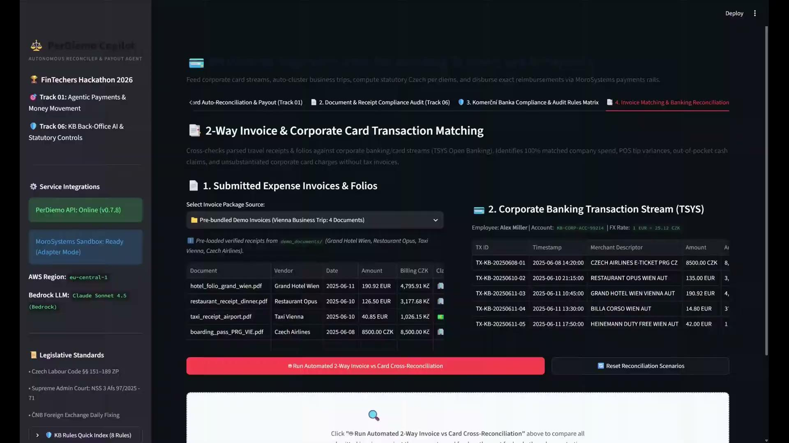
USE CASE 3
CARD + RECEIPTS
Notes:
Use case 3: corporate card plus receipts. Today someone cross-checks invoices against card transactions by hand. AI vision and OCR extract invoice data, and the model matches each invoice to its card transaction.

Slide 12


THE AGENT
Say it. Snap it. Get paid.
RECEIPT
Prague to Munich, Monday to Wednesday.
CZK 7,997.40
sent to Martin
✓ Matched to card payment
Say
Snap
Paid
Notes:
Martin dictates the trip. Snaps the receipt. The agent matches it with his card payments, calculates by law and pays him. That's it. (If receipt matching is not finished for the demo, say: card payments are matched automatically.)

Slide 13

WHAT WE NEED NEXT
Our ask
1-month pilot with one large company and its corporate-card bank.
Martin Michalik · perdiemo.eu
perdiemo.eu
Notes:
2:50–3:00. We're looking for one bank to pilot this with real business-card transactions. Talk to us. Leave this slide on screen during Q&A.

Slide 14
SLIDE 12 / 12 • PRICING
SAAS PLANS
Free to start. Scales with every trip.
Our focus
FREE
BUSINESS
ENTERPRISE
PARTNER
CZK 0
Annual plan
Per closed trip
White-label
Try it
Growing teams
Large companies
Banks and card issuers
✓ 10 trips a year
✓ More trips
✓ AI agent: say, snap, paid
✓ PerDiemo inside your app
✓ Calculated by the Labour Code
✓ No per-user fees
✓ Corporate card matching
✓ API and MCP access
✓ PDF and XML export
✓ Export to accounting
✓ ERP and payroll connectors
✓ Revenue share
✓ Compliance rules, audit trail
No per-user fees on any plan. Enterprise and partner prices are set with the pilot.
Notes:
SaaS model. Free: 10 trips a year (live today). Business: annual plan with no per-user fees (live today). Enterprise: our focus, the AI agent for large companies, priced as an annual licence plus a fee per closed trip. Partner: white-label for banks and card issuers, API and MCP, revenue share. Exact prices to be confirmed by Martin.

Slide 15
SLIDE 03 / 12 • SOLUTION
ZERO CLICKS
Stop clicking. Just ask for it.
TODAY
WITH PERDIEMO
1
Fill in the expense form
Close my trip to Munich.
2
Find and scan every receipt
Done. 9 card payments matched, per diems calculated by law.
3
Match card payments by hand
✓ CZK 7,997.40 sent to Martin
4
Wait for finance to check it
Before: one sentence → a legal travel claim. Now: card payments → money in the account.
Notes:
0:30–0:40. PerDiemo already turns one sentence into a legal travel claim. Here, we connected it to card payments and gave it an agent that pays out. Stop clicking. Just ask for it.

Slide 16



SLIDE 08 / 12 • TEAM
WHY US
Team: product, AI and go-to-market
Martin Michalik
Hiro M
Dana Hrušková
Founder of PerDiemo. Product, AI and the Labour Code engine.
DevOps Engineer
Python Expert
Go-to-market, onboarding and customer success in B2B SaaS.

Slide 17
SLIDE 09 / 12 • STACK
WHAT WE BUILT ON
Stack: what we built on top of
DATA Business card transactions · receipts
AI AWS Bedrock (Claude, Frankfurt): reads and matches
RULES PerDiemo Labour Code engine via MCP: calculates and explains
PAYOUT Payments sandbox: exact amount to the employee
Next: receipt photos cross-checked with transactions · calendar-prepared trips

Slide 18
SLIDE 10 / 12 • RESPONSIBLE AI
COMPLIANCE
AI reads. Rules decide.
Calculated by law
Every amount comes from the Labour Code engine, never guessed by AI.
Explained
Ask why any rule was applied and get a plain-language answer.
8 passed
1 flagged
Why only 8 of 9?
One hotel payment falls outside the trip dates, so the company's travel-dates rule excluded it.
Audit trail
Every trip keeps time, place, rule and source for each number.
Data stays in the EU
Built on AWS in Frankfurt (eu-central-1).

