Slide 1
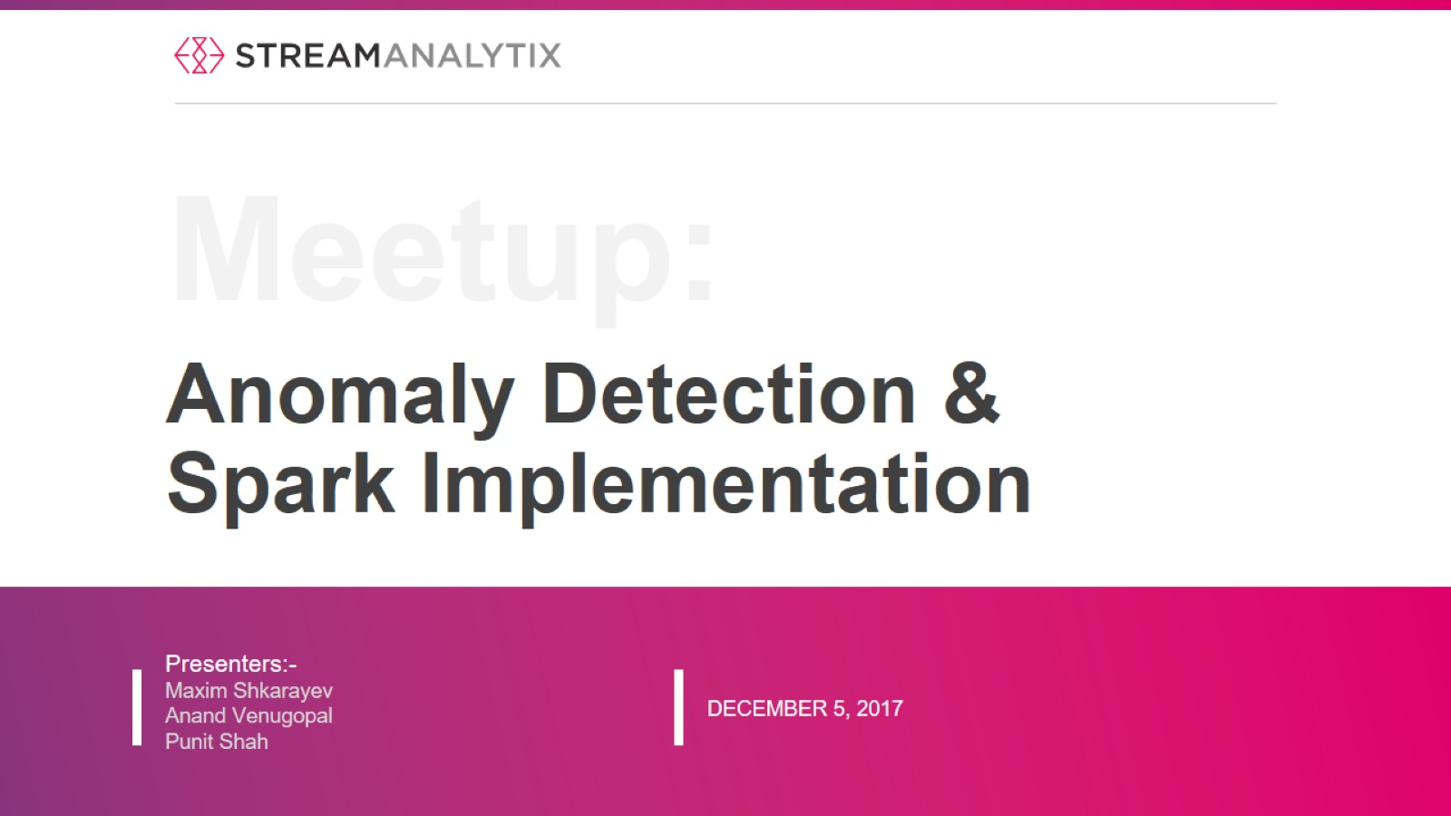
Anomaly Detection &
Spark Implementation

Slide 2


Slide 3
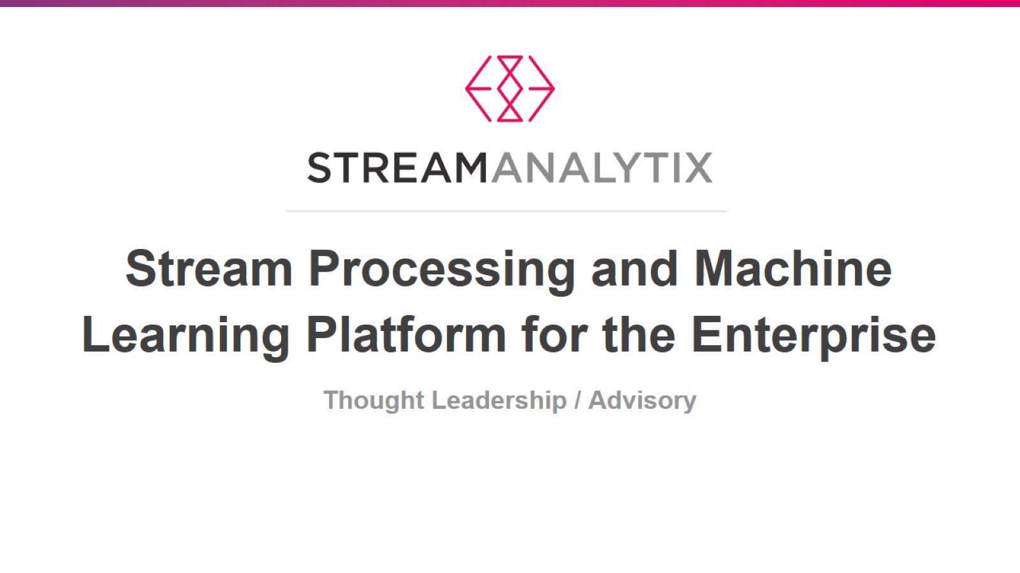

Slide 4
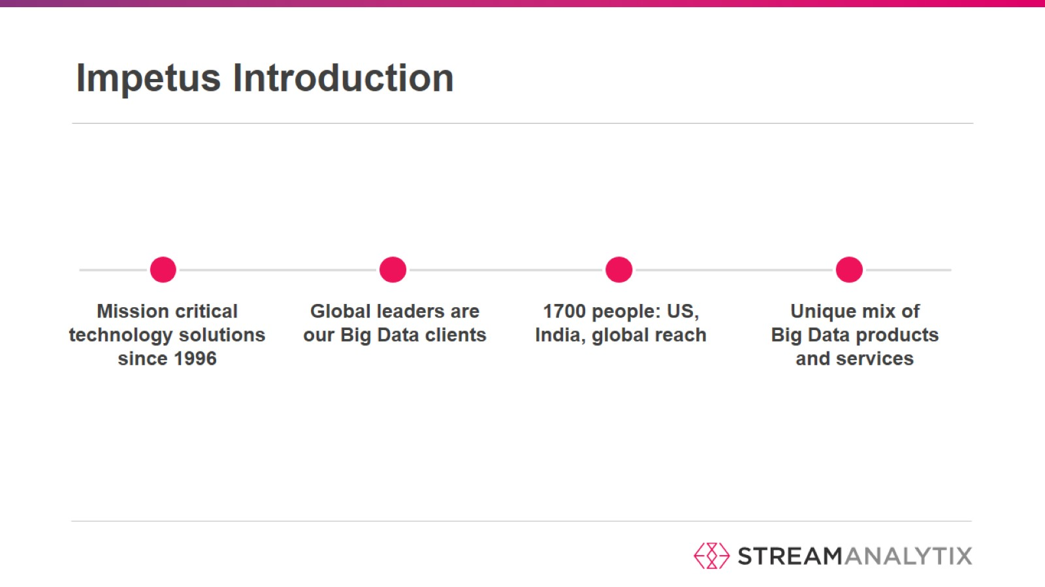
Impetus Introduction

Slide 5
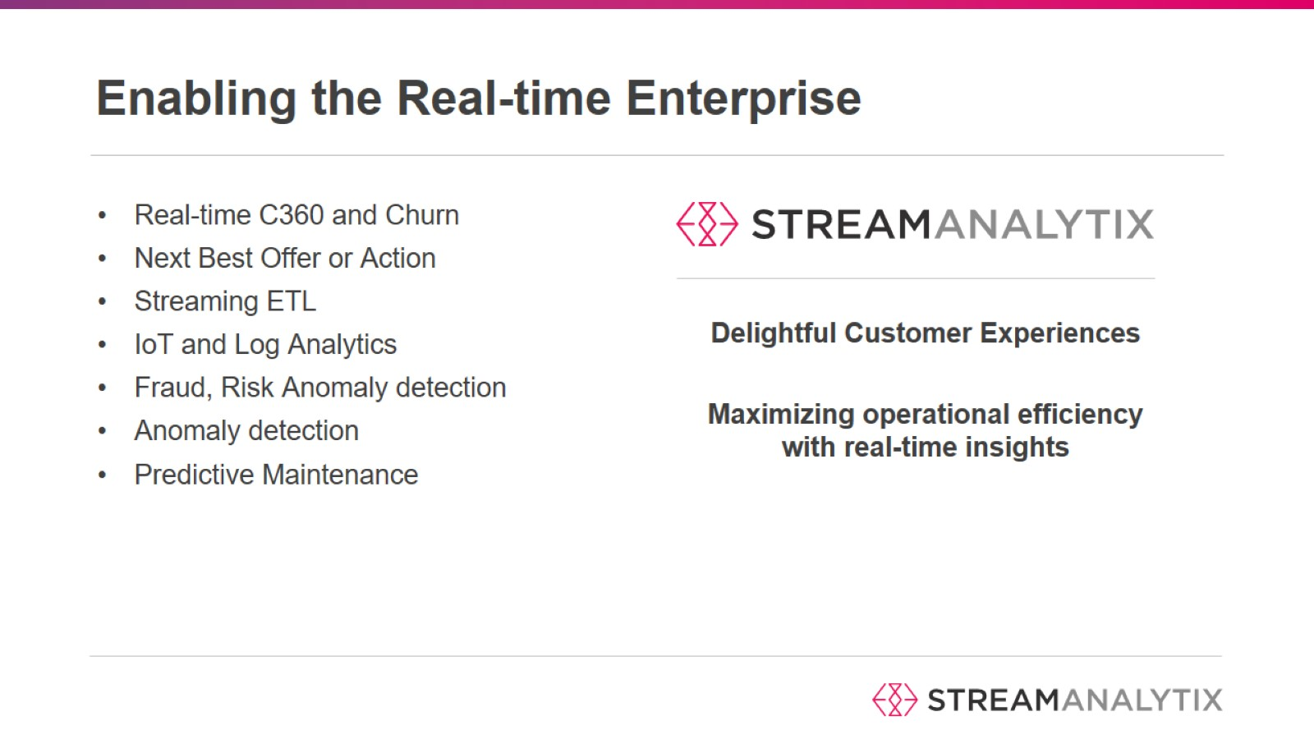

Slide 6
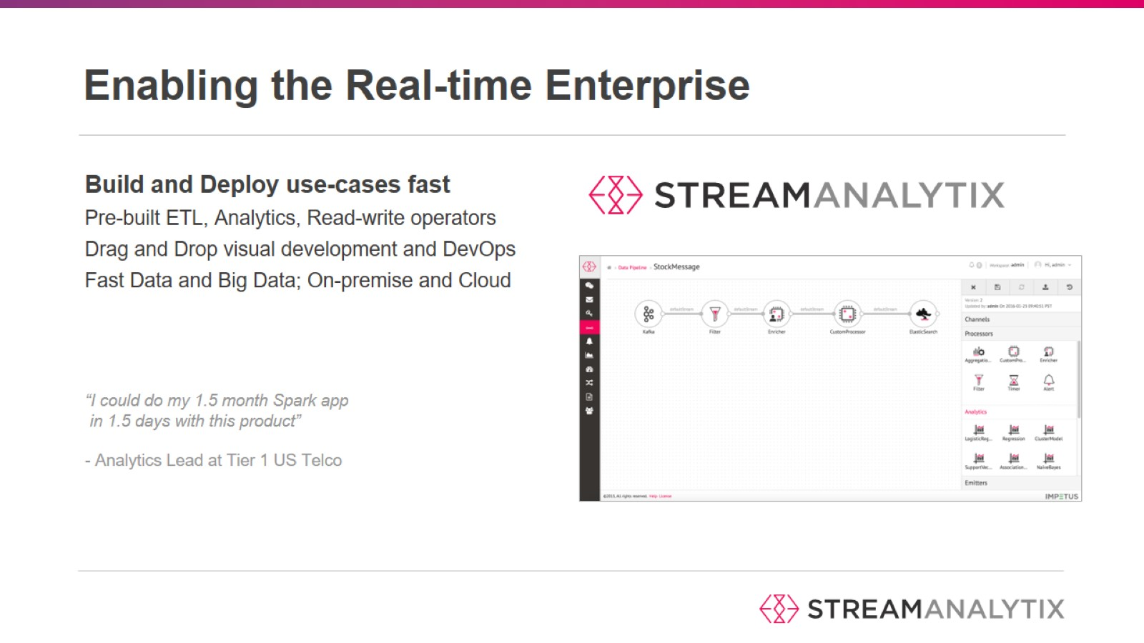

Slide 7
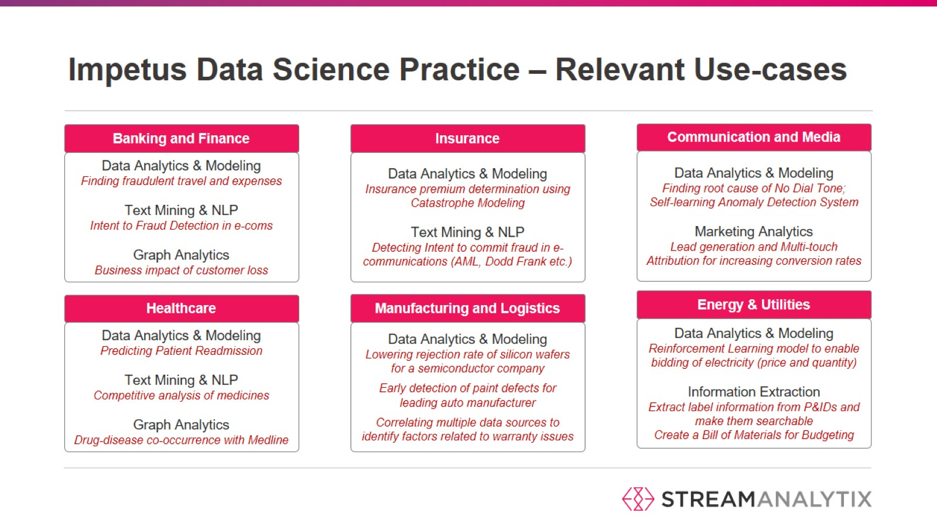
Impetus Data Science Practice – Relevant Use-cases

Slide 8
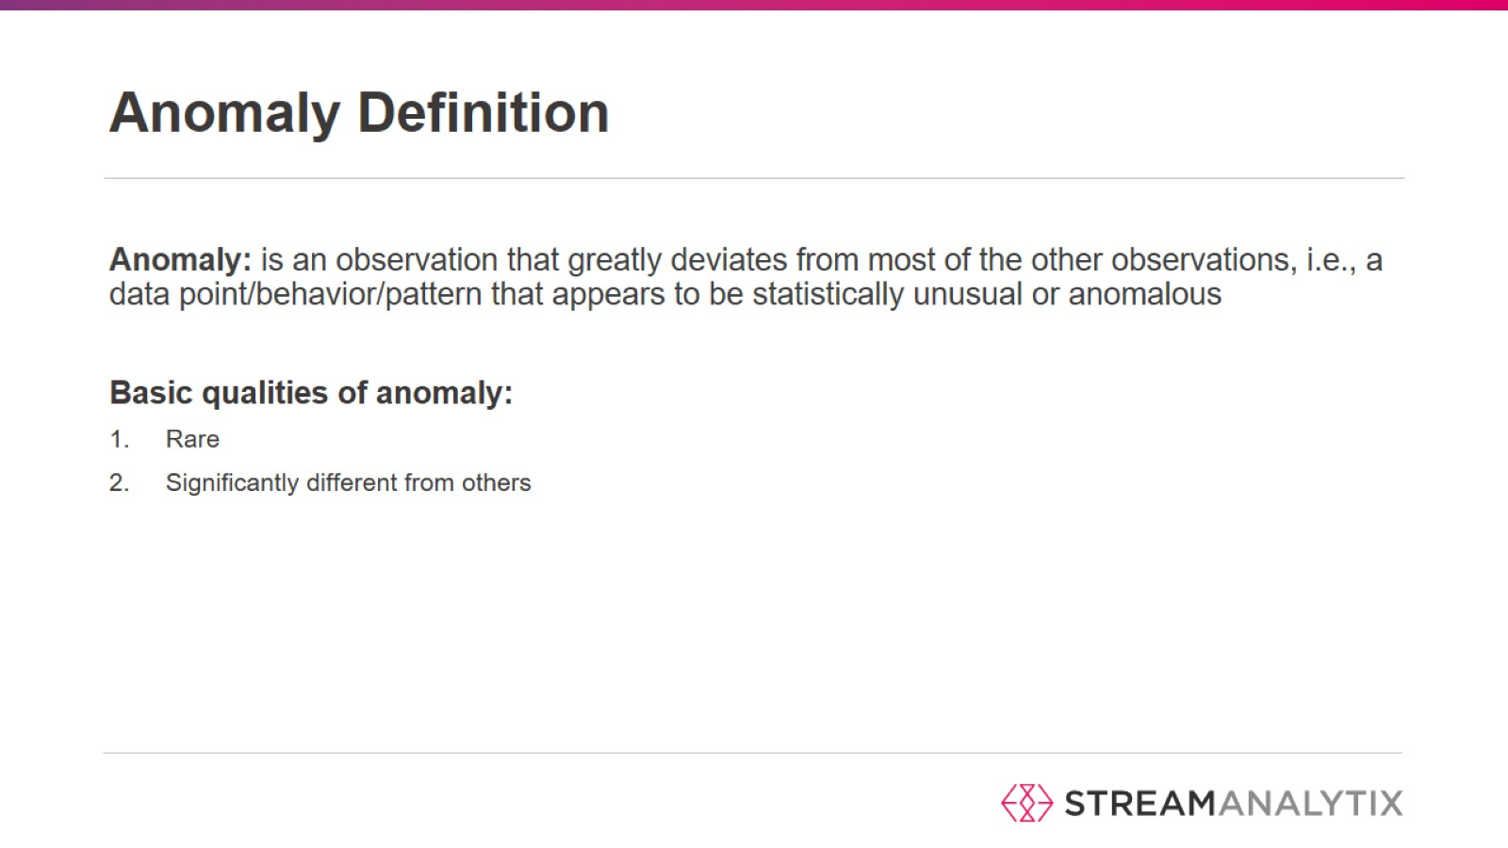
Anomaly Definition

Slide 9
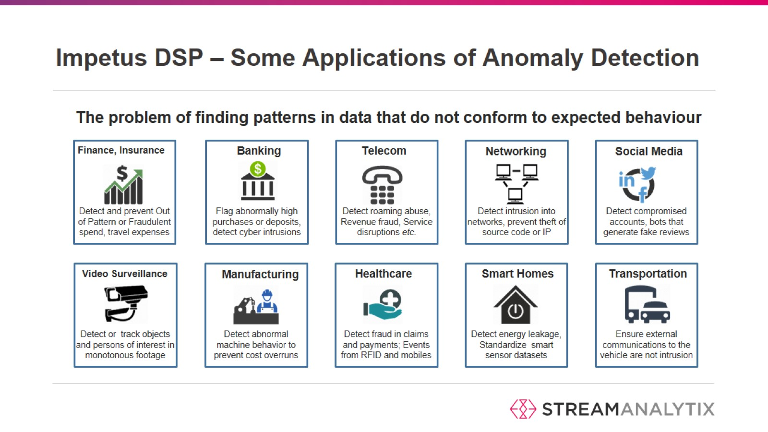
Impetus DSP – Some Applications of Anomaly Detection

Slide 10
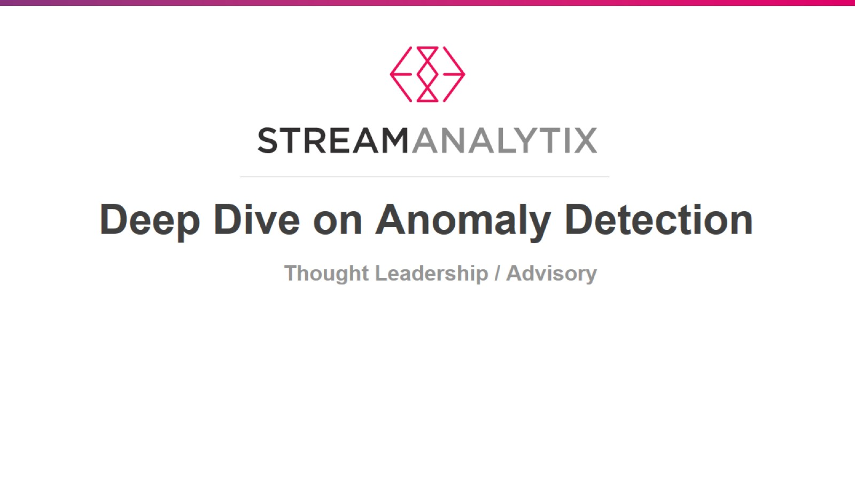

Slide 11
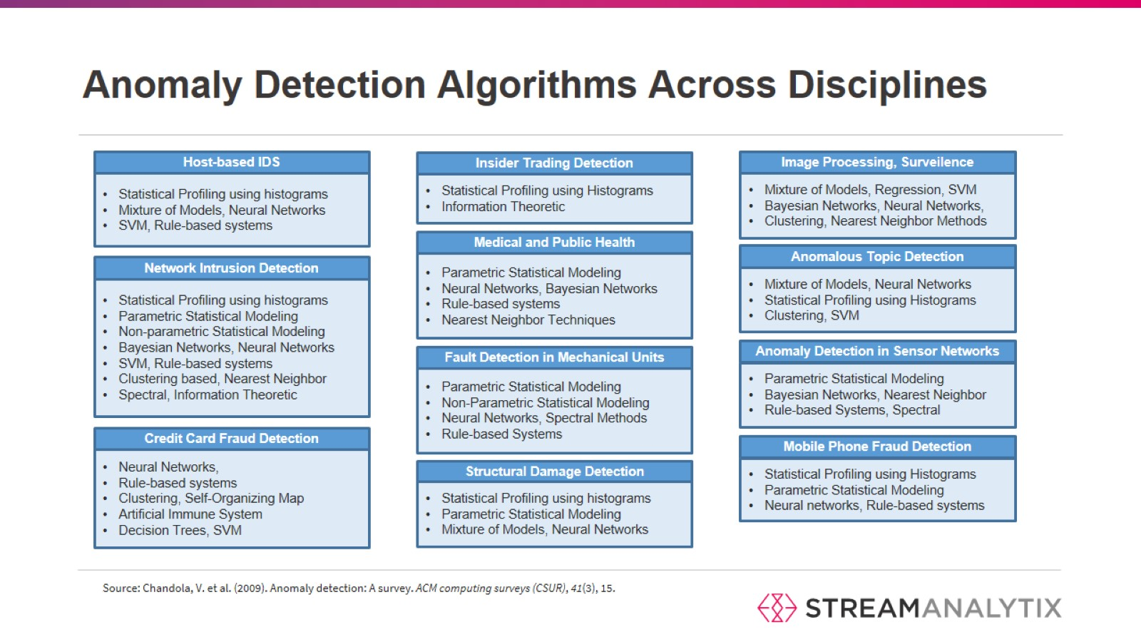
Anomaly Detection Algorithms Across Disciplines

Slide 12
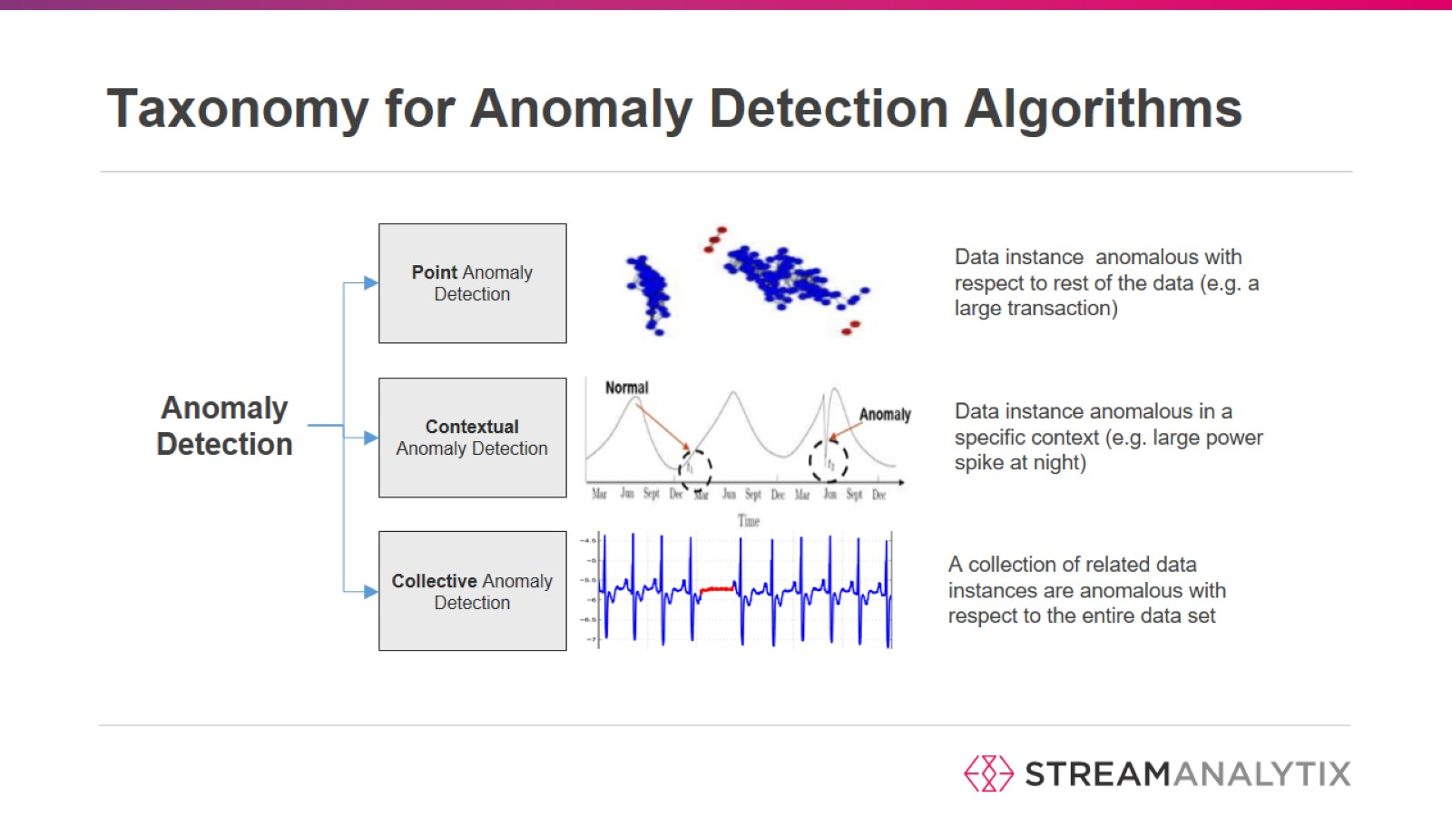
Taxonomy for Anomaly Detection Algorithms

Slide 13
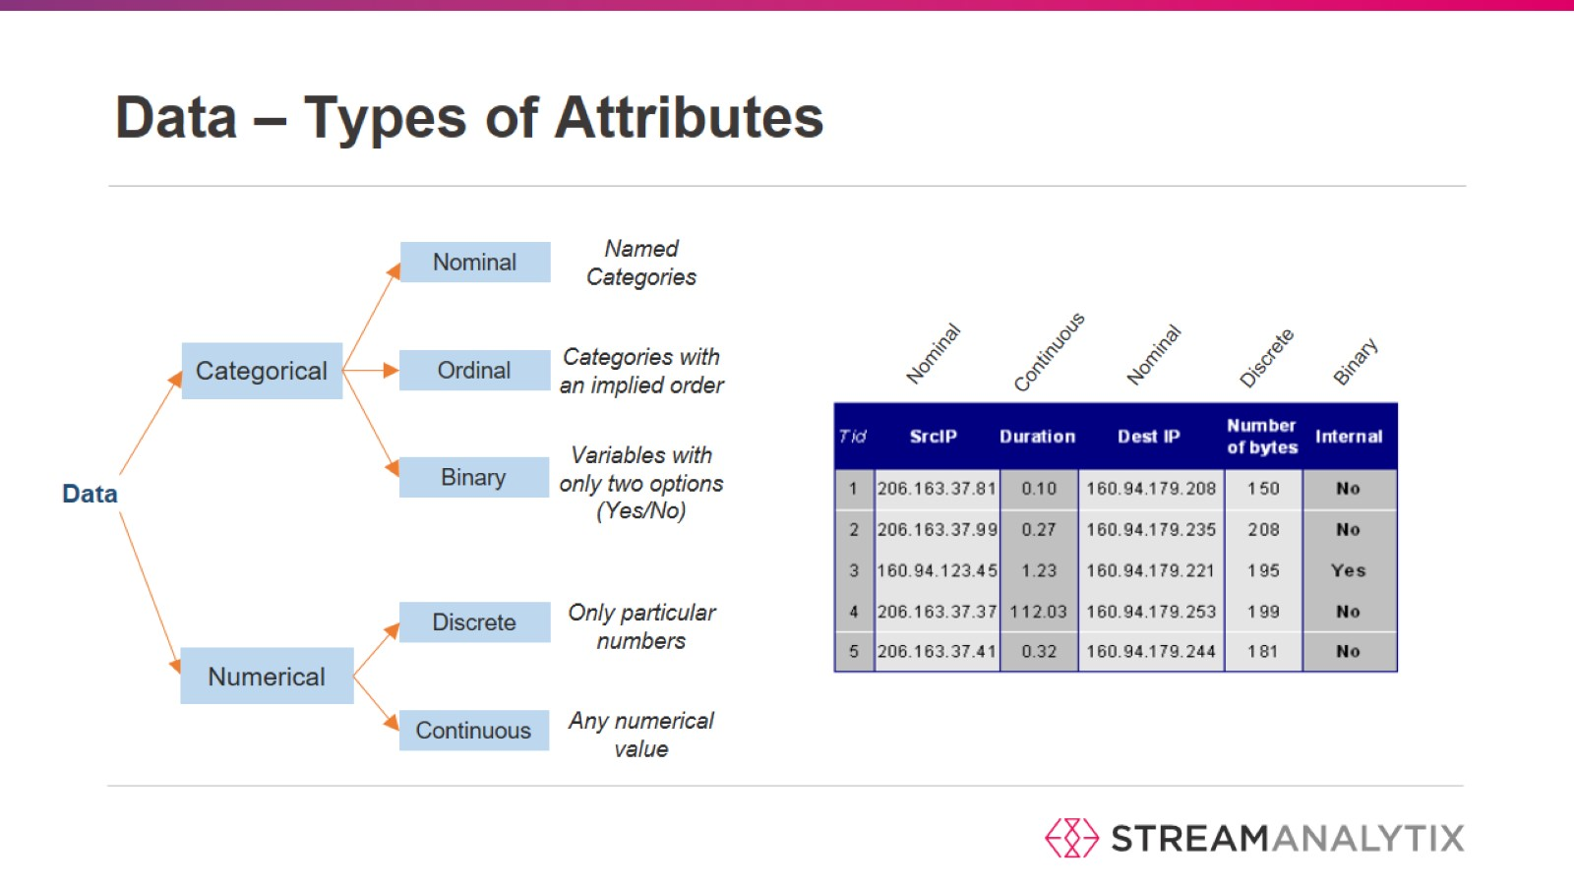
Data – Types of Attributes

Slide 14
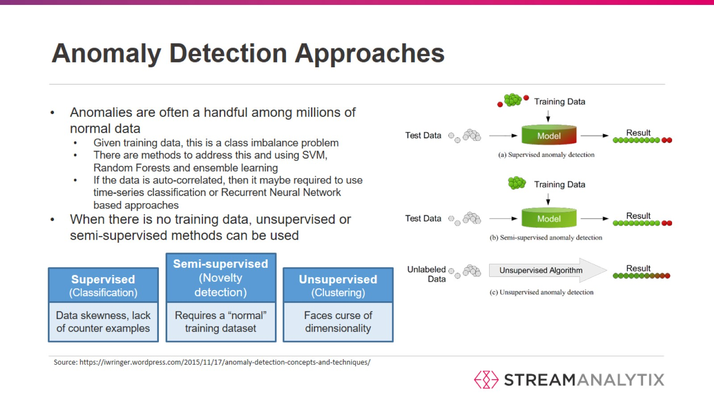
Anomaly Detection Approaches

Slide 15
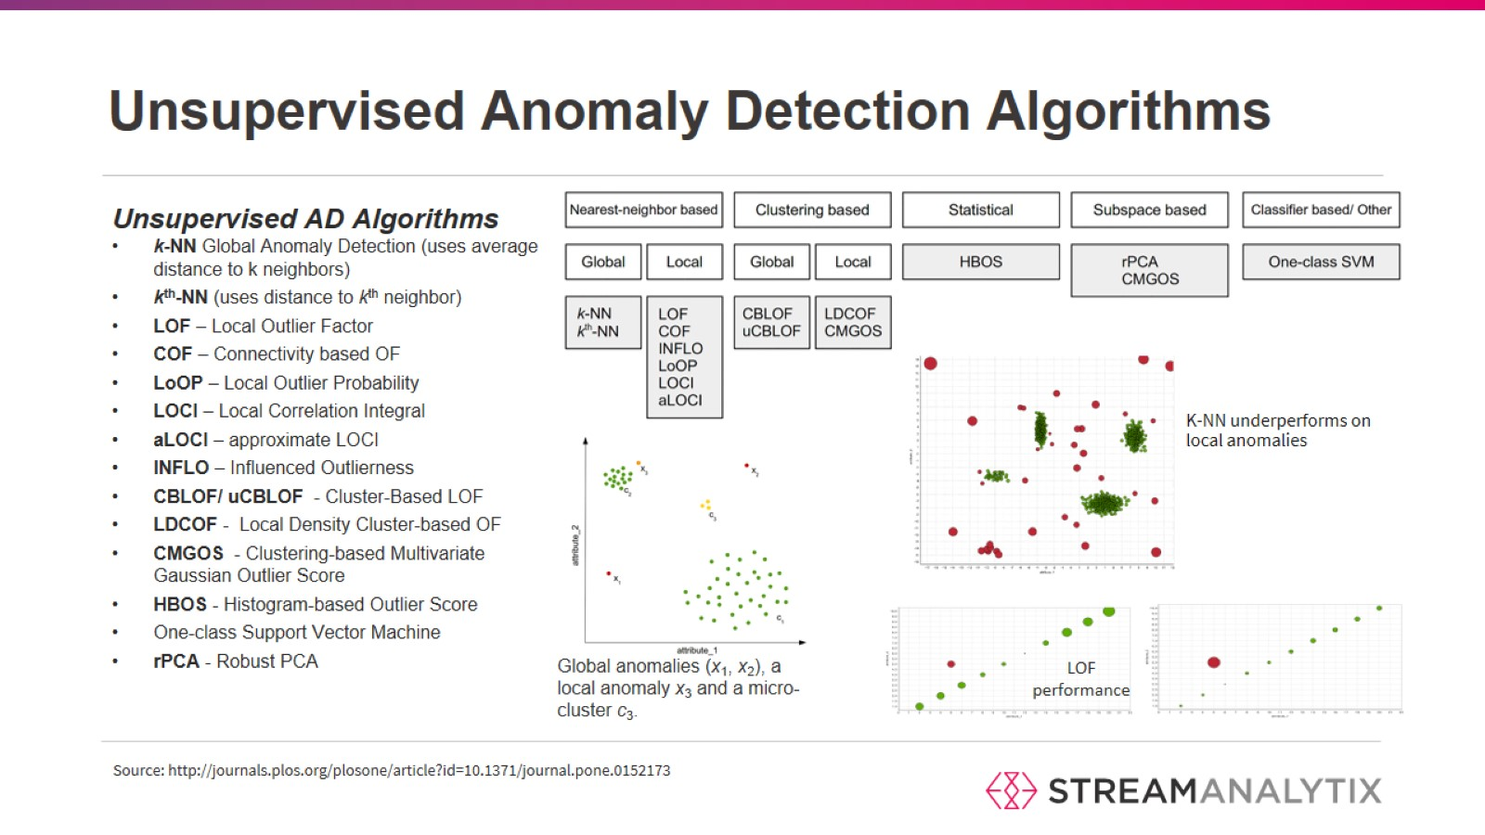
Unsupervised Anomaly Detection Algorithms

Slide 16
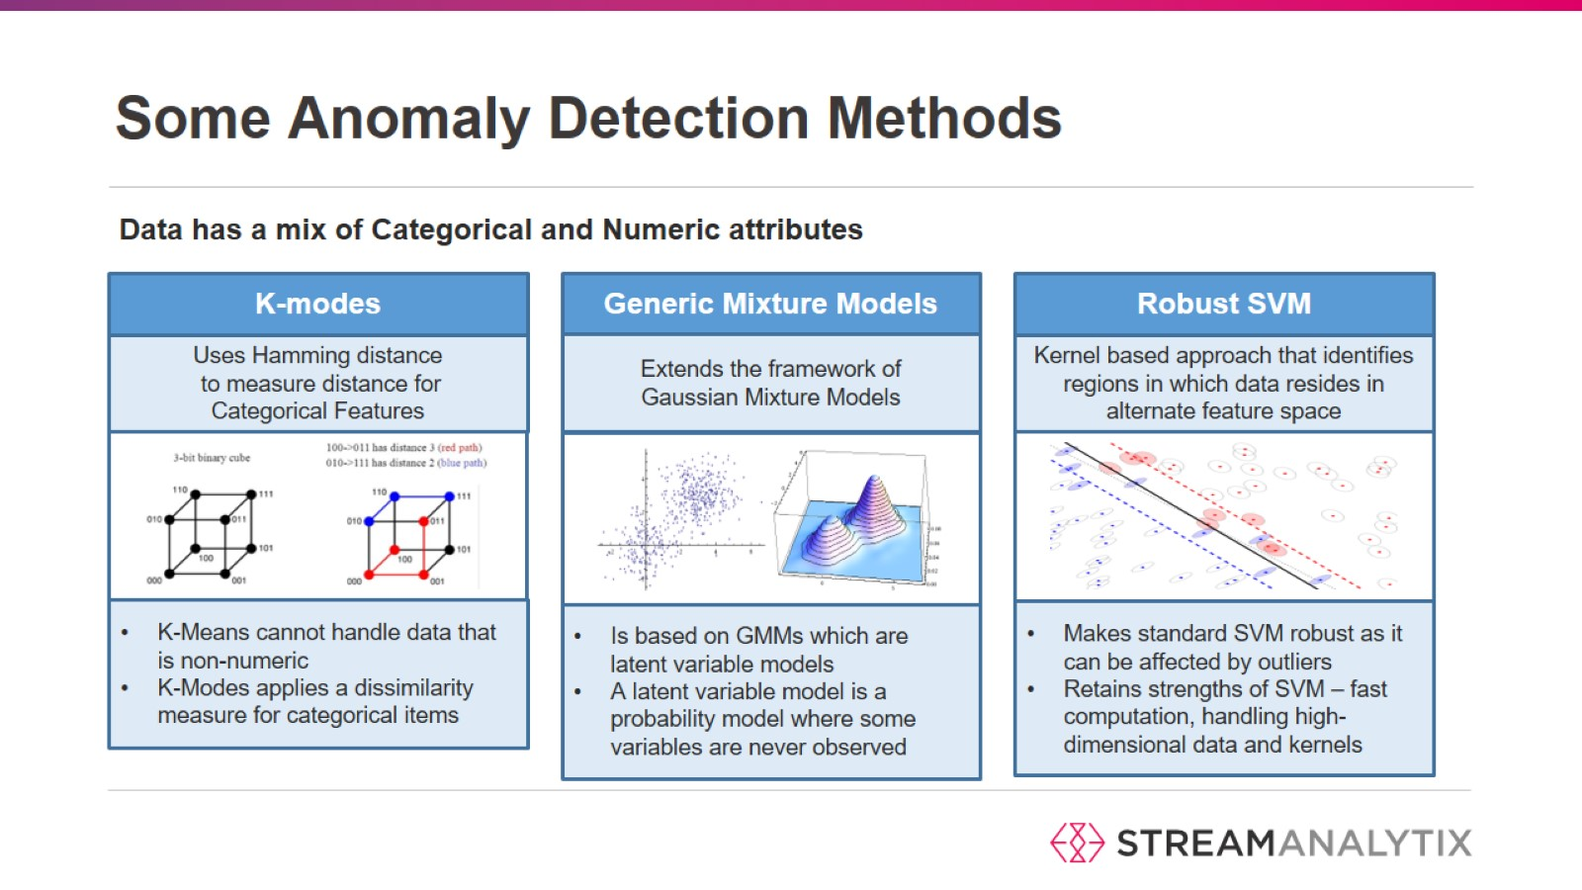
Some Anomaly Detection Methods

Slide 17
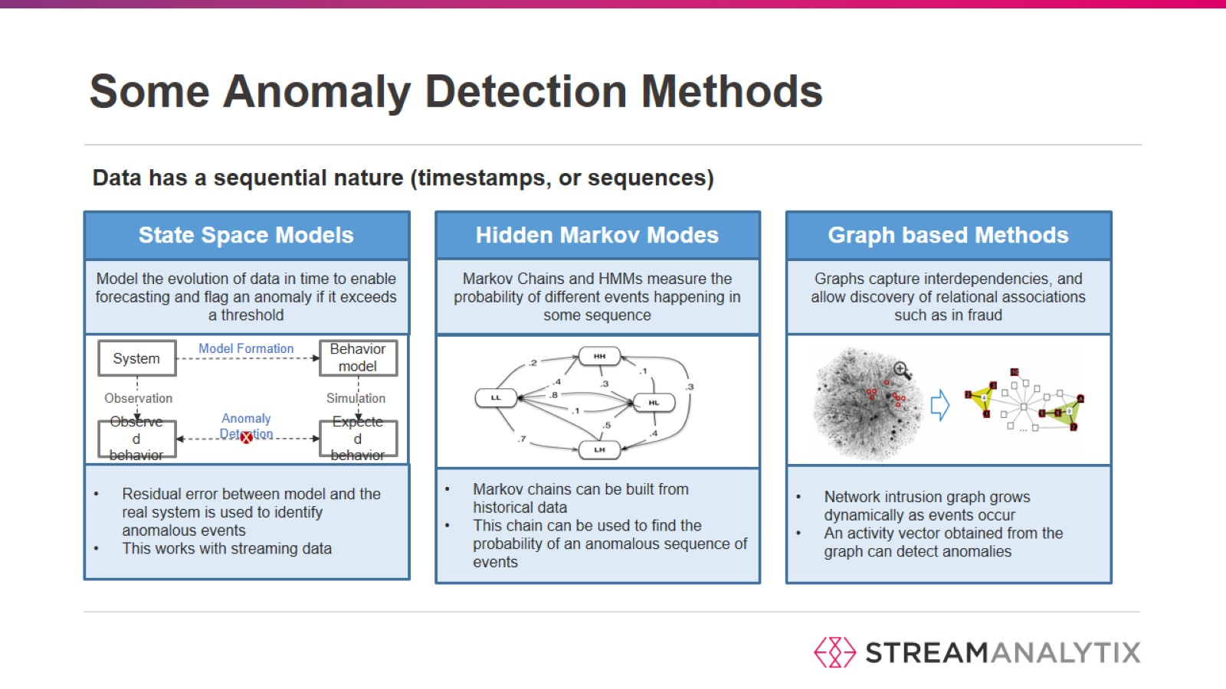
Some Anomaly Detection Methods

Slide 18
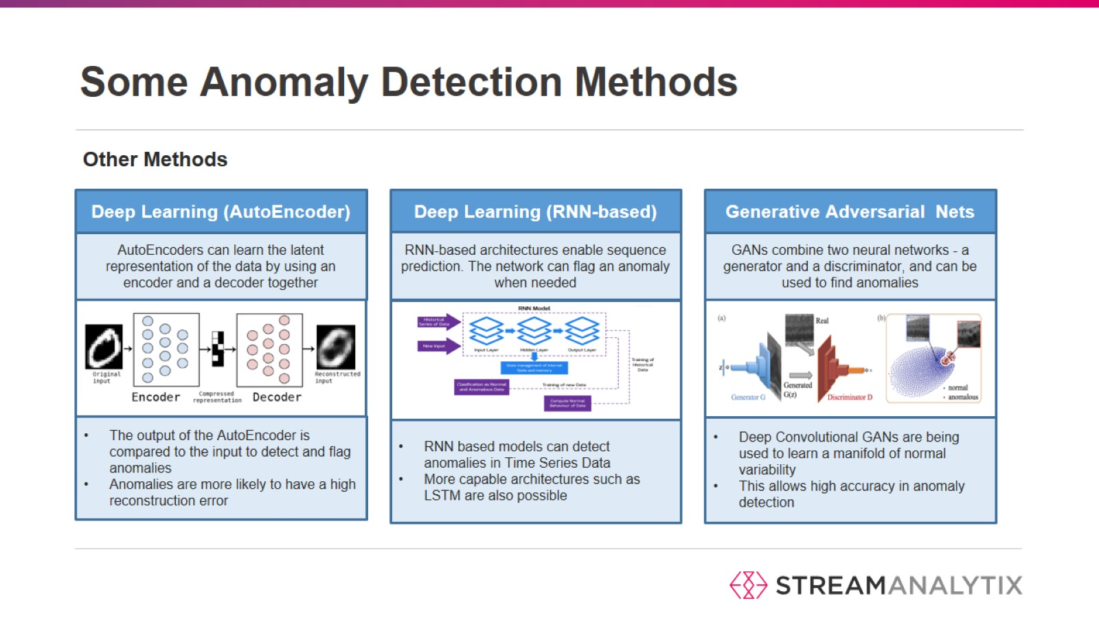
Some Anomaly Detection Methods

Slide 19
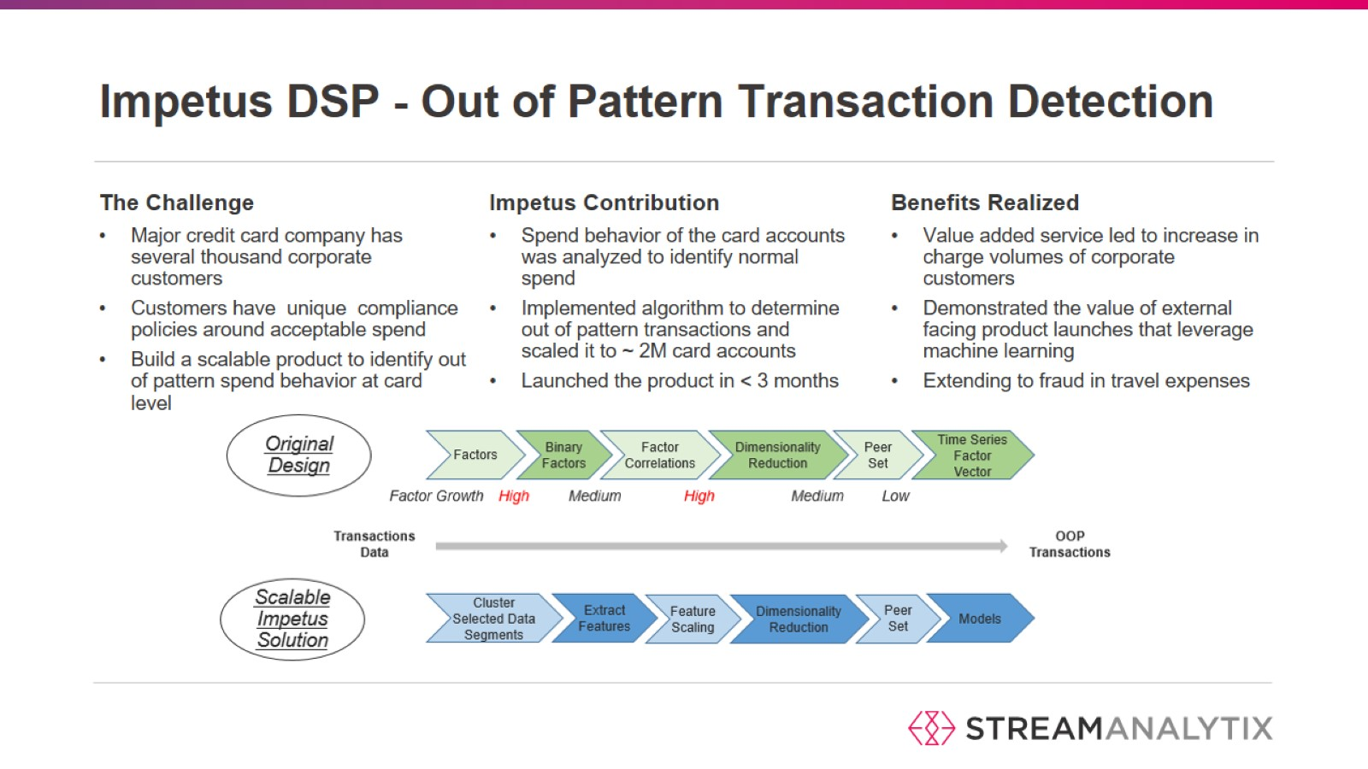
Impetus DSP - Out of Pattern Transaction Detection

Slide 20
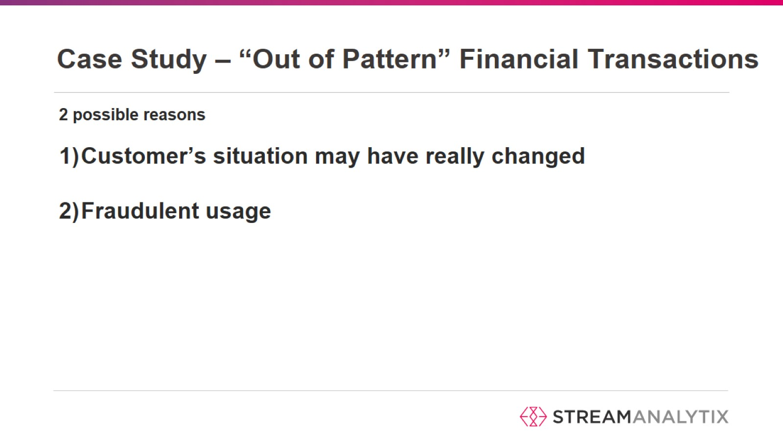
Case Study – “Out of Pattern” Financial Transactions

Slide 21
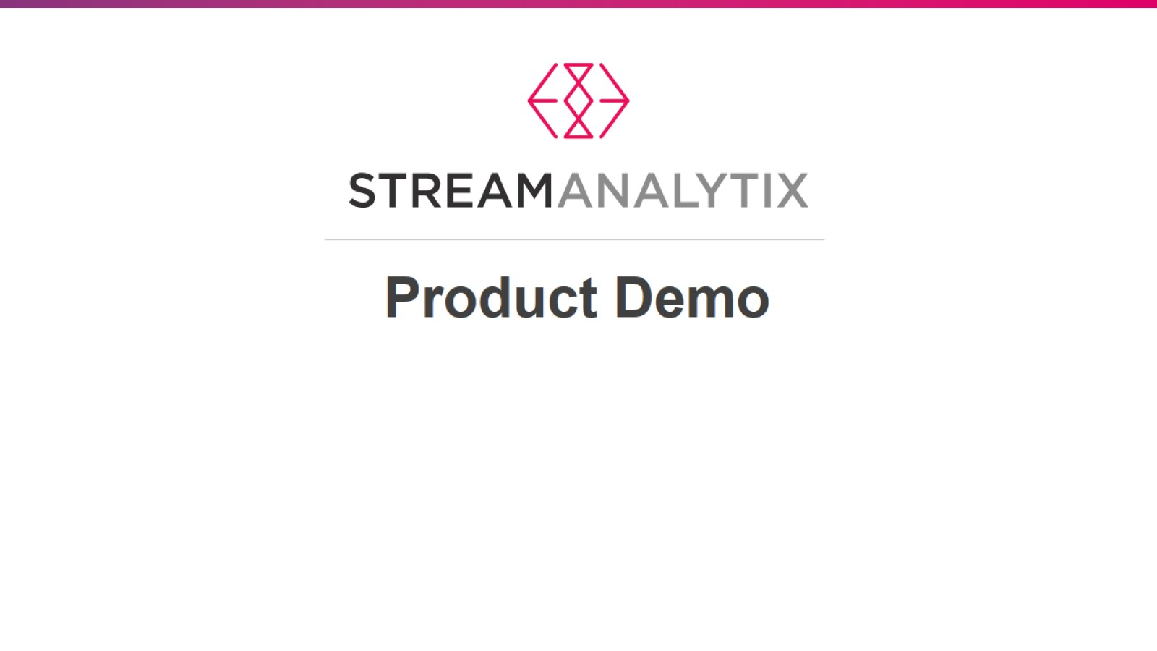

Slide 22
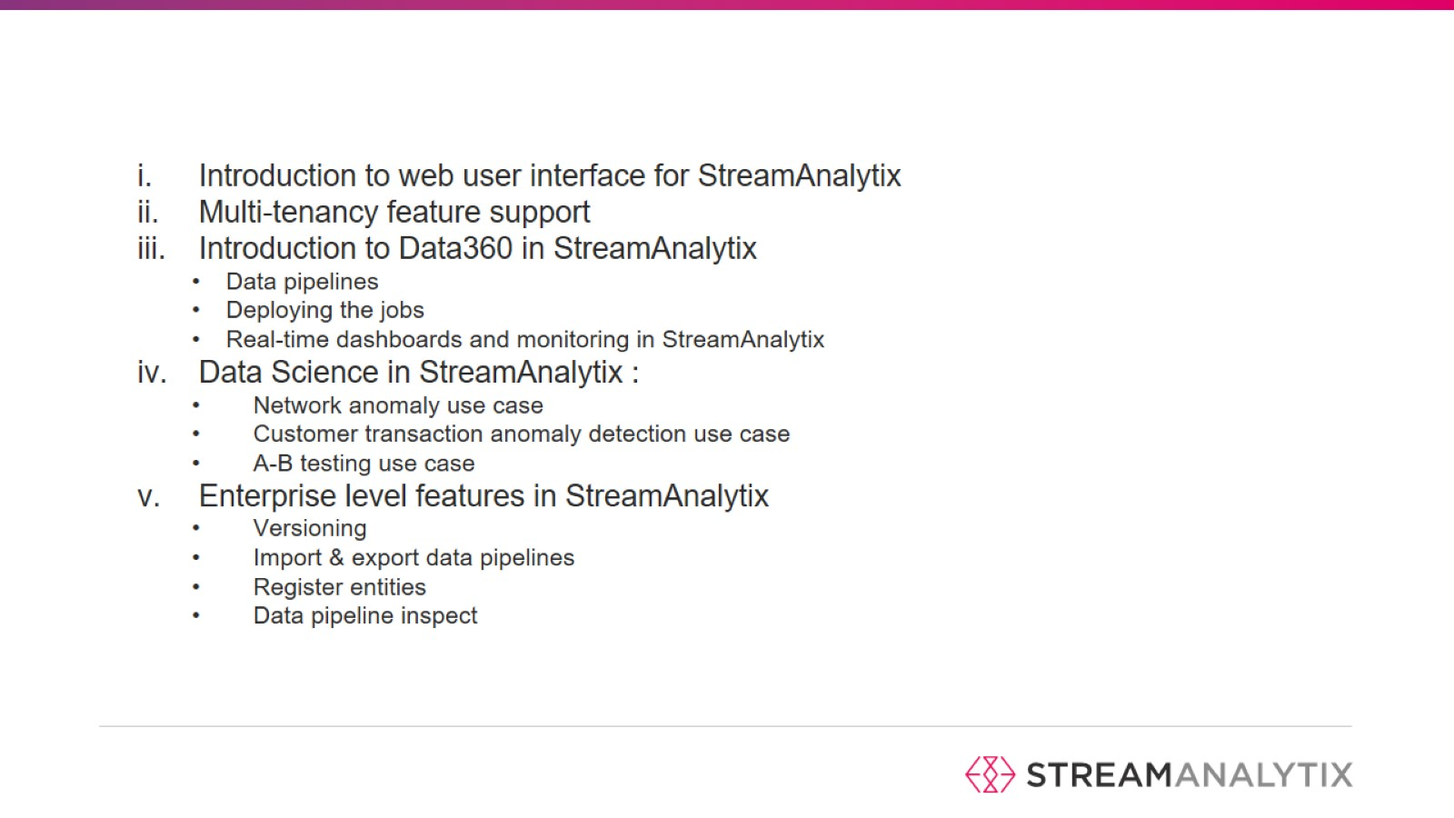

Slide 23


