Slide 1
Predicting the Boston Housing Dataset:
An Application of Stacked Generalization.
Preliminary-Do not cite or distribute

Slide 2
Purpose:
Stacked Generalization, aka Stacking, is used to improve predictive accuracy on the well known Boston Housing data set
Stacking is an ensembling method
Flexible – will work for either regression or classification
Essential part of Kaggle contests
These competitions often combine thousands of models in creative ways

Slide 3
Boston Housing Data
Data sourced from Boston Standard Metropolitan Statistical Area Census of 1970
Data made up of 506 census tracts (N=506)
Featured in paper by Harrison and Rubenfeld (1978)
Our target is the median housing price (000’s) per census tract (MEDV)
There are 13 numerical/categorical predictive attributes
Importance of valuation of housing
  Helps buyers/sellers of the houses
  Also important for property agents and developers

Slide 4
Data Attributes
13 predictive Inputs:
  CRIM :per capita crime rate by town
  ZN : proportion of residential land zoned for lots over 25,000 sq.ft.
  INDUS: proportion of non-retail business acres per town
  CHAS: Charles River dummy variable (= 1 if tract bounds river; 0 otherwise)
  NOX: nitric oxides concentration (parts per 10 million)

Slide 5
Data Attributes - 2
- RM: average number of rooms per dwelling
- AGE: proportion of owner-occupied units built prior to 1940
- DIS: weighted distances to five Boston employment centers
- RAD: index of accessibility to radial highways
- TAX: full-value property-tax rate per $10,000

Slide 6
Data Attributes - 3
- PTRATIO: pupil-teacher ratio by town
- B: 1000(Bk - 0.63)^2 where Bk is the proportion of blacks by town
- LSTAT: % lower status of the population

Slide 7
Data Exploration
It has been known since Gilley and Pace (1996) that 16 observations have MEDV censored at 50.0
MEDV in general is right skewed and non-negative
A log transform of MEDV was used to create LMEDV as the new target of the regression

Slide 8
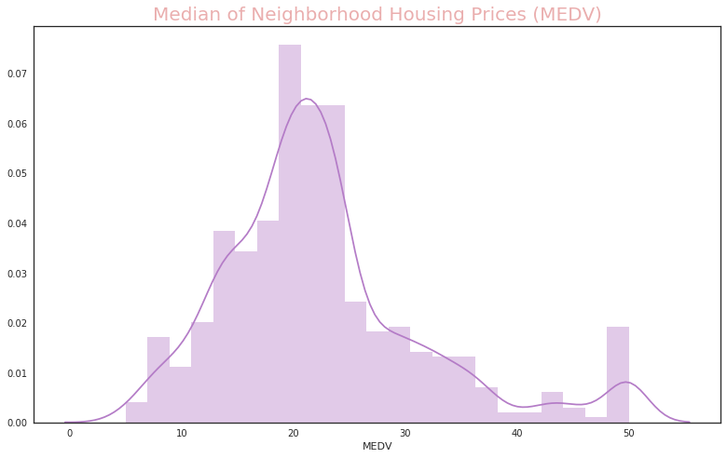
MEDV Variable

Slide 9
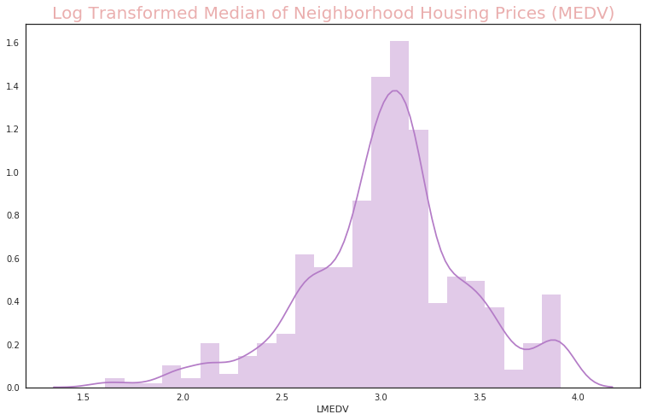
Log(MEDV) Variable

Slide 10
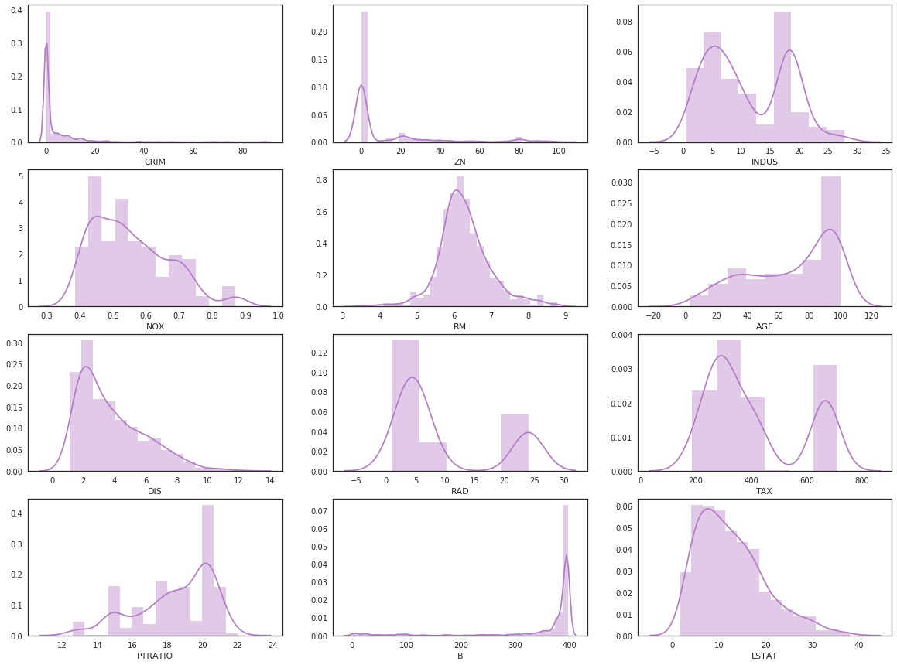
Input Variables

Slide 11
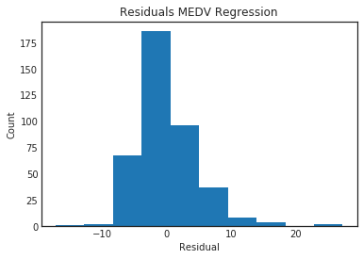
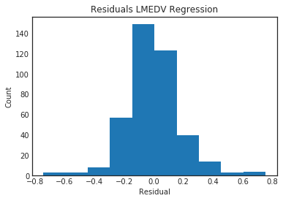
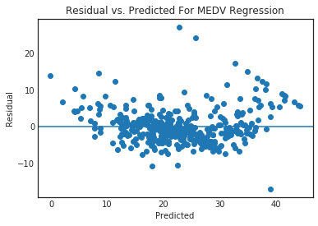
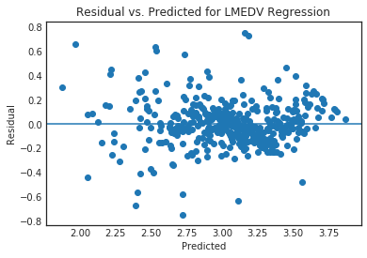
Data Transformation

Slide 12
Regression Results
OLS Regression Results
==============================================================================
Dep. Variable: LMEDV R-squared: 0.796
Model: OLS Adj. R-squared: 0.789
Method: Least Squares F-statistic: 116.9
Date: Mon, 07 May 2018 Prob (F-statistic): 1.28e-125
Time: 05:17:46 Log-Likelihood: 106.83
No. Observations: 404 AIC: -185.7
Df Residuals: 390 BIC: -129.6
Df Model: 13
Covariance Type: nonrobust
==============================================================================
coef std err t P>|t| [0.025 0.975]
------------------------------------------------------------------------------
AGE -0.0001 0.001 -0.230 0.818 -0.001 0.001
B 0.0006 0.000 4.970 0.000 0.000 0.001
CHAS 0.0964 0.038 2.526 0.012 0.021 0.171
CRIM -0.0096 0.001 -6.975 0.000 -0.012 -0.007
DIS -0.0490 0.009 -5.431 0.000 -0.067 -0.031
INDUS 0.0031 0.003 1.148 0.252 -0.002 0.008
LSTAT -0.0284 0.002 -12.772 0.000 -0.033 -0.024
NOX -0.7306 0.169 -4.319 0.000 -1.063 -0.398
PTRATIO -0.0371 0.006 -6.447 0.000 -0.048 -0.026
RAD 0.0111 0.003 3.666 0.000 0.005 0.017
RM 0.1125 0.019 6.074 0.000 0.076 0.149
TAX -0.0005 0.000 -2.976 0.003 -0.001 -0.000
ZN 0.0008 0.001 1.181 0.238 -0.001 0.002
intercept 3.8447 0.227 16.959 0.000 3.399 4.290
==============================================================================
Omnibus: 38.486 Durbin-Watson: 2.136
Prob(Omnibus): 0.000 Jarque-Bera (JB): 150.602
Skew: 0.288 Prob(JB): 1.98e-33
Kurtosis: 5.935 Cond. No. 1.49e+04
==============================================================================

Slide 13
Other Models
OLS regression has very good results ~80%
  Fits with Economic Intuition
Lasso and Ridge regression decreases fit for all lambda settings
Sign of regression results is consistent with basic economic thinking
Random Forest (200 trees, max_features=5
  10 fold CV of 83.1%
Gradient Boosting (100 trees)
  10 fold CV of 85.6%

Slide 14
Stacking Procedure
Different from other Ensemble Techniques
  We will train a metalearner to find the optimal combination of M base learners
The creation of data for the metalearner depends on a clever use of cross-validation
Details of the procedure can be found in the Appendix

Slide 15
Stacking Justification
A model can be worse than another globally on a dataset but still add value in a subset of the data.

Slide 16
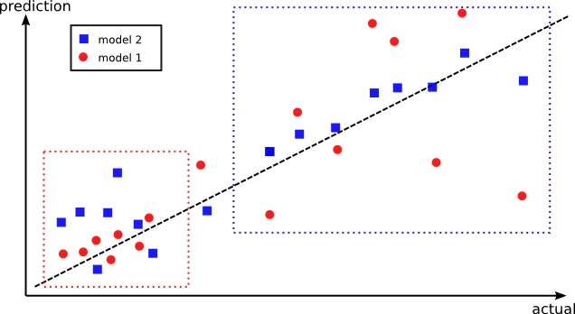
Stacking Justification

Slide 17
Stacking Results
Created a small ensemble made of our Log-linear regression model from above (LREG)
A random forest (n_estimators=200, max_depth=5,max_features=5)
A gradient boosting ensemble (n_estimators=100, max_depth=3)
No hyperparameter optimization was tried

Slide 18
Stacking Results
Metalearner was linear regression
Test set results
  Log-Linear Regression - R² = .746
  Random Forest Regression - R² = .833
  Gradient Boosting Regression - R² = .850
Level 2 Stacking by Linear Regression
  R² = .856
Increase is modest but typical for stacking

Slide 19
Stacking Results - 2
Stacking typically results in small prediction
accuracy increases of approx. 1- 2%
This is enough in Kaggle to differentiate
a good result from a world class level result
Our example was small often in Kaggle competitions thousands of variations of models could be stacked

Slide 20
Extensions
In Kaggle , everything is a hyperparameter
  Optimization Algorithm
  Scaling (No, Standardize, Ranking)
  Feature Sets
  Random Folds used (Etc.)
Often leads to thousands of models
  But it works

Slide 21
Extensions
We could have more than two levels in stacking
Could also average (vote) over randomized folds
More Art than Science

Slide 22
References
MLWave – Kaggle Ensembling Guide
Burakhommetoglu – Stacking Models for Improved Predictions (graphics in slides from this blog)
Wolpert D. (1992) Stacked Generalization, Neural Networks
van der Laan, M. J., Polley, E. C. and Hubbard, A. E. (2008) Super Learner, Statistical Applications of Genetics and Molecular Biology
Breiman L. (1996) – Stacked Regressions, Machine Learning
DA Belsley, E. Kuh, RE Welsch (1980) Regression Diagnostics
Harrison, D. and Rubinfeld, D.L. (1978) Hedonic prices and the demand for clean air, J. Environ. Economics & Management
Gilley, O.W., and R. Kelley Pace, (1996) On the Harrison and Rubinfeld Data, Journal of Environmental Economics and Management

Slide 23
Appendix: Stacking Details
If we fit the metalearner to predictions from the M base learners that were fit to ALL of the training data then the Metalearner will simply predict the best of the M models
We don’t want that

Slide 24
Introduction to Ensembling
Ensemble methods in general use multiple machine learning methods to obtain improved performance over the base learners
Examples we have seen include Random Forest (bagged decision trees) and Gradient Boosting (boosted decision trees)
General idea – reduce variance on unseen data by voting or averaging models

Slide 25
Stacking Algorithm (Simple case)
Start with initial (level-zero data):N x F training set (N data points, F features)
Select a set of M base learners (level-zero)
Select first-level metalearner (Linear model typically)
Create level-one data (metafeatures) by K-fold Cross Validation (out of fold predictions becomes N x M (original was leave-one out)
The M base learner predictions become data
for the metalearner

Slide 26
Stacking Algorithm (cont.)
Now we can do predictions on a holdout fold (validation) or the original testset
Estimate base learners on all training data
Run base learners on test data and form first-level data
Apply metalearner for final prediction

Slide 27
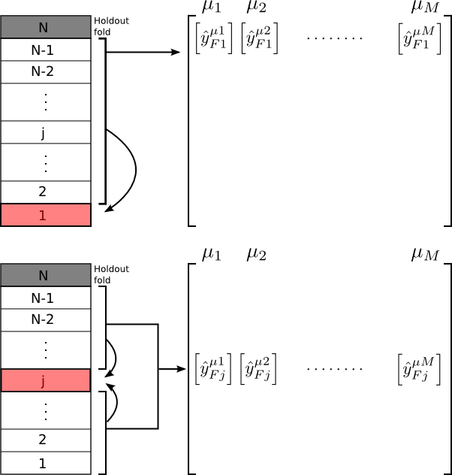
Graphical View of Stacking

Slide 28
Stacking References
Original paper is by Wolpert (1992) – Stacked Generalization
Excellent overview (highly recommended) by Leo Breiman – Stacking Regressions (1996)
Recent work has proven that stacking will work asymptotically as well or better than any of the base models - van der Laan et al., (2006)

