Slide 1

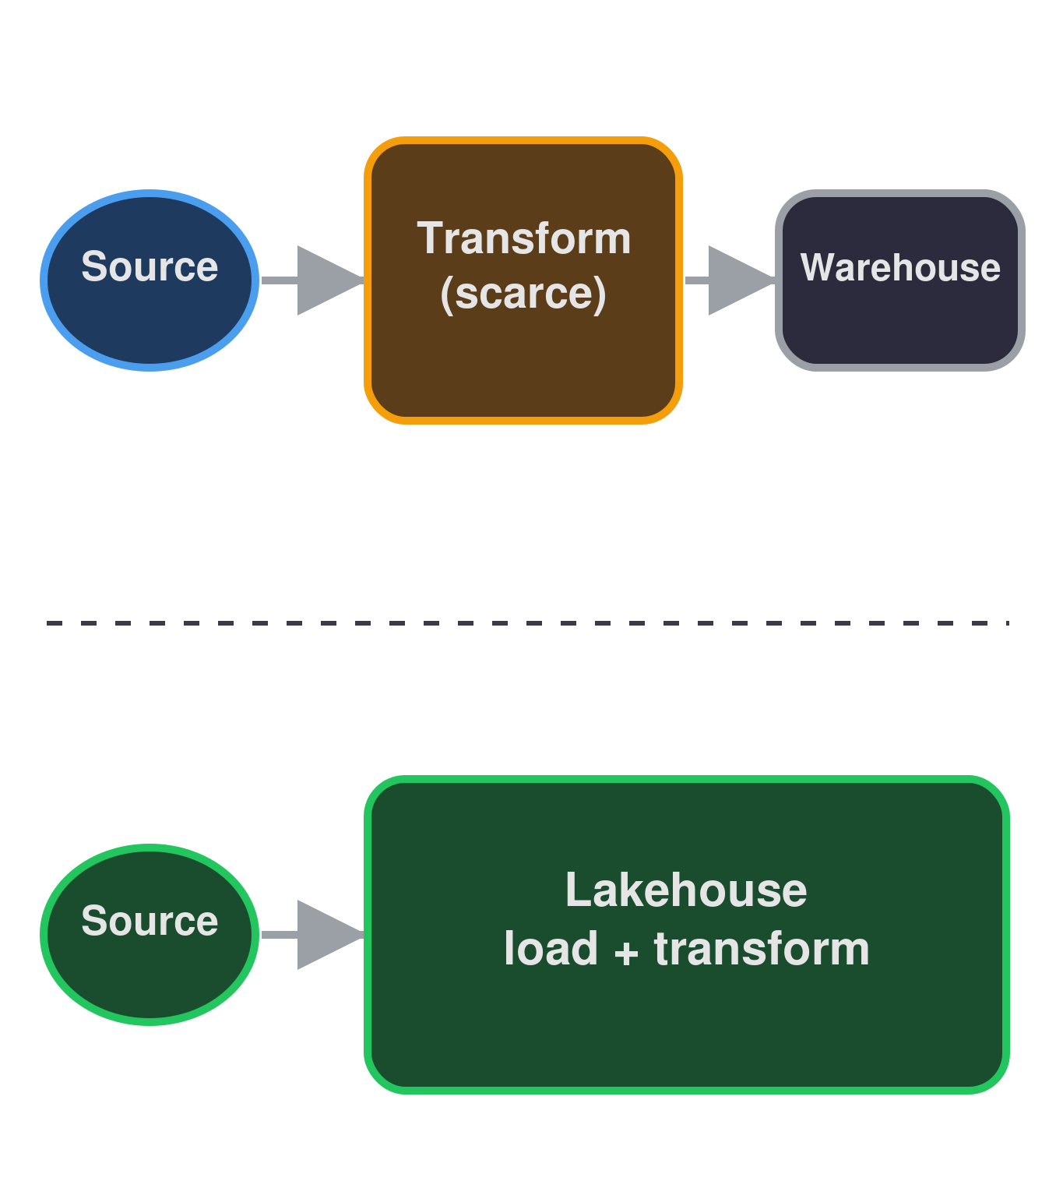
ROOTSACADEMY 2026 · DE & DP
From ETL to ELT: What Changed, and Why
Han | han@dataroots.io

Slide 2

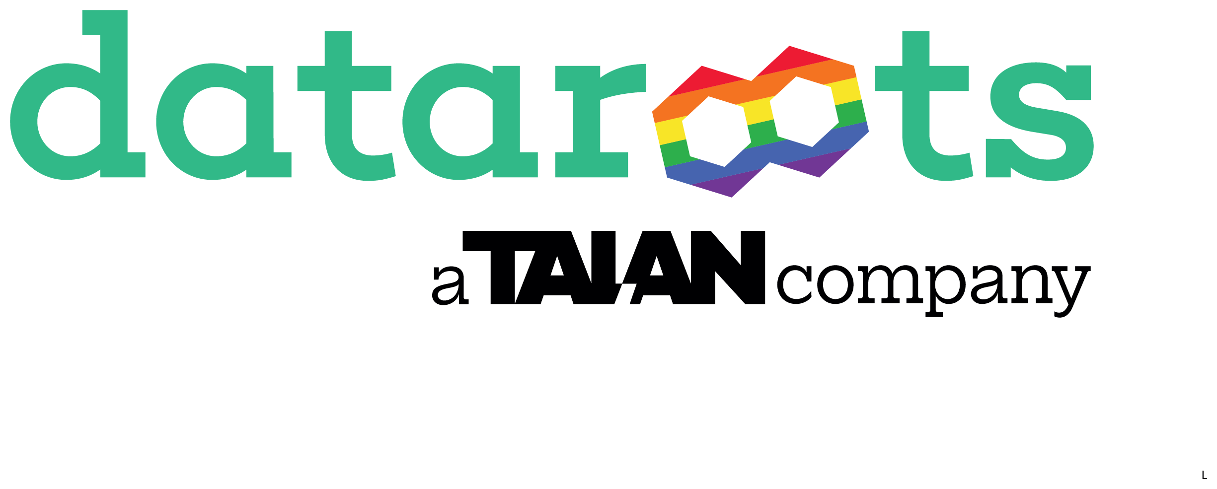
YOUR TRAINER
Meet your trainer
Han Sahin
Tech Lead - Data Engineering @dataroots
AWS, Azure, GCP, Kubernetes, Databricks,Spark,dbt, Python & SQL
Lately working on Hybrid Cloud Data Platform Deployment for Belgium Government
Education:
  BSc. Engineering, Istanbul
  MSc. Artificial Engineering, Copenhagen
Previously worked at Novo Nordisk as Data Scientist, Data & Cloud Engineer
han@dataroots.io
This session
RootsAcademy 2026
Data Engineering & Data Platform track
From ETL to ELT - what changed, and why
Then straight into the Olist exercise
Solo build, hands-on, all questions welcome
RootsAcademy 2026 - Data Engineering & Data Platform track - ask questions any time.

Slide 3
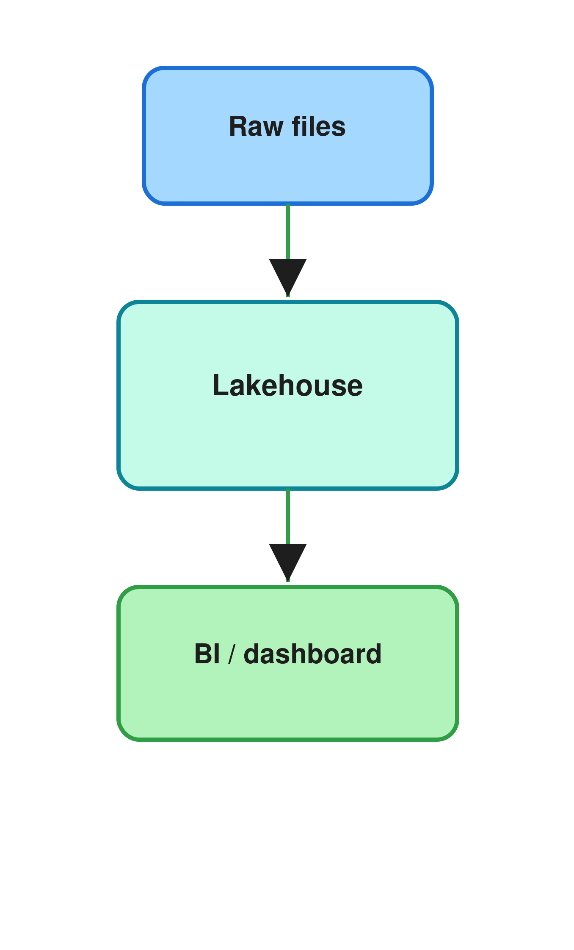
What we will cover
Why ETL was the default
01
8 min
The old constraints
What actually changed
02
8 min
Storage and compute
The lakehouse
03
8 min
From files to a real table
Why ELT wins now
04
13 min
Four enablers, Spark vs dbt
When ETL still wins
05
9 min
Exceptions and the trade-off

Slide 4
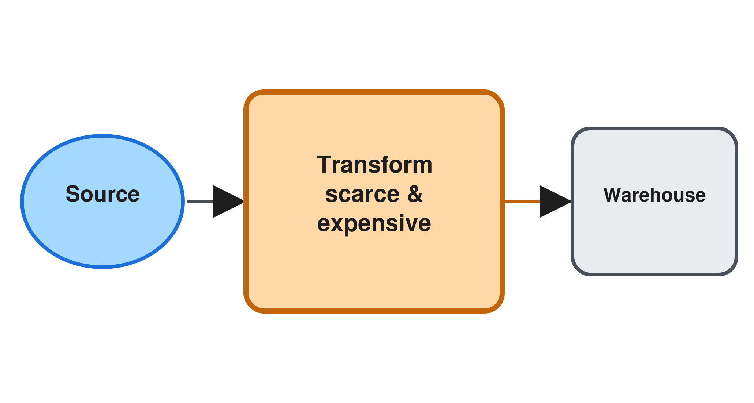
01 / THE OLD WORLD
Storage was expensive
ETL was a constraint, not a preference
• Every byte in the warehouse cost money
• Raw or messy data was too costly to keep
Compute was scarce
• A single PostgreSQL box ran the transform, so scaling meant a bigger machine, not more machines
• Postgres cannot split one query across nodes on its own, so teams paid for ever larger AWS RDS instance classes, e.g. db.r5.large to db.r5.24xlarge
Warehouses were schema on write
• Only clean, pre modeled data could load
• Nothing raw or unstructured was welcome
Notes:
Sources for the PostgreSQL vertical-scaling example on this slide:
- AWS, Amazon RDS DB instance classes (scaling compute means picking a larger instance class): https://docs.aws.amazon.com/AmazonRDS/latest/UserGuide/Concepts.DBInstanceClass.html
- Citus Data / Microsoft, "What is Citus?" (why vanilla PostgreSQL cannot shard a query across nodes on its own): https://docs.citusdata.com/en/stable/get_started/what_is_citus.html
Schema-on-Write structures data according to a predefined schema before writing the data into the storage. This approach ensures data consistency and facilitates efficient querying. However, it requires a detailed understanding of the data schema before ingesting the data.
Schema-on-Read postpones the structuring of data to the time of analysis or reading. This approach supports flexible data models and is ideal for unstructured data. It allows for ad-hoc querying and makes evolving schemas easier to manage.

Slide 5
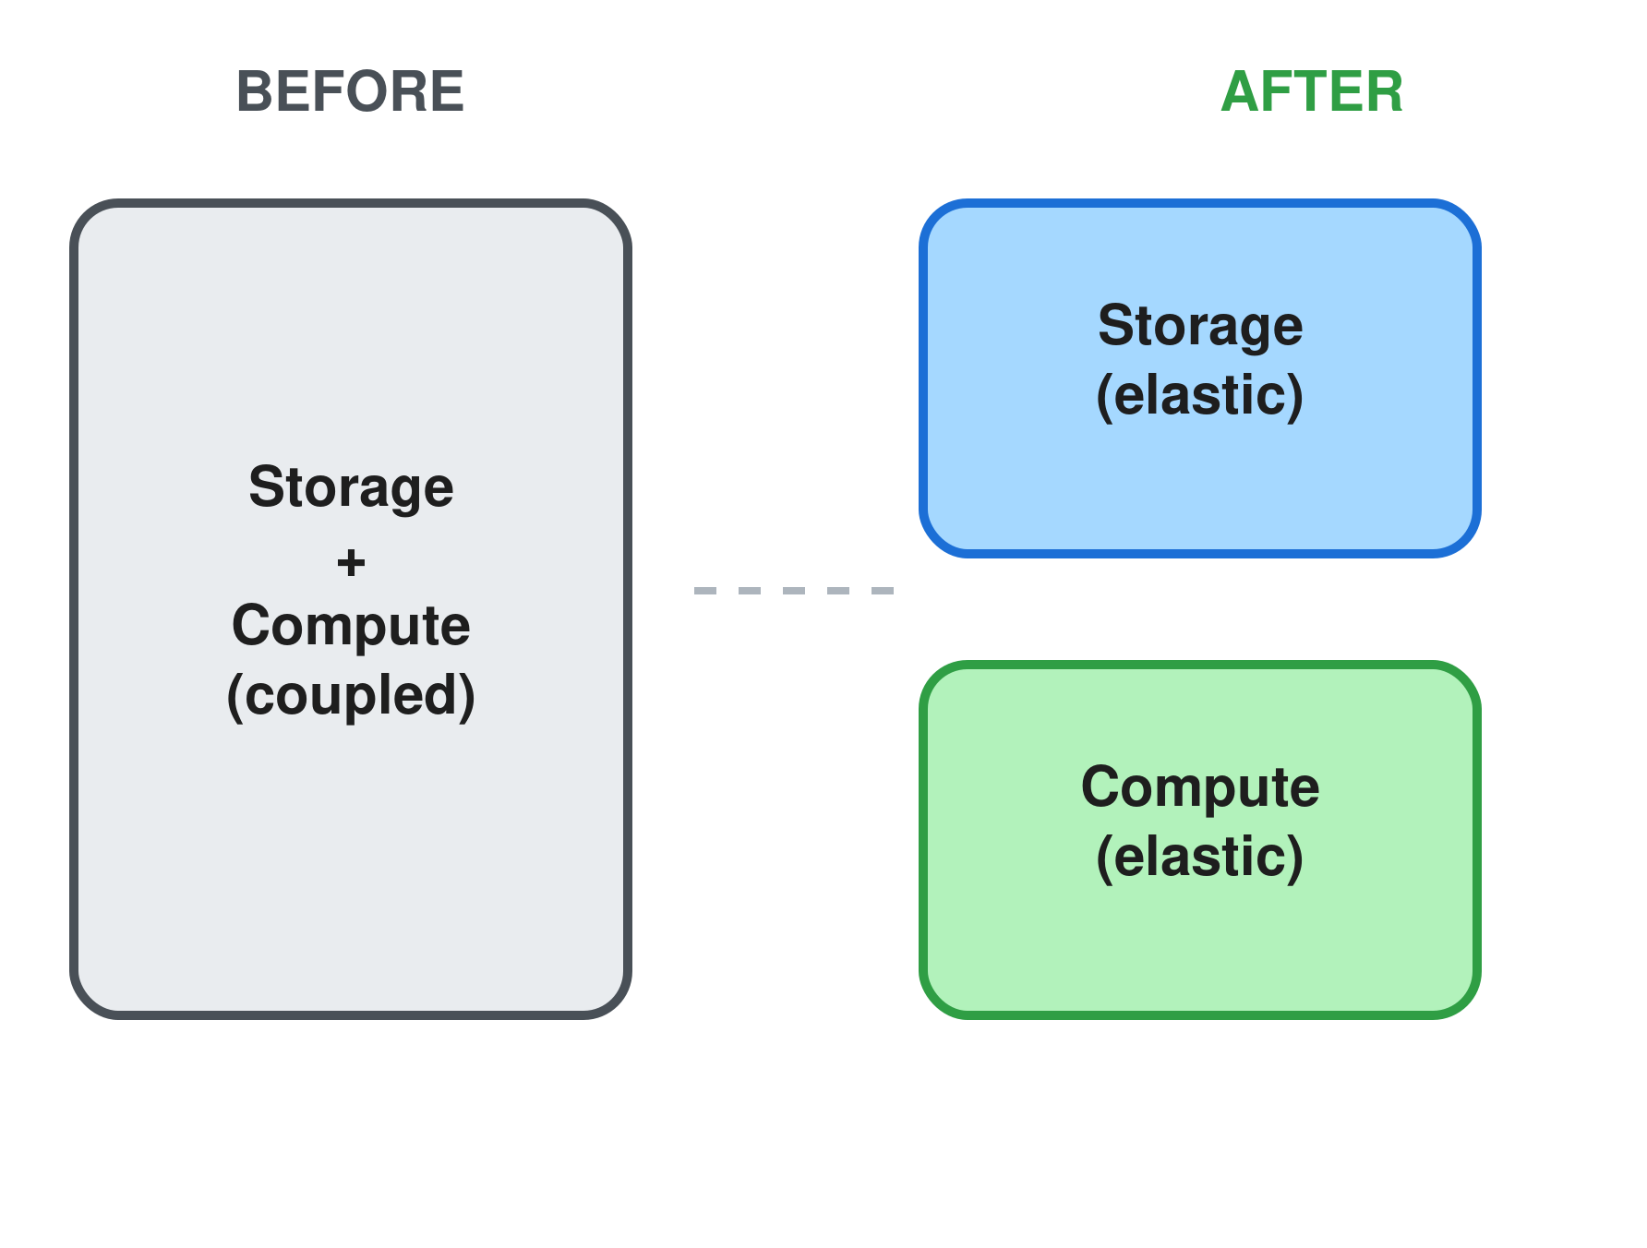
02 / THE SHIFT
What actually changed?
Two things stopped being scarce at the same time.
STORAGE ECONOMICS
COMPUTE ECONOMICS
• Object storage costs pennies per gigabyte
• AWS S3, Azure ADLS Gen2 (or a Databricks Volume on top), and GCS all separate storage from any engine
• Elastic compute nodes
• AWS EMR nodes,Databricks all purpose clusters and SQL warehouses, and Azure Synapse serverless pools all spin up on demand
NET EFFECT
• Loading raw data first stopped being wasteful
Notes:
Sources for the facts on this slide:
- AWS, Redshift Spectrum overview: https://docs.aws.amazon.com/redshift/latest/dg/c-spectrum-overview.html
- Google Cloud, "Separation of storage and compute in BigQuery": https://cloud.google.com/blog/products/bigquery/separation-of-storage-and-compute-in-bigquery
- Microsoft Learn, OneLake documentation (Microsoft Fabric): https://learn.microsoft.com/en-us/fabric/onelake/
- Databricks, "What is a data lakehouse" (SQL warehouses decoupled from storage): https://docs.databricks.com/aws/en/lakehouse/
- AWS, Amazon EMR overview (elastic Spark compute): https://aws.amazon.com/emr/
- Microsoft Learn, Azure Synapse serverless SQL pools: https://learn.microsoft.com/en-us/azure/synapse-analytics/sql/on-demand-workspace-overview
- Databricks, Unity Catalog Volumes: https://docs.databricks.com/aws/en/volumes/
Elastic: capacity that scales up or down automatically, billed only for what runs, not a fixed box sized for peak load

Slide 6
03 / THE LAKEHOUSE
The lakehouse in three steps
01
02
03
Parquet
Delta Lake and Iceberg
The lakehouse
• Cheap columnar files on S3, ADLS Gen2, or a Databricks Volume
• Schema on read: Spark or a SQL warehouse applies structure at query time, the file enforces nothing
• Added ACID transactions and time travel
• Schema evolution without breaking readers
• Lake economics with warehouse reliability
• One layer for raw through curated data
Notes:
Sources for the schema-on-read vs schema-on-write facts on this slide:
- Apache Parquet documentation: https://parquet.apache.org/docs/
- Databricks, "What is Delta Lake": https://docs.databricks.com/aws/en/delta
- Databricks, schema enforcement and evolution: https://docs.databricks.com/aws/en/delta/update-schema

Slide 7
Ingestion
Compute
Managed connectors
Elastic warehouse power
• Lakeflow Connect and Fivetran land data with no code
• Nobody hand writes extraction scripts anymore
• A Databricks SQL warehouse or all purpose cluster is a managed VM pool (AWS r5, Azure Standard_E) that scales itself
• Pay only for the seconds you use
Enablers
Four things that made ELT the default
Storage
Transformation
Open table formats
dbt and modular orchestration
• Delta Lake adds ACID and time travel on plain Parquet, sitting on S3 or ADLS Gen2
• No separate warehouse required anymore
• dbt only does the T in ELT, it never extracts or loads
• Airflow style DAGs split load from transform
Notes:
Sources for the facts on this slide:
- Databricks, Lakeflow Connect connector concepts: https://docs.databricks.com/aws/en/ingestion/lakeflow-connect/
- Fivetran, "ETL vs. ELT: Why a post-load process wins every time": https://www.fivetran.com/blog/etl-vs-elt-why-a-post-load-process-wins-every-time
- Google Cloud, "Separation of storage and compute in BigQuery": https://cloud.google.com/blog/products/bigquery/separation-of-storage-and-compute-in-bigquery
- Databricks, "What is Delta Lake": https://docs.databricks.com/aws/en/delta
- dbt Labs, "Data transformation vs ETL": https://www.getdbt.com/blog/data-transformation-vs-etl
- Databricks, compute options (all purpose clusters vs SQL warehouses): https://docs.databricks.com/aws/en/compute/

Slide 8
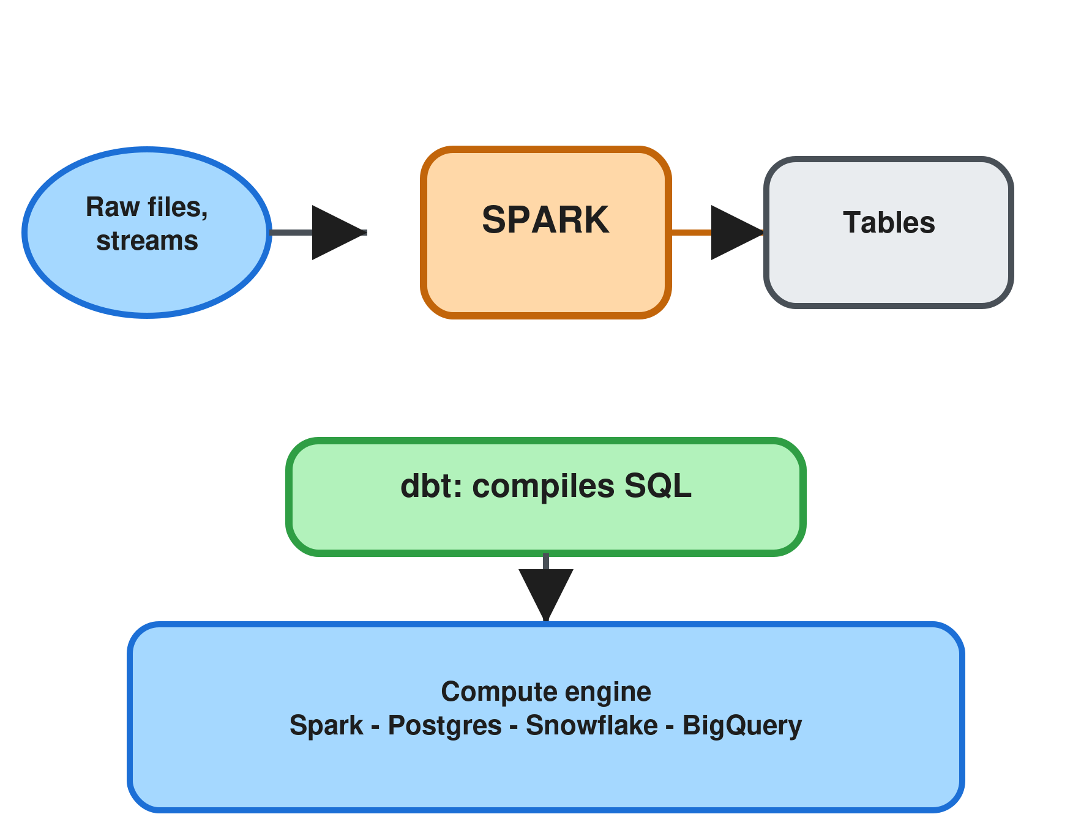
04 / THE TOOLS
Spark vs dbt: an engine and a framework, not two engines
dbt has no compute of its own. It compiles SQL and pushes it down to whatever engine you connect.
SPARK
DBT
• A distributed compute engine, it actually executes the work
• Multi language: data engineering, ML, and streaming at scale
• Runs as AWS EMR, Databricks all purpose clusters, or Azure Synapse Spark pools
• A SQL transformation framework with no query engine of its own
• dbt-databricks pushes down to Spark and Photon, dbt-postgres to Postgres, same dbt code either way
RULE OF THUMB
• On Databricks, dbt IS Spark underneath, the adapter just decides how the SQL gets submitted
Notes:
Sources for the facts on this slide (dbt has no engine of its own, it pushes SQL down to whatever platform it is connected to):
- Apache Spark, official site: https://spark.apache.org/
- dbt Developer Hub, Supported data platforms: https://docs.getdbt.com/docs/supported-data-platforms
- dbt Developer Hub, "Why dbt compile needs a data platform connection": https://docs.getdbt.com/faqs/Warehouse/db-connection-dbt-compile
- dbt Developer Hub, "Migrate from dbt-spark to dbt-databricks" (dbt-databricks pushes down to Spark/Photon on Databricks): https://docs.getdbt.com/guides/migrate-from-spark-to-databricks
- AWS, Amazon EMR overview: https://aws.amazon.com/emr/
- Microsoft Learn, Apache Spark pools in Azure Synapse Analytics: https://learn.microsoft.com/en-us/azure/synapse-analytics/spark/apache-spark-overview

Slide 9
ELT became possible once storage and compute stopped sharing a single bill.

Slide 10
EXCEPTIONS, NOT DEFAULTS
When ETL still wins
COMPLIANCE
STREAMING
DESTINATION
Mask before it lands
Real time decisions
Not every target is a warehouse
- Sensitive fields cannot land unmasked
- Healthcare, finance, and residency rules apply
- Fraud and IoT need in flight transforms
- The decision window is too short to wait
- Operational systems expect already shaped records
CONSTRAINTS
MINIMIZATION
INTERCHANGE
Edge and bandwidth limits
Nothing to mask if never collected
Partners still expect flat files
- Filtering before transport reduces what moves
- Storage limits still exist outside the cloud
- GDPR and CCPA can require dropping fields pre storage
- Minimization is a design constraint, not a preference
- Mainframes and EDI feeds expect fixed format extracts
- The lakehouse is not always the last mile

Slide 11
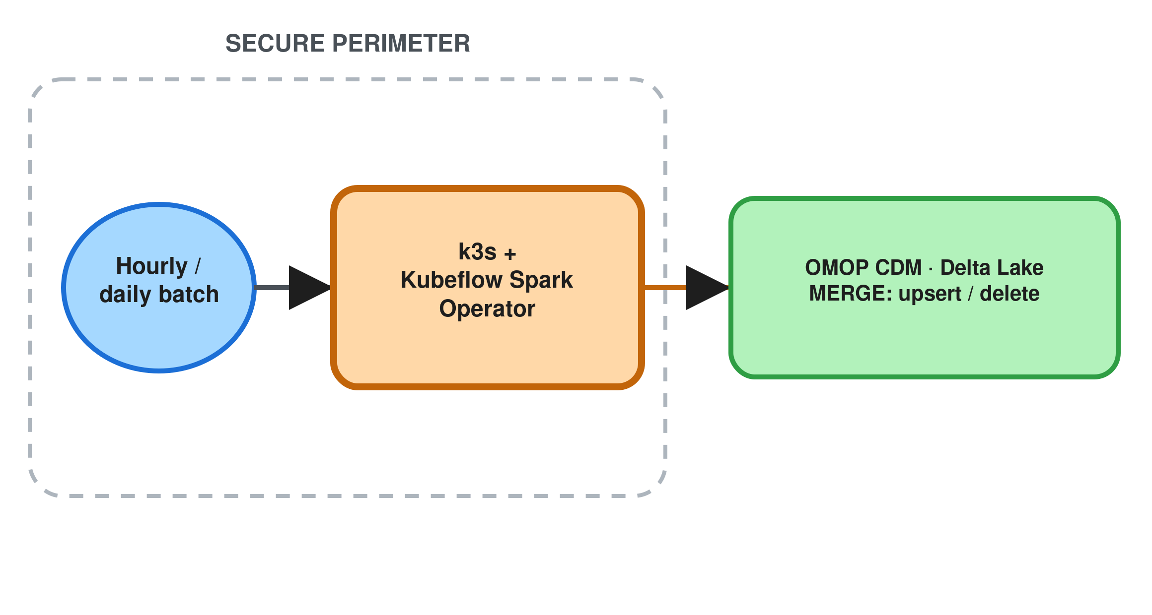
SPOTLIGHT · FROM MY OWN WORK
Data can't land unmapped
A real OMOP pipeline: why this one runs ETL, not ELT
• Hourly and daily batches arrive on a dedicated, secured on prem box, nothing routes through an open lake first
• The regulatory constraints on this data mean transformation has to happen before anything is persisted
Spark runs inside the perimeter
• A k3s cluster running the Kubeflow Spark Operator does the concept mapping in place, as data arrives
• Spark earns its place here: it scales the mapping step, not the ingestion or the load
Delta Lake absorbs corrections cheaply
• Mapped records upsert and delete straight into Delta Lake tables with MERGE
• A correction to one mapping means updating rows, not reprocessing the whole table
Notes:
This is a real production pipeline I built, not a hypothetical:
- Kubeflow, Spark Operator documentation: https://www.kubeflow.org/docs/components/spark-operator/
- k3s, lightweight Kubernetes documentation: https://docs.k3s.io/
- Databricks, MERGE INTO (upsert and delete in one statement): https://docs.databricks.com/aws/en/sql/language-manual/delta-merge-into
- OHDSI, OMOP CDM and data standardization (why concept mapping must happen before load): https://www.ohdsi.org/data-standardization/

Slide 12
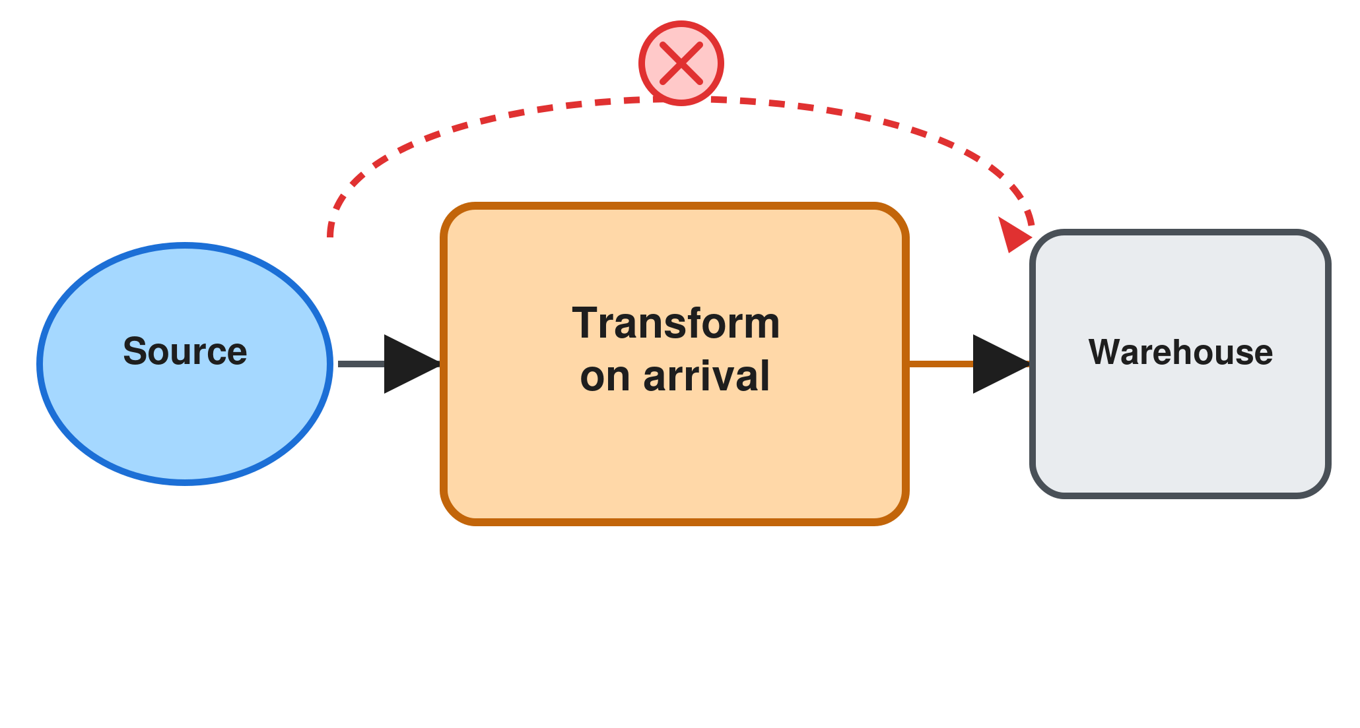
05 / THE TRADE-OFF
Loses replayability
Transforming in flight skips the lakehouse's whole point
• Raw history is never kept once transformed on arrival
• A transform bug cannot be replayed from source
Fights the engine's design
• BigQuery and Databricks SQL scale for set based SQL, not row by row code
• Elastic compute sits unused while upstream logic runs serially
Breaks the audit trail
• Delta Lake time travel depends on every raw version landing first
• A schema change means redeploying a connector, not editing SQL
Notes:
Sources for the facts on this slide:
- Google Cloud, "Separation of storage and compute in BigQuery": https://cloud.google.com/blog/products/bigquery/separation-of-storage-and-compute-in-bigquery
- Databricks, "What is Delta Lake" (transaction log and time travel): https://docs.databricks.com/aws/en/delta

Slide 13

ROOTSACADEMY 2026
Now, build both yourself
02

Slide 14
THE OLIST DATASET
8 tables, about 100,000 orders, one story
orders + customers
products + sellers
order_items
status, timestamps, delivery dates; city/state/zip
category, dimensions, weight; seller city/state
order -> product + seller + price + freight
order_payments
order_reviews
category translation
type, installments, value (many per order)
score 1-5, comments - satisfaction
product category name: PT -> EN mapping
Source: kaggle.com/datasets/olistbr/brazilian-ecommerce - the dataset behind today's exercise.

Slide 15
OLIST EXERCISE
Today: one dataset, two ways to build it
01
02
03
Delivery performance by state
Monthly revenue by category
Review score vs delivery delay
• Built twice: PySpark ETL and dbt ELT
• Your choice: PySpark or dbt
• Your choice: PySpark or dbt

Slide 16
OLIST EXERCISE — IN DETAIL
What each question actually asks for
Q1 — Delivery performance by state
Q2 — Monthly revenue by category
Q3 — Review score vs delivery delay
Built BOTH ways — PySpark and dbt.
Your choice — PySpark or dbt.
Your choice — PySpark or dbt.
For every state, work out how many delivered orders there were, how late deliveries tend to run on average, and what share of orders arrive after the date customers were promised.
Dataset: the orders table and the customers table (to know which state each order shipped to).
End result: one row per state, ready to rank from worst to best delivery experience.
For each month and each product category, work out total revenue and how many orders were placed, using the English category names, and leaving out cancelled orders.
Dataset: order items, products, orders, and the category translation table (product categories are recorded in Portuguese and need mapping to English).
End result: one row per month per category, showing how revenue shifts over time and across categories.
Group delivered orders into a few bands — on time, and increasingly late — and see how the average review score differs between those bands.
Dataset: the orders table and the order reviews table.
End result: one row per delay band, so you can say out loud whether shipping speed actually seems to move satisfaction.
Exact required output columns are in the notebook/dbt file headers — this slide is the plain-language version.

Slide 17
DEFAULT
ELT is the default now
Cheap storage, elastic compute, managed ingestion
Main takeaways
EXCEPTION
ETL still has real jobs
Compliance, streaming, edge constraints
TODAY
You are building both
Same question, ETL and ELT, side by side

Slide 18
Thank you.
Han | han@dataroots.io

