Slide 1
R Community Demographics
Carl Howe
June 19, 2020

Slide 2
Data sources
Two years of the R Community Survey
December 2018
December 2019 to early January 2020
The rstudio::conf 2020 attendee survey

Slide 3
Summary
The demographics of the RStudio community
Remain more than 65% male and white online
Are slightly less male-dominated at rstudio::conf (59%)
May be becoming more diverse but we need more data before we can make this claim (we've only done two of them)
Because we haven't done random samples, we don't know how this data relates to the broader R community
We still have significant work to do to make the RStudio community more representative of the population at large in both gender and ethnicity

Slide 4

Caveats
WARNING: Our samples have significant bias!
The data shown are not necessarily representative of
the general R population!
See the slide "What does this data mean"
for how to think about this data

Slide 5

2018 and 2019 Survey Data

Slide 6
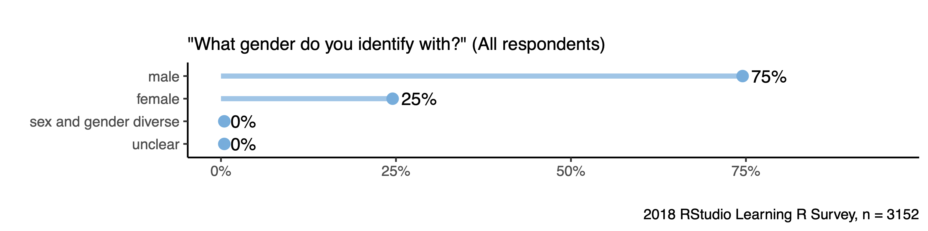
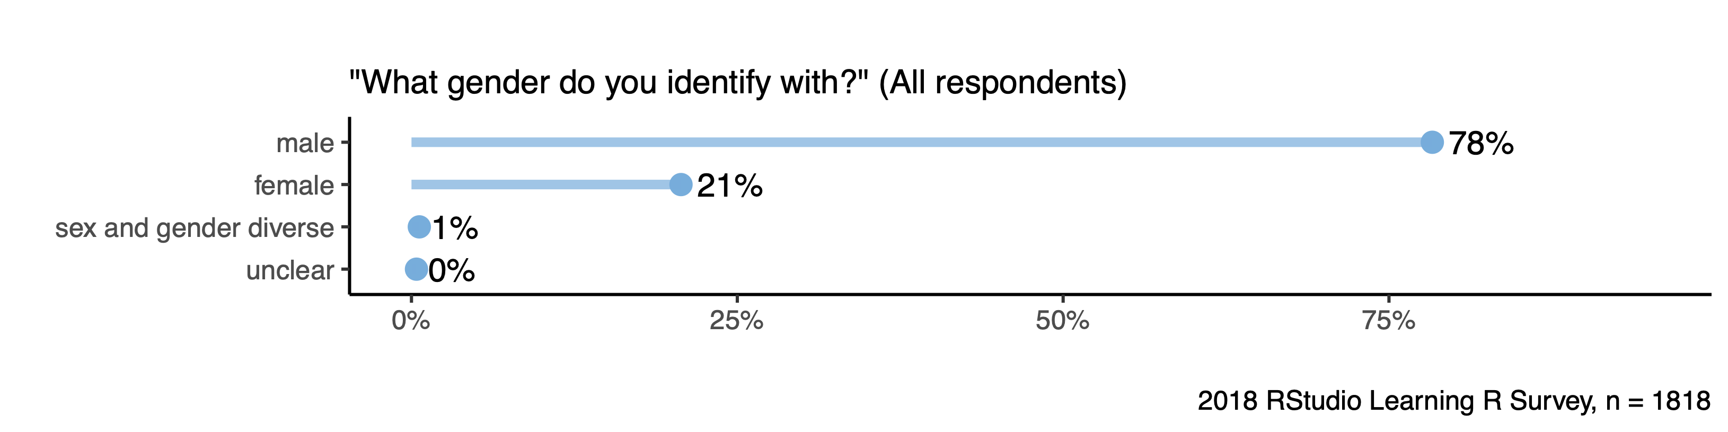
Males make up 75% of our survey samples

Slide 7
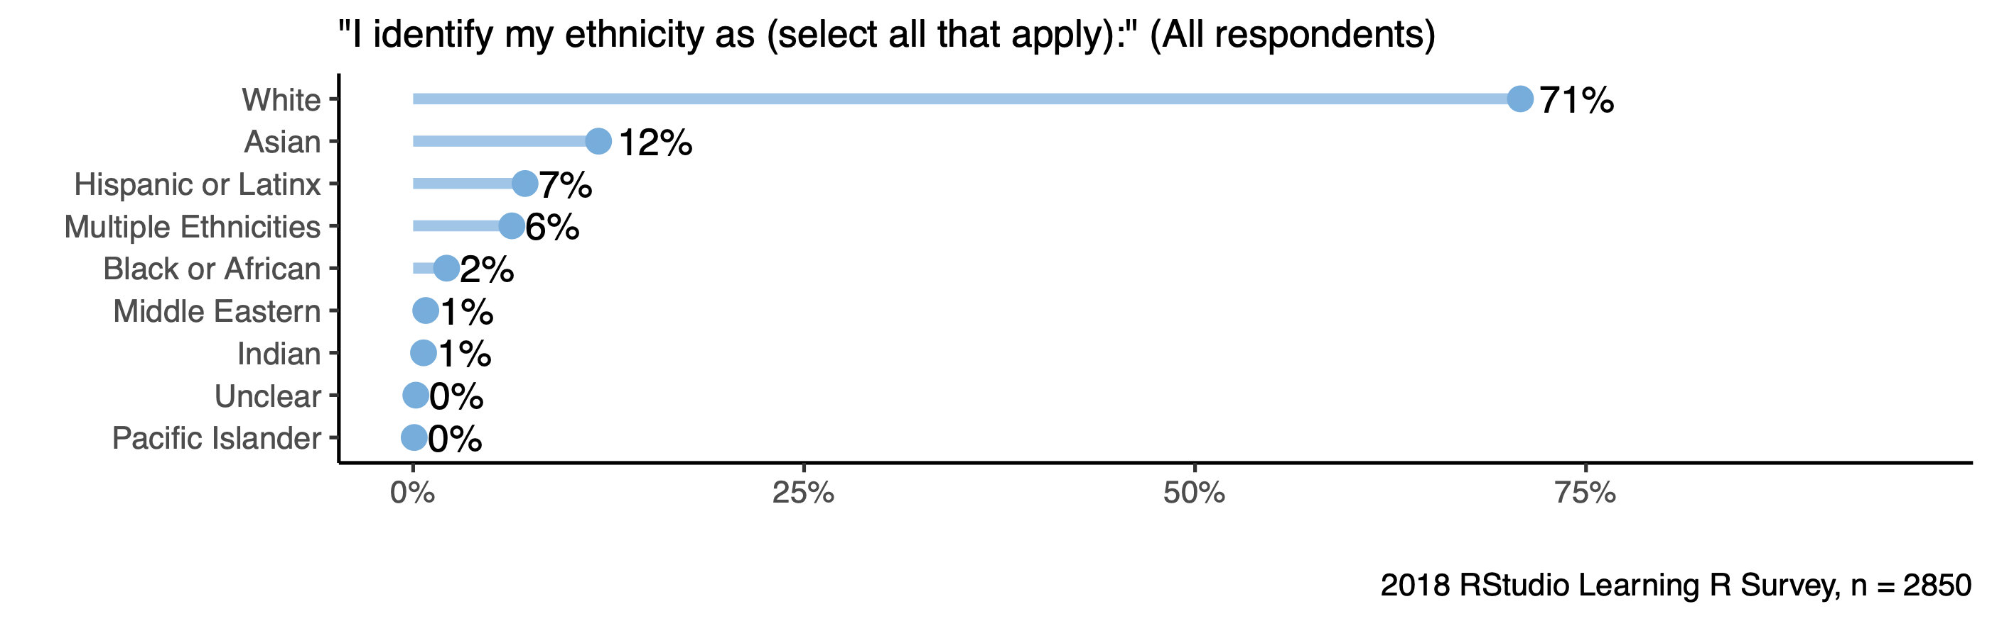
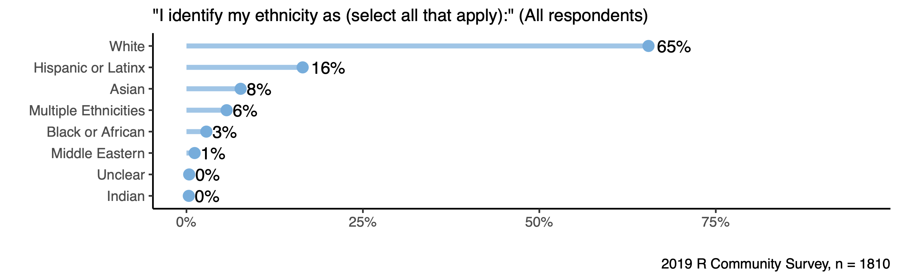
R users are predominantly white

Slide 8
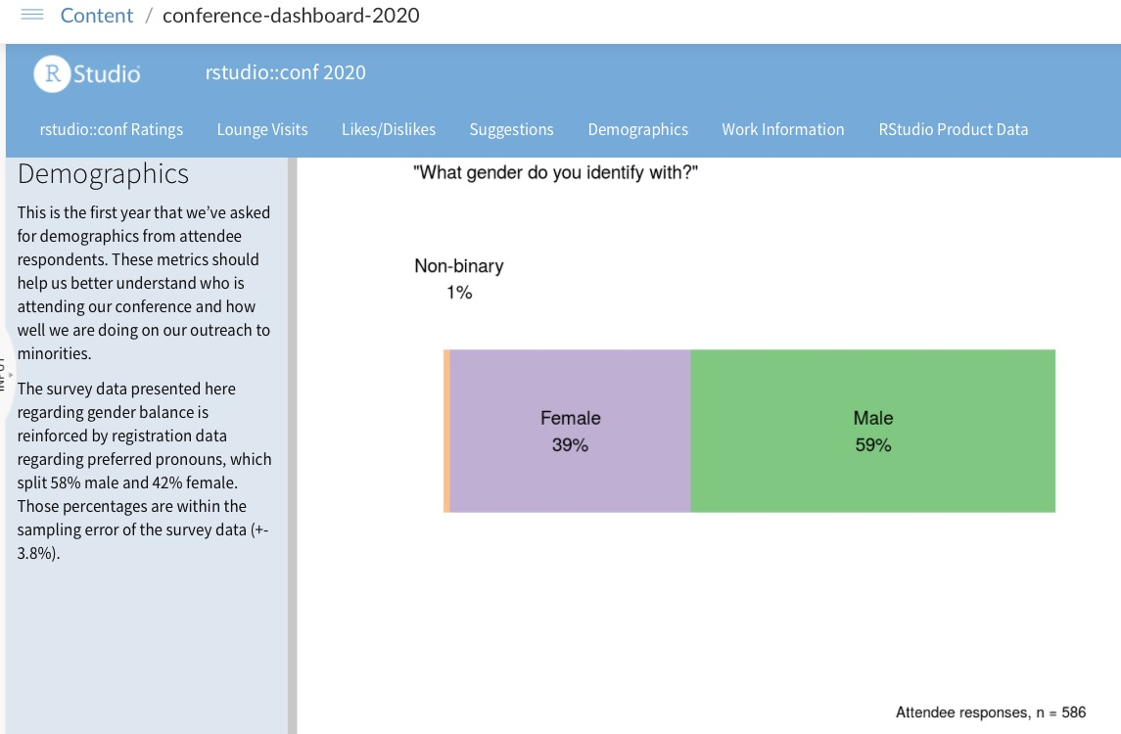
RStudio::conf attracted slightly more females

Slide 9
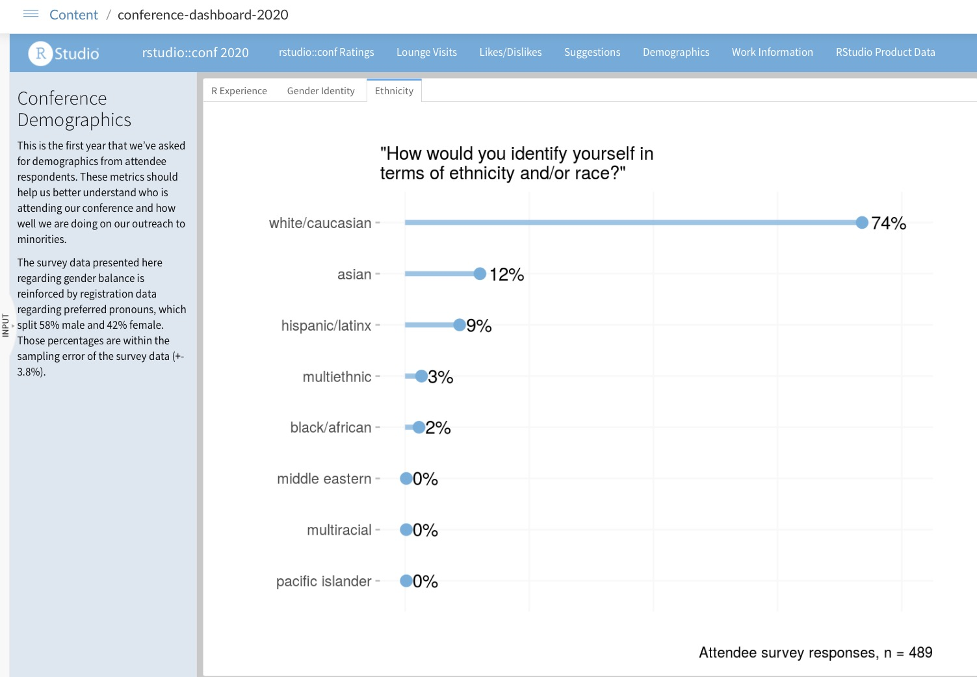
rstudio::conf attendees are also predominantly white

Slide 10
What does this data mean?
Everyone should be aware of significant bias in our data collection
People were recruited on Twitter to fill out the survey via Hadley and other RStudio employees
The survey was fielded in English and Spanish, causing those languages to be over-represented
No random sampling was done
The best way to think about this data is that it loosely represents the demographics of the RStudio community, not the broader R community
The best way to use this data is to think of it as directionally correct, but the actual numbers have large error components due to bias
The summary at the beginning and on the next slide has the most specific conclusions I felt comfortable with distributing

Slide 11
Summary
The demographics of the RStudio community
Remain more than 65% male and white online
Are slightly less male-dominated at rstudio::conf (59%)
May be becoming more diverse but we need more data before we can make this claim (we've only done two of them)
Because we haven't done random samples, we don't know how this data relates to the broader R community
We still have significant work to do to make the RStudio community more representative of the population at large in both gender and ethnicity

