Slide 1
Trend Analysis: VA Health Systems Research Forums
Presented By: Jeremy Ramirez

Slide 2

Introduction
Background
Problem Statement
Methodology
Results & Discussion
Conclusion
Questions

Slide 3
Introduction
Overview:
Largest integrated healthcare system in the US (170 medical centers, 1,193 facilities)
$68 billion in services for 9M veterans annually
Focus on VA Health Systems Research (HSR) Forum publications
Objective: Track topic trends to guide policy-making and service delivery

Slide 4
Background
Veteran Healthcare Challenges:
Complex needs: Physical injuries, mental health disorders, social determinants of health
Digital divide and health literacy issues
NLP Applications:
Social determinants of health extraction
Targeted health information access
Research in specialized domains (e.g., cancer, Alzheimer’s)

Slide 5
Problem Statement
Challenges Identified
Gaps in health information access
Limited research on NLP’s role in improving veterans' health literacy
Focus:
NLP techniques to address these challenges

Slide 6
Methodology
Data Collection:
78 publications from 1998–2024 (VA HSR Forum)
Text extraction with PyPDF2 and cleaned for analysis
NLP Models:
LDA: Initial text mining and topic frequency
LSTM & BERT: Context tracking, sentiment, and coherence analysis

Slide 7
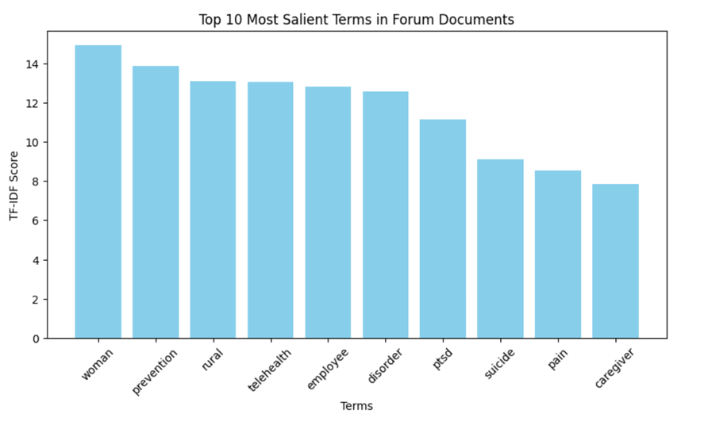
Results & Discussion

Slide 8
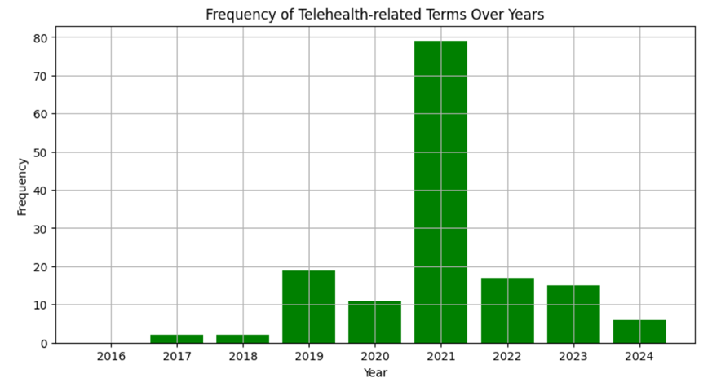
Results & Discussion (Cont’d)

Slide 9
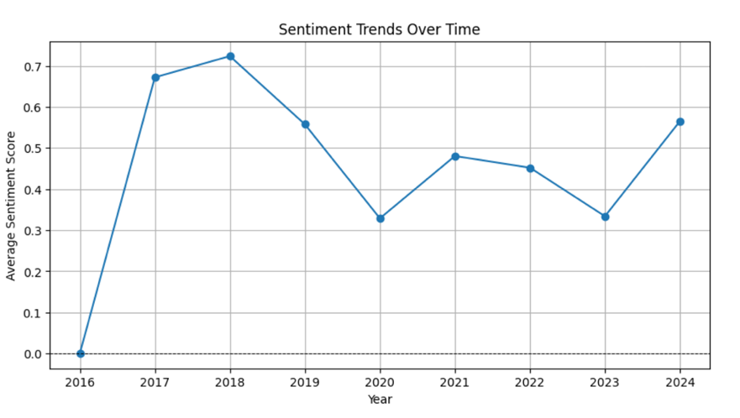
Results & Discussion (Cont’d)

Slide 10
Limitations
Reliance on a single data source
Challenges in capturing nuanced veteran health system topics
Need for qualitative assessments and diverse data sources

Slide 11
Conclusion
Findings
NLP techniques reveal trends in telehealth, PTSD, caregiver topics
BERT model excels in accuracy and coherence
Implications:
Enhanced understanding of health information
Improved policy-making and healthcare strategies

Slide 12

Questions?

