Slide 1
Project 3: UMD
Yangjianchen Xu

Slide 2
Overview
Background
Purpose
Related questions
Data processing
Answers for questions
Conclusions
Future work

Slide 3
Background
The programs of Urban Ministries of Durham (UMD) end homelessness by providing neighbors with emergency shelter and case management to help them overcome barriers such as unemployment, medical and mental health problems, past criminal convictions and addiction.
The data from UMD contains the demographic (gender, age, race and ethnicity), income, disability and other information of the clients.

Slide 4
Purpose
Overall purpose: We aim to provide better service for the clients by analyzing these data.

Slide 5
Related questions
What are the demographic characteristics of the clients?
How do the demographics influence the income of the clients?
How do the demographics influence the disability of the clients?

Slide 6
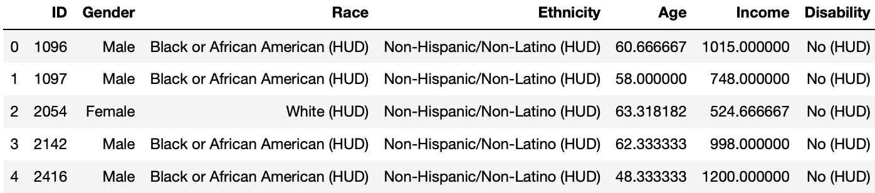
Data processing
Select variables: ID, Age, Gender, Race, Ethnicity, Income and whether disabled or not.
Discard observations with NA in these variables.
Group the data by Client ID.
Merge different datasets by Client ID.

Slide 7
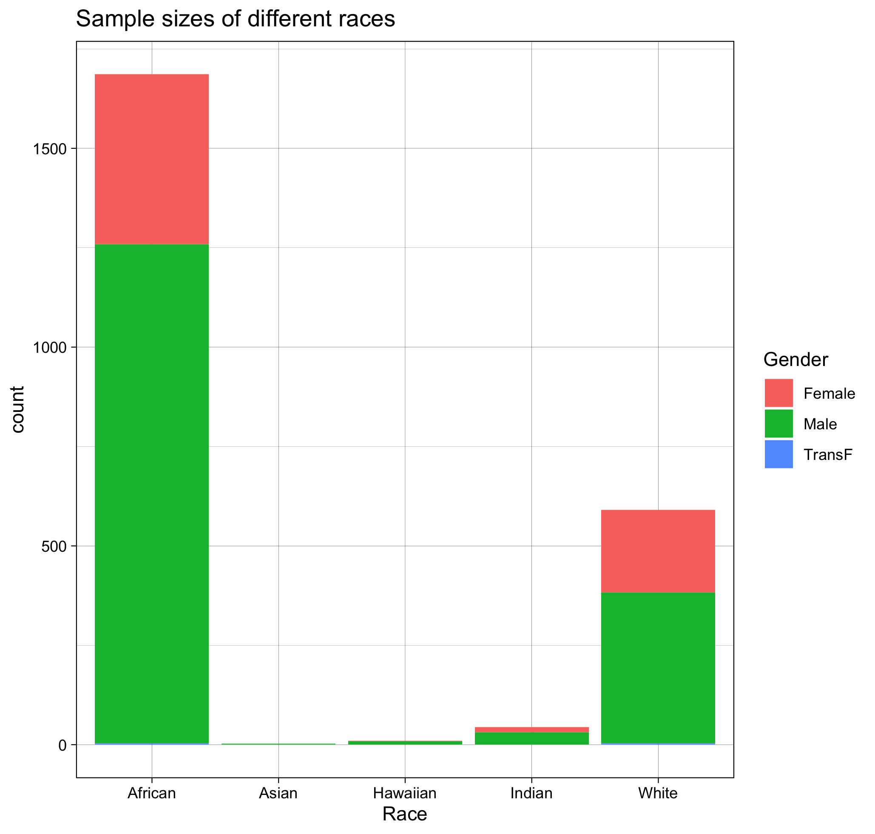
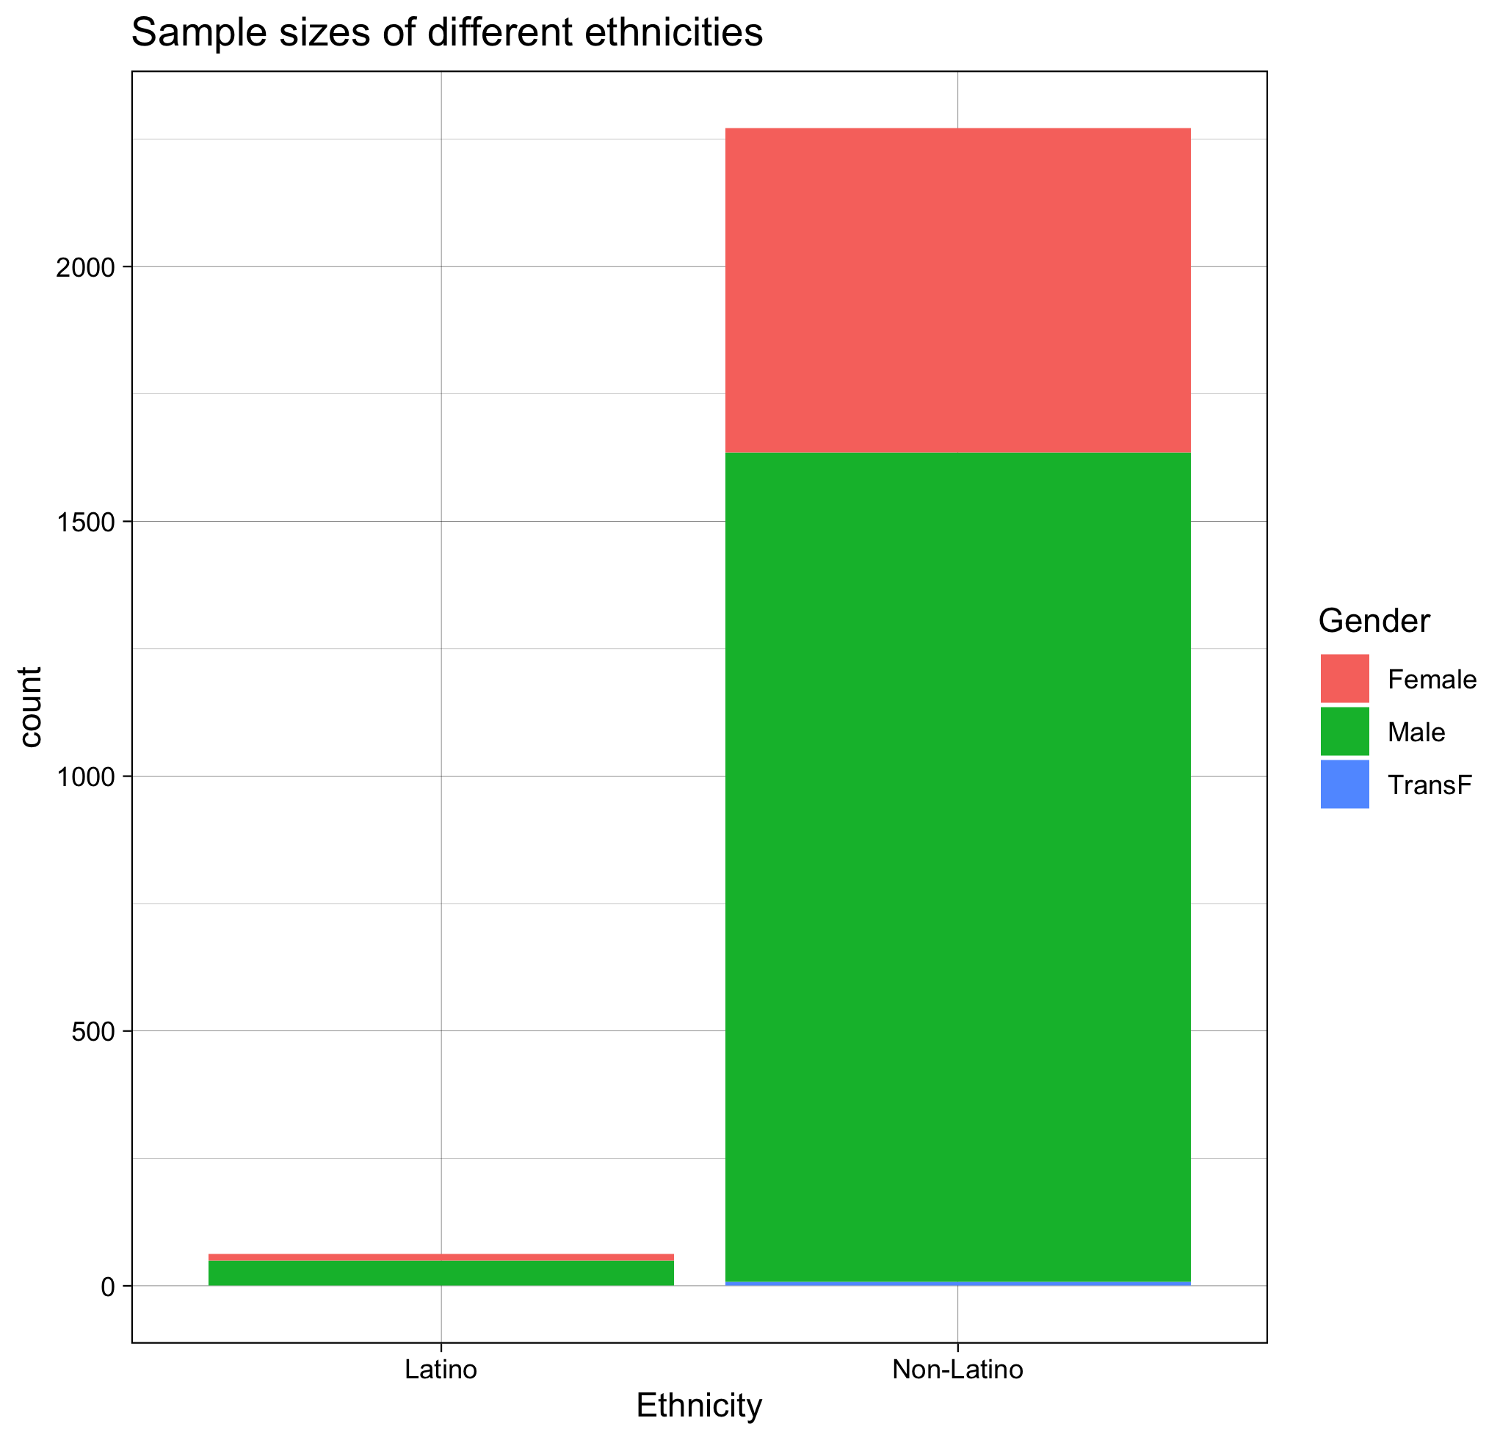
Demographic characteristics

Slide 8
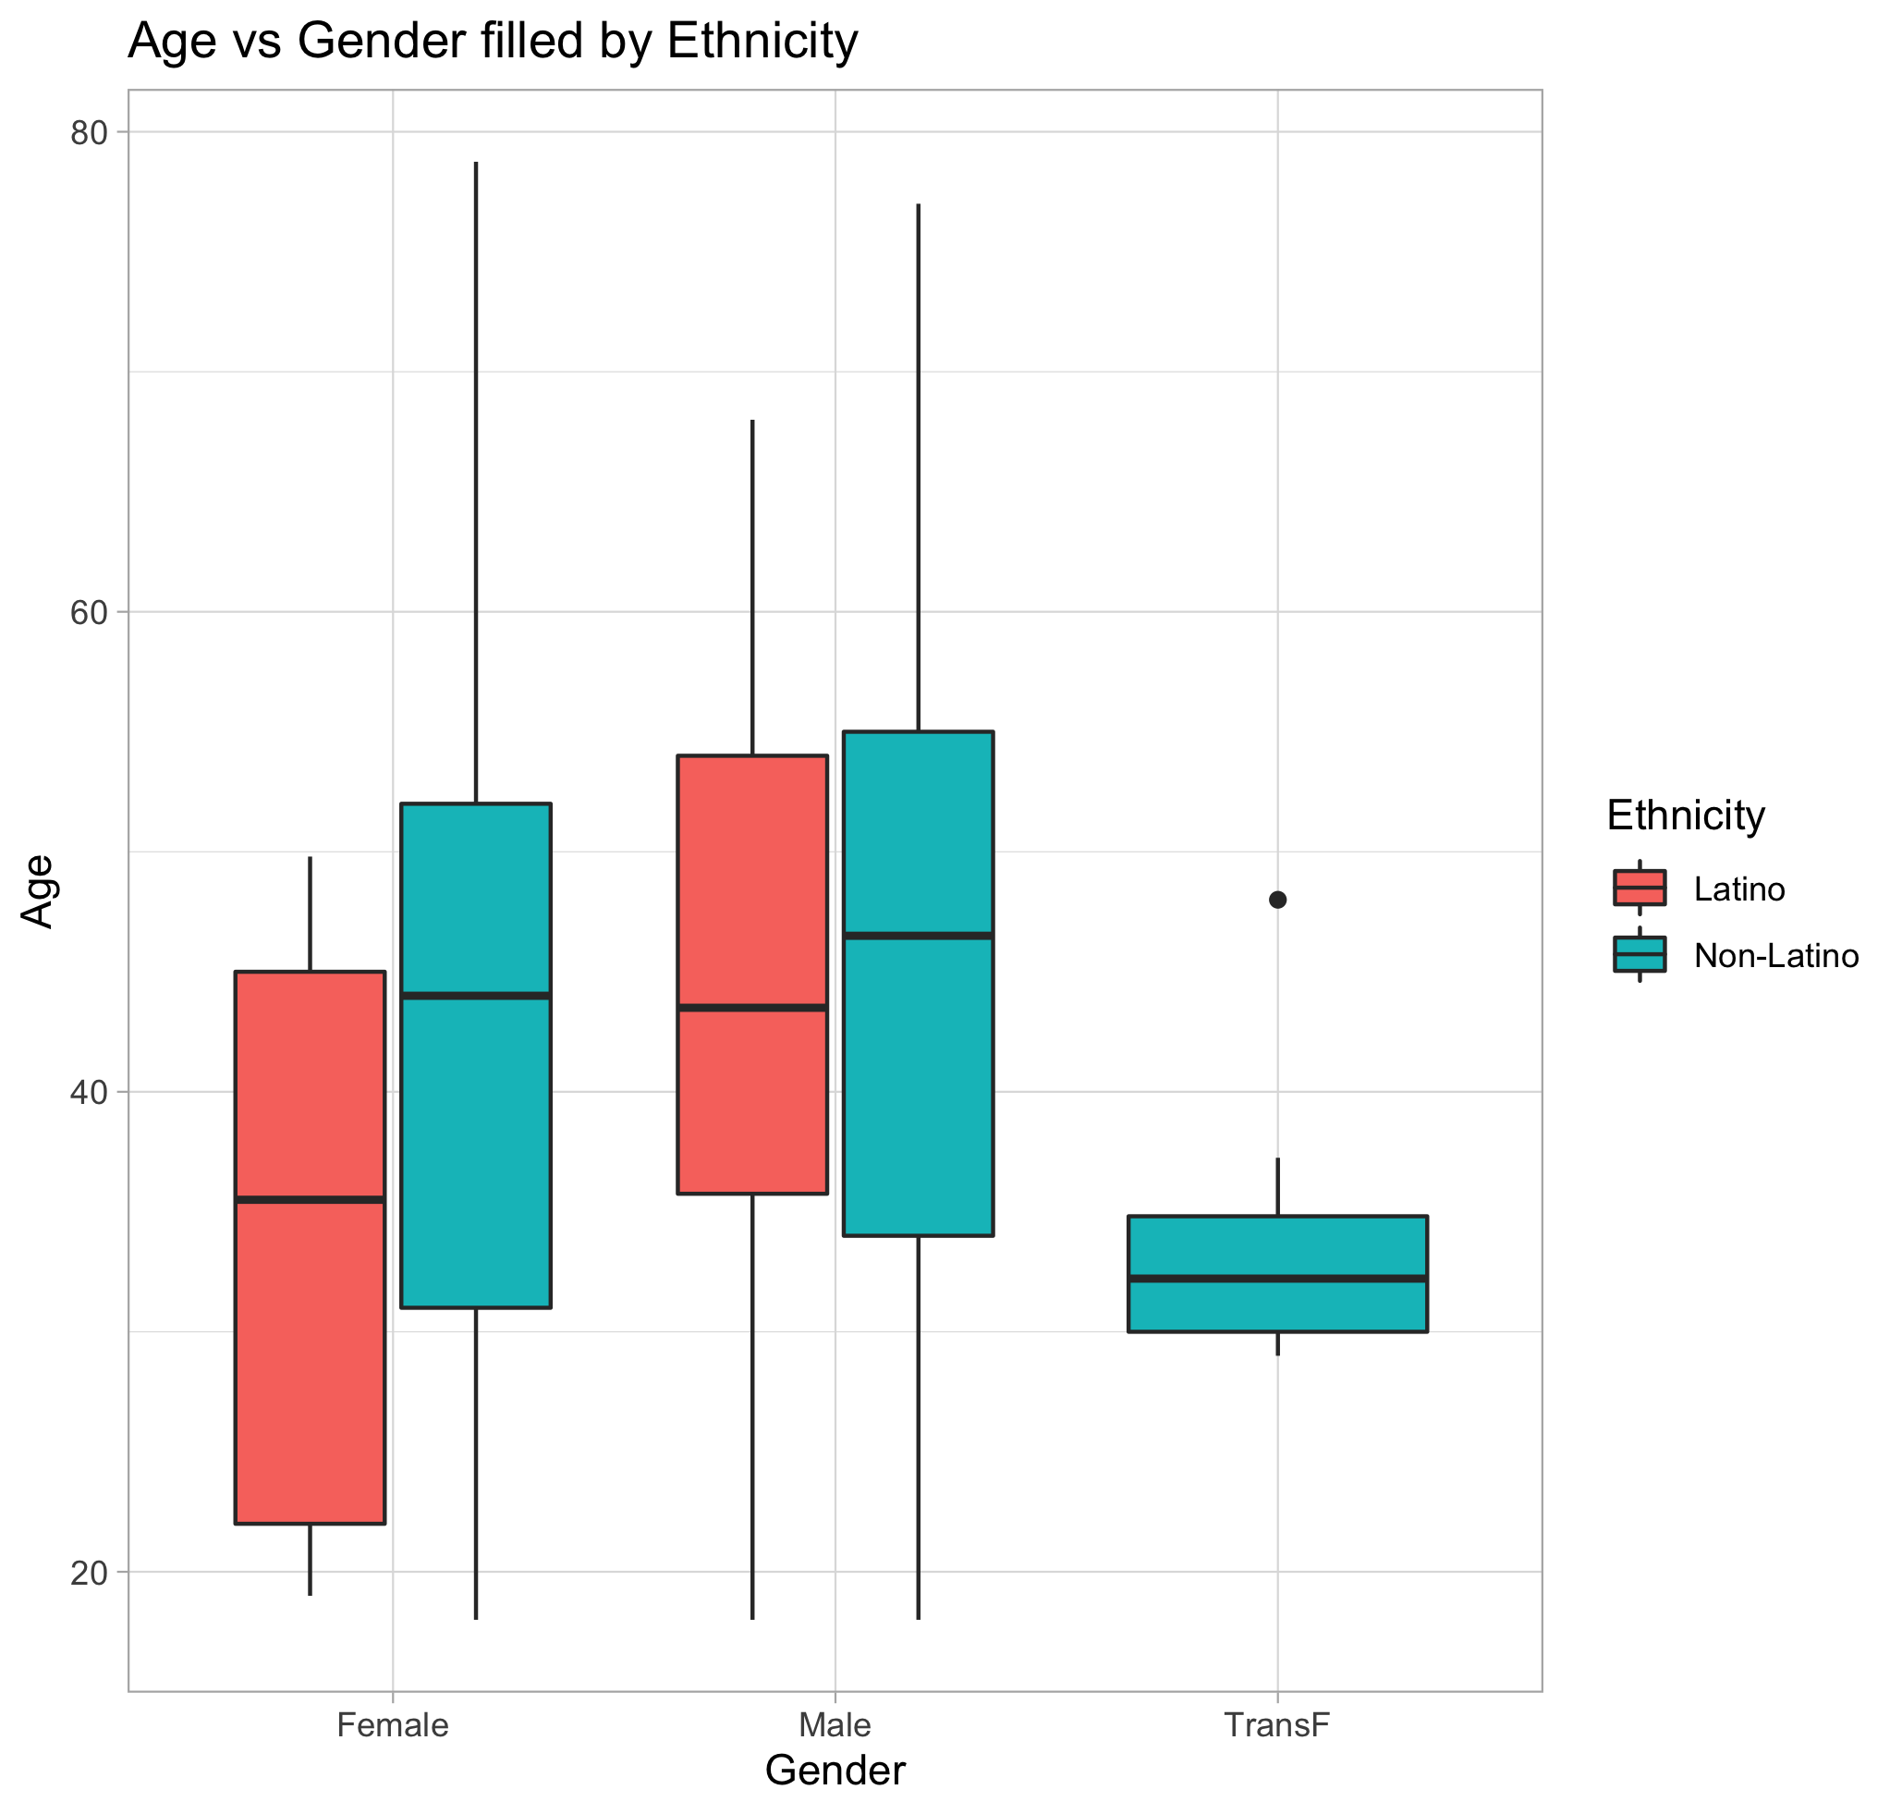
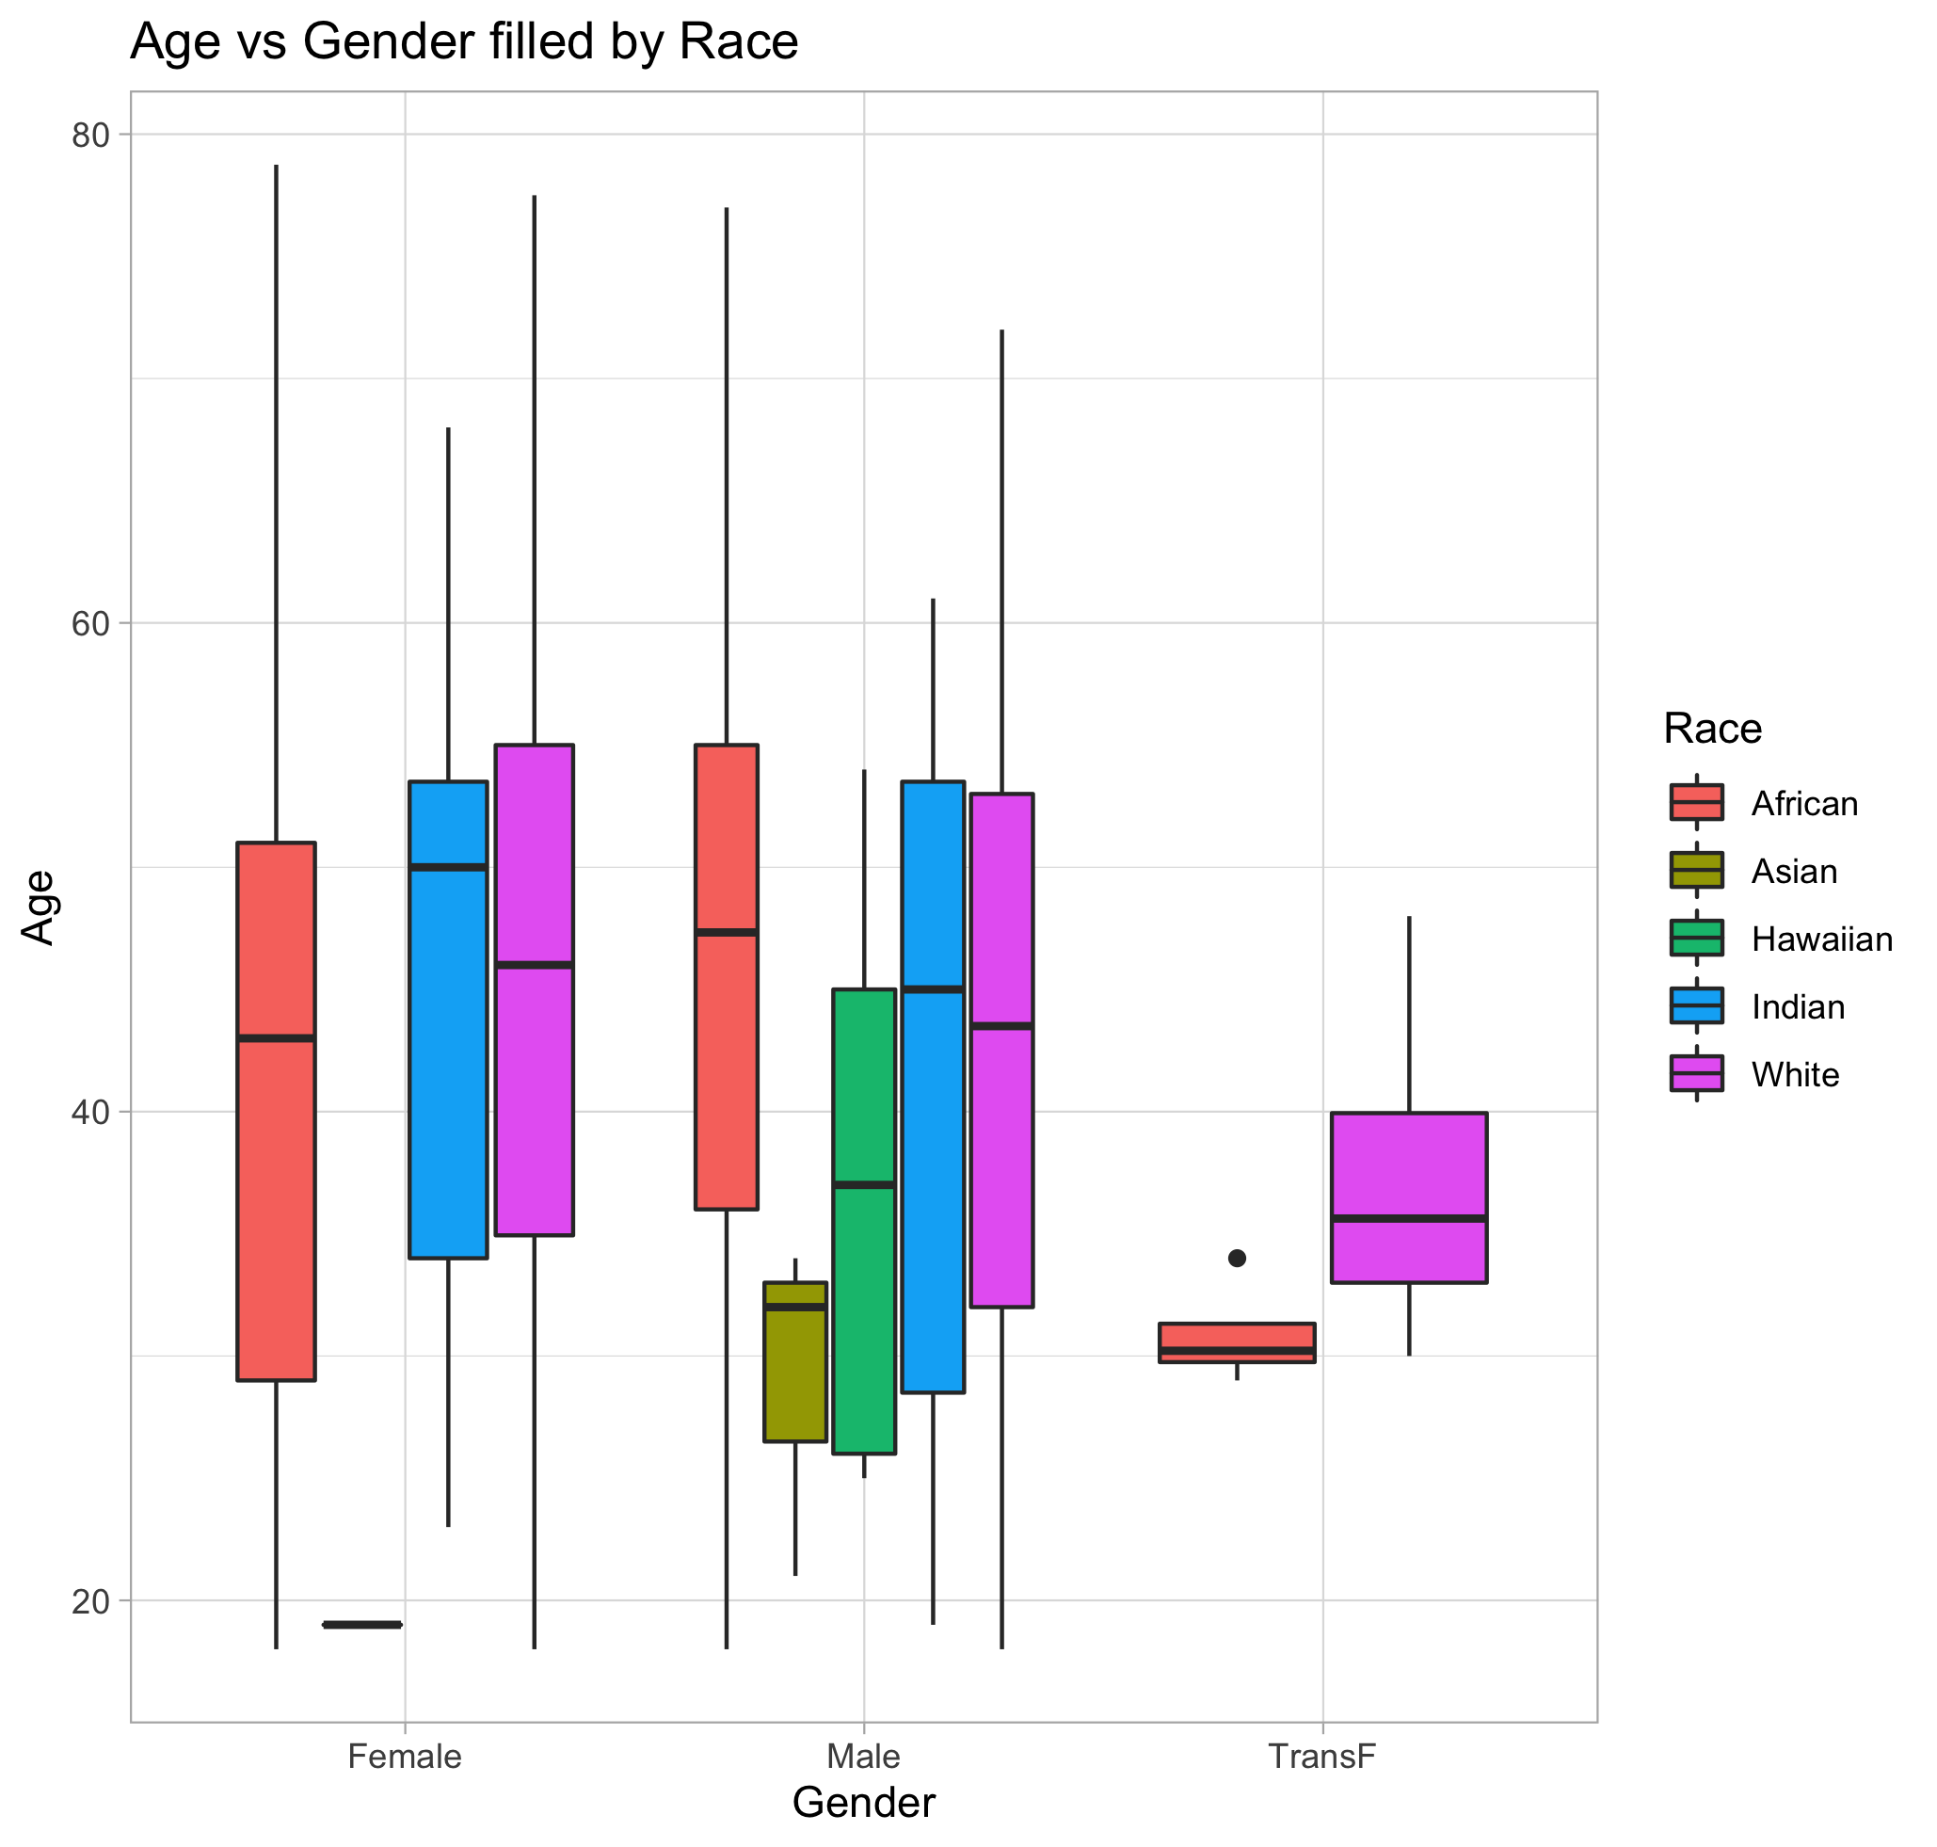
Demographic characteristics

Slide 9
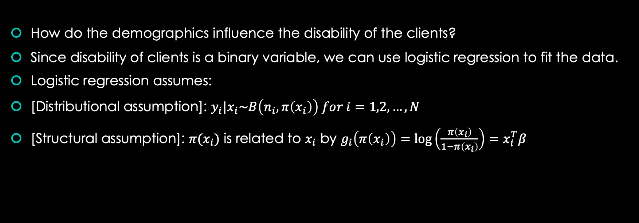
Logistic regression
How do the demographics influence the disability of the clients?
Since disability of clients is a binary variable, we can use logistic regression to fit the data.
Logistic regression assumes:
[Distributional assumption]: $y_{i}|x_{i}\sim B\left(n_{i}, π\left(x_{i}\right)\right) for i=1,2,…,N$
[Structural assumption]: $π(x_{i})$ is related to $x_{i}$ by $g_{i}\left(π\left(x_{i}\right)\right)=\log\left(\frac{π\left(x_{i}\right)}{1−π\left(x_{i}\right)}\right)=x_{i}^{T}β$

Slide 10
Logistic regression results
Variable | Estimate | StdErr | Z-value | P-value
Intercept | -4.012 | 1.471 | 0.008 | 0.006384 **
Gender_Male | -0.770 | 0.216 | -3.566 | 0.000363 ***
Gender_TransF | -13.729 | 901.387 | -0.015 | 0.987848
Race_Asian | 3.327 | 1.600 | 2.080 | 0.037524 *
Race_African | 0.708 | 1.022 | 0.693 | 0.488258
Race_Hawaiian | -12.586 | 753.695 | -0.017 | 0.986676
Race_White | 0.067 | 1.047 | 0.064 | 0.948648
Ethnicity_Non-Latino | 0.571 | 1.024 | 0.558 | 0.576533
Age | 0.007 | 0.008 | 0.812 | 0.416732

Slide 11
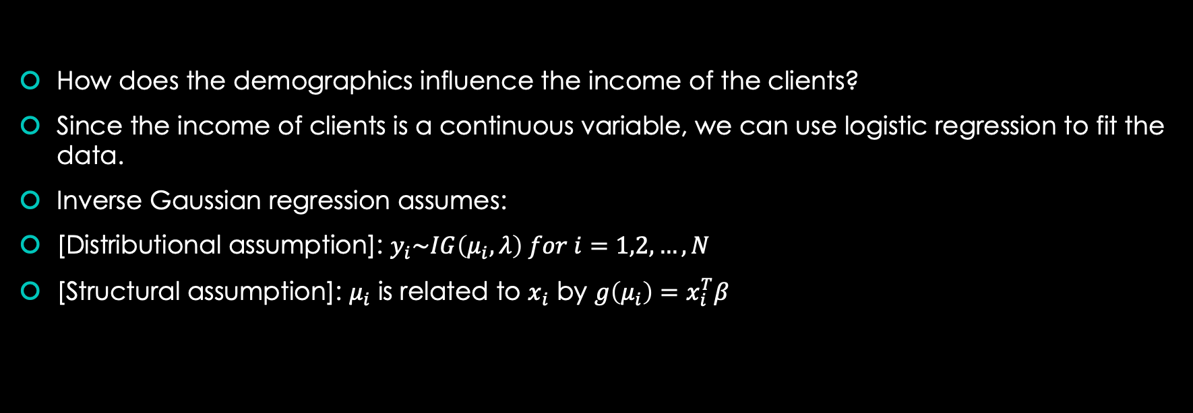
Inverse Gaussian regression
How does the demographics influence the income of the clients?
Since the income of clients is a continuous variable, we can use logistic regression to fit the data.
Inverse Gaussian regression assumes:
[Distributional assumption]: $y_{i}\sim IG\left(μ_{i}, λ\right) for i=1,2,…,N$
[Structural assumption]: $μ_{i}$ is related to $x_{i}$ by $g\left(μ_{i}\right)=x_{i}^{T}β$

Slide 12
Inverse Gaussian regression results
Variable | Estimate | StdErr | t-value | P-value
Intercept | 8.890e-07 | 3.254e-07 | 2.732 | 0.00638 **
Gender_Male | -2.653e-07 | 9.196e-08 | -2.885 | 0.00398 **
Gender_TransF | 1.990e-06 | 1.296e-06 | 1.536 | 0.12493
Race_African | 3.451e-07 | 2.366e-07 | 1.459 | 0.14491
Race_Hawaiian | 1.644e-06 | 1.262e-06 | 1.303 | 0.19272
Race_White | 3.809e-07 | 2.461e-07 | 1.548 | 0.12199
Ethnicity_Non-Latino | 2.900e-07 | 2.044e-07 | 1.419 | 0.15619
Age | -3.655e-09 | 2.897e-09 | -1.262 | 0.20738

Slide 13
Conclusion
Most of the clients are African American and white.
Most of the clients are non-Latino.
Asian and American Indian clients are mostly male.
Non-Latino women are older than Latinos.
Male are less likely to be disabled than female.
Asian are more likely to be disabled than American Indian.
UMD can use these results to adjust their policy.

Slide 14
Future work
Find a better model to fit the income data.

