Slide 1

Visualizing Shelter Time
Alvin G. Thomas, MSPH BIOS 611, Fall 2019 Project 3

Slide 2
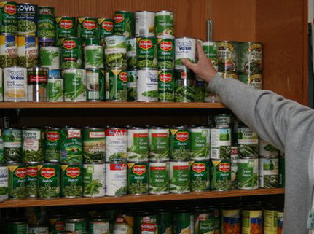
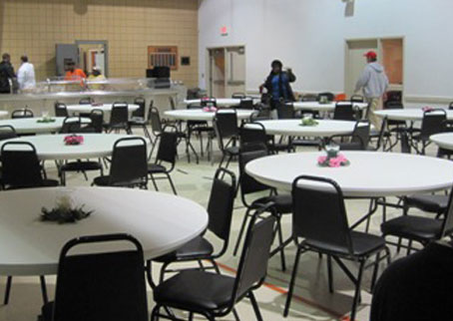
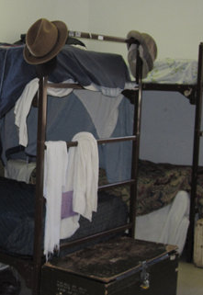
The UMD Mission
The Urban Ministries of Durham (UMD) fights poverty and homelessness by offering food, shelter, and a future to neighbors in need

Slide 3
UMD Programs
Community shelter
Community café
Food pantry and clothing closet

Slide 4
UMD Programs
Community shelter
Community café
Food pantry and clothing closet

Slide 5
Study Aim: Visualize shelter time to identify demographic groups
Gender
Race
Veteran Status
Insurance Status

Slide 6
Data Source: Urban Ministries of Durham
Dataset focuses on services provided by shelter program
16 original datasets
The analytic dataset focused on demographics and entry/exit time

Slide 7
How to interpret figures
Treemaps compare groups by AREA
Left Figure: Area = Number of Individuals
Right Figure : Area = Length of Stay
Interpretation: Right Area > Left Area
That group stayed longer than you would expect

Slide 8
Gender

Slide 9
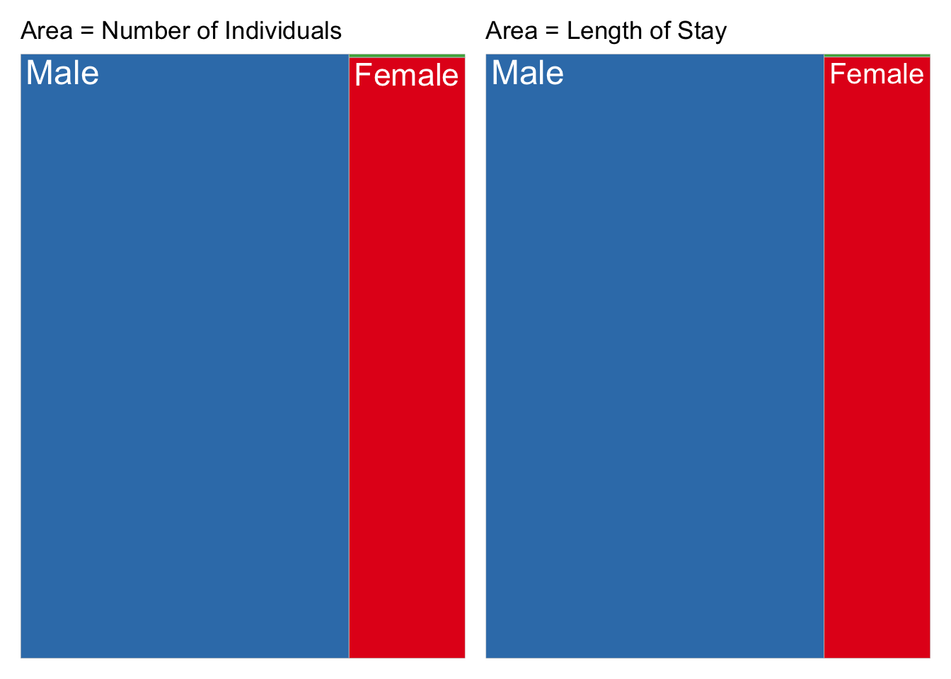

Slide 10
Race

Slide 11
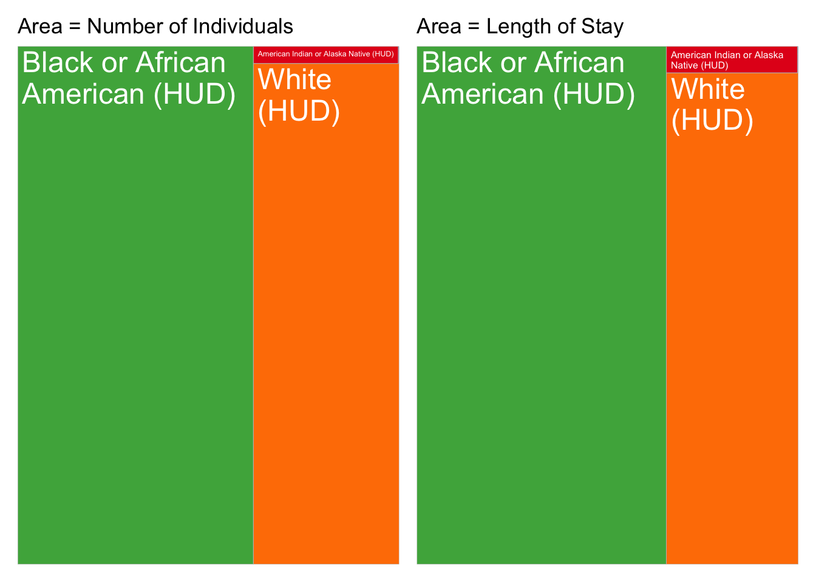

Slide 12
Veteran Status

Slide 13
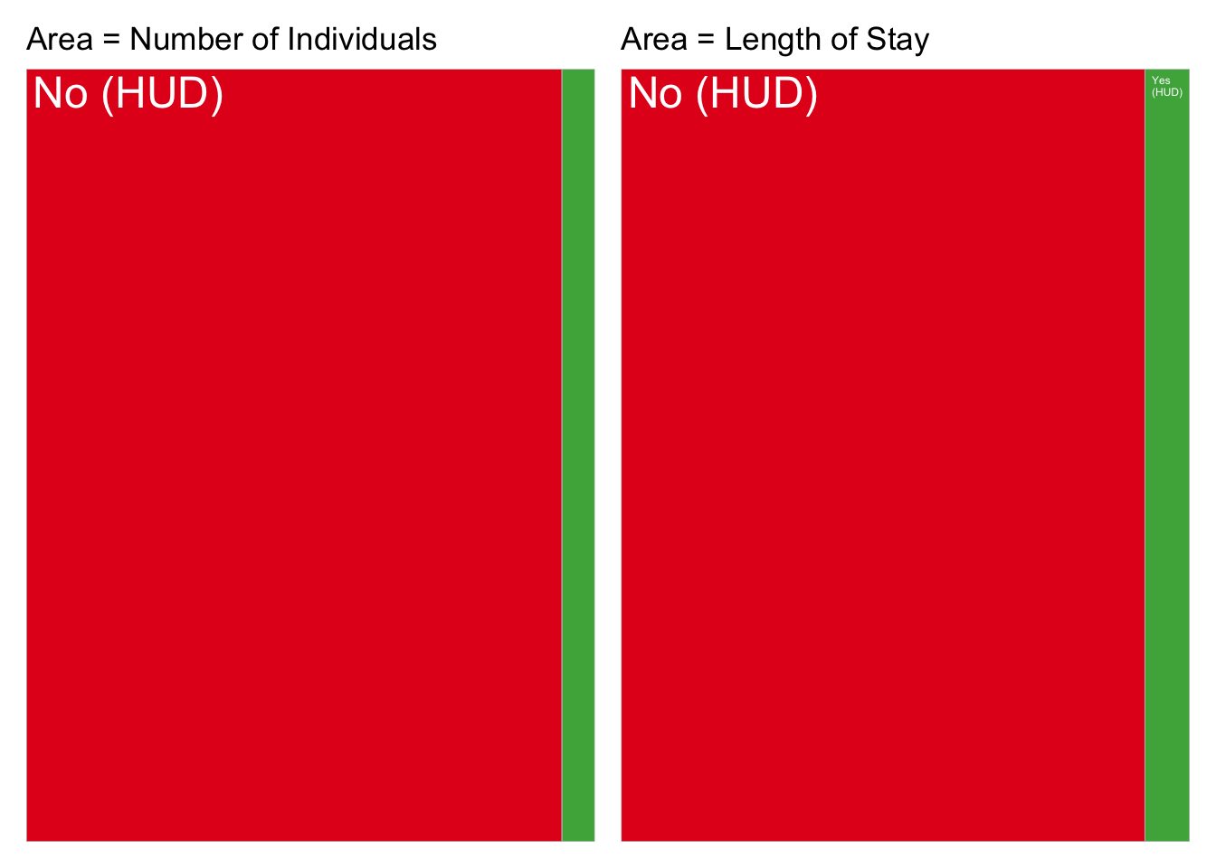

Slide 14
Insurance Status

Slide 15
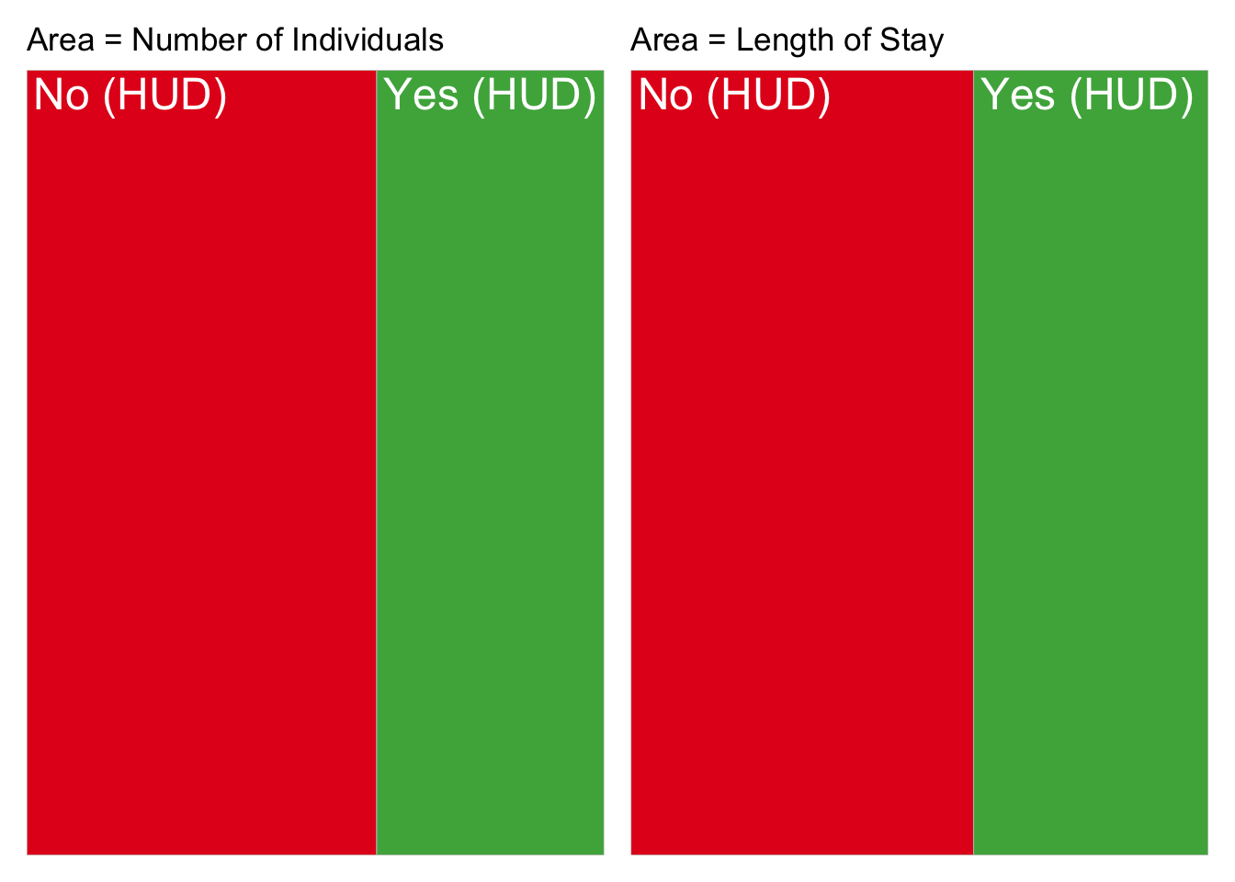

Slide 16
Reason for Leaving

Slide 17
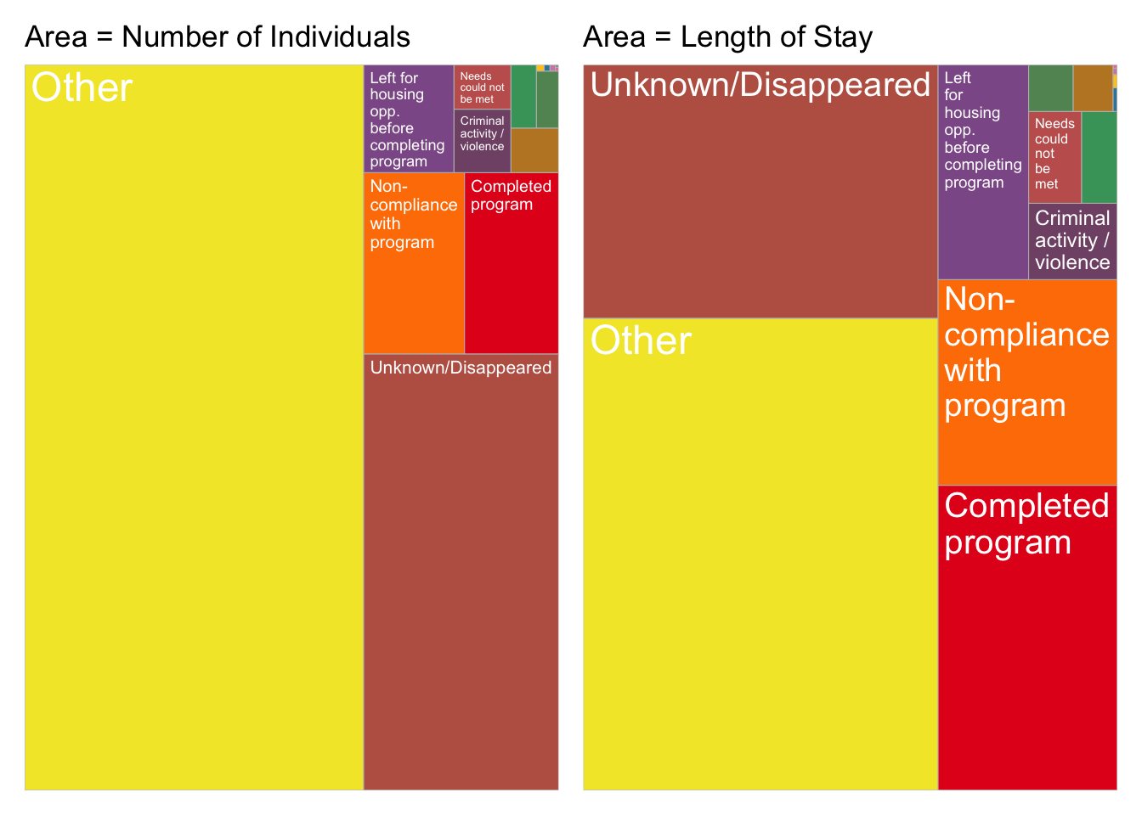

Slide 18
Combining Treemaps

Slide 20
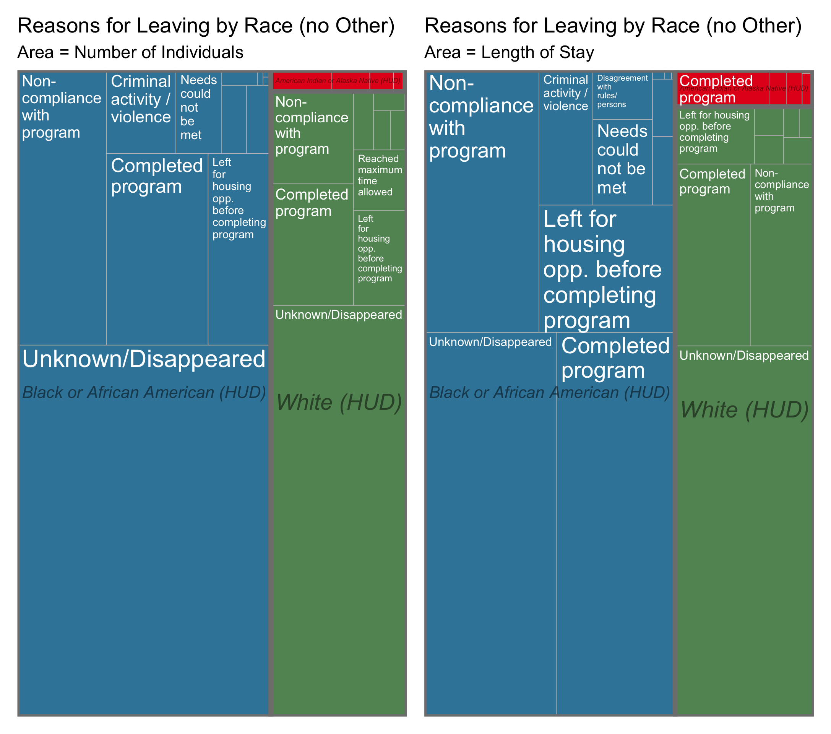

Slide 21
What have we learned?
Neighbors who use the shelter are more likely to be male, African American, non-Veterans, and not insured
Treemaps can be used to visualize demographic groups and length of stay
Those that ultimately ”disappear” stay at the shelter for a long time

Slide 22
What next?
Deliverable:
Client Summary
Reproducible, Containerized Repository for Data scientists
Create a Shiny Dashboard

