Slide 1

Food Pantry Services over Time
Alvin G. Thomas, MSPH BIOS 611, Fall 2019 Project 1

Slide 2
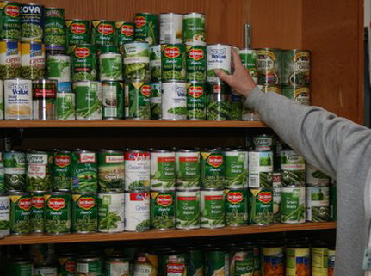
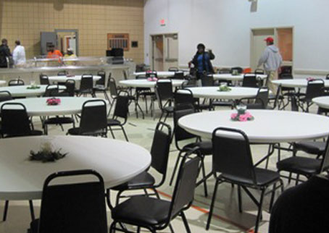
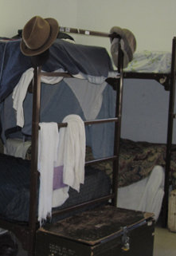
The UMD Mission
The Urban Ministries of Durham (UMD) fights poverty and homelessness by offering food, shelter, and a future to neighbors in need

Slide 3
UMD Programs
Community shelter
Community café
Food pantry and clothing closet

Slide 4
Primary Service Programs
Community shelter
Community café
Food pantry and clothing closet

Slide 5
Study Aim: Describe the change in food pantry core services between 2010-2017
Food
Clothing
School Kits
Hygiene Kits
Diapers

Slide 6
Data Source: Urban Ministries of Durham
Dataset focuses on services provided by the food pantry and clothing closet
Original dataset had 18 variables and 79,838 observations
The analytic dataset used observations from 2010-2017 (N=42,770)

Slide 7
How many encounters per neighbor?

Slide 8
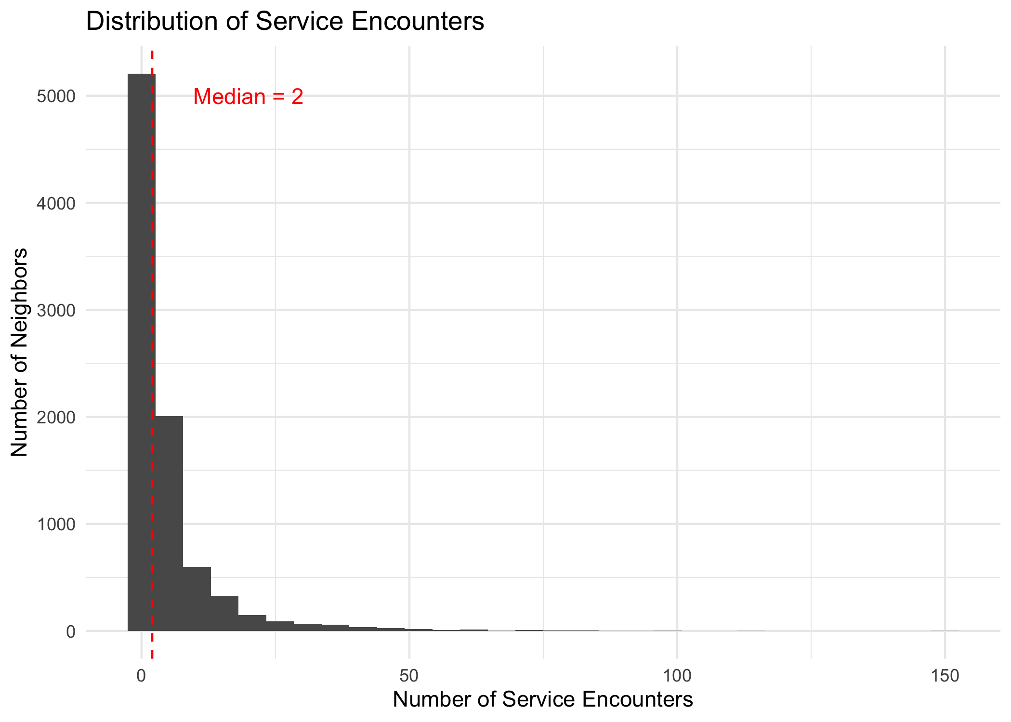

Slide 9
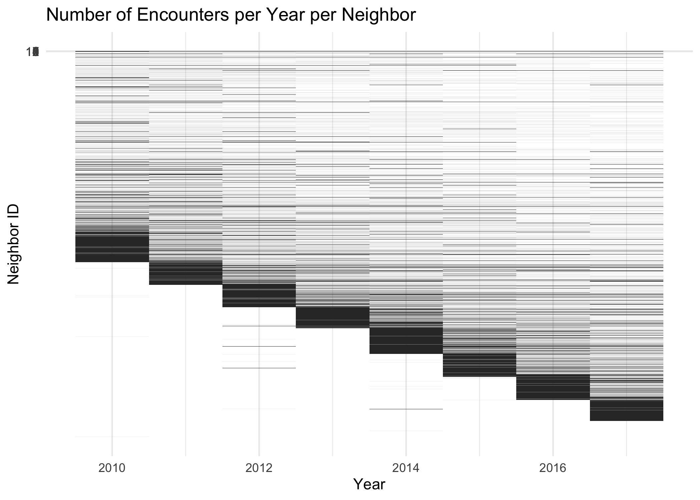

Slide 10
How has food distribution changed over time?

Slide 11
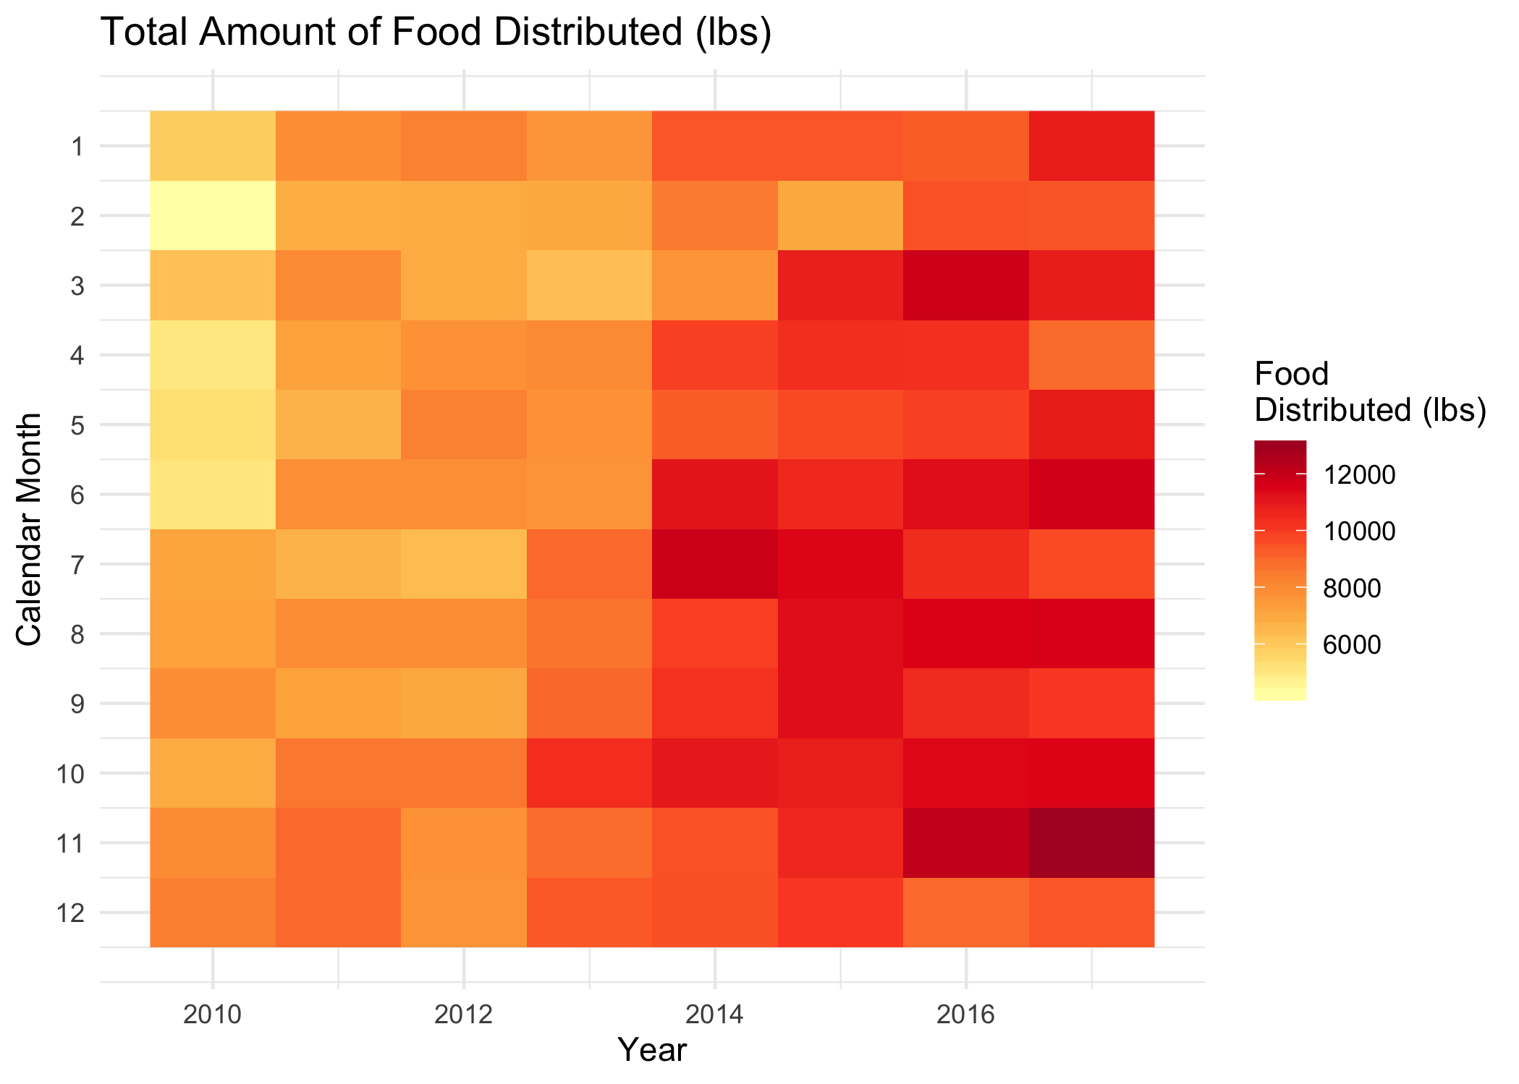

Slide 12
How has clothing distribution changed over time?

Slide 13
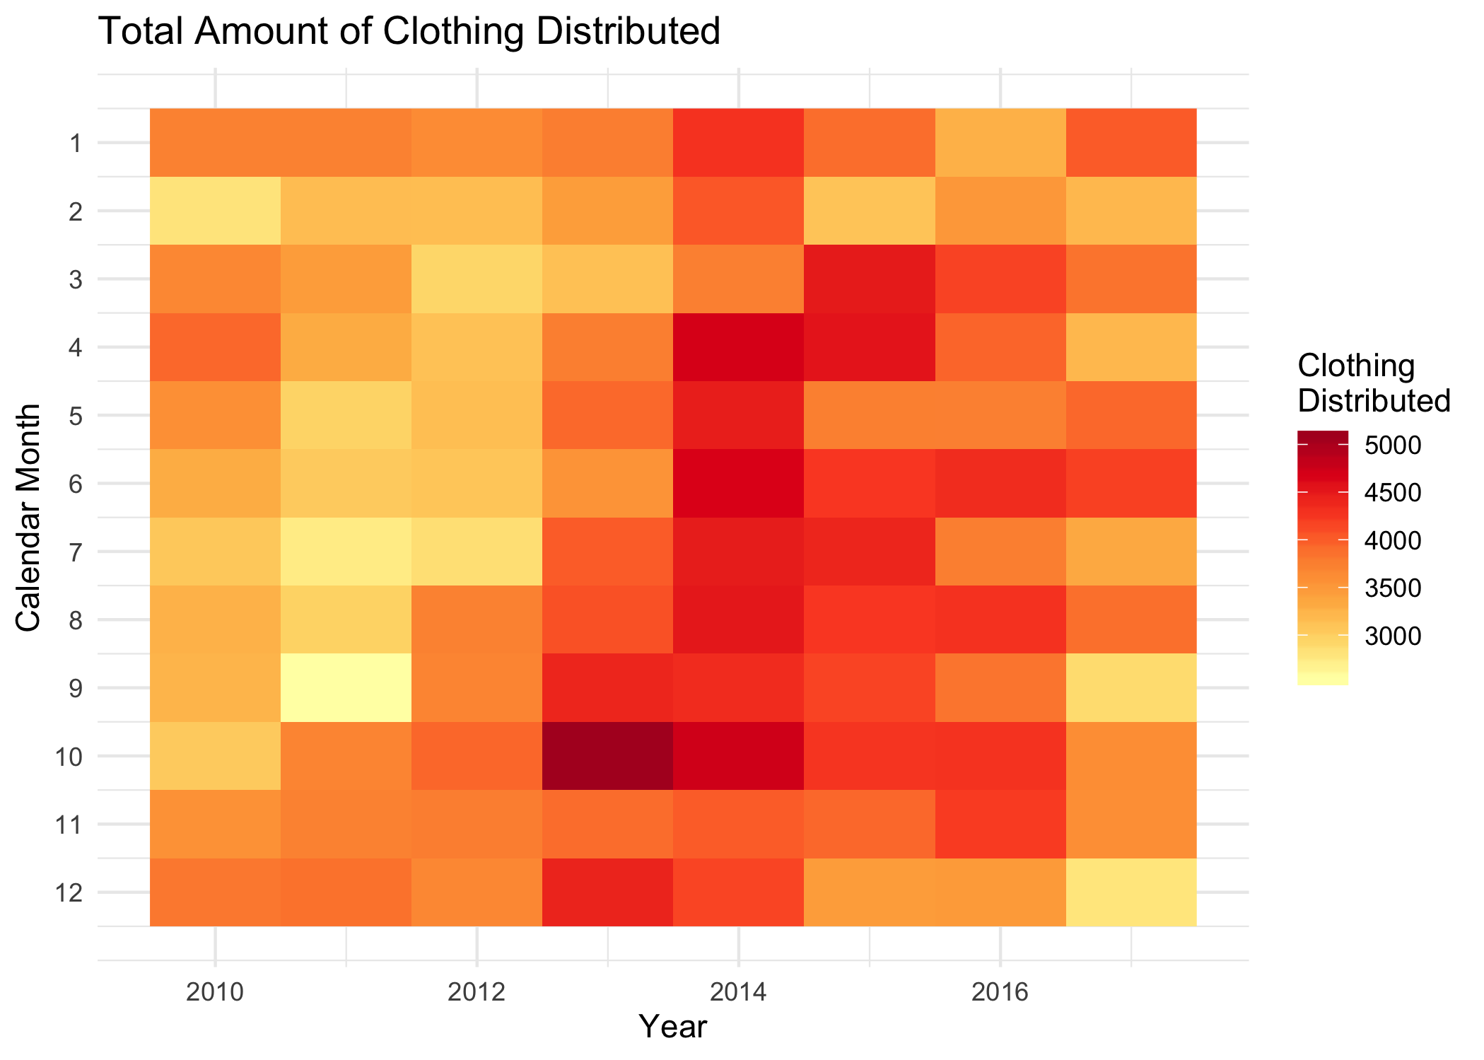

Slide 14
How about the other services?

Slide 15
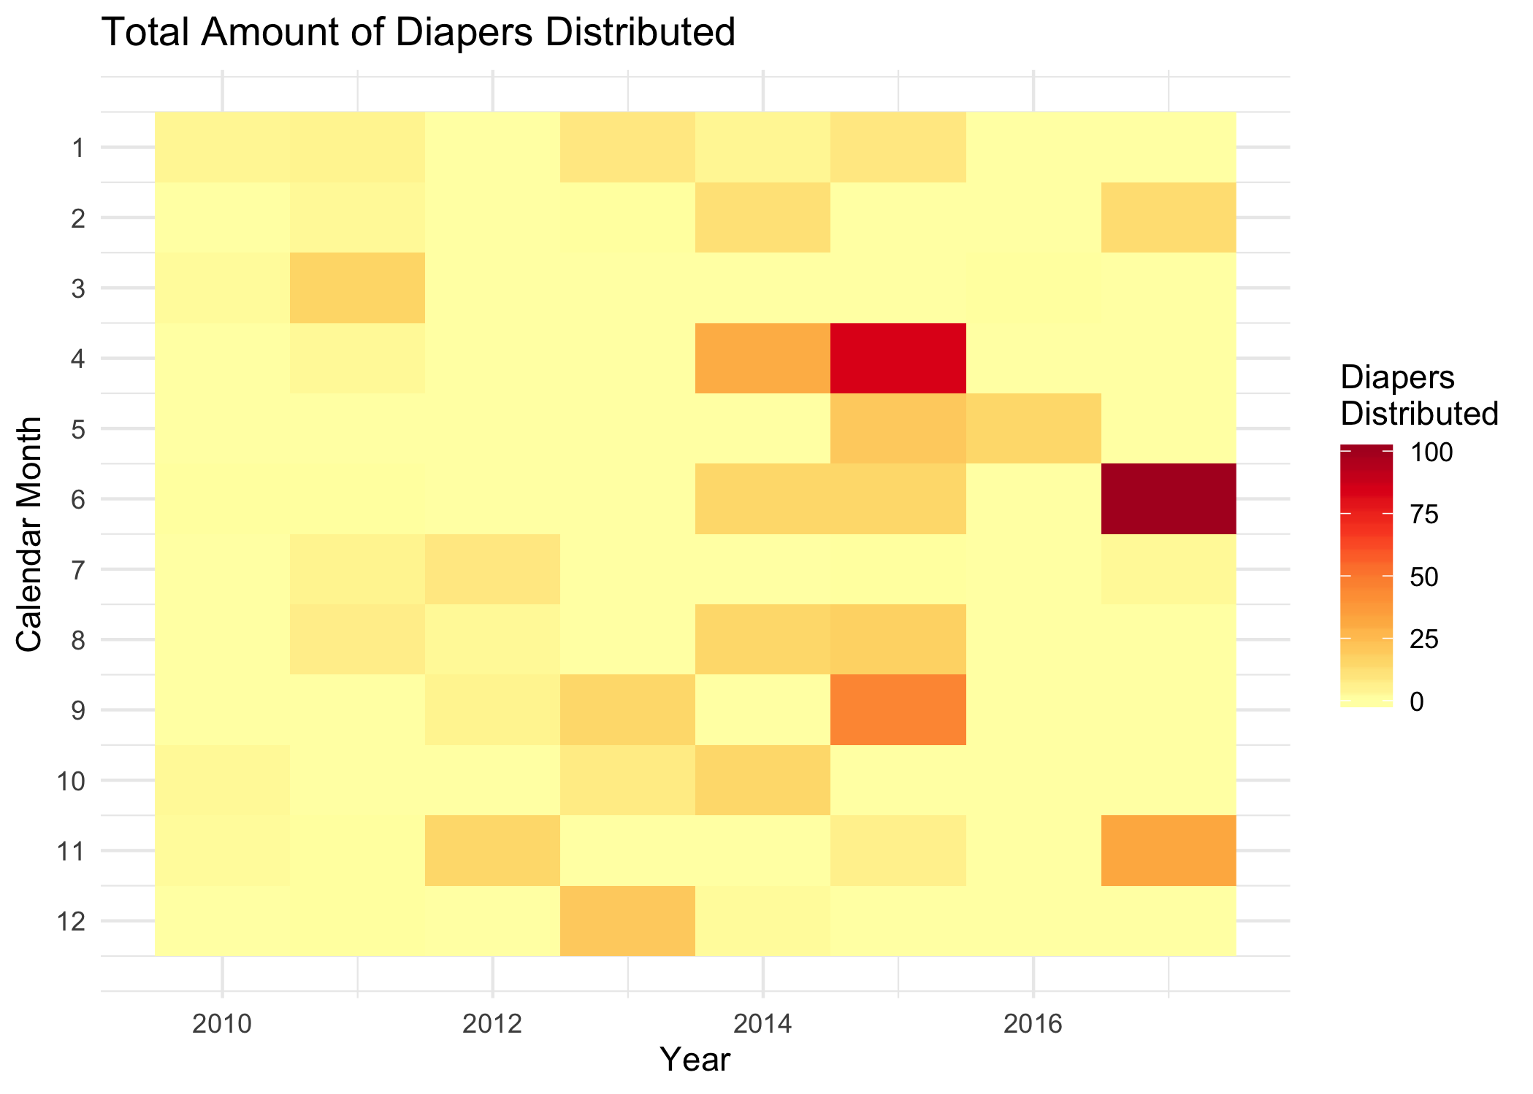
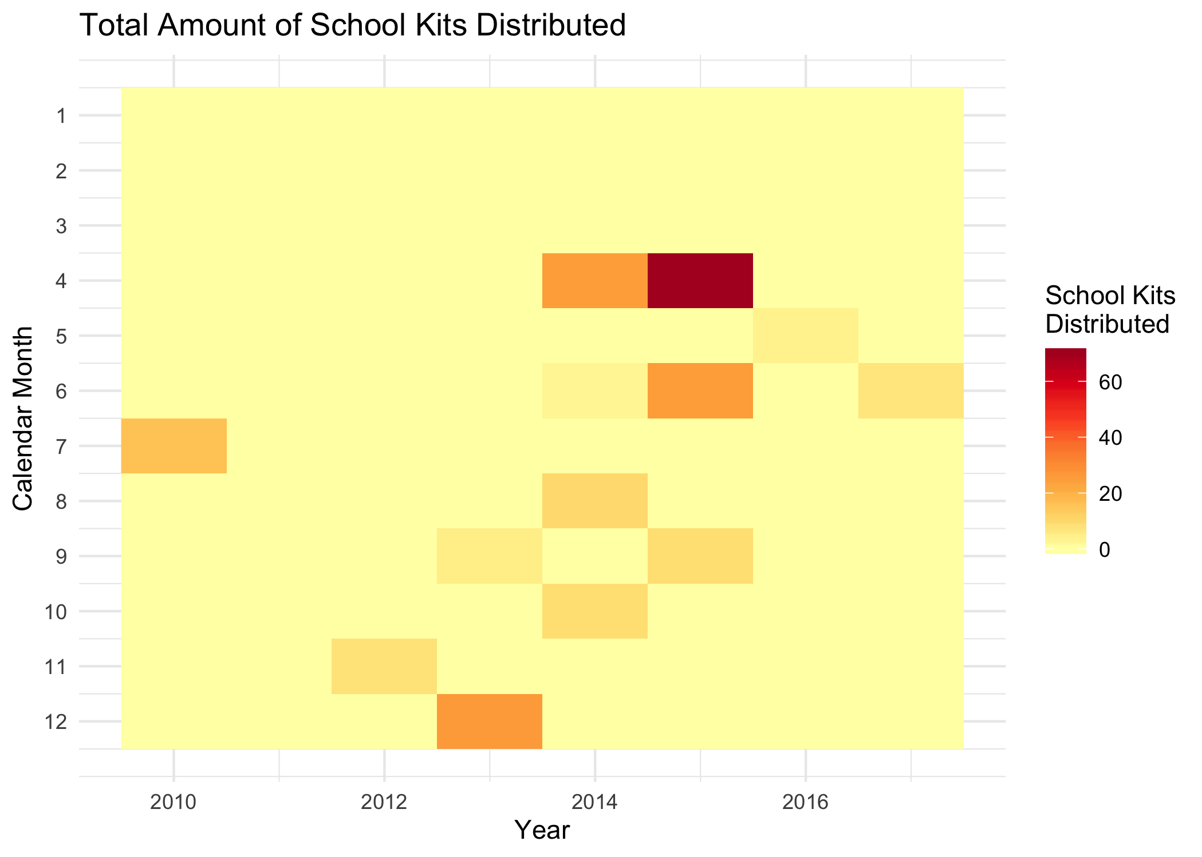
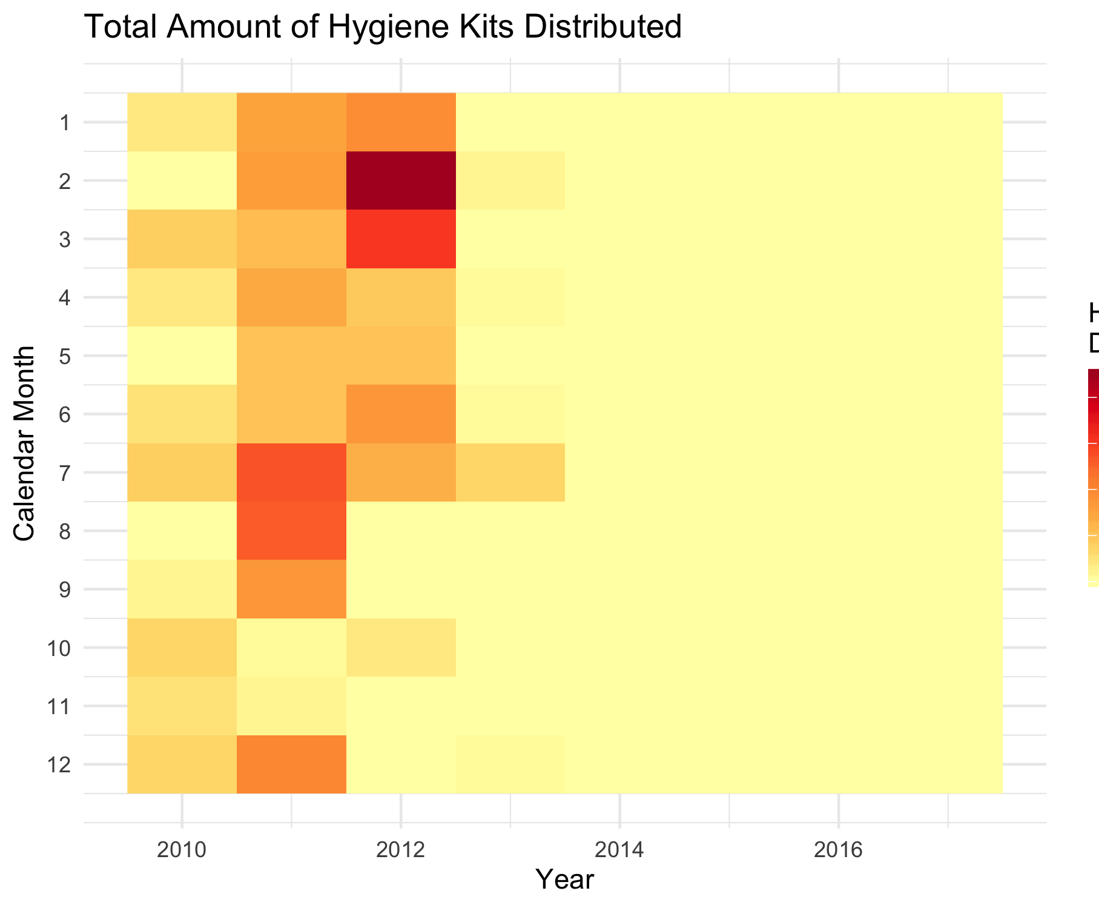

Slide 16
What have we learned?
The median number of encounters per neighbor: 2
Data quality likely varies between services
Food distribution is the most complete variable
Food distribution has increased over time
2014 was the peak year for clothing distribution

Slide 17
What next?
Deliverables:
Executive Summary and Detailed Analysis Reports on Github
Incorporate data collection protocols and other datasets
Study neighbors who are high service utilizers and how UMD can best serve them

