Slide 1
BIOS 611 Project 1
Christina Zhou
10/7/2019

Slide 2
Introduction
Homelessness: any person living without a home, typically living on the streets
In North Carolina, approximately 9,268 people experience homelessness on any given day as of January 2018 (1)
Established in 1983, Urban Ministries of Durham (UMD) is a non-profit organization that focuses on lowering the community’s rate of homelessness by providing food, shelter and other resources to those in need
3 organizations merged in 2001 to create UMD as it exists today
UMD provides “food, shelter, and a future” to over 6,000 men, women, and children every year (2)

Slide 3
Project Aim
In our exploratory analysis for Project 1, we seek to explore the trends of household types that visit UMD, regarding number of visits and amount of food. For this project, we focus our data analysis on examining the relationship of number of visits and average pounds of food per visit between family households and single households. We would expect family households to obtain more food, and perhaps have less visits to UMD (maybe because they are trying harder to find a sustainable home due to more members at stake).

Slide 4
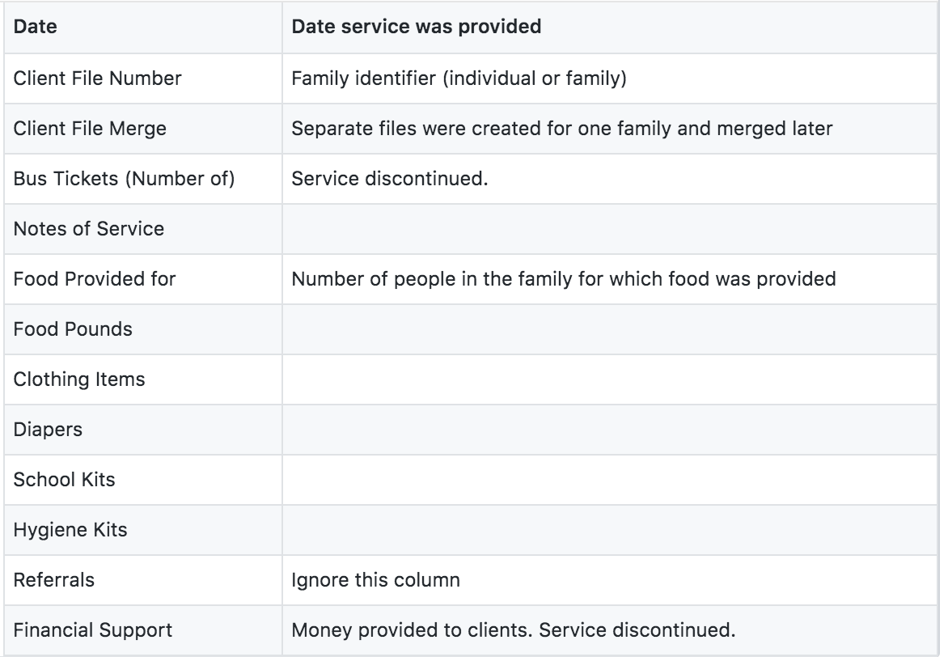
Data Source: UMD
Decades of data collection
The total number of observations: 79838
Lots of missing data

Slide 5
Data cleaning
Only keep dates from Jan 1, 2001 to Dec 31, 2018
DEFINE: family household if the number of people the food given that visit was provided for more than 1 person, and single household otherwise
Complete case analysis for those without missing variables Food.Provided.for (defined as number of people the food given that visit was provided for) and Food.Pounds (defined as the number of pounds given for that visit) variables
Further subset by only keeping observations with the same number of family members for every visit
Consistency of household definition
Remove observations who do not take food from UMD (given our questions of interest for this analysis)
Remove outliers regarding family members and average pounds of food per day per household
Final analysis population: 7191 households: 3405 single households and 3786 family households
See Project 1 report on Github for more descriptive details on data cleaning

Slide 6

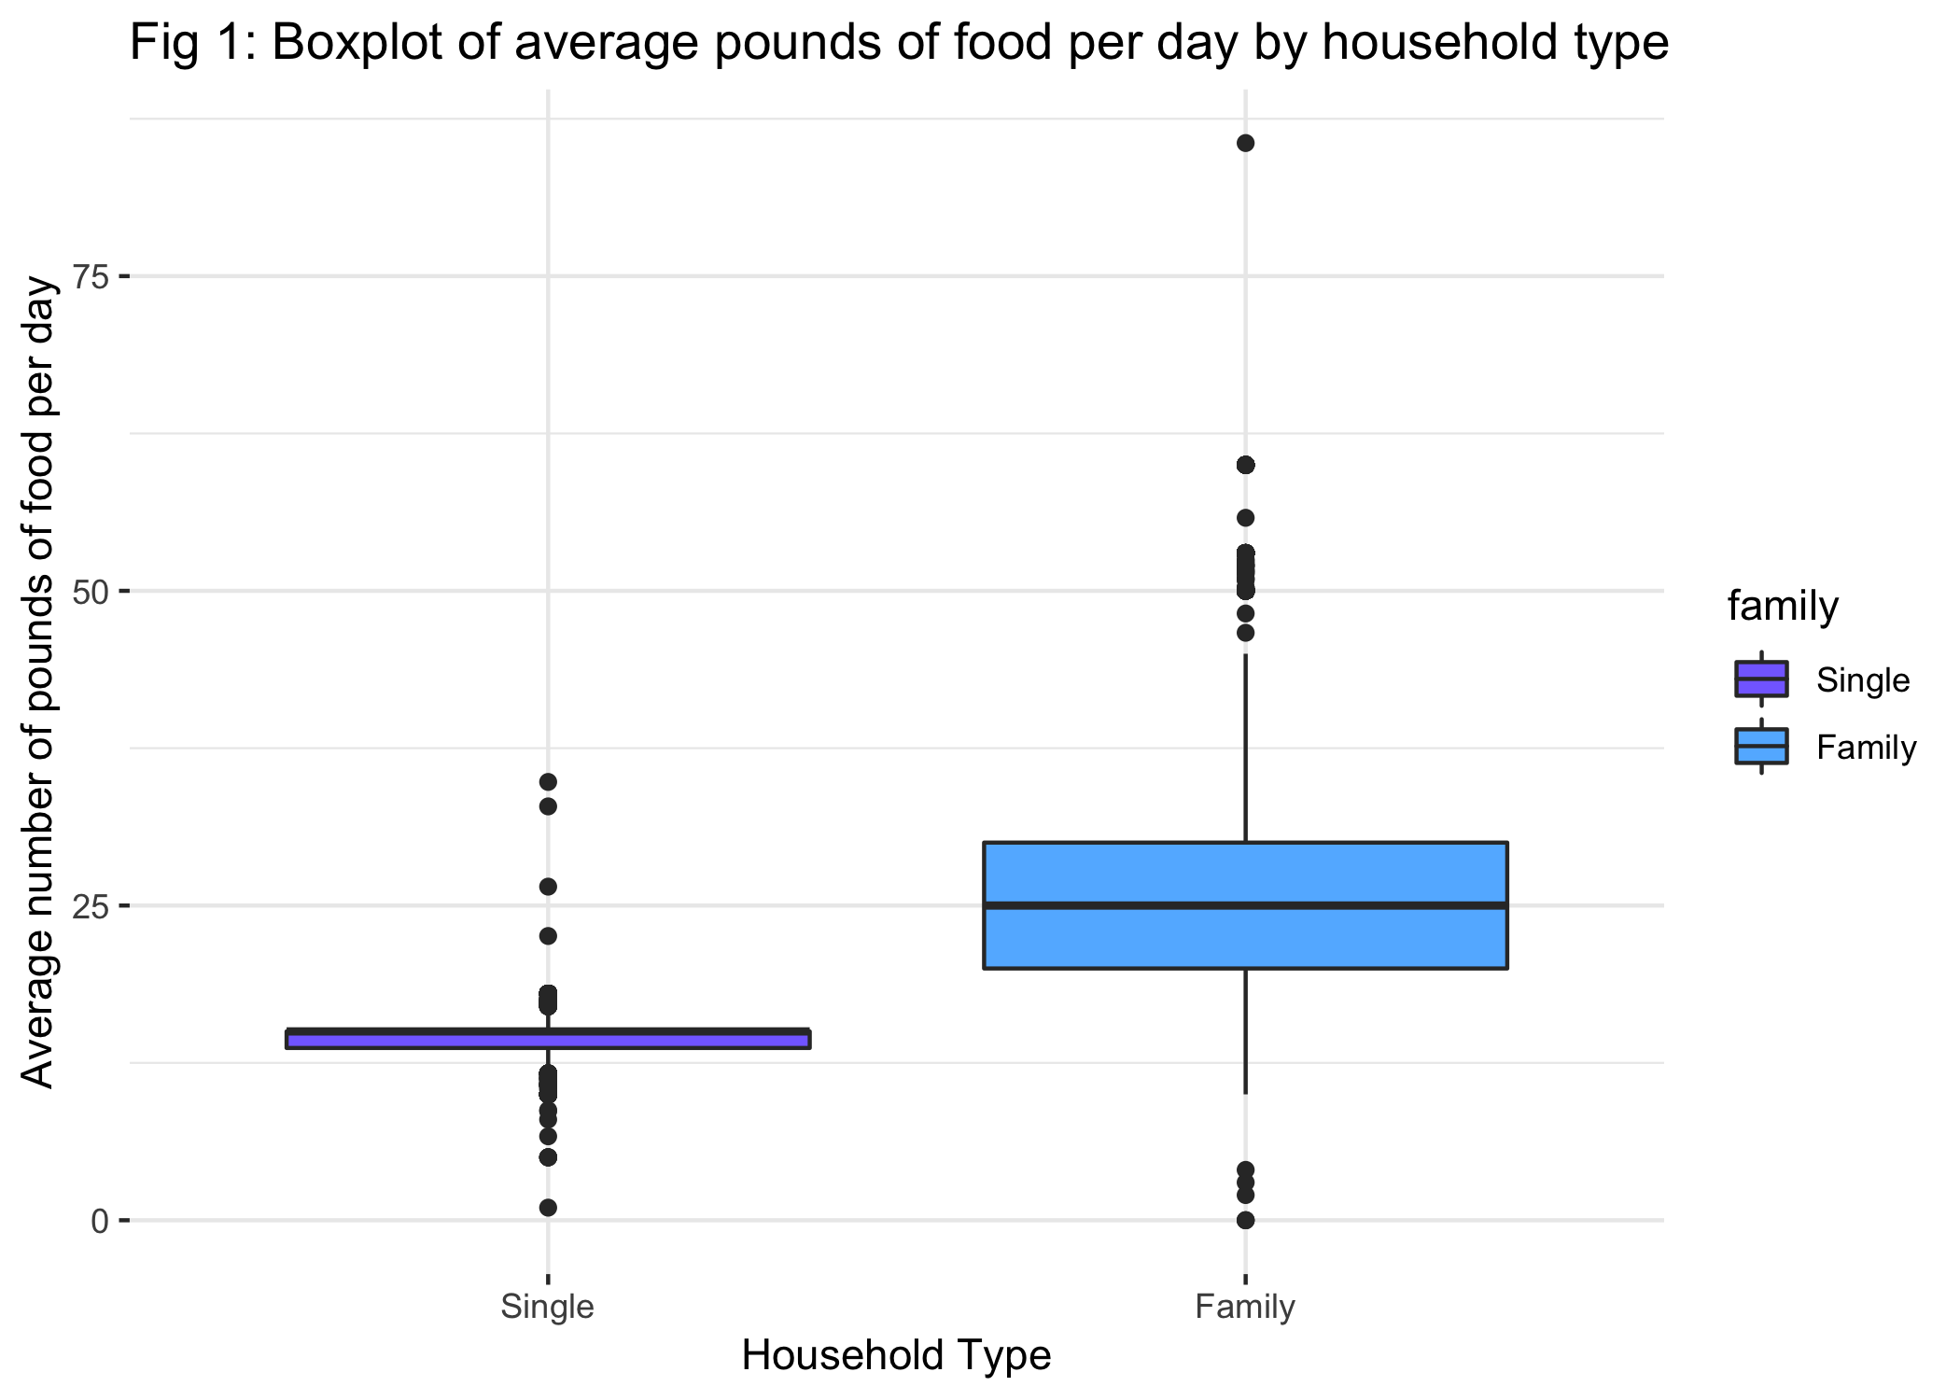
Figure 1
Boxplots comparing the average number of pounds of food taken from the UMD food pantry per day between household types (single-member households vs. family households)
Families have higher overall mean per day
More and larger outliers for larger average pounds per day for the family households
Single-member households have more lower outliers for average pounds per day
This is expected since family households have more people to feed than single households

Slide 7
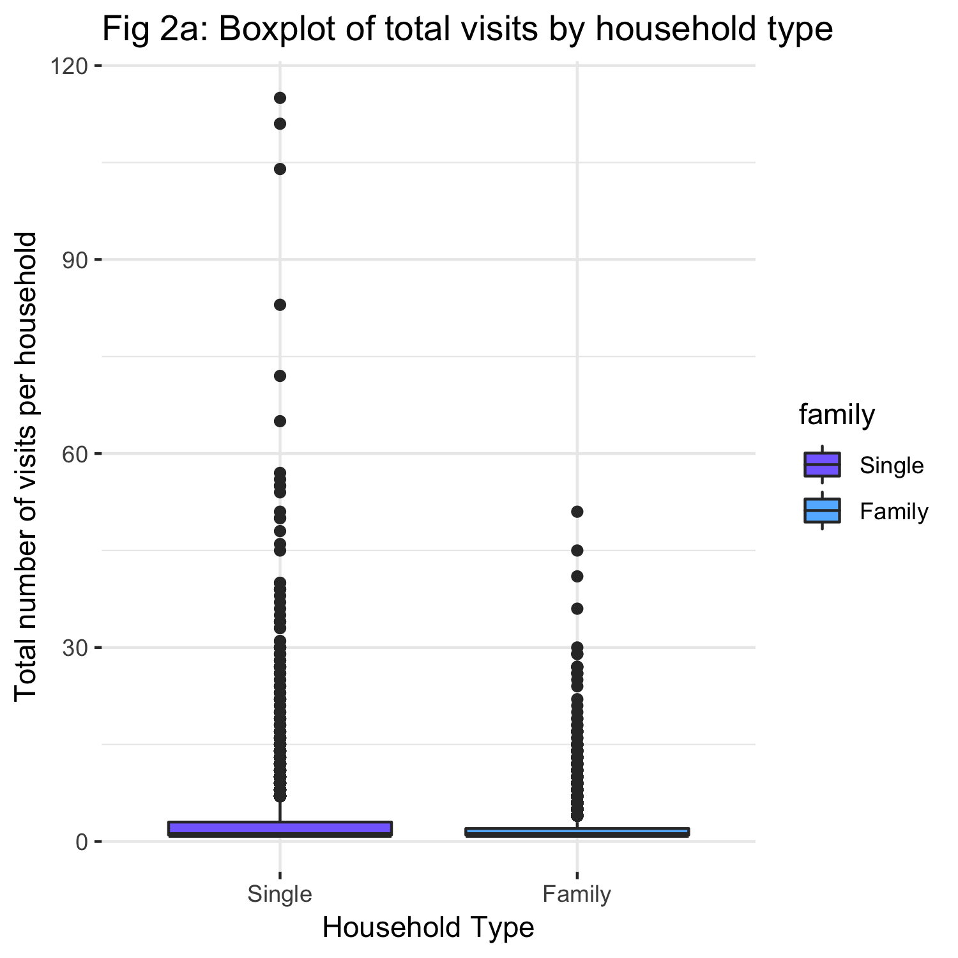
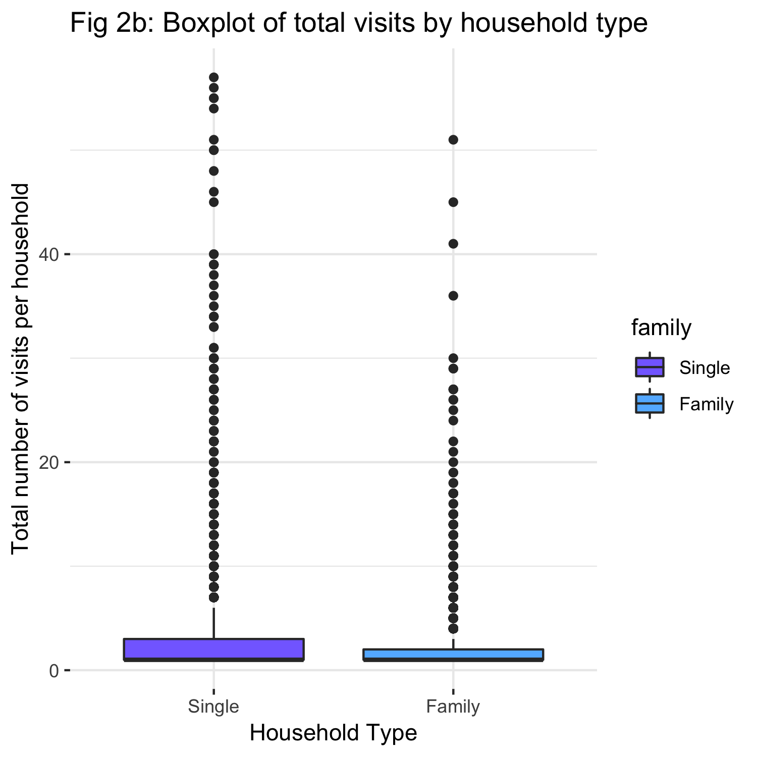
Figures 2
Figure 2a: distribution of total visits by household type in last 20 years
For both household types, the overall average number of total visits in the last 20 years is low
Larger quantity of outliers for single households than family households → larger variance (wider spread). Similarly, some of these outliers are more extreme than those of the family household total visits.
One reason for the larger variance in single family household is that single people may come in whenever they need to, but families may try to be more consistent since they may be more aware of the fact that they will need food. This is possibly because of the feeling of higher risk of taking care of someone more than just oneself.
Figure 2b is a closer look (households with <= 60 total visits)

Slide 8
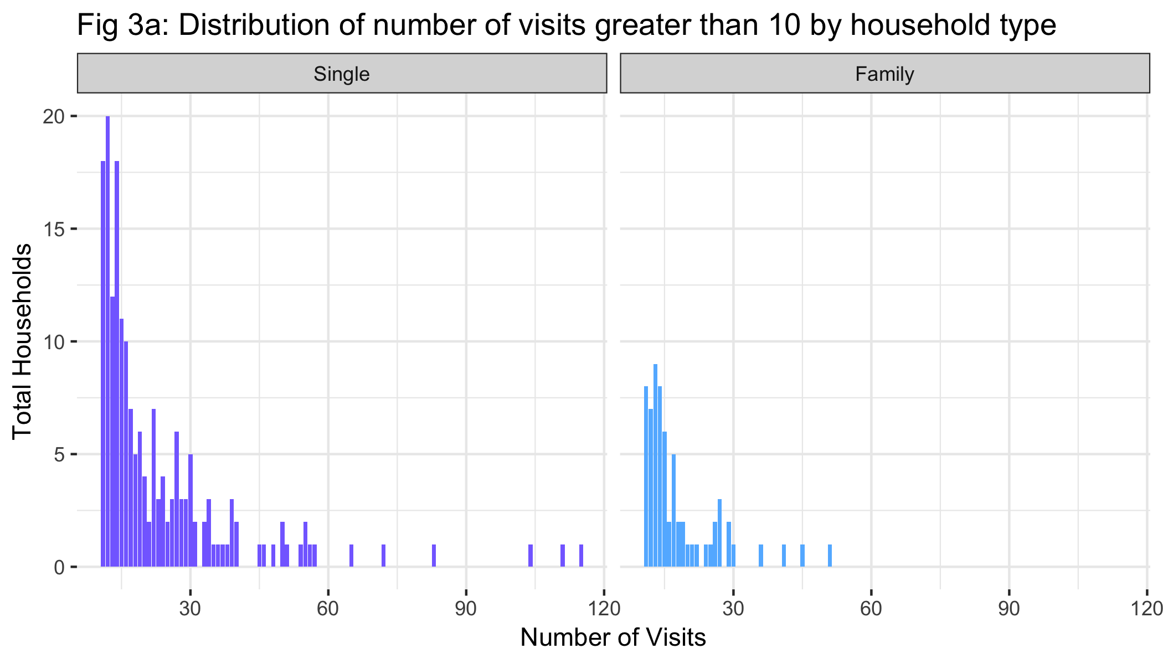
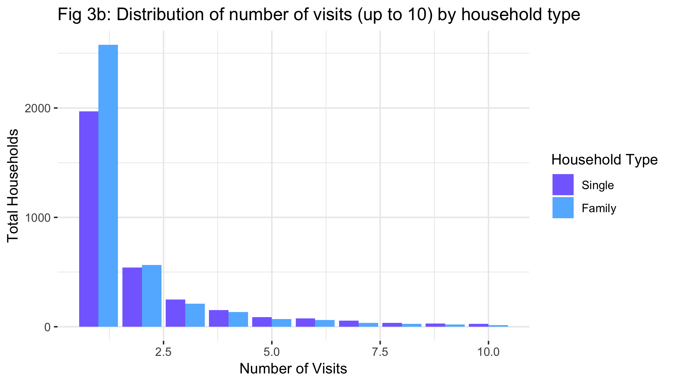
Figures 3
Figure 3a is a histogram comparison of total number of visits between families vs single people
Generally, more visits from single households
Greater spread for number of visits
Largest count of total number of visits is low, close to 1 for both household types
Figure 3b: truncate our dataset to households with no more than 10 total visits to UMD within our date range
More family visits than single visits
But more long-term visits from single households
Possibly due to family households trying harder to find homes for their family (rather than just their selves)

Slide 9
conclusions
In conclusion, we examined two trends comparing household types. The first trend confirms that families have on average greater average pounds of food per day from the pantry. The second trend reveals that families tend to visit less often than single households. However, most households for both household types tend to have “fewer visits” compared to “more visits”.

Slide 10
References
1) https://www.usich.gov/homelessness-statistics/nc/
2) http://www.umdurham.org/

Slide 11
thank you
Questions?

