Slide 1
Project 3
Helal El-Zaatari
12/02/2019

Slide 2
Main Goals
Use the client's current living situation in order to predict the number of days the client will stay.
Demographic analysis for each group.
UMD will be able to use this analysis in the future for other clients.

Slide 3
The 5 Destinations
Staying with Friends
Staying with Family
Renting
Staying in a Medical facility
Other (jail, transitional, housing emergency sheltery...)
There is also a subgroup of permanent and temporary tenure.

Slide 4
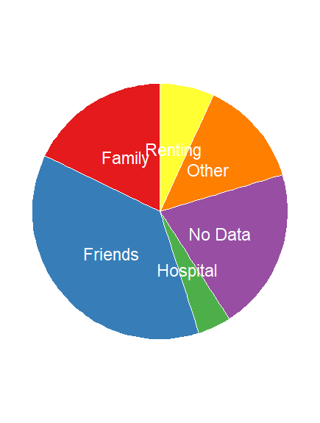
The 5 Destinations

Slide 5
General Demographic Analysis
The average stay was 127 days.
The mean age of entry was 28 years old, median was 32
We want to see how the average stay changes when we focus on a group

Slide 6
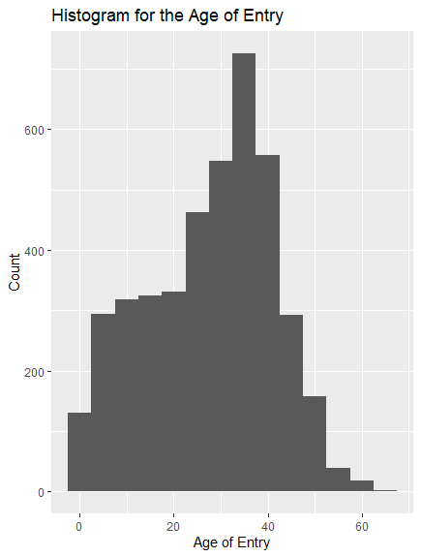

Slide 7
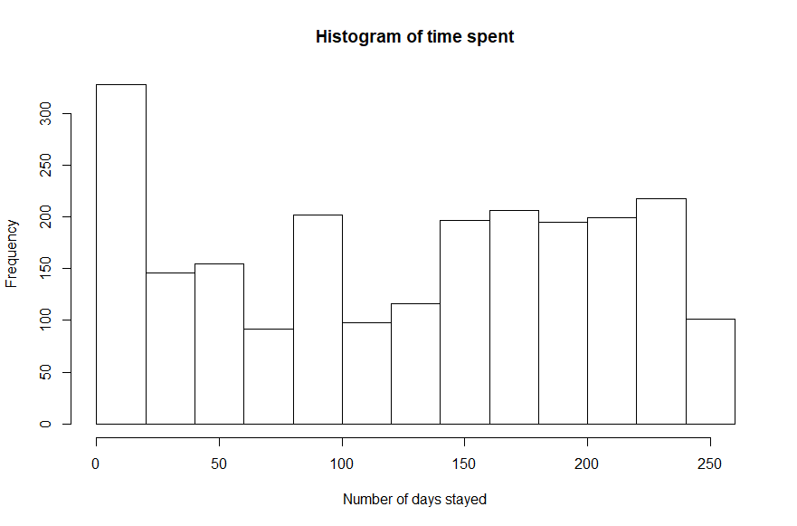

Slide 8
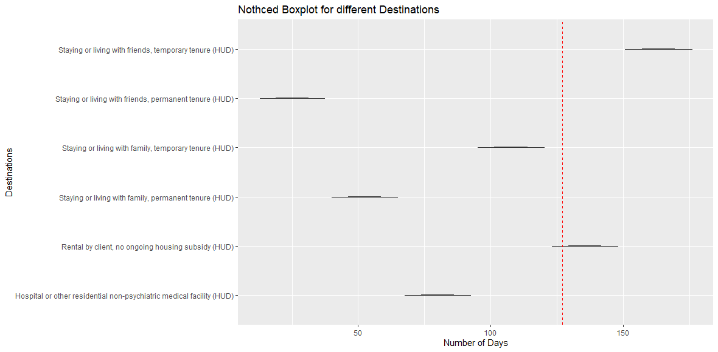

Slide 9
Data Source
:https://raw.githubusercontent.com/biodatascience/datasci611/gh-pages/data/project1_2019/UMD_Services_Provided_20190719.tsv

