Slide 1

UMD Data Analysis
Clients and Duration of Assistance
Logo from UMD website
William King

Slide 2
What data to focus on?
People-centered - analysis based at client level
Time scales - for how long are people being helped?
Restricted to years 2000-2019
Assistance duration = time from first visit to last visit
Frequency of visits
Patterns - what similarities and differences can we notice?
Compare time periods
Single-visit vs. repeat-visit clients
Stratify by assistance duration

Slide 3
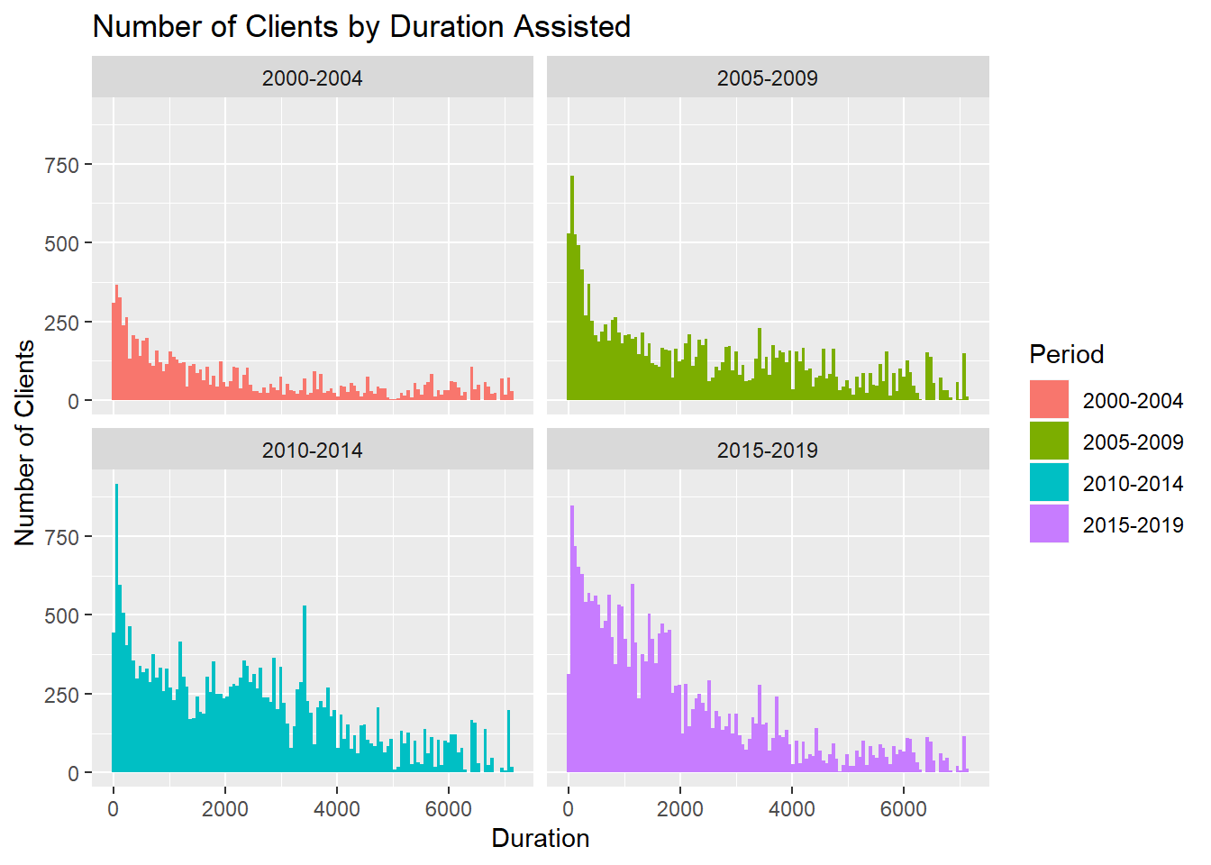
How long do clients
receive assistance for?
Big spike around 0
Exponential decrease, but not smooth
Overall client numbers increasing

Slide 4
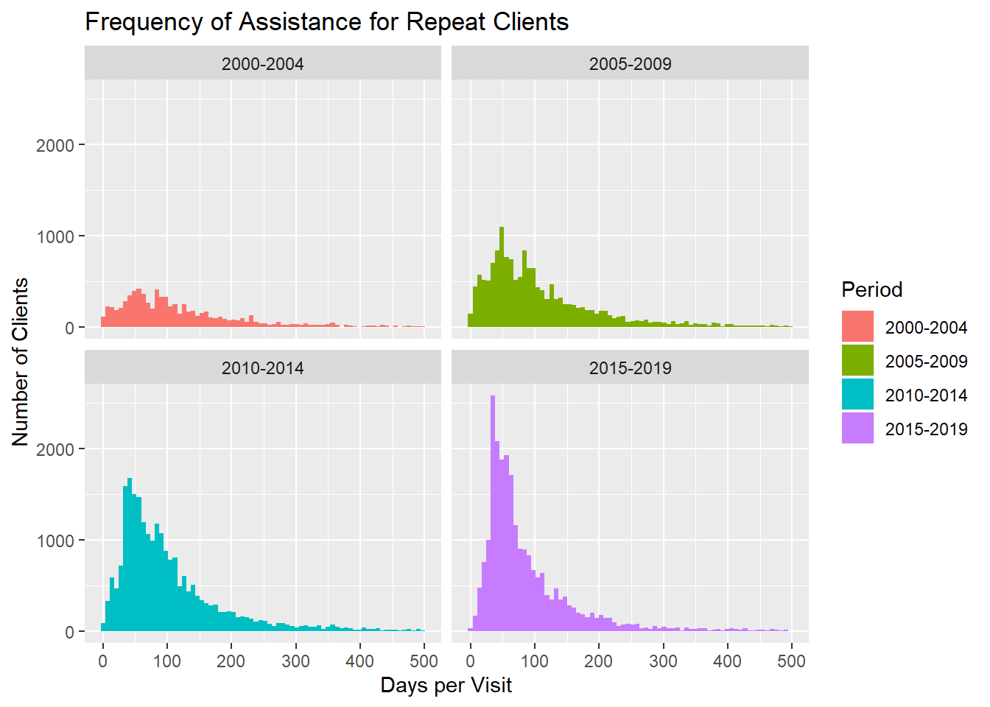
Repeat visits:
Frequency
Majority between 1-3 months (~30-90 days)
Frequent assistance increased over time
Infrequent assistance slightly decreased over time

Slide 5
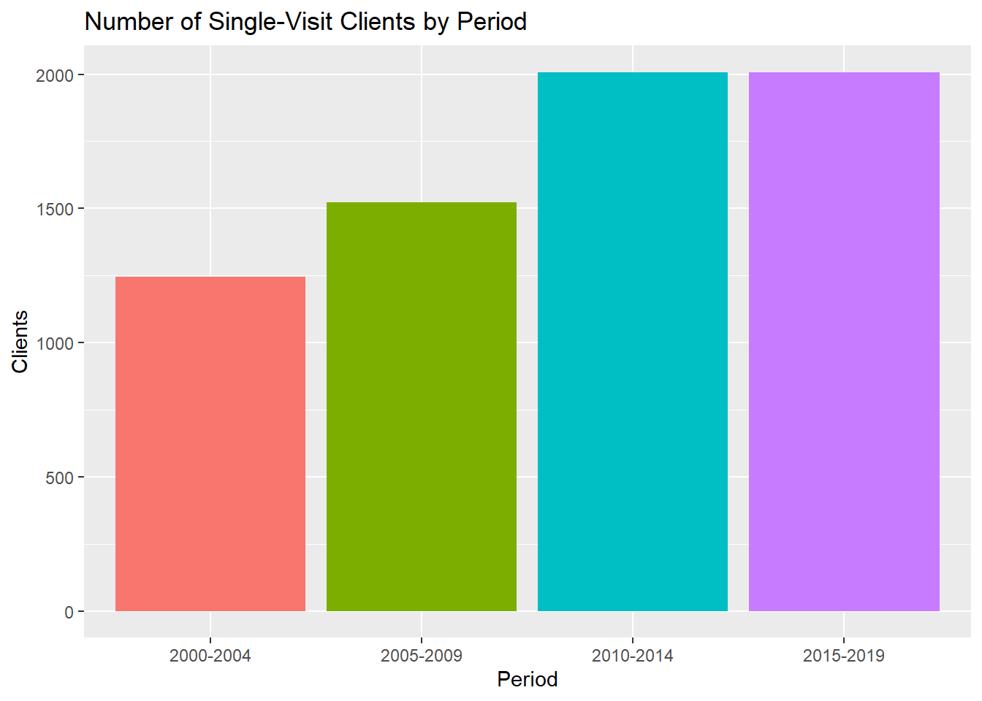
Single visits:
Number of clients
Increased from periods 1-3
Steady over periods 3-4

Slide 6
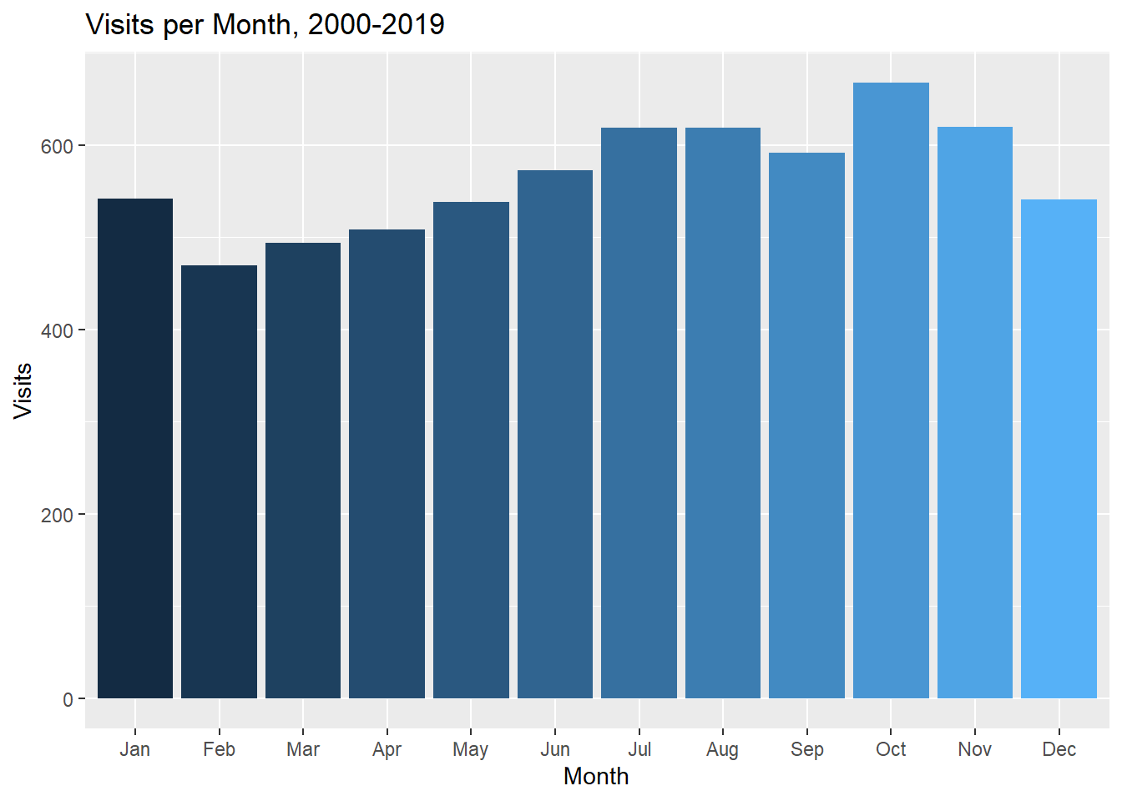
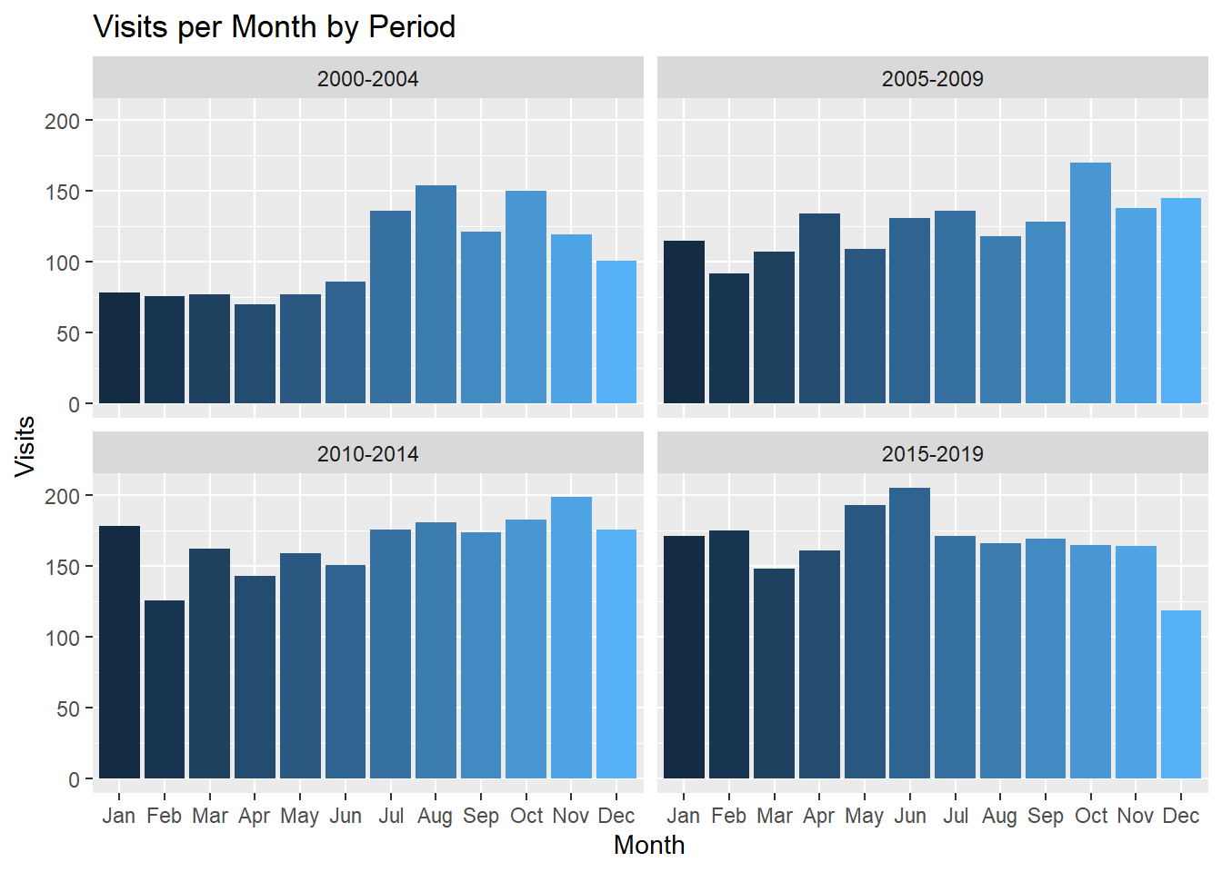
Single visits:
Visits per month
Difficult to see strong, consistent patterns
Summer consistently high
Spring consistently low

Slide 7
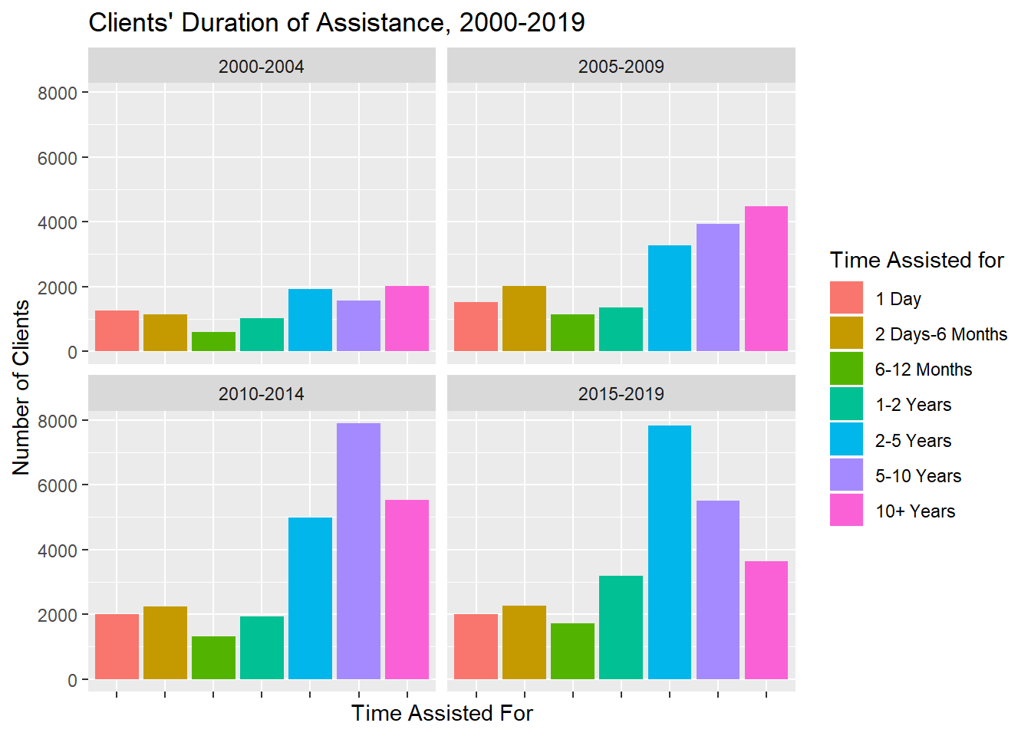
Duration of Assistance:
Stratification
2-5, 5-10, 10+ groups grew considerably
Roughly equal numbers in 1 Day and 2 Days-6 Months groups
Final period saw 2-5 jump, 5-10 and 10+ drop

Slide 8
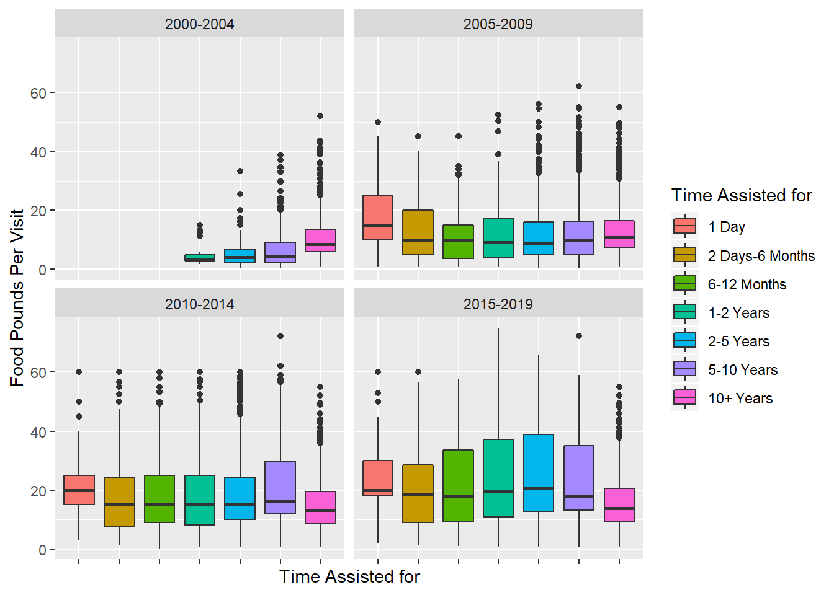
Food pounds per visit by
Assistance duration
Differences between duration groups not extreme
Slightly higher food amounts for 1 Day group
More varied over time

Slide 9
Conclusions
Different strata of clients worth analyzing further
Single-visit clients
Short-term clients
Extra long-term clients
Next step would be to check in with UMD
Receive feedback on progress so far
Determine what directions they would like to continue in further

