Slide 1
UMD Demographical Data Analysis
Olesia Gololobova
Project 3

Slide 2

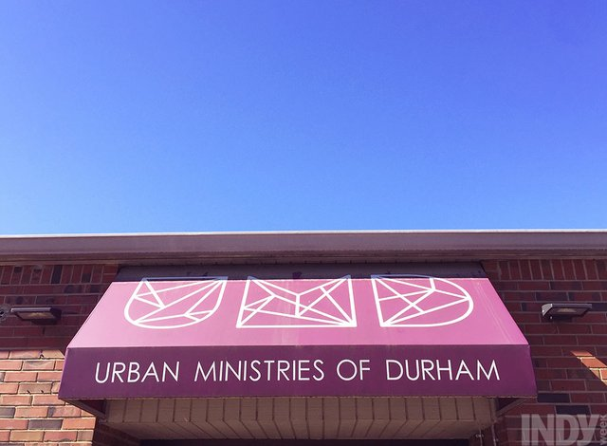
Data
Data was provided by Urban Ministries of Durham.
Urban Ministries of Durham(UMD) ended homelessness for 248 people in FY 2018-19.
The programs end homelessness by providing neighbors with emergency shelter and case management to help them overcome barriers such as unemployment, medical and mental health problems, past criminal convictions and addiction. UMD assist around 6,000 people each year who need food, shelter, clothing and/or supportive services through these main programs:
Community Shelter for men, women and families who need a safe emergency place to sleep.

Slide 3
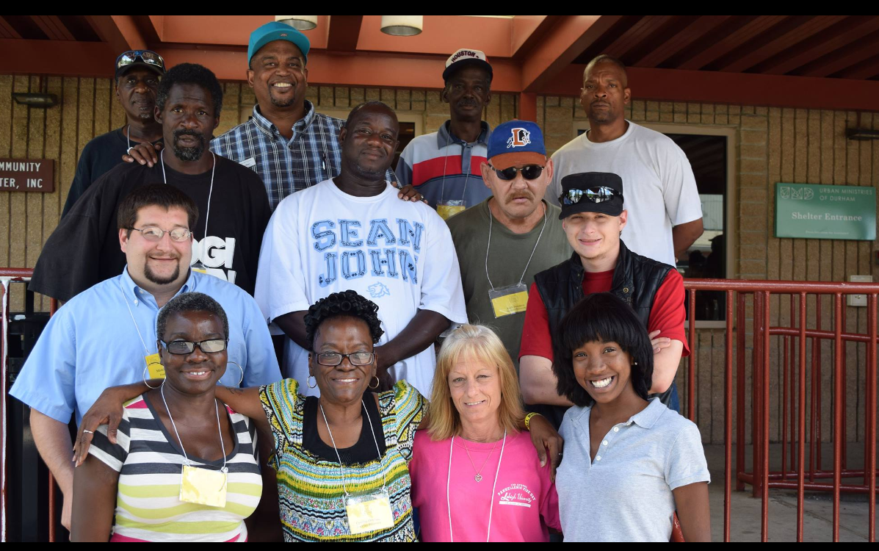
Project goal
I want to help UMD better understand their new clients. I will select only the information about the people who entered the program and analyze demographical information.
I hope this will help UMD to create new specific programs for some of the groups under the risk of homeless.

Slide 4
Data Wrangling
The wrangling step is completed using Python programming language.
I selected the data from CLIENTS database to obtain the demographical information.
Added the information about health insurance and disability status from EE_UDES table.
Added information about income from INCOME_ENTRY database.

Slide 5
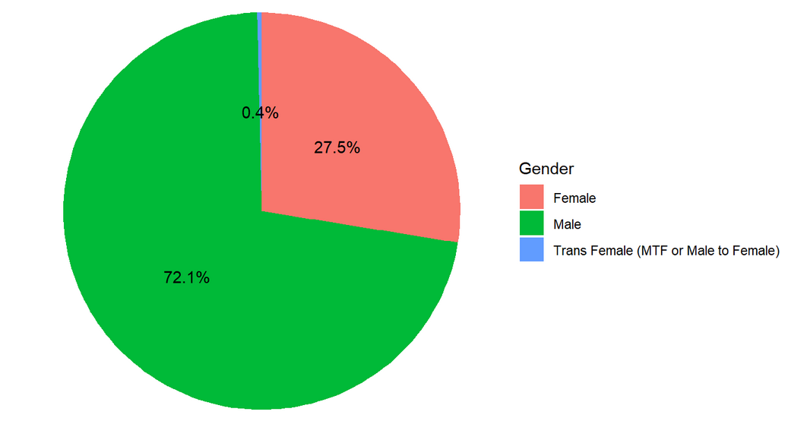
Distribution by Gender

Slide 6
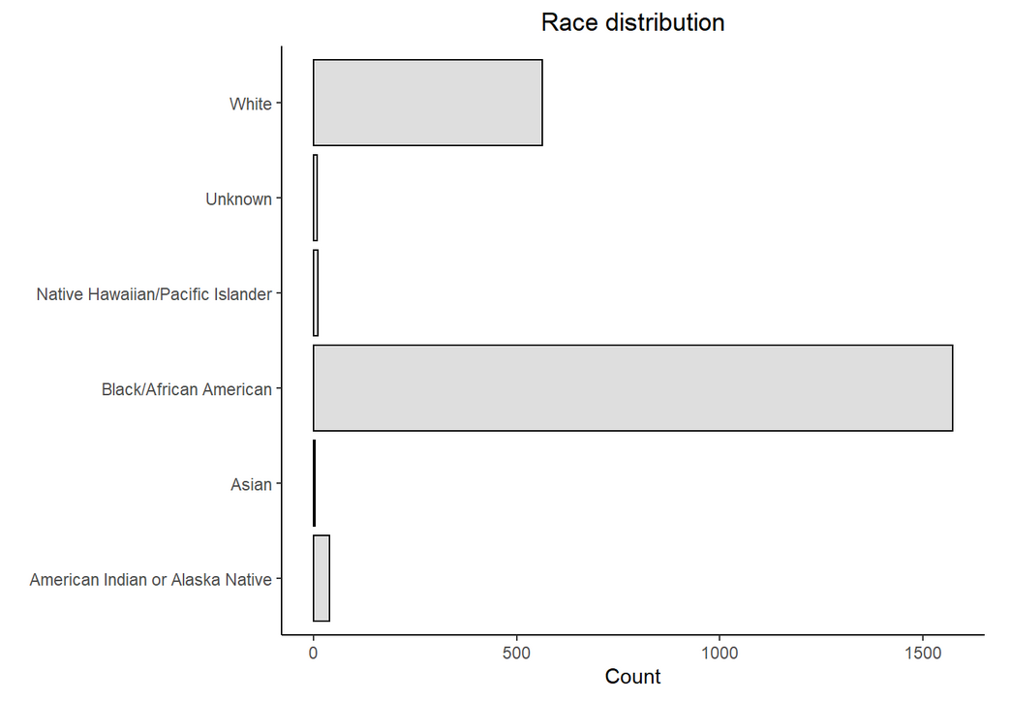
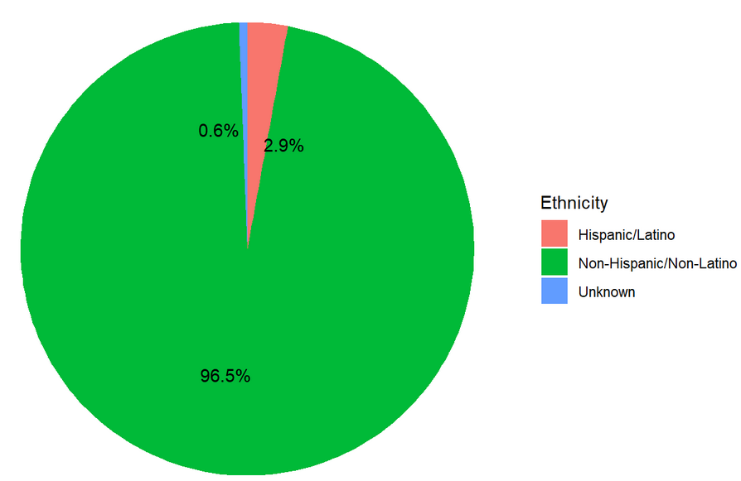
Distribution by Race and Ethnicity

Slide 7
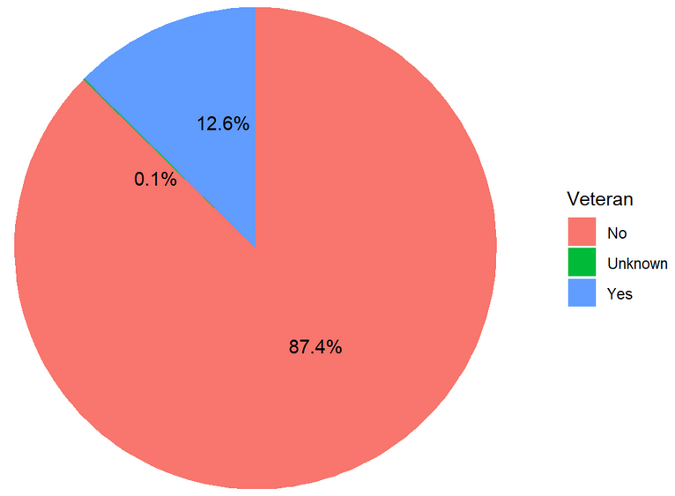
Veteran Status

Slide 8
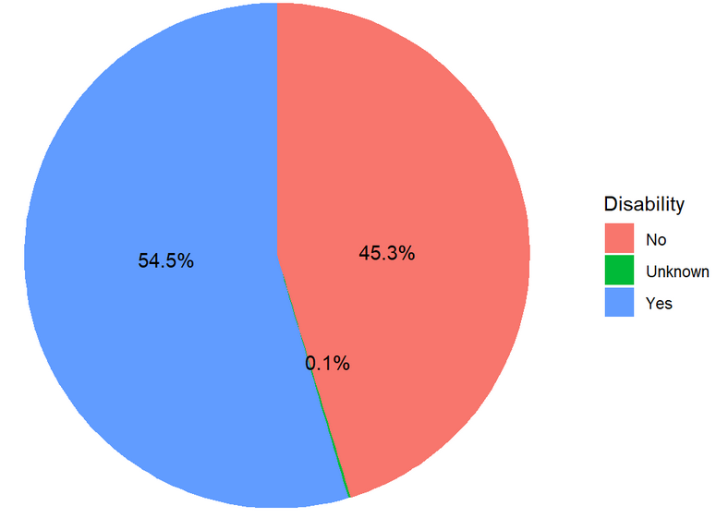
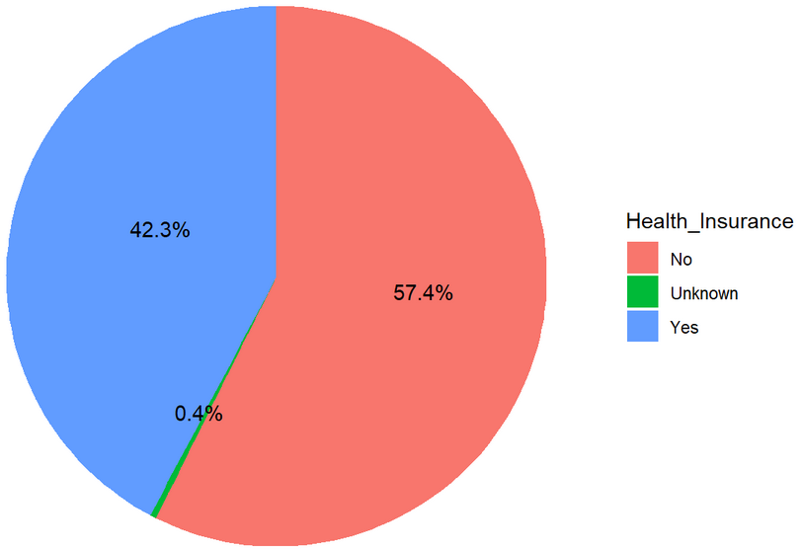
Disability Status and Health Insurance

Slide 9
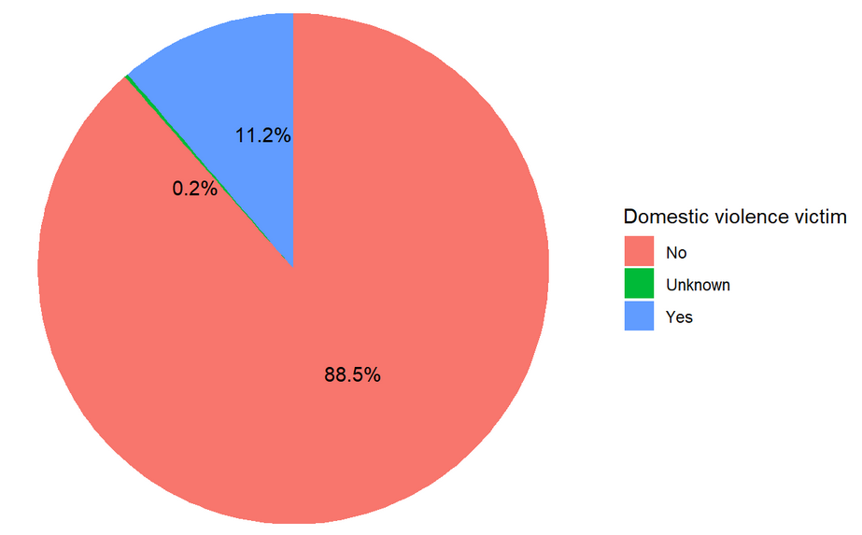
Domestic Violence Victims

Slide 10
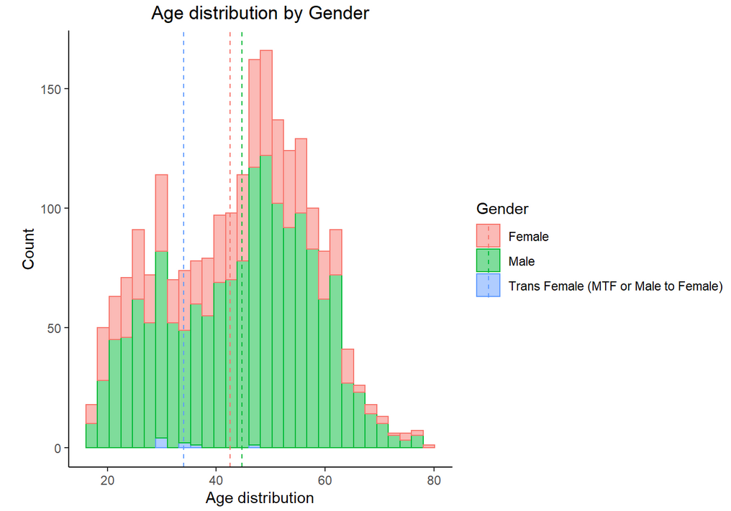
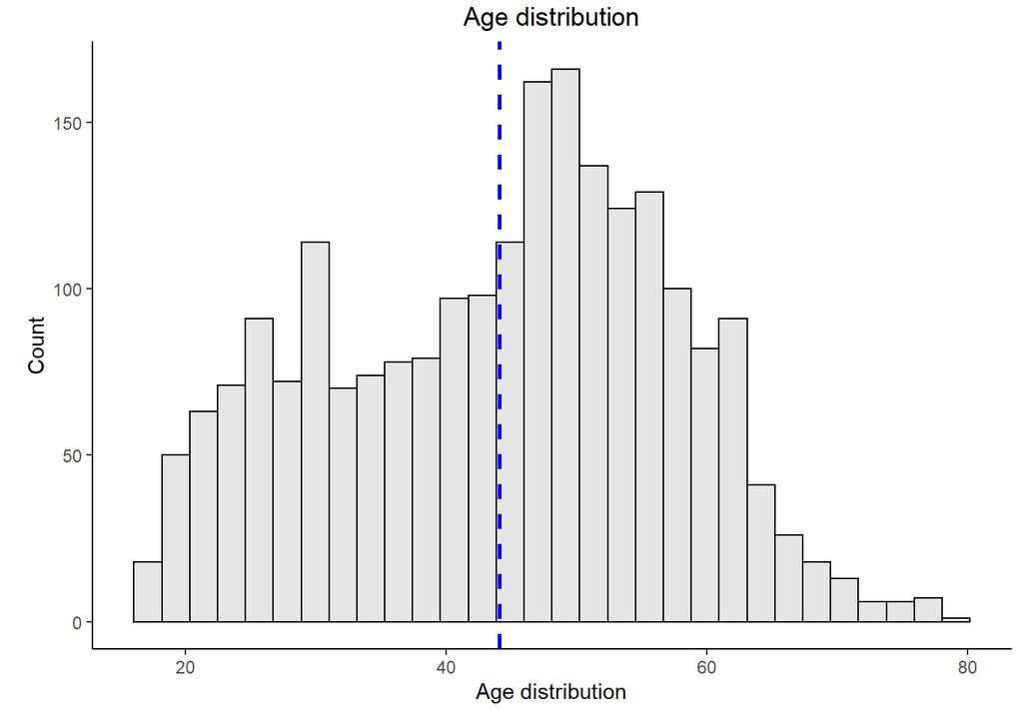
Age Distribution

Slide 11

Thank you!

