Slide 1

PRE-SESSION WK1
DAWSON, C.

Slide 2
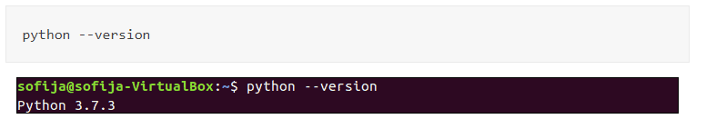
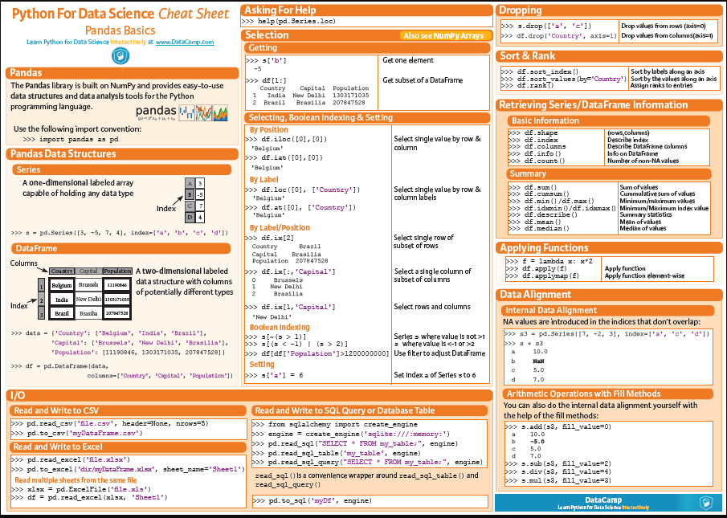
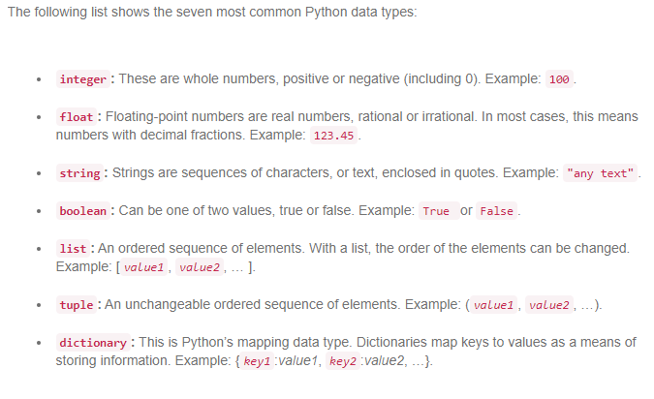
Python for Data Science
Python Versions
Data Types
Pandas

Slide 3
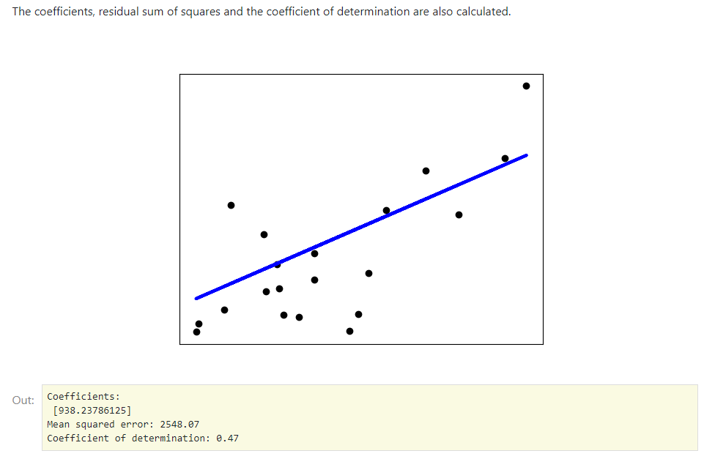
Python for Data Science: Linear Regression
print(__doc__)
# License: BSD 3 clause
import matplotlib.pyplot as plt
import numpy as np
from sklearn import datasets, linear_model
from sklearn.metrics import mean_squared_error, r2_score
# Load the diabetes dataset
diabetes_X, diabetes_y = datasets.load_diabetes(return_X_y=True)
# Use only one feature
diabetes_X = diabetes_X[:, np.newaxis, 2]
# Split the data into training/testing sets
diabetes_X_train = diabetes_X[:-20]
diabetes_X_test = diabetes_X[-20:]
# Split the targets into training/testing sets
diabetes_y_train = diabetes_y[:-20]
diabetes_y_test = diabetes_y[-20:]
# Create linear regression object
regr = linear_model.LinearRegression()
# Train the model using the training sets
regr.fit(diabetes_X_train, diabetes_y_train)
# Make predictions using the testing set
diabetes_y_pred = regr.predict(diabetes_X_test)
# The coefficients
print('Coefficients: \n', regr.coef_)
# The mean squared error
print('Mean squared error: %.2f'
% mean_squared_error(diabetes_y_test, diabetes_y_pred))
# The coefficient of determination: 1 is perfect prediction
print('Coefficient of determination: %.2f'
% r2_score(diabetes_y_test, diabetes_y_pred))
# Plot outputs
plt.scatter(diabetes_X_test, diabetes_y_test, color='black')
plt.plot(diabetes_X_test, diabetes_y_pred, color='blue', linewidth=3)
plt.xticks(())
plt.yticks(())
plt.show()

