Slide 1

PRE-SESSION WK2
DAWSON, C.

Slide 2
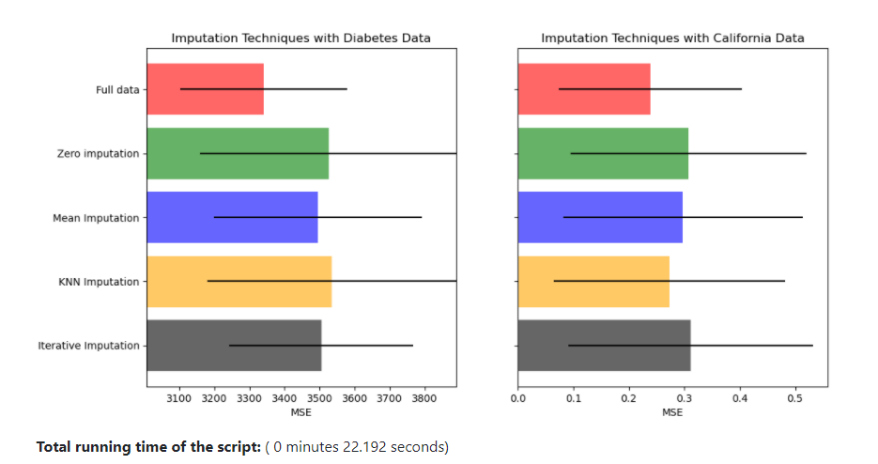
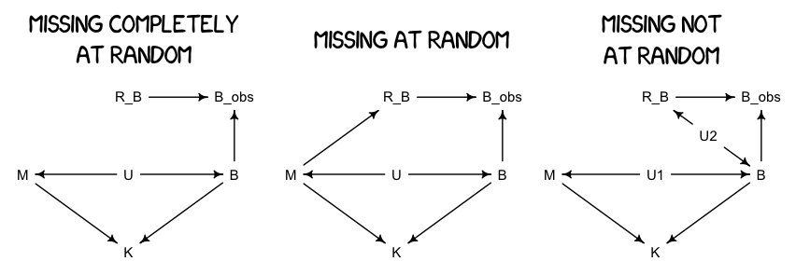
Missing Data
Example:
https://scikit-learn.org/stable/auto_examples/impute/plot_missing_values.html#sphx-glr-auto-examples-impute-plot-missing-values-py

