Slide 1

PRE-SESSION WK3
DAWSON, C.

Slide 2
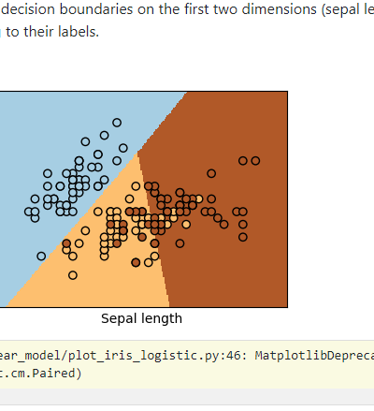
Logistic Regression
One-Hot Encoding
Example:
print(__doc__)
# Code source: Gaël Varoquaux
# Modified for documentation by Jaques Grobler
# License: BSD 3 clause
import numpy as np
import matplotlib.pyplot as plt
from sklearn.linear_model import LogisticRegression
from sklearn import datasets
# import some data to play with
iris = datasets.load_iris()
X = iris.data[:, :2] # we only take the first two features.
Y = iris.target
# Create an instance of Logistic Regression Classifier and fit the data.
logreg = LogisticRegression(C=1e5)
logreg.fit(X, Y)
# Plot the decision boundary. For that, we will assign a color to each
# point in the mesh [x_min, x_max]x[y_min, y_max].
x_min, x_max = X[:, 0].min() - .5, X[:, 0].max() + .5
y_min, y_max = X[:, 1].min() - .5, X[:, 1].max() + .5
h = .02 # step size in the mesh
xx, yy = np.meshgrid(np.arange(x_min, x_max, h), np.arange(y_min, y_max, h))
Z = logreg.predict(np.c_[xx.ravel(), yy.ravel()])
# Put the result into a color plot
Z = Z.reshape(xx.shape)
plt.figure(1, figsize=(4, 3))
plt.pcolormesh(xx, yy, Z, cmap=plt.cm.Paired)
# Plot also the training points
plt.scatter(X[:, 0], X[:, 1], c=Y, edgecolors='k', cmap=plt.cm.Paired)
plt.xlabel('Sepal length')
plt.ylabel('Sepal width')
plt.xlim(xx.min(), xx.max())
plt.ylim(yy.min(), yy.max())
plt.xticks(())
plt.yticks(())
plt.show()

