Slide 1
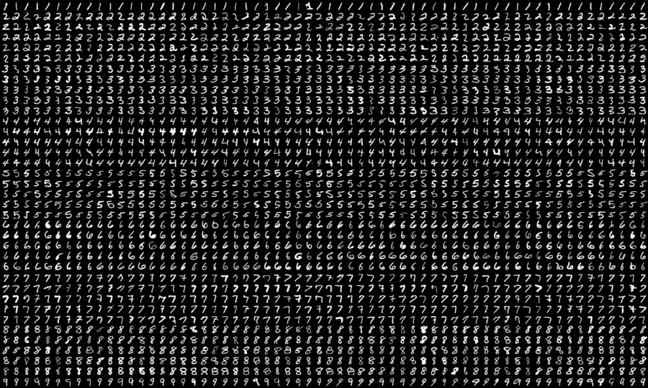
Digit Recognition
Based on MNIST dataset
Supervisor: Karl Rohr, Christian Ritter
Project Proposal 2022/05/17
By Lena Fleischhacker, Benjamin Wehnert, Pia Röhrich, Hellen Röttgen
https://neurohive.io/en/datasets/researchers-expanded-the-popular-mnist-dataset-with-50-000-new-images/

Slide 2
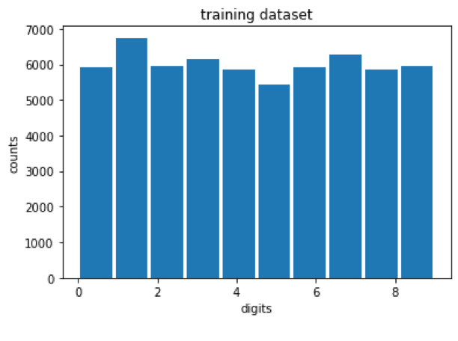

MNIST Dataset
Modified National Institute of Standards and Technology database
Data from NIST training dataset and NIST testing dataset
50% written by Census Bureau employees, 50% written by high-school students
first column: digit (random order)
other colums: 784 pixel intensities from 0 to 256
Training dataset:
60 000 images
Test dataset:
10 000 images

Slide 3
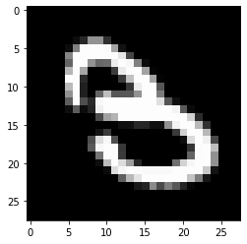
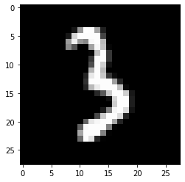
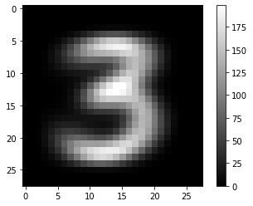
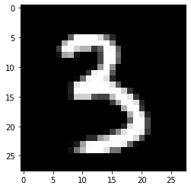
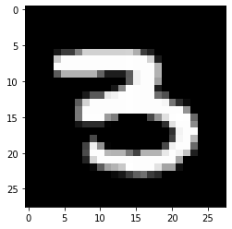
Digits
Input:
one image from
test dataset
compare to average images from training dataset
Output:
closest average digit as prediction for test image
Correct predictions: 66,85 %

Slide 4

KNN (k-nearest neighbors)
Non parametric, lazy & supervised learning algorithm
Application:
predicting classification of new sample point by looking at its k-nearest neighbors
Classification:
- Output: class membership
- assigned by „majority vote“
Regression:
- Output: value of object
https://towardsdatascience.com/machine-learning-basics-with-the-k-nearest-neighbors-algorithm-6a6e71d01761

Slide 5
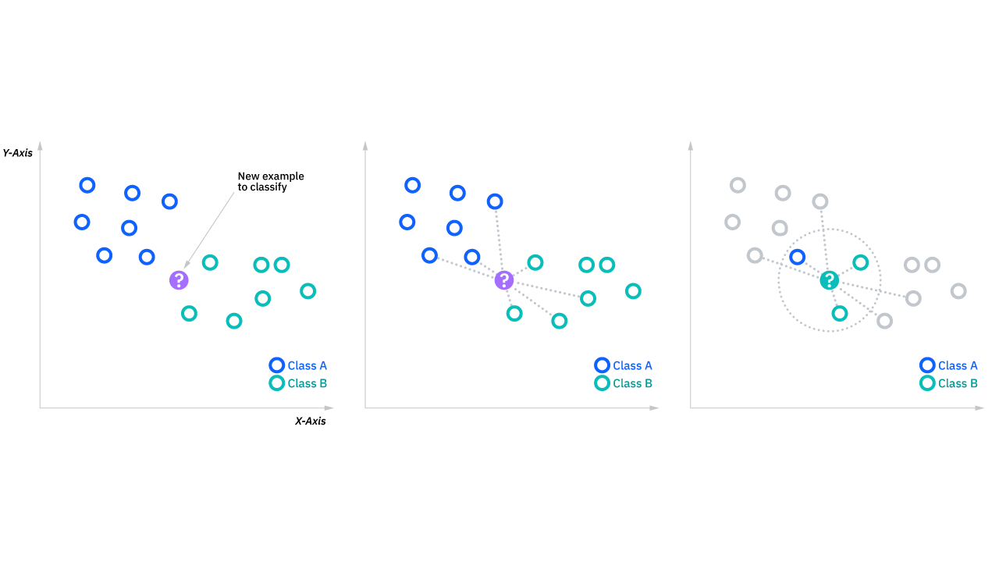
KNN: Step-by-Step
Choose k
Calculate Euclidean distance
Pre-PCA: pixels → 784 axes
Post-PCA: principle components → fewer axes
Select k closest entries
Determine classification by „majority vote“
https://www.ibm.com/topics/knn

Slide 6
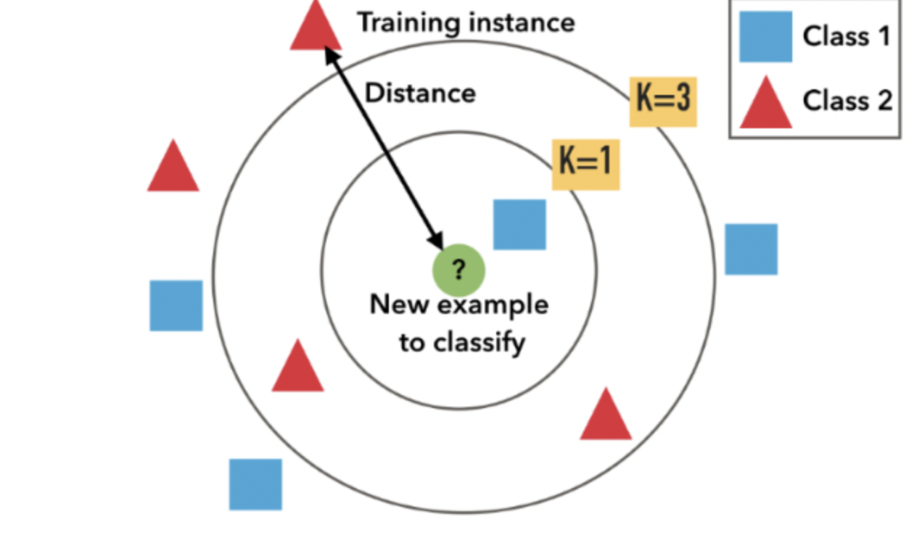
KNN: Finding k
Influences classification of new sample point → Optimizing prediction accuracy
https://medium.com/@adi.bronshtein/a-quick-introduction-to-k-nearest-neighbors-algorithm-62214cea29c7

Slide 7
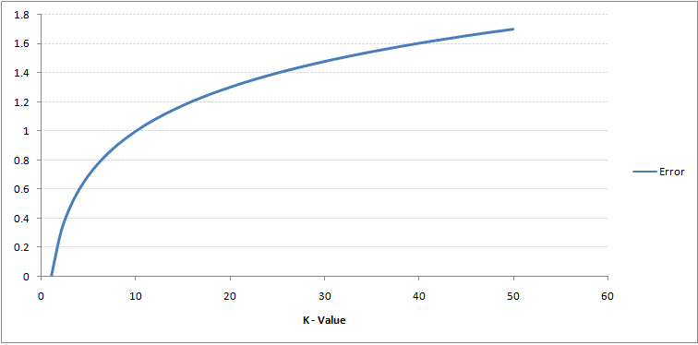
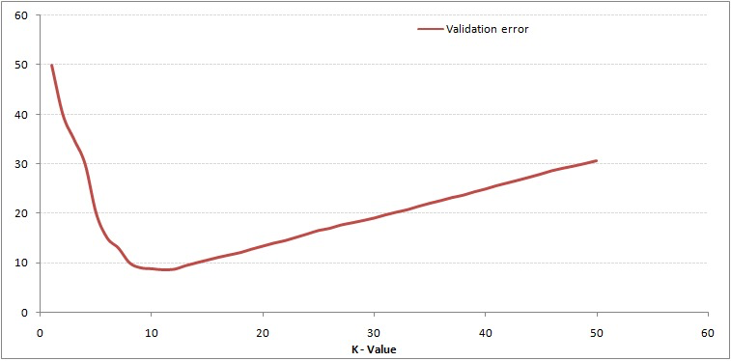
KNN: Finding k
Approach:
Segregating training and test data
Problem: overfitting boundaries (k=1)
→ removing nearest neighbor
Optimal k = kink in graph (local minimum)
https://www.analyticsvidhya.com/blog/2018/03/introduction-k-neighbours-algorithm-clustering/

Slide 8
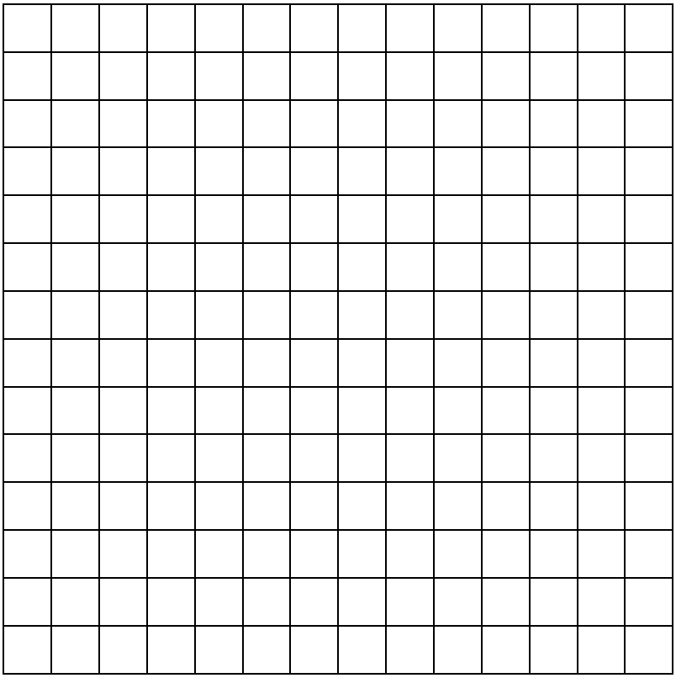
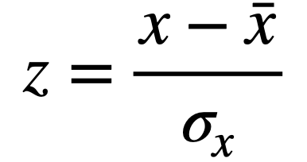
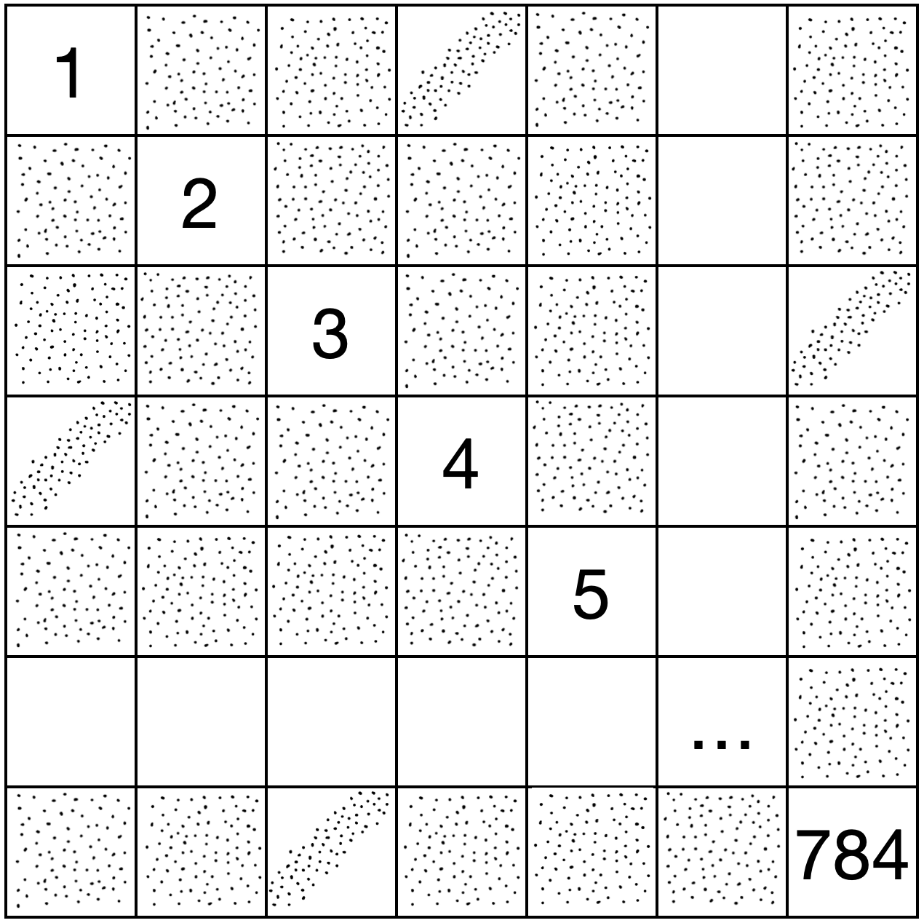

Principal Component Analysis
28 * 28 = 784 pixel
= 784 variables
= 784 dimensions
28
PCA
Reduce dimensions without losing too much information
28
I
II
III
z-tranformation
Correlations
Diagonalization

Slide 9
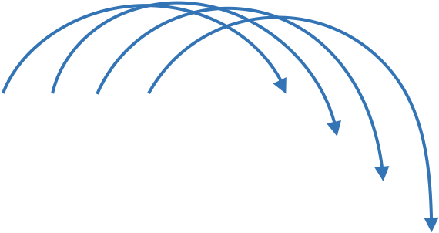
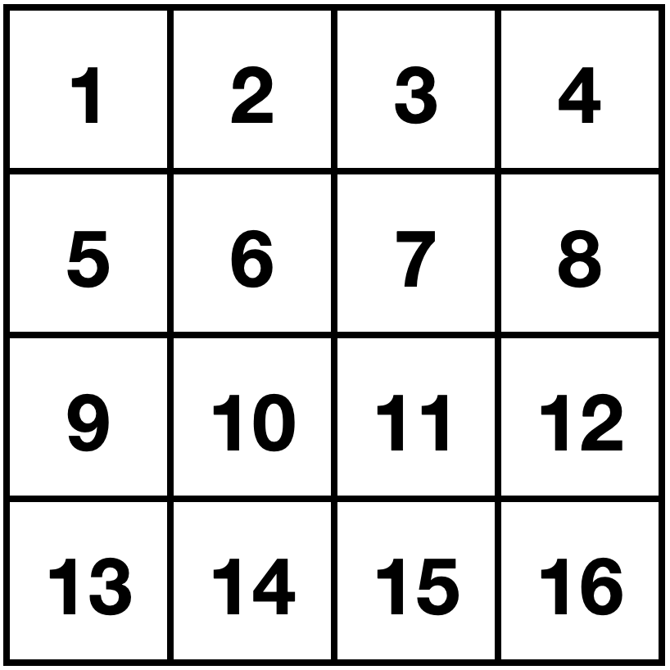
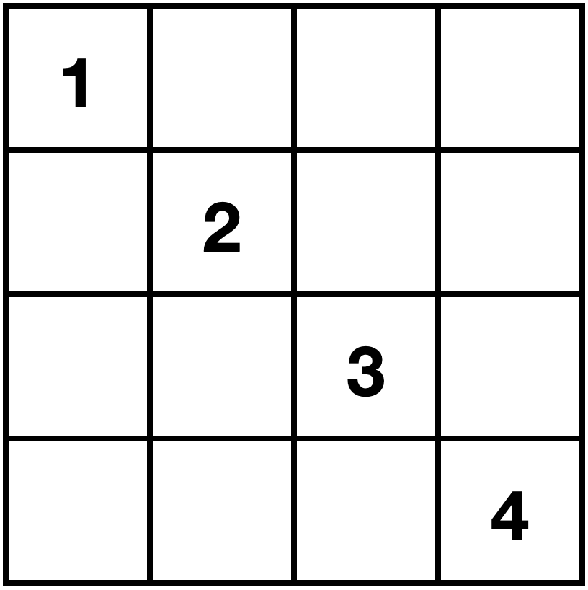
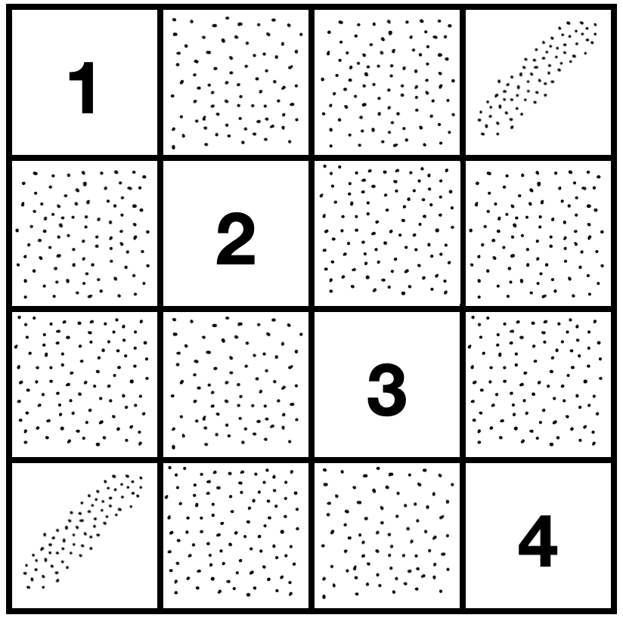
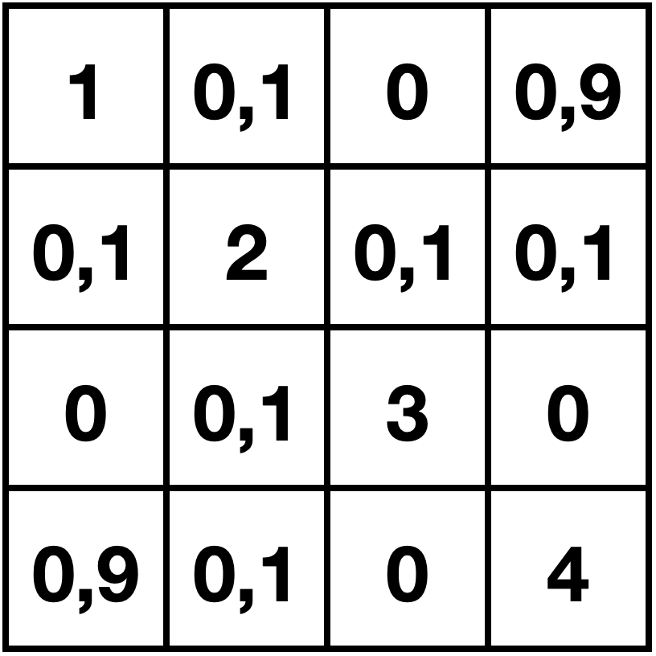
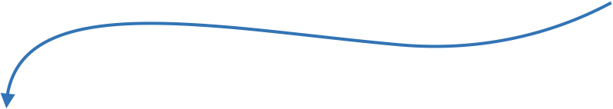

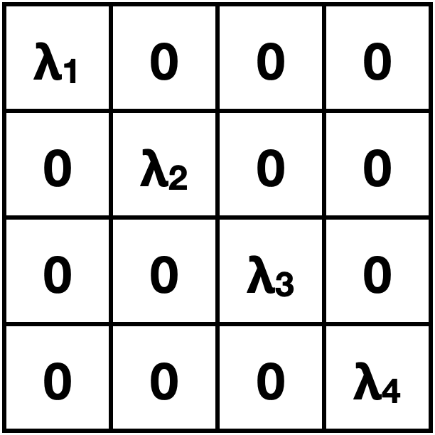
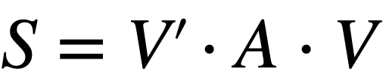
Principal Component Analysis
II
Correlations
Image (4x4 pixels)
Scatter plots
Pearson correlation
III
Diagonalization
Hier kommt dann noch ne Veranschaulichung des neuen Koordinatensystems hin, da weiß ich gerade noch nicht, wie man die Eigenwerte passend auswählt und so

Slide 10



Project management
Communication: Slack and weekly meetings
Task management: GitHub Project
Time management: Gantt chart

Slide 11



Milestones
09/05
15/05
18/05
27/05
02/06
Familiarization with data
Background knowledge on PCA & kNN
Project proposal
Finish PCA
Finish kNN
04/06
13/07
13/07
20/07
Choose idea for project expansion
Finish expanded code
Finish report
Final presentation

Slide 12
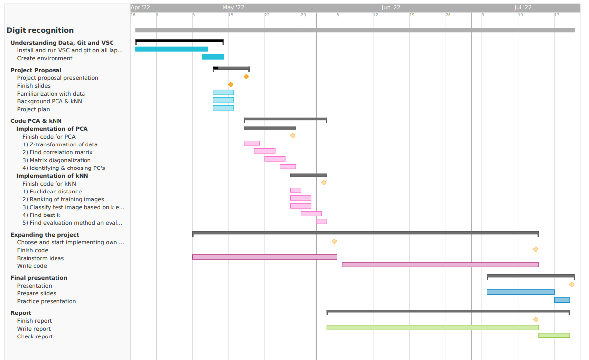
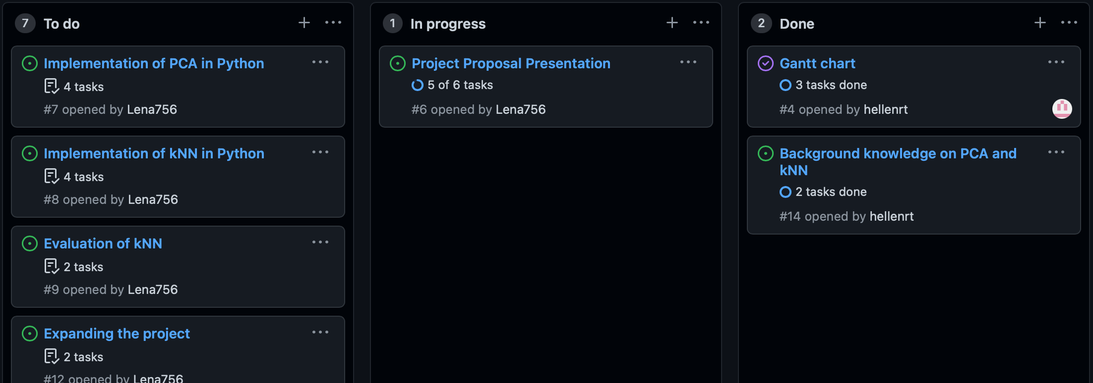
Overview

