Slide 1
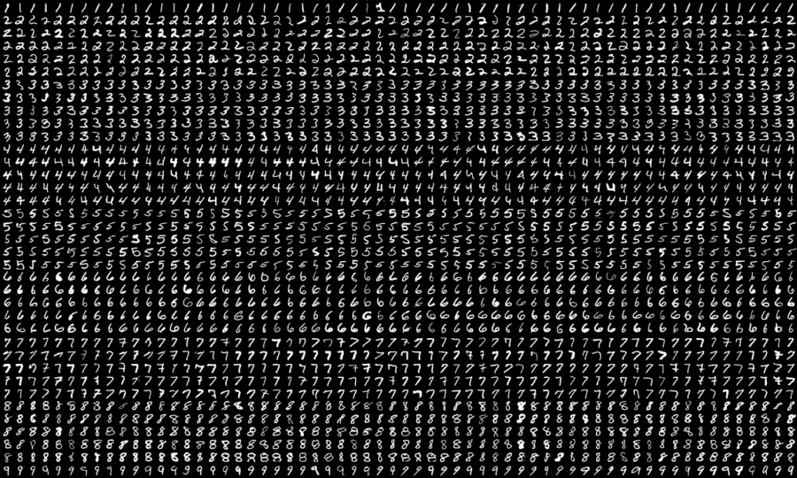
Digit Recognition
Based on MNIST dataset
Supervisors: Karl Rohr, Christian Ritter
Final presentation 2022/07/20
By Lena Fleischhacker, Pia Röhrich, Hellen Röttgen, Benjamin Wehnert
https://neurohive.io/en/datasets/researchers-expanded-the-popular-mnist-dataset-with-50-000-new-images/
Notes:
For our

Slide 2
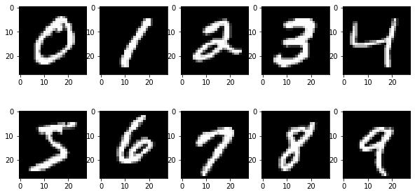
Overview
input:
image
PCA
kNN
output: prediction
it’s a
5!
Notes:
Quick overview and reminder of steps we took

Slide 3
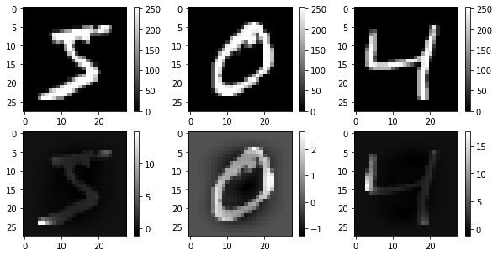


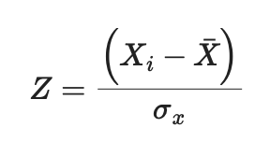
Z-transformation
Notes:
scale
some pixels std = 0 → were left out → only 717 Pixels anymore

Slide 4
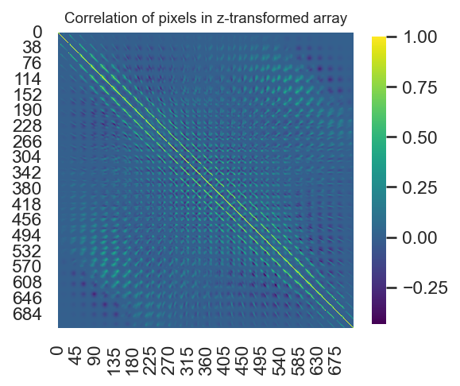
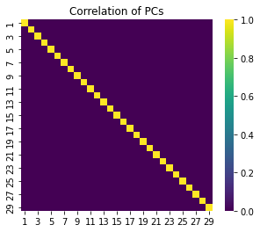


Principal Component Analysis
Singular Value Decomposition
$$X=USV^{T}$$
Principal Components:
$$XV=USV^{T}V=US$$
Notes:
X = Datamatrix
U = Unitary Matrix
S = diagonal Matrix of singular values
V = Matrix of Eigenvectors

Slide 5
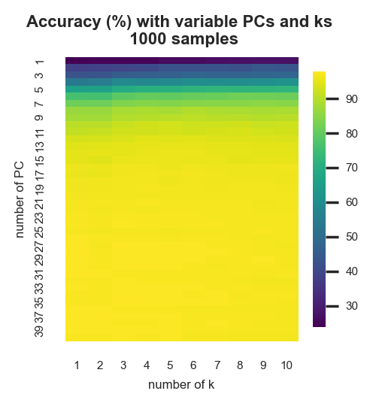
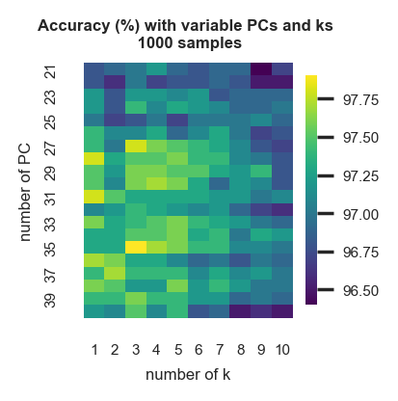
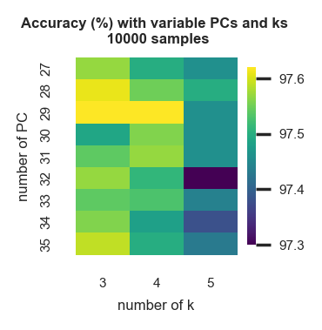
Finding optimal k and PCs
PCs: 29 , k = 3
Notes:
MNIST stands for…
-training 60000 images
-test 10000 images
each row represents…
entry of first col -> label of digit
other cols -> intensity values from 0 -255 for 784 pixels

Slide 6
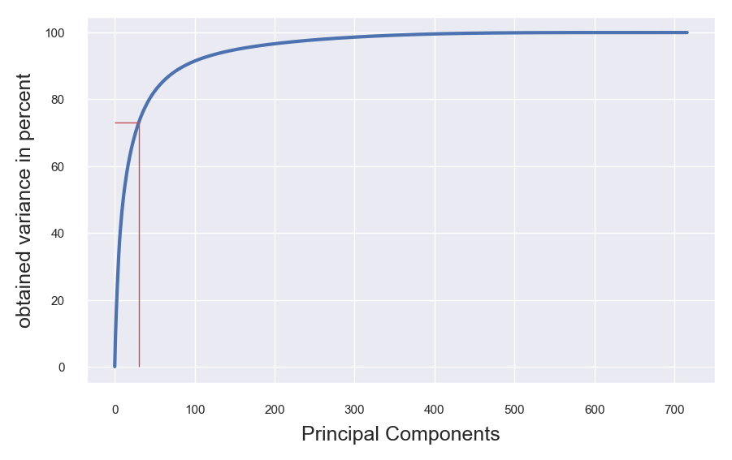
Variance covered by PCs
Notes:
MNIST stands for…
-training 60000 images
-test 10000 images
each row represents…
entry of first col -> label of digit
other cols -> intensity values from 0 -255 for 784 pixels

Slide 7
Results
input:
image
PCA
input:
image
PCA
kNN
output: prediction
input:
image
PCA
kNN
output: prediction
input:
image
PCA
kNN
output: prediction
input:
image
PCA
kNN
output: prediction
kNN
output: prediction
How reliably does the algorithm recognize handwritten digits?
97,25% accuracy on digits from test-dataset
Further improvement?
Notes:
MNIST stands for…
-training 60000 images
-test 10000 images
each row represents…
entry of first col -> label of digit
other cols -> intensity values from 0 -255 for 784 pixels

Slide 8
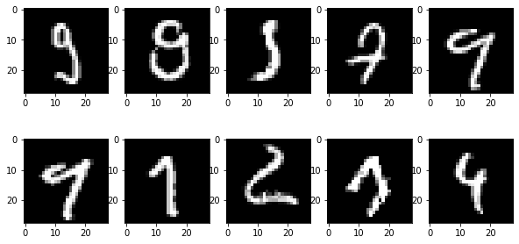
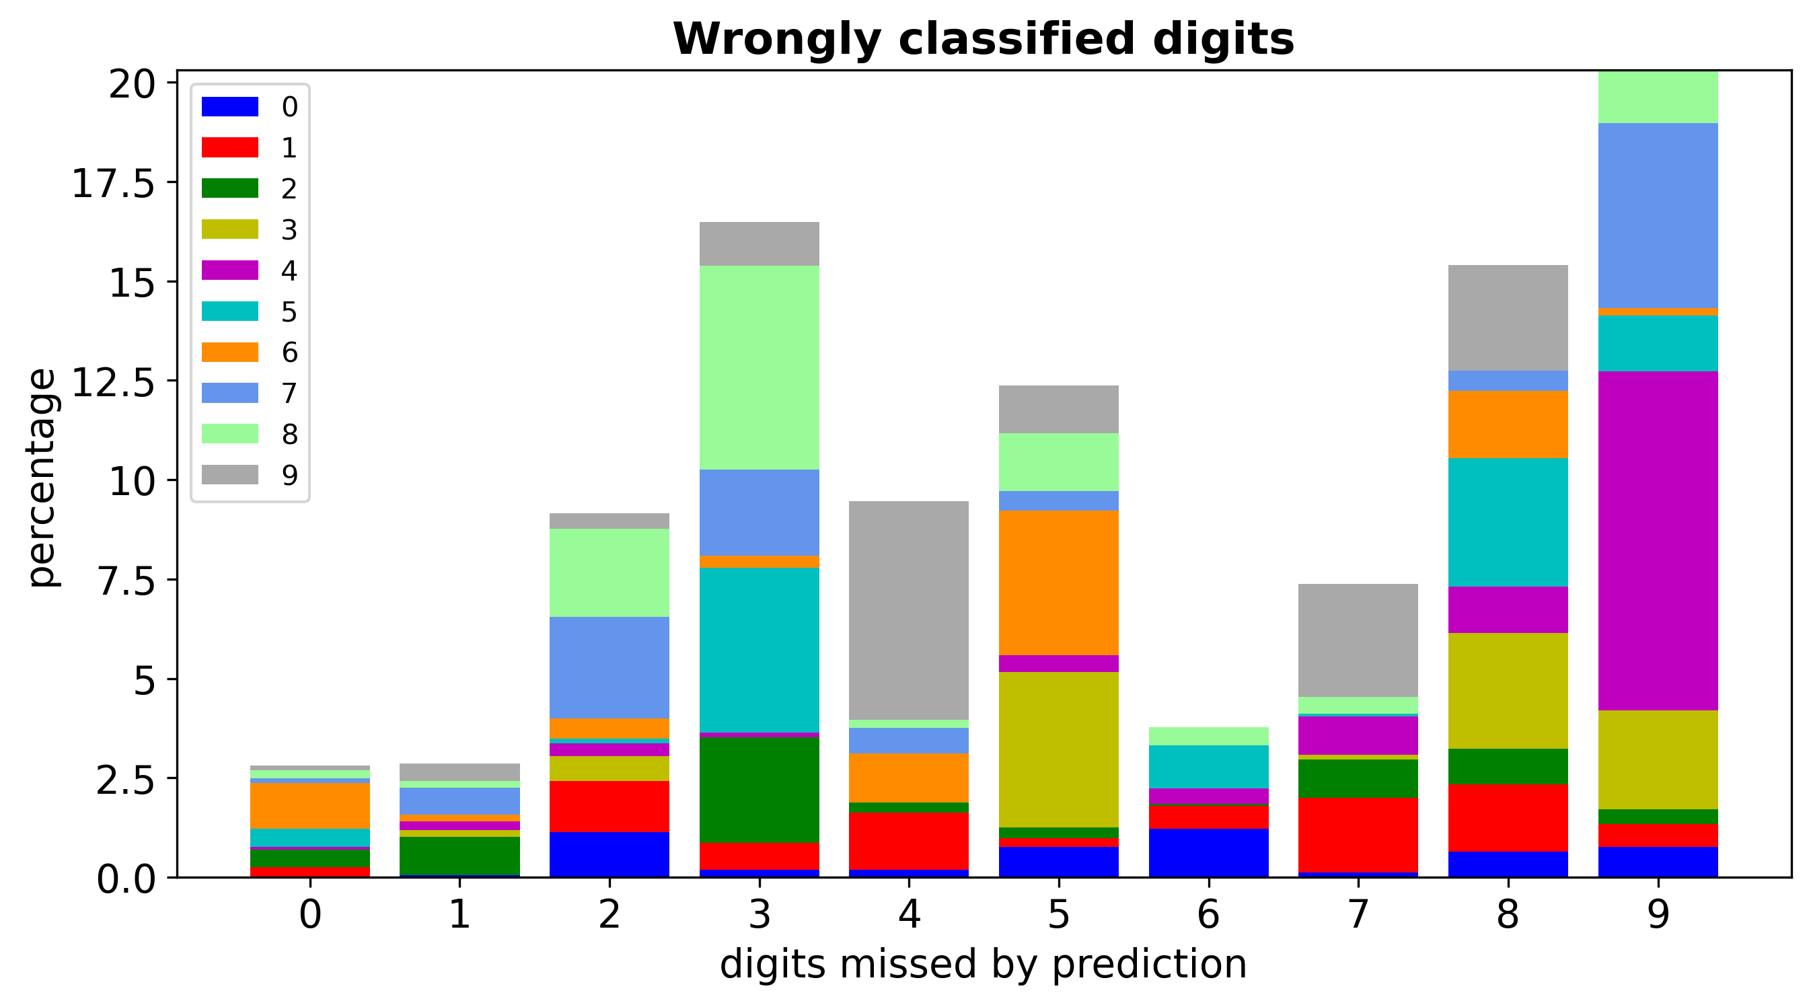
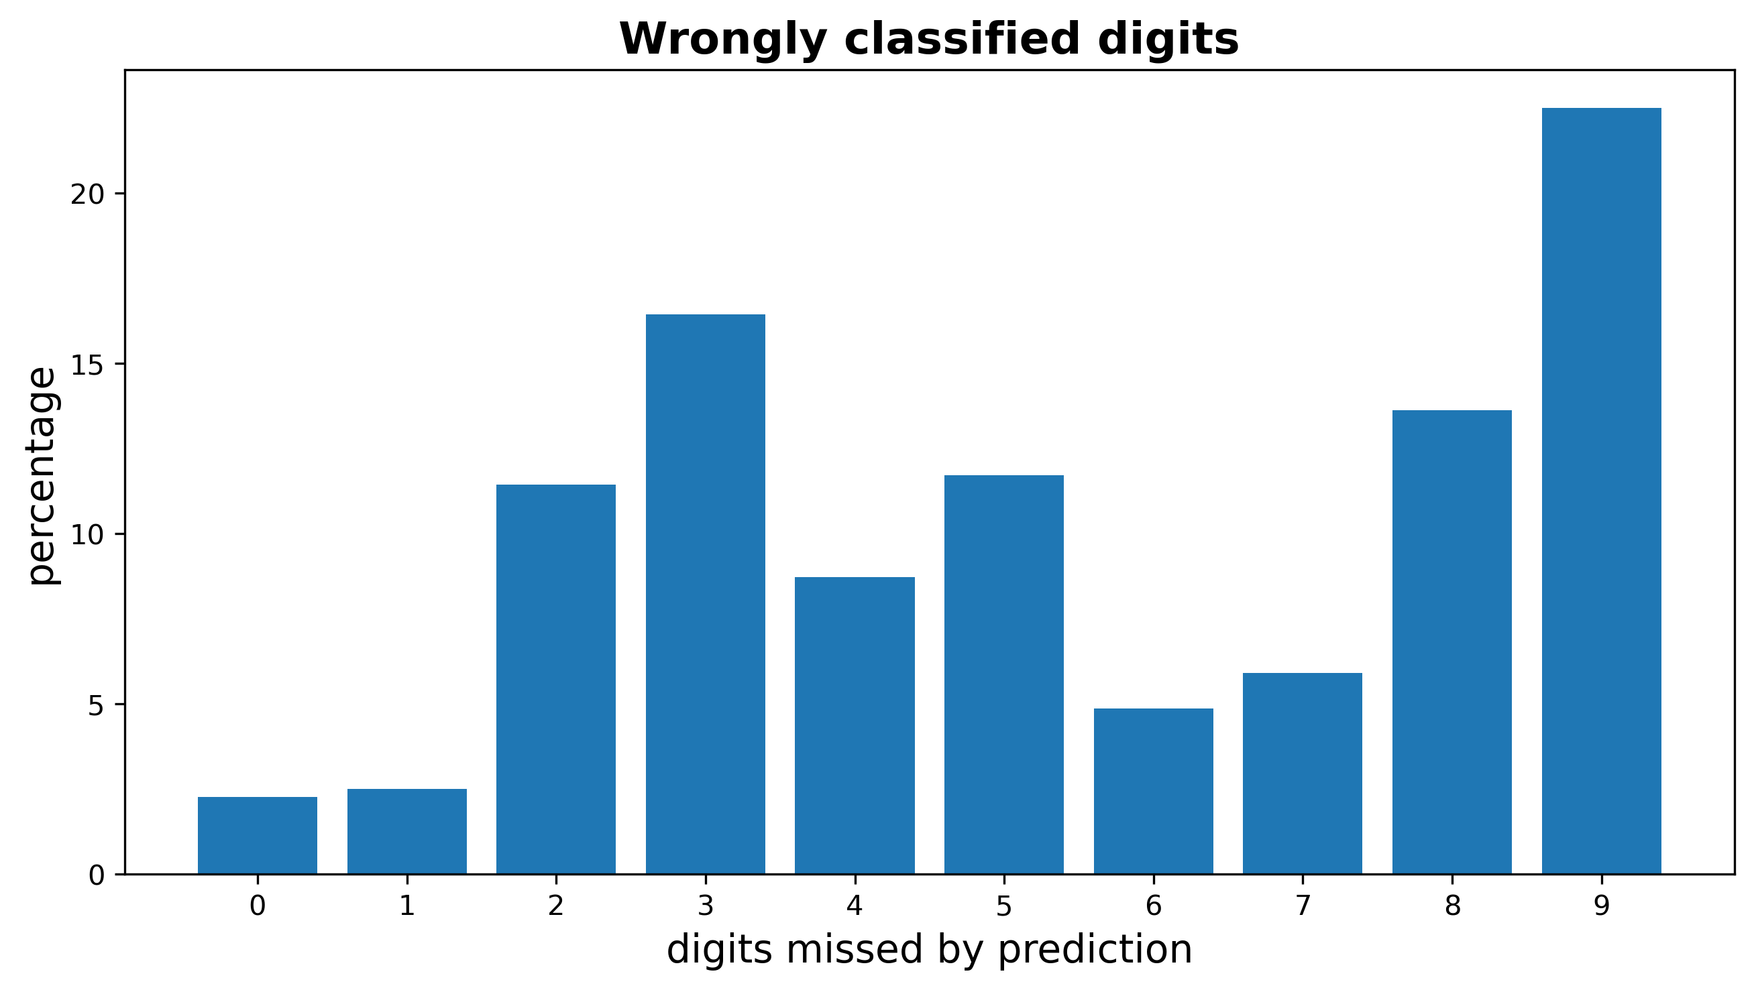
Results
Which digits are most often wrongly predicted?
Which digits are predicted instead?
Notes:
MNIST stands for…
-training 60000 images
-test 10000 images
each row represents…
entry of first col -> label of digit
other cols -> intensity values from 0 -255 for 784 pixels

Slide 9



Discussion
Accuracy of 97,25%
Additional applications:
Average digits
Classification of self-written digits
Supervised: limited to training data
Lazy: high run time
Tie between k-nearest neighbors
Improvements based on most common errors
Use ties for higher accuracy
Expansion to recognize multi-figure numbers
Expansion to recognize digits from photos
Other machine learning algorithms for same problem
Notes:
Project implemented successfully
-what went well
-difficulties/limitations
-futere ideas
-tie problem accuracy Pia, most common errors Benni

Slide 10
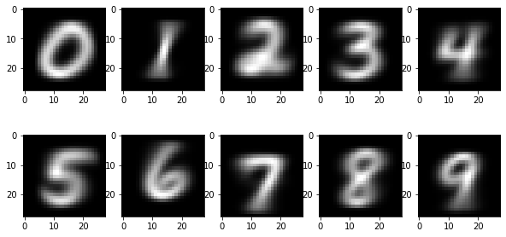
Average digits
Prediction accuracy: 66,85%
→
72,07%
Notes:
Avrage über 60.000 images
Already shown in project proposal
- Average digits are recognizable
- Average digits used for digit recognition: 66.85%
New: -> accuracy 72.07%
- Weighted recognition
Average images
1. Choosing all images from the training data set displaying one same number
2. Summing up the intensity values for each pixel of these images
3. Dividing the intensity sums by the number of images used
Digit recognition (normal)
1. subtracting the intensity values of each average digit from the input image
2. identifies the image as the digit with the lowest intensity difference
(Improved by saving average digits in array (shorter run time) and weighting pixel)
Weighted digit recognition
Find variance covered by each pixel
Calculate intensity difference sum for each pixel
Calculate global intensity difference sum
Divide pixel intensity difference sums by global intensity difference sum
Apply weightings to recognition
Calculate intensity differences between input image and each average digit
Multiply intensity differences of each pixel with weighting for that pixel
Identify input image as digit with lowest intensity sum difference

Slide 11
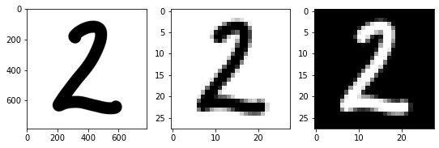
Self-written digit recognition
Import jpeg
Preprocessing:
Conversion to grayscale
Conversion to numpy array
Divisibility by 28
Reduction of pixels to 784
Inversion of color scale
Application of algorithm
Notes:
Problem US numbers
Using the PCA and KNN algorithm and the MNIST training array to recognize self-written digits instead of test array
Import jpeg using pillow package
Preprocessing for comparability to MNISt training array: Square image converted to the same format as training images
Conversion to grayscale
Conversion to numpy array
Make number of rows and pixels divisible by 28
Reduce number of pixels in the image to 784 by averaging squares
Invert color scale
Apply z-transformstion, knn and Pca algorithm
1. importing a jpeg image of the handwritten digit into the notebook using functions from the pillow package.
2. reformatting the image to make it comparable with training images from MNISt data set <br>
i. conversion to grayscale <br>
ii. converting the jpeg into a numpy array <br>
iii. deleting rows and columns so that tha overall number of pixels is divisible by 28 <br>
iv. reducing the number of pixels in the image to 784 by averaging squares of pixels and creating a 28x28 image from the means <br>
3. apply z-transformation, PCA and KNN algorithms to image

Slide 12
Self-written digit recognition
Now it’s your turn!
Notes:
Write down an American number, as mentioned lazy

Slide 13
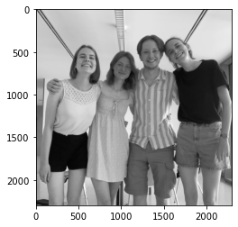
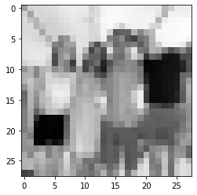
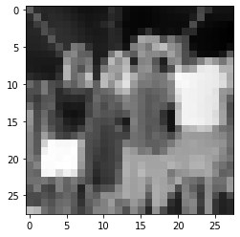
Thank you for your attention!

Slide 14
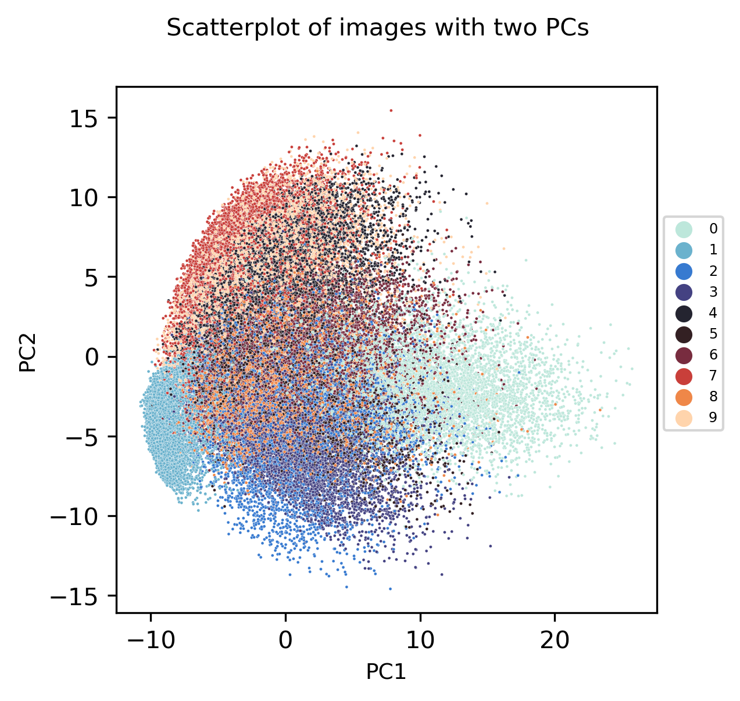
Visualization PCA
Notes:
Calculating intensity difference sum for each pixel and sum of the intensity difference sums over all pixels
Dividing each intensity difference sum by the total intensity difference sum -> percentages of how much variance is covered by each pixel
Calculate intensity sum differences with average images
Multiply intensity sum differences with average images with percentages

